Slide 1
Using GIS in Postgres – Part 2
Real World Examples of PostGIS
By Lloyd Albin
Seattle Postgres Users Group (SeaPUG)

Slide 2
Common Use for GIS Data
Many website need to find all of y within x miles of z.
Examples:
Groupon.com - Find all of ad’s within x miles of home/work/city.
Limos.com - Find all of limo companies within x miles of pickup.
Maps.google.com - Find all business’s within x miles of address/city.
In this demo we will be using a charter airlines quoting system that uses the same math as the above examples.

Slide 3

Challenger 601-3A - Performance
Max Fuel Range (nm) | Max Payload Range (nm) | Long Range Cruise Speed (nmph) | Min Runway Length (ft) | Fuel | Max Pax | Rate (hr)
3,370 | 2,182 | 425 | 2,850 | Jet A | 12 | $10,000
Notes:
http://www.controller.com/listingsdetail/aircraft-for-sale/BOMBARDIER-CHALLENGER-601-3A-ER/1991-BOMBARDIER-CHALLENGER-601-3A-ER/1271959.htm
http://e-ditionsbyfry.com/ActiveMagazine/getBook.asp?Path=WAC/2008/07/01&BookCollection=WAC&ReaderStyle=Gray&page=92
Runway length can vary based on temperature and weight. Sodona, AZ airport, while can support this aircraft, you can not take off during the heat of the day for a long flight.

Slide 4
The Math
The great circle distance d between two points with coordinates {lat1,lon1} and {lat2,lon2} is given by:
d=acos(sin(lat1)*sin(lat2)+cos(lat1)*cos(lat2)*cos(lon1-lon2))
A mathematically equivalent formula, which is less subject to rounding error for short distances is:
d=2*asin(sqrt((sin((lat1-lat2)/2))^2 +
cos(lat1)*cos(lat2)*(sin((lon1-lon2)/2))^2))
Convert longitude and latitude to radians (multiply lat/lon by pi/180)
Convert radians to nautical miles (multiply d by 180*60/pi())
Notes:
http://williams.best.vwh.net/avform.htm#Dist
http://www.gcmap.com/faq/gccalc

Slide 5
Normal SQL Query
SELECT d.airportname, d.identifier,
(2*asin(sqrt((sin(((o.lat*pi()/180)-(d.lat*pi()/180))/2))^2+cos((o.lat*pi()/180))*cos((d.lat*pi()/180))*(sin(((o.lon*pi()/180)-(d.lon*pi()/180))/2))^2)))*180*60/pi() AS distance_nm,
((2*asin(sqrt((sin(((o.lat*pi()/180)-(d.lat*pi()/180))/2))^2+cos((o.lat*pi()/180))*cos((d.lat*pi()/180))*(sin(((o.lon*pi()/180)-(d.lon*pi()/180))/2))^2)))*180*60/pi())/400 AS hours,
((2*asin(sqrt((sin(((o.lat*pi()/180)-(d.lat*pi()/180))/2))^2+cos((o.lat*pi()/180))*cos((d.lat*pi()/180))*(sin(((o.lon*pi()/180)-(d.lon*pi()/180))/2))^2)))*180*60/pi())/400*10000 AS rate
FROM flights.airports AS o, flights.airports AS d
WHERE o.identifier = 'KBLI' AND d.identifier <> 'KBLI' AND d.jet = 1 AND d.runwaylength > 5000
AND (2*asin(sqrt((sin(((o.lat*pi()/180)-(d.lat*pi()/180))/2))^2+cos((o.lat*pi()/180))*cos((d.lat*pi()/180))*(sin(((o.lon*pi()/180)-(d.lon*pi()/180))/2))^2)))*180*60/pi() < 3000
ORDER BY 3
Airport Name | Identifier | Distance (nm) | Hours | Rate
Las Vegas/Mc Carran Intl,NV | KLAS | 828.9384 | 2.072346 | $20,723.46
Notes:
http://www.chartersuitesoftware.com/updateairports.htm

Slide 6
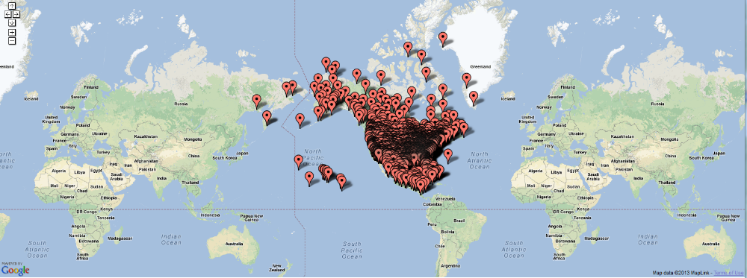
Airports within Range of Bellingham
Notes:
We did not take into account the 2 hour fuel reserve that is required.
I believe that there is also special fuel requirement when flying over water.

Slide 7
How to add geom to Database
ALTER TABLE flights.airports
ADD COLUMN geom public.geography;
UPDATE flights.airports SET geom =
ST_SetSRID(ST_Point(lon, lat),4326)::geography;
4326 Longitude/Latitude based on WGS 84
32661 Meter based on WGS 84
Notes:
http://www.spatialreference.org/ref/epsg/4326/
http://postgis.net/docs/manual-2.0/ST_Point.html
WGS 84 = World Geodetic System dated 1984

Slide 8
PostGIS Query
SELECT d.airportname, d.identifier,
ST_Distance(o.geom, d.geom)/1000 AS distance_km,
ST_Distance(o.geom, d.geom)/1000*0.53996 AS distance_nm,
ST_Distance(o.geom, d.geom)/1000*0.53996/400 AS hours,
ST_Distance(o.geom, d.geom)/1000*0.53996/400*10000 AS rate
FROM flights.airports AS o, flights.airports AS d
WHERE o.identifier = 'KBLI' AND d.identifier <> 'KBLI' AND d.jet = 1
AND d.runwaylength > 5000
AND ST_Distance(o.geom, d.geom)/1000*0.53996 < 3000
ORDER BY 4
Airport Name | Identifier | Distance (km) | Distance (nm) | Hours | Rate
Las Vegas/Mc Carran Intl,NV | KLAS | 1535.533 | 829.1265 | 2.072816 | $20,728.16
Notes:
0.1881 nm difference between the two methods.
http://postgis.net/docs/manual-2.0/ST_DWithin.html

Slide 9
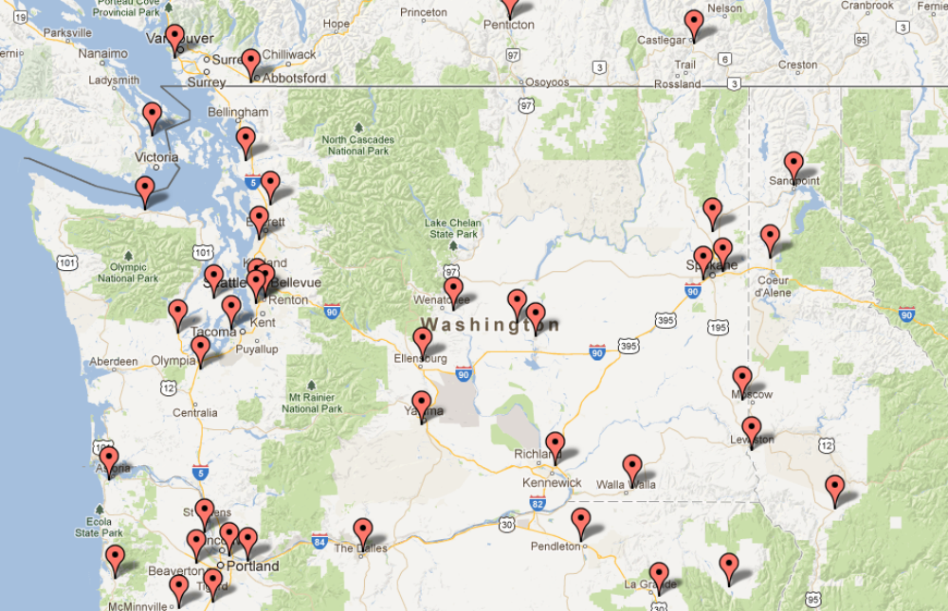
Airports within Washington State

Slide 10
True Rates with Taxes
Item | Rate | Amount
Flight | $10,000 per flight hour | $20,728.16
Federal Excise Tax | 7.5% | $1,554.61
Domestic Segment Tax | $3.90 per passenger x 12 passengers | $46.80
Grand Total |  | $22,329.57
Most Quoting software bases the rates on per hour, nautical mile, or mile.
The Federal Excise Tax is also applied to Food, Stewards, Ground Transportation, etc.
No segment tax at rural airports
International Segment Tax of $17.20 per passenger.
Notes:
http://www.irs.gov/pub/irs-pdf/i720.pdf

Slide 11
Other GeoSpatial Downloads
http://geography.wa.gov/GeospatialPortal/index.shtml
http://geography.wa.gov/GeospatialPortal/dataDownload.shtml

Slide 12
References
Aircraft Photo
http://www.controller.com/listingsdetail/aircraft-for-sale/BOMBARDIER-CHALLENGER-601-3A-ER/1991-BOMBARDIER-CHALLENGER-601-3A-ER/1271959.htm
Aircraft Specifications
http://e-ditionsbyfry.com/ActiveMagazine/getBook.asp?Path=WAC/2008/07/01&BookCollection=WAC&ReaderStyle=Gray&page=92
Great Circle Math and other aircraft related math
http://williams.best.vwh.net/avform.htm#Dist
http://www.gcmap.com/faq/gccalc
Airport Database
http://www.chartersuitesoftware.com/updateairports.htm
Spatial Reference: EPSG Projection 4326 - WGS 84
http://www.spatialreference.org/ref/epsg/4326/
IRS Publication 720 – Flight Taxes
http://www.irs.gov/pub/irs-pdf/i720.pdf

