Slide 1

http://Lloyd.TheAlbins.com/AutoVacuum
https://www.youtube.com?v=smt7qYn/watchpUb8
Notes:
http://Lloyd.TheAlbins.com/AutoVacuum
https://www.youtube.com?v=smt7qYn/watchpUb8

Slide 2
Lloyd Albin – 22 Years as a PostgreSQL DBA
SCHARP at Fred Hutchinson Cancer Research Center – Principal Database Administrator
PostgresConf.org – United States Organizer, Presenter & Board Member
Postgres Track at LinuxFest Northwest – Organizer & Presenter
Seattle Postgres Users Group – Host & Presenter
PostgreSQL.org – Contributor
  Postgres 8.4, 9.0, 9.1, 9.2, 9.3 – Various Patches
  Postgres 11
    pg_dump/pg_restore of database level grants
    Security Fix Part 1
  Postgres 12
    Security Fix Part 2

Slide 3
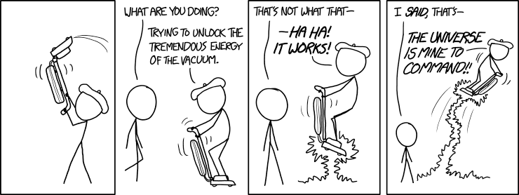

Heavy Churn Workloads and AutoVacuum
  By Lloyd Albin
Additional notes in the note section of the slide when you see this icon
( ) in the upper right corner of the slide.
© xkcd.xom (Randall Munroe) under the Creative Commons Attribution-NonCommercial 2.5 License

Slide 4
AutoVacuum: Is this presentation for me?
Who should pay attention to this presentation?
  Anyone who is running a lot of transactions, especially lots of deletes, updates, or rollbacked inserts. All of these commands cause deleted tuples (records) in the tables which needs to be vacuumed.
Why should I adjust these values?
  For most people PostgreSQL needs to be re-tuned because PostgreSQL is configured to run optimally on old hardware.
  PostgreSQL has acknowledged this with Postgres 12 by changing ONE of the seven default AutoVacuum values.
What happens if I don’t adjust the AutoVacuum?
  Table bloat can happen, especially on heavily used PostgreSQL Clusters (Servers). Enough bloat can happen on very heavily used systems to run them out of disk space which then crashes the PostgreSQL Cluster.

Slide 5
AutoVacuum: Is this presentation for me?
Where can I find out how to adjust the AutoVacuum?
  This presentation gives you all the knowledge you need to be able to re-tune your AutoVacuum along with links to relevant documentation.
When can I tell if the adjustments work?
  After you manually vacuum one of the bloated table, you should be able to see that the bloat does not come back after churning the tuples (records) within the table.

Slide 6
Causes and Effects

Slide 7
Heavy churn on small table
A Small table that gets thousands of rows added and deleted. This table is then joined to a large table to view a set of results.
  Effect: Your queries get slower and slower until a query that was 10 ms now takes 5 seconds or more, but if you start and stop your application, then the problem self fixes itself.
  Caused by the AutoAnalyze not updating the table stats. This causes the query planner to run slowly and to pick the wrong query plan which then causes the query to perform in minutes vers milliseconds. A manual Analyze will fix this issue. This issue can be verified by checking the row count vers the estimated table rows in the stats and/or by monitoring the query planning time. When you stop and restart your application, this gives AutoVacuum and AutoAnalyze time to catch up and update the table stats.
  Solution: Make your AutoVacuum/AutoAnalyze more aggressive if you have the spare Disk I/O. If you have high Disk I/O then you need to figure out the right trade off between database responsiveness and acceptable table bloat.

Slide 8
Heavy churn on large tables
Large table with tens of millions of rows where you are deleting and adding millions of rows per hour.
  Effect: You find that your queries are slowing down and when you look at your AutoVacuum, the AutoVacuum seems to be AutoVacuumig this table 24 hours per day, but if you stop your application for a few days or dump and restore your database it fixes itself.
  Caused by not enough time for the AutoVacuum to complete before the next churn cycle. This make the AutoVacuum take longer and longer to complete with the table bloat getting worse and worse until the AutoVacuum takes over 24 hours to complete. Stopping the Application lets the AutoVacuum catch up and then the queries run fast again. This can be fixed by either stopping the churn and doing a manual vacuum/analyze or by increasing your AutoVacuum's I/O rate by increasing the AutoVacuum Cost Limit. This can be verified by watching the currently running AutoVacuum's and the estimated dirty rows in the table stats.
  Caused by a long running transaction on the same server or a long running transaction on the secondary server, via streaming replication, that prevents the autovacuum event horizon from moving forward.

Slide 9

Heavy churn on large table indexs
Large table with tens of millions of rows where you are deleting and then adding millions of rows per hour with the same index values inside of a transaction.
  Effect: Your queries get slower and slower, but if you dump and restore your database, everything is fast again.
  Caused by the deleted records needing to be in the index at the same time as the new records. This means that all the index pages need to be split causing the index to double in size (or more) to allow the new entries to be inserted. The space is not recovered by the AutoVacuum system because it does not do a true vacuum of the index. The AutoVacuum will only vacuum/delete an index page which is 100% empty. The AutoVacuum does not do anything with partially filled pages except to remove deleted index entries. This can be verified by either looking for index bloat or by replacing the index and the query runs fast again.
  Solution: Make your AutoVacuum more aggressive if you have the spare Disk I/O. If you have high Disk I/O then you need to figure out the right trade off between database responsiveness and the AutoVacuum
Notes:
http://lloyd.thealbins.com/IndexBloat

Slide 10
Drop database is slow
When you try dropping a database and it takes 5 minutes.
  Effect: When you try dropping a database it takes a long time, such as 5 minutes.
  Caused by the AutoVacuum being very aggressive and the server having high Disk I/O with lots of Pending Writes.
  Solution: This one is not so easy because you have to make tough choice between database responsiveness and table/index bloat. This is a process of trial and error finding the right balance between AutoVacuum’s aggressiveness and Disk I/O and Pending Writes.
High Disk I/O AutoVacuum Tunning Choices
Database Responsiveness
More Table Bloat
Lower I/O Usage
Less Table Bloat
Higher I/O Usage

Slide 11
AutoVacuum
  What to monitor

Slide 12
What to Monitor
Currently running AutoVacuum Process’s
AutoVacuum Thresholds per Table
Active and Idle in Transaction Connections
AutoVacuum Threads in Use
Max AutoVacuum’s
CPU Usage
Disc Read Usage
Disc Write Usage
Disc Pending Write
Write Efficiency
Disc I/O Time
Last AutoVacuum per Table
Disc Free Space
Custom Table Settings Per Table
Granted Locks
AutoVacuum Settings

Slide 13
AutoVacuum Settings
  Viewing the server settings

Slide 14
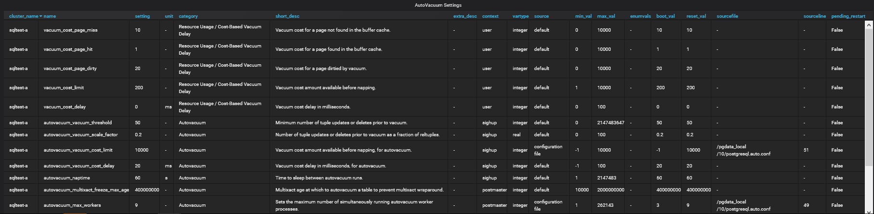
AutoVacuum Settings
This is more informational than anything, but the line will highlight when a restart is required for the change to take effect and Pending Restart will be True.
Postgres 12+ vacuum_cost_delay’s default changed from 20ms to 2ms
  BUT if you upgrade your database to v12, you will still have your original databases defaults. You need to manually update this value.
Notes:
https://www.postgresql.org/docs/12/release-12.html#id-1.11.6.5.5.3.8

Slide 15
AutoVacuum Logs
  Viewing the log files

Slide 16
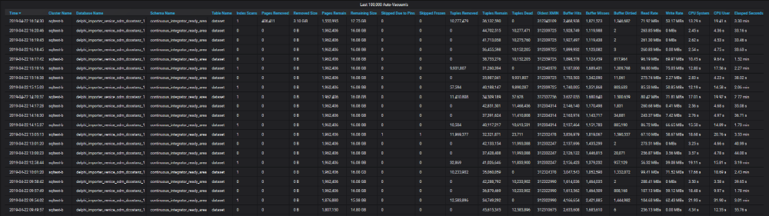
AutoVacuum Logs
Pages Removed / Removed Size – The AutoVacuum was able to reduce the table size.
Tuples Removed – The AutoVaccum was able to remove records.
Tupled Dead – The AutoVacuum was not able to remove these records due to they were created after the Oldest XMIN aka Oldest Transaction ID.

Slide 17
AutoVacuum Logs
((Buffer Hits * vacuum_cost_page_hit) + (Buffer Misses * vacuum_cost_page_miss) + (Buffer Dirtied * vacuum_cost_page_dirty)) = Total Cost
(((Buffer Hits * vacuum_cost_page_hit) + (Buffer Misses * vacuum_cost_page_miss) + (Buffer Dirtied * vacuum_cost_page_dirty)) / autovacuum/ vacuum_cost_limit) = Number of Delay Cycles
(((Buffer Hits * vacuum_cost_page_hit) + (Buffer Misses * vacuum_cost_page_miss) + (Buffer Dirtied * vacuum_cost_page_dirty)) / autovacuum/vacuum_cost_limit) * autovacuum/vacuum_cost_delay = Total Delay’s for Disk IO to Catch up.

Slide 18
AutoVacuum Logs
Here is how these formulas affect how long the AutoVacuum waits idle to let the Disk IO catch up for other processes.
Table Size 15.85 GB, 3.10 GB Removed from the end of the table by AutoVacuum with 12.75 GB remaining. Removing 10,277,479 Tuples / Records / Rows.
This AutoVacuum took 3.30 minutes with the autovacuum_cost_limit of 10,000 of which 1.63 minutes was the AutoVacuum sitting idle. This means that the AutoVacuum really only takes 1.67 minutes. This means that the default setting on PostgreSQL 11- would be 82.67 minutes and on PostgreSQL 12+ 9.67 minutes. Using out current tuning, it takes 4.67 minutes.
If your Tuple is over 2K LZ compressed, the extra amount will be stored in the Toast Table.
Buffer Hits | vacuum_cost_page_hit | Buffer Misses | vacuum_cost_page_miss | Buffers Dirtied | vacuum_cost_page_dirty | Total Cost
3,468,938 | 1 | 1,821,682 | 10 | 1,346,682 | 20 | 48,619,398
Total Cost | autovacuum_cost_limit | Number of Delay Cycles | autovacuum_cost_delay | Total Delay's for Disk IO
48,619,398 | 200 | 243,096 | 20 ms | 4,861,940 ms or 81 m
48,619,398 | 200 | 243,096 | 2 ms | 486,194 ms or 8 m
48,619,398 | 10,000 | 4,861 | 20 ms | 97,239 ms or 1 m
48,619,398 | 8,000 | 6,077 | 20 ms | 121,548 ms or 2 m
48,619,398 | 5,000 | 9,723 | 20 ms | 194,478 ms or 3 m
48,619,398 | 500 | 97,238 | 2 ms | 194,478 ms or 3 m

Slide 19
pg_stat_activity
Looking at pg_stat_activity, we can see that the long running transaction in a different database is creating the xmin event horizon that the autovacuum is using. Only items older than the xmin event horizon will be autovacuumed.
backend_xid = Top-level transaction identifier of this backend, if any.
backend_xmin = The current backend's xmin horizon.
The xmin event horizon can also come from a long running transaction on the secondary server due to hot_standby_feedback turn on for streaming replication.
  However, the cleanup situation will be no worse than if the standby queries were running directly on the primary server, and you are still getting the benefit of off-loading execution onto the standby.
datname | pid | usename | application_name | backend_start | xact_start | wait_event_type | wait_event | state | backend_xid | backend_xmin | backend_type
datamart02_dcostanz_1 | 18504 | dcostanz | fw delphi-datamart-renderer development | 4/22/19 1:21 PM | 4/22/19 11:00 PM | Client | ClientRead | idle in transaction | 312352069 |  | client backend
delphi_datamart_renderer_dcostanz_1 | 18493 | dcostanz | fw delphi-datamart-renderer development | 4/22/19 1:21 PM | 4/22/19 11:00 PM | Client | ClientRead | idle in transaction | 312352070 | 312352069 | client backend
developer_datamart_dcostanz_1 | 16478 | dcostanz | fw delphi-datamart-renderer development | 4/23/19 5:50 AM | 4/23/19 8:00 AM | Client | ClientRead | idle in transaction | 312382224 |  | client backend
datamart02_realtime_dcostanz_1 | 16462 | dcostanz | fw delphi-datamart-renderer development | 4/23/19 5:50 AM | 4/23/19 8:00 AM | Client | ClientRead | idle in transaction | 312382225 |  | client backend
delphi_datamart_renderer_dcostanz_1 | 16454 | dcostanz | fw delphi-datamart-renderer development | 4/23/19 5:50 AM | 4/23/19 8:00 AM | Client | ClientRead | idle in transaction | 312382226 | 312352069 | client backend
delphi_datamart_renderer_dcostanz_1 | 16453 | dcostanz | fw delphi-datamart-renderer development | 4/23/19 5:50 AM | 4/23/19 8:00 AM | Client | ClientRead | idle in transaction | 312382227 | 312352069 | client backend
delphi_continuous_integrator_dcostanz_1 | 2772 | dcostanz | fw delphi-continuous-integrator development | 4/22/19 12:30 PM | 4/23/19 10:39 AM | Client | ClientRead | idle in transaction | 312399443 | 312352069 | client backend
delphi_importer_venice_odm_dcostanz_1 | 3925 | dcostanz | fw delphi-importer-venice-odm development | 4/22/19 12:35 PM | 4/23/19 11:00 AM |  |  | active | 312402170 | 312352069 | client backend
datamart02_realtime_testing | 2796 | xapps | fw delphi-datamart-renderer testing | 4/22/19 12:30 PM | 4/23/19 11:07 AM | Client | ClientRead | idle in transaction | 312402304 |  | client backend
developer_datamart_testing | 2889 | xapps | fw delphi-datamart-renderer testing | 4/22/19 12:30 PM | 4/23/19 11:07 AM | IO | DataFileImmediateSync | active | 312402305 | 312352069 | client backend
delphi_datamart_renderer_testing | 2783 | xapps | fw delphi-datamart-renderer testing | 4/22/19 12:30 PM | 4/23/19 11:07 AM | Client | ClientRead | idle in transaction | 312402306 | 312352069 | client backend
delphi_datamart_renderer_testing | 2785 | xapps | fw delphi-datamart-renderer testing | 4/22/19 12:30 PM | 4/23/19 11:07 AM | Client | ClientRead | idle in transaction | 312402307 | 312352069 | client backend
df_repository_demo | 3670 | xapps | fw df-repository demo | 4/22/19 12:34 PM | 4/23/19 11:09 AM | Client | ClientRead | idle in transaction | 312402334 | 312352069 | client backend
df_repository_staging | 3040 | xapps | fw df-repository staging | 4/22/19 12:31 PM | 4/23/19 11:09 AM | Client | ClientRead | idle in transaction | 312402335 | 312352069 | client backend
delphi_importer_venice_odm_dcostanz_1 | 23442 |  |  | 4/23/19 11:03 AM | 4/23/19 11:03 AM |  |  | active |  | 312352069 | autovacuum worker
venice_odm_dcostanz_2 | 24849 |  |  | 4/23/19 11:09 AM | 4/23/19 11:09 AM |  |  | active |  | 312352069 | autovacuum worker
delphi_importer_venice_odm_testing | 23243 |  |  | 4/23/19 11:03 AM | 4/23/19 11:03 AM |  |  | active |  | 312352069 | autovacuum worker
delphi_continuous_integrator_dcostanz_1 | 21980 |  |  | 4/23/19 10:58 AM | 4/23/19 10:58 AM |  |  | active |  | 312352069 | autovacuum worker
delphi_continuous_integrator_dcostanz_1 | 18488 | dcostanz | fw delphi-datamart-renderer development | 4/22/19 1:21 PM | 4/23/19 8:00 AM | Client | ClientRead | idle in transaction |  | 312352069 | client backend
delphi_continuous_integrator_dcostanz_1 | 18490 | dcostanz | fw delphi-datamart-renderer development | 4/22/19 1:21 PM | 4/22/19 11:00 PM | Client | ClientRead | idle in transaction |  | 312347264 | client backend
delphi_continuous_integrator_dcostanz_1 | 16463 | dcostanz | fw delphi-datamart-renderer development | 4/23/19 5:50 AM | 4/23/19 8:00 AM | Client | ClientRead | idle in transaction |  | 312352069 | client backend
delphi_continuous_integrator_testing | 23489 |  |  | 4/23/19 11:04 AM | 4/23/19 11:04 AM | IO | DataFileRead | active |  | 312352069 | autovacuum worker
delphi_continuous_integrator_testing | 2874 | xapps | fw delphi-datamart-renderer testing | 4/22/19 12:30 PM | 4/23/19 11:07 AM | Client | ClientRead | idle in transaction |  | 312352069 | client backend
delphi_continuous_integrator_testing | 2888 | xapps | fw delphi-datamart-renderer testing | 4/22/19 12:30 PM | 4/23/19 11:07 AM | Client | ClientRead | idle in transaction |  | 312352069 | client backend
 | 4767 | postgres | sqltest_a | 4/22/19 8:21 PM |  | Activity | WalSenderMain | active |  | 312352069 | walsender

Slide 20
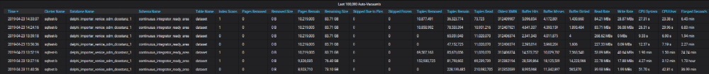
AutoVacuum Logs
You will notice that once the blocking transactions completed, that the table went from 228,199,485 records to 36,323,774 records but did not decrease in size.
AutoVacuum:
  Removes empty pages at the end of the table.
  Mark’s old records as reusable space.
  DOES NOT condense pages
  DOES NOT remove empty pages in the middle of the table
This means that once your table is bloated like this, there are only several solutions.
  Vacuum Full
  Cluster
  Truncate and re-insert the data – Truncate cleans up the pages immediately.
This type of bloat will cause sequential table scans to run slowly, because they have to read every page, even the empty ones.

Slide 21
Finding tuple usage on each page within the table
We can find out the used verse unused tuples on each page by running this query.
To be able to run this query you need to load my toolset from https://github.com/LloydAlbin/SCHARP-PG-DBA-Debugging-Tools which uses the pageinspect extension.
SELECT
p,
sum(unused_tuples) AS unused_tuples,
sum(used_tuples) AS used_tuples,
sum(deleted_tuples) AS deleted_tuples
FROM (
SELECT
p,
CASE WHEN (t_xmin IS NULL AND t_xmax IS NULL)
THEN 1
ELSE 0
END AS unused_tuples,
CASE WHEN (t_xmin IS NULL AND t_xmax IS NULL)
THEN 0
ELSE 1
END AS used_tuples
CASE WHEN heap_xmax_committed
THEN 1
ELSE 0
END AS deleted_tuples
FROM tools.heap_page_item_attrs_details('continuous_integrator_ready_area.dataset’)
) a
GROUP BY p
ORDER BY p;

Slide 22
Finding 100% empty pages
If create a view from the previous query and then write it’s output to a table, we can run various queries against the results.
One such query is how many pages are totally blank, this are only recoverable with a VACUUM FULL.
Default block size is 8K. You can, but should not, override this when compiling PostgreSQL.
CREATE TABLE tools.dataset_pages AS
SELECT * FROM previous_pages_view;
SELECT
count(*) AS empty_pages,
count(*) * current_setting('block_size')::bigint AS bytes,
pg_size_pretty(count(*) * current_setting('block_size')::bigint)
AS empty_page_size
FROM tools.dataset_pages
WHERE used_tuples = 0;
empty_pages | bytes | empty_page_size
7,568,398 | 62,000,316,416 | 58GB

Slide 23
Seeing the total bloat in tuples
In the first result, I am using the WHERE clause to ignoring the 100% empty pages.
In the second result, I am including the 100% empty pages.
SELECT
sum(used_tuples) AS used_tuples,
sum(unused_tuples) AS unused_tuples,
sum(deleted_tuples) AS deleted_tuples
FROM tools.dataset_pages
WHERE used_tuples > 0;
SELECT
sum(used_tuples) AS used_tuples,
sum(unused_tuples) AS unused_tuples,
sum(deleted_tuples) AS deleted_tuples
FROM tools.dataset_pages;
used_tuples | unused_tuples | deleted_tuples
66,813,680 | 6,280,558 | 39,466,746
66,813,680 | 203,492,055 | 39,466,746

Slide 24
PostgreSQL v12
  Does the v12 setting work better? Can it be applied to v10?

Slide 25
AutoVacuum Settings
Table Size 15.85 GB, 3.10 GB Removed from the end of the table by AutoVacuum with 12.75 GB remaining. Removing 10,277,479 Tuples / Records / Rows.
We ran a test on 9/25/2019 using the Custom settings and another test on 10/1/2019 using the V12 settings. We found that the database was more responsive to commands such as drop database, even though it had higher disk I/O, Pending Writes and Blocked Processes (See Graphs in next slides).
Buffer Hits | vacuum_cost_page_hit | Buffer Misses | vacuum_cost_page_miss | Buffers Dirtied | vacuum_cost_page_dirty | Total Cost
3,468,938 | 1 | 1,821,682 | 10 | 1,346,682 | 20 | 48,619,398
Postgres Version | Total Cost | autovacuum_cost_limit | Numer of Delay Cycles | autovacuum_cost_delay | Total Delay's for Disk IO
V11- | 48,619,398 | 200 | 243,096 | 20 ms | 4,861,940 ms or 81 m
Custom | 48,619,398 | 5,000 | 9,723 | 20 ms | 194,478 ms or 3 m
V12+ | 48,619,398 | 200 | 243,096 | 2 ms | 486,194 ms or 8 m

Slide 26
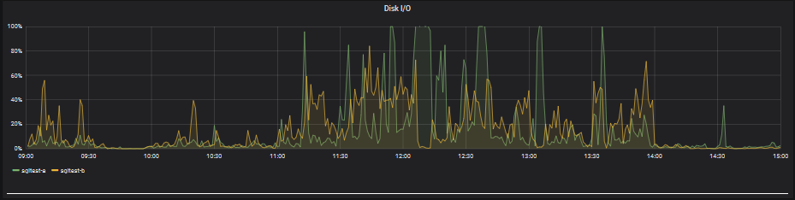
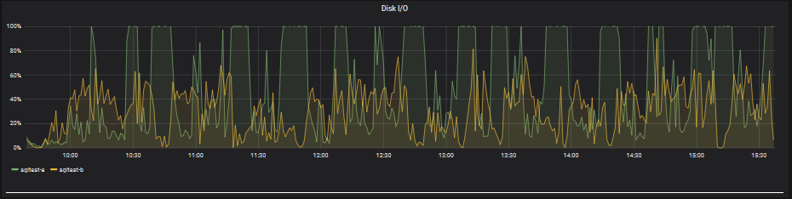
Disk I/O
9/25/2019 Test
10/1/2019 Test
Notes:
pg_stat_progress_vacuum
https://www.postgresql.org/docs/current/progress-reporting.html#VACUUM-PROGRESS-REPORTING
pg_stat_activity
https://www.postgresql.org/docs/current/monitoring-stats.html#PG-STAT-ACTIVITY-VIEW
Vacuum Phases
https://www.postgresql.org/docs/current/progress-reporting.html#VACUUM-PROGRESS-REPORTING
Blocks and Pages interchangeable words.

Slide 27
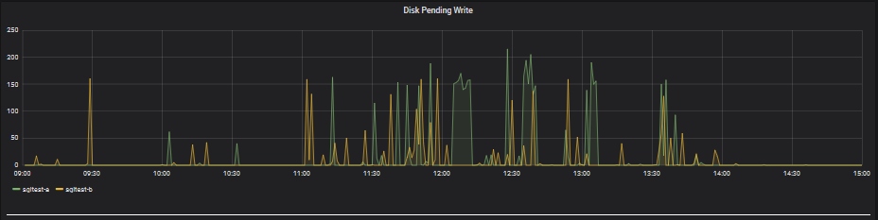
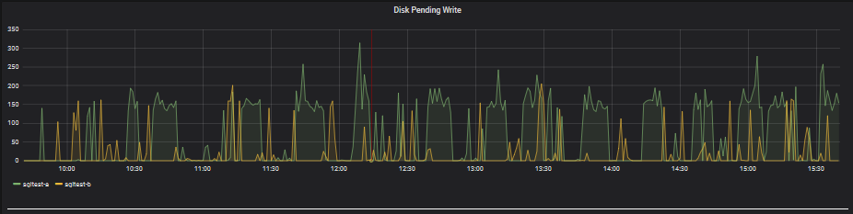
Disk Pending Writes
9/25/2019 Test
10/1/2019 Test
Notes:
pg_stat_progress_vacuum
https://www.postgresql.org/docs/current/progress-reporting.html#VACUUM-PROGRESS-REPORTING
pg_stat_activity
https://www.postgresql.org/docs/current/monitoring-stats.html#PG-STAT-ACTIVITY-VIEW
Vacuum Phases
https://www.postgresql.org/docs/current/progress-reporting.html#VACUUM-PROGRESS-REPORTING
Blocks and Pages interchangeable words.

Slide 28
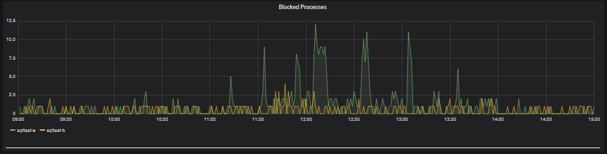
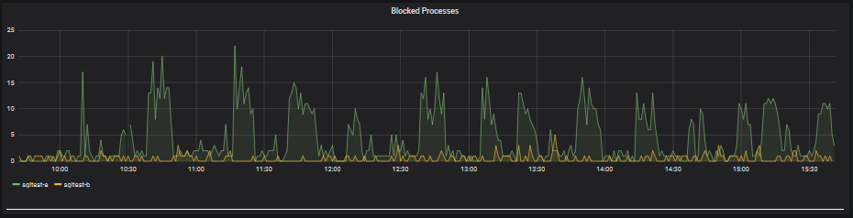
Disk Blocked Processes
9/25/2019 Test
10/1/2019 Test
Notes:
pg_stat_progress_vacuum
https://www.postgresql.org/docs/current/progress-reporting.html#VACUUM-PROGRESS-REPORTING
pg_stat_activity
https://www.postgresql.org/docs/current/monitoring-stats.html#PG-STAT-ACTIVITY-VIEW
Vacuum Phases
https://www.postgresql.org/docs/current/progress-reporting.html#VACUUM-PROGRESS-REPORTING
Blocks and Pages interchangeable words.

Slide 29
AutoVacuum Logs
9/25/2019 Test
  No AutoVacuum’s during 8 hour test window.
  Only AutoVacuum after the test ended.
10/1/2019 Test
  Multiple AutoVacuum’s during the test window.
  System is responsive to other users.
Notes:
pg_stat_progress_vacuum
https://www.postgresql.org/docs/current/progress-reporting.html#VACUUM-PROGRESS-REPORTING
pg_stat_activity
https://www.postgresql.org/docs/current/monitoring-stats.html#PG-STAT-ACTIVITY-VIEW
Vacuum Phases
https://www.postgresql.org/docs/current/progress-reporting.html#VACUUM-PROGRESS-REPORTING
Blocks and Pages interchangeable words.

Slide 30
Currently Running AutoVacuum(s)
  Knowing what is a happening and the speed at which it is happening.
  Requires PostgreSQL 9.6+

Slide 31
Current Running AutoVacuum(s)
Table Name
  This will be displayed in one of the following formats: Cluster.Database.Schema.Table or Database.Schema.Table or Schema.Table depending on your template settings.
Vacuum / Analyze
  This shows you if vacuum and/or Analyze are going to be happening
Running Time
  How long the AutoVacuum has been running on this specific talbe.
Phase
  Initializing, scanning heap, vacuuming indexes, vacuuming heap, cleaning up indexes, truncating heap, performing final cleanup
Total Pages
  This is the number of pages that needs to be processed. Pages by default are 8K.
Table Size
  This is the heap_blks_read * Yours block/page size giving you the size of your table on disc.
Notes:
pg_stat_progress_vacuum
https://www.postgresql.org/docs/current/progress-reporting.html#VACUUM-PROGRESS-REPORTING
pg_stat_activity
https://www.postgresql.org/docs/current/monitoring-stats.html#PG-STAT-ACTIVITY-VIEW
Vacuum Phases
https://www.postgresql.org/docs/current/progress-reporting.html#VACUUM-PROGRESS-REPORTING
Blocks and Pages interchangeable words.

Slide 32
Current Running AutoVacuum(s)
Pages Scanned
  This is the number of blocks/pages that have been scanned. By watching this, you can tell how fast this part of the process it taking.
Pages Scanned %
  This is the percent of blocks/pages that have been scanned. By watching this, you can tell how fast this part of the process it taking.
Pages Vacuumed
  This is the number of blocks/pages that have been vacuumed. By watching this, you can tell how fast this part of the process it taking.
Pages Vacuumed %
  This is the percent of blocks/pages that have been vacuumed. By watching this, you can tell how fast this part of the process it taking.
Index Vacuum Count
  After the “vacuuming indexes” stage has been processed, it will show you the number of indexes.
Max Dead Records
  This is the max number of records that can be processed before an index vacuum is required.
Notes:
pg_stat_progress_vacuum
https://www.postgresql.org/docs/current/progress-reporting.html#VACUUM-PROGRESS-REPORTING

Slide 33
Current Running AutoVacuum(s)
Dead Records
  Estimated number of dead tuples.
Start Time
  This is when the AutoVacuum started working on this table.
Wait Event Type
  LWLock, Lock, BufferPin, Activity, Extension, Client, IPC, Timeout, IO
Wait Event
  To many to cover here, see https://www.postgresql.org/docs/current/monitoring-stats.html#WAIT-EVENT-TABLE
State
  This should normally read “Active”.
Transaction ID Min
  This is the oldest Transaction ID that could read the table.
Notes:
pg_stat_progress_vacuum
https://www.postgresql.org/docs/current/progress-reporting.html#VACUUM-PROGRESS-REPORTING
pg_stat_activity
https://www.postgresql.org/docs/current/monitoring-stats.html#PG-STAT-ACTIVITY-VIEW
Wait Event Type
https://www.postgresql.org/docs/current/monitoring-stats.html#WAIT-EVENT-TABLE

Slide 34
AutoVacuum Thresholds
  Knowing when a table will be AutoVacuum’ed

Slide 35
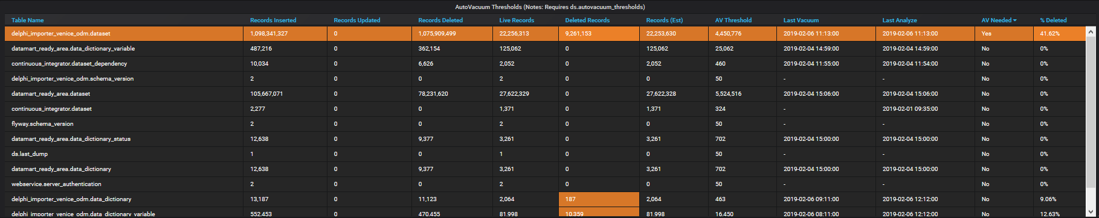
AutoVacuum Thresholds
Table Name
  This will be displayed in one of the following formats: Cluster.Database.Schema.Table or Database.Schema.Table or Schema.Table depending on your template settings.
Records Inserted, Records Updated, Records Deleted
  This is the total number of records inserted, updated and deleted. These numbers will only ever go up.
Live Records, Deleted Records, Record (est)
  This is the estimated number of readable records, deleted records and total records.

Slide 36
AutoVacuum Thresholds
AV Threshold
  This is the number of deleted records needed to kick off the AutoVacuum process for this table.
Last Vacuum, Last Analyze
  These are the Last Vacuum / AutoVacuum and Last Vacuum Analyze or Last AutoVacuum Analyze
AV Needed
  This will show “Yes” if the Deleted Records is more than the AV Threshold
% Deleted
  This shows you the percentage of the table that is deleted.

Slide 37
Active and Idle in Transaction
  Knowing what might be holding locks to prevent AutoVacuum

Slide 38
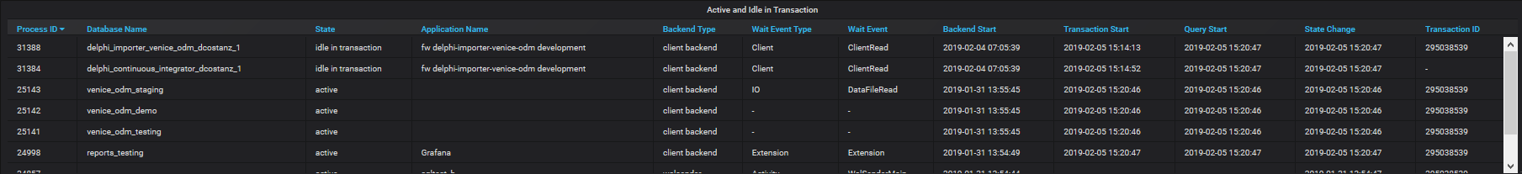
Active and Idle in Transaction
Process ID
  This is the number of deleted records needed to kick off the AutoVacuum process for this table.
Database Name
  These are the Last Vacuum / AutoVacuum and Last Vacuum Analyze or Last AutoVacuum Analyze
State
  This will show “Yes” if the Deleted Records is more than the AV Threshold
Application Name
  This shows you the percentage of the table that is deleted.
Backend Type
  This shows you the percentage of the table that is deleted.

Slide 39
Active and Idle in Transaction
Wait Event Type
  LWLock, Lock, BufferPin, Activity, Extension, Client, IPC, Timeout, IO
Wait Event
  To many to cover here, see https://www.postgresql.org/docs/current/monitoring-stats.html#WAIT-EVENT-TABLE
Backend Start / Transaction Start / Query Start / State Change
  The Backend Start, is when the connection to the server was established.
  The Transaction Start is when you did a BEGIN transaction or started a single item transaction.
  The Query Start is the start of your Query inside of the transaction and will be the same as Transaction Start if running a single item transaction.
  The State Change is the change in state, such as switching from active to “idle” or “idle in transaction”, allowing you to know how long the transaction or connection has been sitting idle.
Transaction ID
  This shows you the percentage of the table that is deleted.

Slide 40
Current Drive Performance
  Monitoring current drive performance

Slide 41
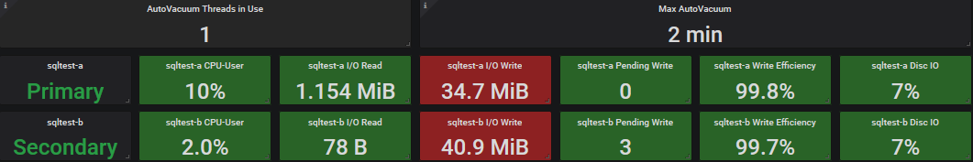
Current Drive Performance
AutoVacuum Threads in Use
  This is the number of AutoVacuum’s threads currently running.
Max AutoVacuum
  This is the longest running AutoVacuum
Server-a / Server-b
  Let’s us know which server is primary vers seconday.
CPU-User
  How much cpu the user, such as user postgres, is currently using.
  servers.virtual.$ServerName-a.aggregation-cpu-average.cpu-user
  servers.virtual.$ServerName-b.aggregation-cpu-average.cpu-user
Notes:
Color coding for I/O Write is set for Random Write, where for high efficiency writes would be > 46 GB Orange, >73 GB Red, 92 GB Max

Slide 42
Current Drive Performance
I/O Read / I/O Write
  Read and Writing in Bytes / KB / MB / GB
  servers.{virtual,physical}.$ServerName-a.disk-xvdb1.disk_octets.read
  servers.{virtual,physical}.$ServerName-b.disk-xvdb1.disk_octets.read
  servers.{virtual,physical}.$ServerName-a.disk-xvdb1.disk_octets.write
  servers.{virtual,physical}.$ServerName-b.disk-xvdb1.disk_octets.write
Pending Writes
  Number of writes that were delayed due to I/O saturation.
  servers.{virtual,physical}.$ServerName-a.disk-xvdb1.pending_operations
  servers.{virtual,physical}.$ServerName-b.disk-xvdb1.pending_operations

Slide 43
Current Drive Performance
Write Efficiency
  Random write is low efficiency, sequential write is high efficiency. We want to see high efficiency.
  offset(scale(asPercent(servers.{virtual,physical}.$ServerName-a.disk-xvdb1.disk_ops.write,servers.{virtual,physical}.$ServerName-a.disk-xvdb1.disk_octets.write),-1),1)
  offset(scale(asPercent(servers.{virtual,physical}.$ServerName-b.disk-xvdb1.disk_ops.write,servers.{virtual,physical}.$ServerName-b.disk-xvdb1.disk_octets.write),-1),1)
Disc I/O
  Disc I/O usage.
  scale(servers.{virtual,physical}.$ServerName-a.disk-xvdb1.disk_io_time.io_time,0.1)
  scale(servers.{virtual,physical}.$ServerName-b.disk-xvdb1.disk_io_time.io_time,0.1)

Slide 44
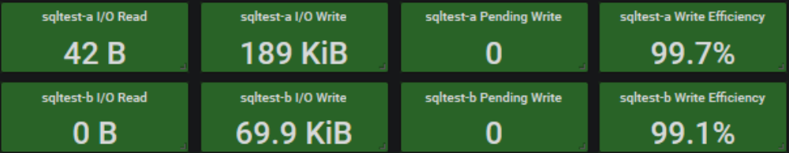
Current Drive Performance
I/O Read / I/O Write Settings
  RAID Type: RAID 6
  Drive Capacity: 146GB
  Single Drive Performance: 6,144 MB/s
  Single Drive Cost: 40
  Number of drives per RAID group: 16
  Number of RAID groups: 1
  Read operations (%): 0 (100% - Write Efficiency, In this case it would be between 0% and 1%)
Online RAID Calculator (See Page Notes)
Percent | MB | KB | B
100% | 92 | 93,696 | 95,944,704
80% | 73 | 74,957 | 76,755,763
50% | 46 | 46,848 | 47,972,352
Drive (Type / RPM) | IOPS (4KB block, random) | IOPS (64KB block, random) | MB/s (64KB block, random) | IOPS (512KB block, random) | MB/s (512KB block, random) | MB/s (large block, sequential)
FC / 15K | 163-178 | 151-169 | 9.7-10.8 | 97-123 | 49.7-63.1 | 73.5-127.5
SAS / 15K | 188-203 | 175-192 | 11.2-12.3 | 115-135 | 58.9-68.9 | 91.5-126.3
FC / 10K | 142-151 | 130-143 | 8.3-9.2 | 80-104 | 40.9-53.1 | 58.1-107.2
SAS / 10K | 142-151 | 130-143 | 8.3-9.2 | 80-104 | 40.9-53.1 | 58.1-107.2
SAS/SATA / 7200 | 73-79 | 69-76 | 4.4-4.9 | 47-63 | 24.3-32.1 | 43.4-97.8
SATA / 5400 | 57 | 55 | 3.5 | 44 | 22.6
SSD | To evaluate SSD RAID performance use the SSD version of the calculator
Notes:
I/O Read / I/O Write
The value you will want to use for your color threshold will be based on your write efficiency.
https://wintelguy.com/raidperf.pl
SSD Calculator
https://wintelguy.com/raidperf.pl/?formid=2
Color coding for I/O Write is set for Random Write, where for high efficiency writes would be > 46 GB Orange, >73 GB Red, 92 GB Max

Slide 45
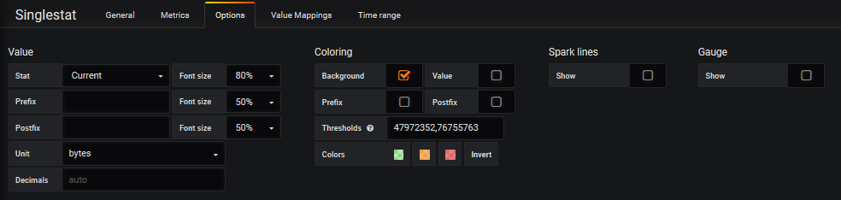
Current Drive Performance
I/O Read / I/O Write Settings
  RAID Type: RAID 6
  Drive Capacity: 146GB
  Single Drive Performance: 6,144 MB/s
  Single Drive Cost: 40
  Number of drives per RAID group: 16
  Number of RAID groups: 1
  Read operations (%): 0 (100% - Write Efficiency, In this case it would be between 0% and 1%)
Percent | MB | KB | B
100% | 92 | 93,696 | 95,944,704
80% | 73 | 74,957 | 76,755,763
50% | 46 | 46,848 | 47,972,352

Slide 46
Performance History
  Monitoring history as thing happen when we are not in front of the monitors.

Slide 47
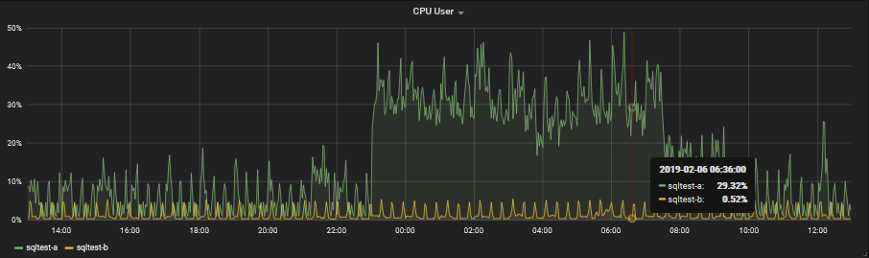
CPU User
We want to make sure that we are not running at full CPU. I try to keep the server below 50% with a max spike of 80%.
aliasByNode(servers.{virtual,physical}.$ServerName-a.aggregation-cpu-average.cpu-user,2)
aliasByNode(servers.{virtual,physical}.$ServerName-b.aggregation-cpu-average.cpu-user,2)

Slide 48
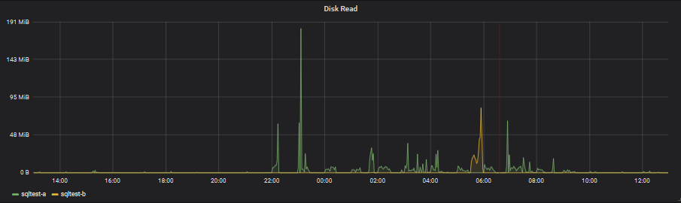
Disk Read
Short duration spikes are OK, as long as there is no real sustained disk reads.
aliasByNode(servers.{virtual,physical}.sqltest-a.disk-xvdb1.disk_octets.read,2)
aliasByNode(servers.{virtual,physical}.sqltest-b.disk-xvdb1.disk_octets.read,2)

Slide 49
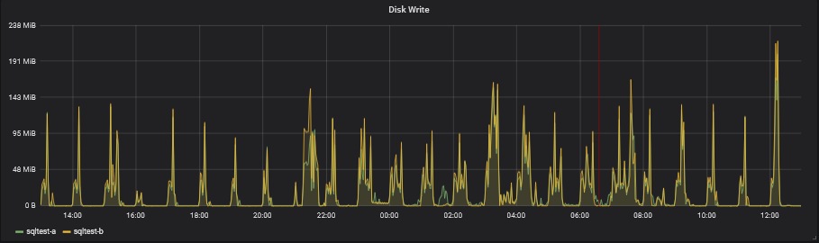
Disk Write
Short duration spikes are OK, as long as there is no real sustained disk writes causing pending writes to build up.
aliasByNode(servers.{virtual,physical}.sqltest-a.disk-xvdb1.disk_octets.write,2)
aliasByNode(servers.{virtual,physical}.sqltest-b.disk-xvdb1.disk_octets.write,2)

Slide 50
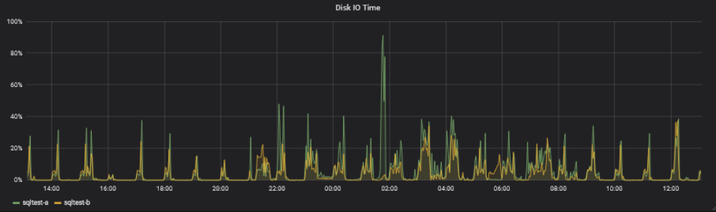
Disk I/O Time
The vacuum spike to 91% is OK, but I will be reducing it to 80% so that other long queries should not be affected as much by the AutoVacuum.
aliasByNode(scale(servers.{virtual,physical}.$ServerName-a.disk-xvdb1.disk_io_time.io_time,0.1),2)
aliasByNode(scale(servers.{virtual,physical}.$ServerName-b.disk-xvdb1.disk_io_time.io_time,0.1),2)

Slide 51
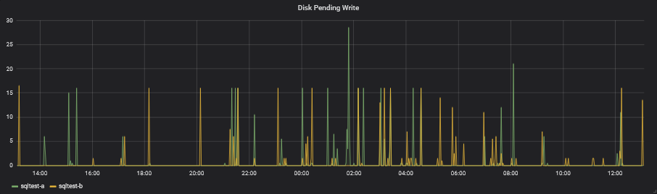
Disk Pending Write
Short pending writes are OK, we just don’t want to see long running pending items.
aliasByNode(servers.{virtual,physical}.$ServerName-a.disk-xvdb1.pending_operations,2)
aliasByNode(servers.{virtual,physical}.$ServerName-b.disk-xvdb1.pending_operations,2)

Slide 52
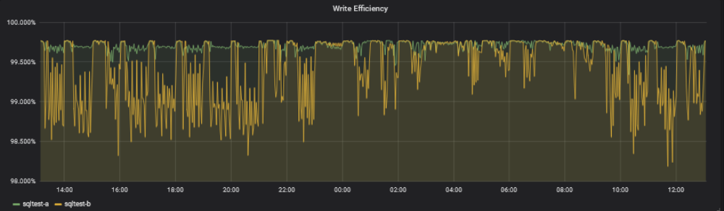
Write Efficiency
Random write is low efficiency, sequential write is high efficiency. We want to see high efficiency.
alias(offset(scale(asPercent(servers.{virtual,physical}.$ServerName-a.disk-xvdb1.disk_ops.write,servers.{virtual,physical}.$ServerName-a.disk-xvdb1.disk_octets.write),-1),1),"$ServerName-a")
alias(offset(scale(asPercent(servers.{virtual,physical}.$ServerName-b.disk-xvdb1.disk_ops.write,servers.{virtual,physical}.$ServerName-b.disk-xvdb1.disk_octets.write),-1),1),"$ServerName-b")

Slide 53
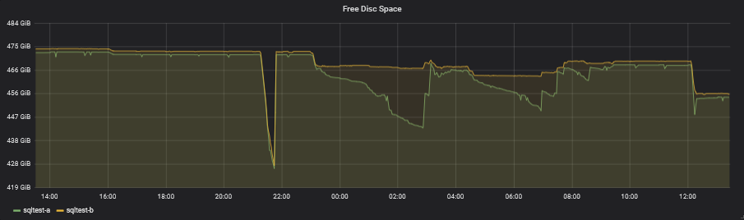
Free Disc Space
We need to make sure that we don’t run the server out of space due to bloating of the tables.
aliasByNode(servers.{virtual,physical}.$ServerName-a.df-pgdata_local.df_complex-free,2)
aliasByNode(servers.{virtual,physical}.$ServerName-b.df-pgdata_local.df_complex-free,2)

Slide 54
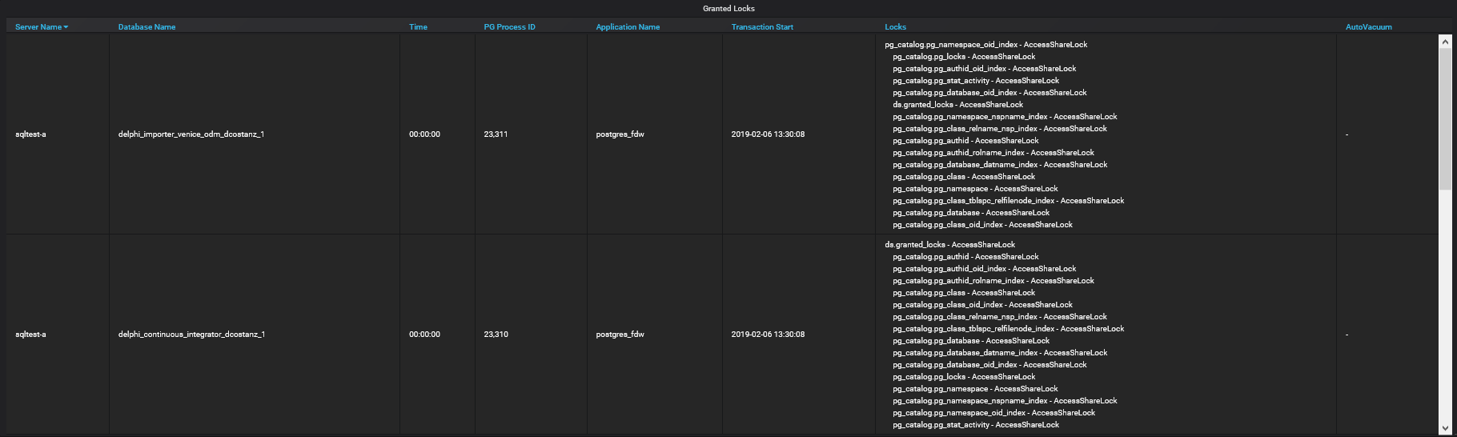
Granted Locks
If a table should be AutoVacuum’ed but is not, it could be because our long running transactions are holding locks on that table. We want to see if there are any Exclusive locks on the tables that should be AutoVacuum’ed.

Slide 55
Custom Table Settings
  Adjusting the AutoVacuum per Table

Slide 56
Custom Table Settings
This query allows us to retrieve all the custom table settings for all tables, excluding the tables located in pg_catalog and the information_schema.
SELECT
current_setting('cluster_name'::text)
AS cluster_name,
current_database() AS database_name,
pn.nspname AS schema_name,
pc.relname AS table_name,
quote_ident(pn.nspname::text) ||
'.'::text ||
quote_ident(pc.relname::text)
AS "Table Name",
unnest(pc.reloptions) AS "Table Setting"
FROM pg_class pc
JOIN pg_namespace pn
ON pn.oid = pc.relnamespace
WHERE pc.reloptions IS NOT NULL
AND (pn.nspname <> ALL (ARRAY [ 'pg_catalog'::name, 'information_schema':: name ]));

Slide 57
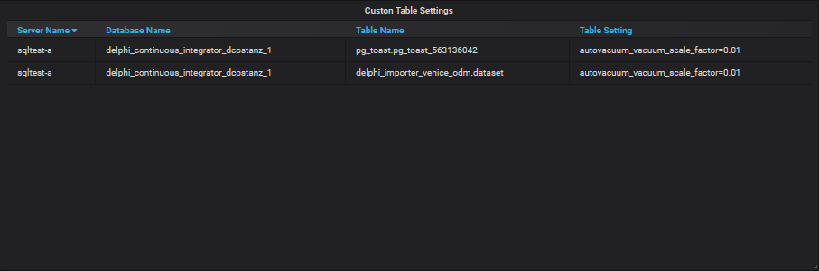
Custom Table Settings
The larger the table, the larger the threshold for AutoVacuum. For very large table we might want to lower this threshold. Instead of doing this for the entire server, we can do it for individual tables.
ALTER TABLE IF EXISTS ONLY delphi_importer_venice_odm.dataset
SET
(
autovacuum_vacuum_scale_factor=0.01,
toast.autovacuum_vacuum_scale_factor=0.01
);

Slide 58
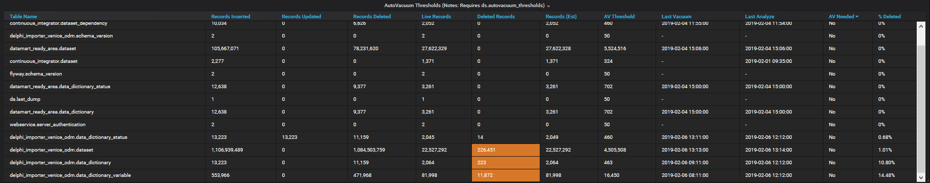
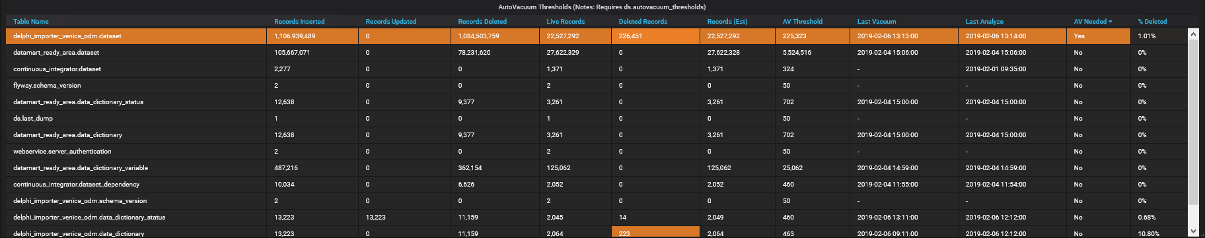
Custom Table Settings
Default
Custom

Slide 60
http://Lloyd.TheAlbins.com/AutoVacuum

