Slide 1

http://Lloyd.TheAlbins.com/

Slide 2
Splitting your data across devices
  By Lloyd Albin

Slide 3
Reasons for splitting your data
There may be several reasons to split your data across multiple devices, such as:
PII data needs encryption at rest
Performance, splitting your writes across multiple devices
Additional storage space
Partitions can make this even more powerful.
Storage and performance – Partitioning by device type and speed
  Local SSD
  Local Disk
  Network Attached Storage (Fast)
  Network Attached Storage (Slow)
What about using Foreign Data Wrappers to additional Postgres servers?
Most of these things can also be done with FDW’s except for writing Data, WAL and Logs to separate devices, but we can combine the methods to make an even more powerful system.
Multiple Disks
A
B
C
Multiple Directories
A
B
Multiple Disks & Directories
C
A
D
E
B
C

Slide 4
Tablespace’s
Tablespaces are physical disk locations that Postgres may use to store information.
Tablespaces are cluster wide; this means that definition for the tablespace is at the cluster level and are not backed up by pg_dump.
Multiple databases can use the same or different tablespaces.
You may even select different tablespaces per database, table, index/constraint.
Tablespaces can only be created by superusers but may be owned by a specified user.

Slide 5

Tablespace
We can use TABLESPACE to write a database, table, index, or constraint to a separate device.
Creating TABLESPACES:
Must be superuser
Must be an absolute path.
BEGIN [ WORK | TRANSACTION ] [ transaction_mode [, ...] ]
SET TRANSACTION transaction_mode [, ...]
SET TRANSACTION SNAPSHOT snapshot_id
SET SESSION CHARACTERISTICS AS TRANSACTION transaction_mode [, ...]
where transaction_mode is one of:
ISOLATION LEVEL { SERIALIZABLE | REPEATABLE READ | READ COMMITTED | READ UNCOMMITTED }
READ WRITE | READ ONLY
[ NOT ] DEFERRABLE
Notes:
Create Tablespace
https://www.postgresql.org/docs/current/sql-createtablespace.html

Slide 6
Caveats
Because tablespaces are cluster wide, the creation of the tablespaces are not dumped by pg_dump. You must use pg_dump_all for this which you will not want to use. It is best to maintain a separate sql script that will create your tablespaces before you restore your databases. There are 3rd party backup utilities that will backup these settings.
Can’t be created inside a transaction.
Only supported on systems that support symbolic links.
Can’t include single quotes.
Can’t be inside the current data directory.
Can’t begin with pg_
Use different mount points for the devices when doing streaming replication, so that they don’t overwrite each others' data set.
Notes:
These are some 3rd party backup software. I have not tested or endorse any of these for handling tablespaces properly or for general useability.
pgbarman
https://www.pgbarman.org/ - Free
http://docs.pgbarman.org/release/2.12/ - Talks about tablespaces
pgbackrest
https://pgbackrest.org/ - Free
https://pgbackrest.org/configuration.html - 7.6 & 7.7 deal with tablespaces
pg_probackup
https://github.com/postgrespro/pg_probackup - Free
BART
https://www.enterprisedb.com/docs/bart/2.6.1/ - Commercial Product
https://www.enterprisedb.com/docs/bart/2.6.1/bart_user/04_using_tablespaces/ - Tablespaces

Slide 7
Create/Alter Database
When creating a database, you can set the tablespace. When altering a database, you can set/change the tablespace.
BEGIN [ WORK | TRANSACTION ] [ transaction_mode [, ...] ]
SET TRANSACTION transaction_mode [, ...]
SET TRANSACTION SNAPSHOT snapshot_id
SET SESSION CHARACTERISTICS AS TRANSACTION transaction_mode [, ...]
where transaction_mode is one of:
ISOLATION LEVEL { SERIALIZABLE | REPEATABLE READ | READ COMMITTED | READ UNCOMMITTED }
READ WRITE | READ ONLY
[ NOT ] DEFERRABLE
Notes:
Create Database
https://www.postgresql.org/docs/current/sql-createdatabase.html
Alter Database
https://www.postgresql.org/docs/current/sql-alterdatabase.html

Slide 8
Create/Alter Table
When creating a database, you can set the tablespace. When altering a database, you can set/change the tablespace.
BEGIN [ WORK | TRANSACTION ] [ transaction_mode [, ...] ]
SET TRANSACTION transaction_mode [, ...]
SET TRANSACTION SNAPSHOT snapshot_id
SET SESSION CHARACTERISTICS AS TRANSACTION transaction_mode [, ...]
where transaction_mode is one of:
ISOLATION LEVEL { SERIALIZABLE | REPEATABLE READ | READ COMMITTED | READ UNCOMMITTED }
READ WRITE | READ ONLY
[ NOT ] DEFERRABLE
Notes:
Create Table
https://www.postgresql.org/docs/current/sql-createtable.html
Alter Table
https://www.postgresql.org/docs/current/sql-altertable.html

Slide 9
Create/Alter Index
When creating a database, you can set the tablespace. When altering a database, you can set/change the tablespace.
CREATE [ UNIQUE ] INDEX [ CONCURRENTLY ] [ [ IF NOT EXISTS ] name ] ON [ ONLY ] table_name [ USING method ]
( { column_name | ( expression ) } [ COLLATE collation ] [ opclass [ ( opclass_parameter = value [, ... ] ) ] ] [ ASC | DESC ] [ NULLS { FIRST | LAST } ] [, ...] )
[ INCLUDE ( column_name [, ...] ) ]
[ WITH ( storage_parameter [= value] [, ... ] ) ]
[ TABLESPACE tablespace_name ]
[ WHERE predicate ]
ALTER INDEX [ IF EXISTS ] name SET TABLESPACE tablespace_name
ALTER INDEX ALL IN TABLESPACE name [ OWNED BY role_name [, ... ] ]
SET TABLESPACE new_tablespace [ NOWAIT ]
Notes:
Create Index
https://www.postgresql.org/docs/current/sql-createindex.html
Alter Index
https://www.postgresql.org/docs/current/sql-alterindex.html

Slide 10
Example 1
  Adding more space using a network device

Slide 11
Setting up the Tablespace
The path that you wish to use, must already be created and usable.
Then you will need the superuser to create the TABLESPACE.
There are three options that are optional and will override the defaults from your postgresql.conf or postgresql.auto.conf files. This may be important if your local drives are SSD’s and your remote/network drives are the older spinning disks. In this case you will want to have different random_page_costs and effective_io_concurrency. You may also want to adjust these based on network latency, etc.
-- Spinning Disks
CREATE TABLESPACE archive LOCATION '/home/postgres/10_archive';
ALTER TABLESPACE archive SET (
seq_page_cost=1.0,
random_page_cost=4.0,
effective_io_concurrency=1
);
-- SSD's Disks
CREATE TABLESPACE archive LOCATION '/home/postgres/10_archive'
WITH (
seq_page_cost=1.0,
random_page_cost=1.1,
effective_io_concurrency=256
);
Notes:
Create Tablespace
https://www.postgresql.org/docs/current/sql-createtablespace.html
Alter Tablespace
https://www.postgresql.org/docs/current/sql-altertablespace.html

Slide 12
Looking at the filesystem
After you create the TABLESPACE, there will be a new directory for your instance on your remote device’s filesystem.
By reading the tablespace.c file, we can find out what the directory name means.
  PG_MAJORVER_CATVER
postgres:% ls -l /home/postgres/10_archive/
total 4
drwx------ 2 postgres staff 4096 Apr 22 13:46 PG_10_201707211
postgres:% ls -l /home/postgres/10_archive/PG_10_201707211/
total 0
The CATVER is the Catalog Version number.
  The catalog version number is used to flag incompatible changes in the PostgreSQL system catalogs. Whenever anyone changes the format of a system catalog relation, or adds, deletes, or modifies standard catalog entries in such a way that an updated backend wouldn't work with an old database (or vice versa), the catalog version number should be changed. The version number stored in pg_control by initdb is checked against the version number compiled into the backend at startup time, so that a backend can refuse to run in an incompatible database.
Notes:
tablespace.c
https://github.com/postgres/postgres/blob/master/src/backend/commands/tablespace.c
CATVER
https://github.com/postgres/postgres/blob/master/src/include/catalog/catversion.h

Slide 13
Setting up the Tables
When creating the table, you can specify the TABLESPACE.
The table will be created on the TABLESPACE device that you specified at the time of its creation.
NOTE: This is most likely not the way you intended to create the archive table’s index. See the next several slide for an understanding of what happened on the file system.
-- Create Local Table
CREATE TABLE public.local_table (
id SERIAL,
message TEXT,
CONSTRAINT local_table_pkey PRIMARY KEY(id)
) WITH (oids = false);
-- Create Local Table – Forcing to the default
CREATE TABLE public.local_table (
id SERIAL,
message TEXT,
CONSTRAINT local_table_pkey PRIMARY KEY(id)
) WITH (oids = false) TABLESPACE pg_default;
-- Create Remote Table
CREATE TABLE public.archive_table (
id SERIAL,
message TEXT,
CONSTRAINT archive_table_pkey PRIMARY KEY(id)
) WITH (oids = false) TABLESPACE archive;
Notes:
Create Table
https://www.postgresql.org/docs/current/sql-createtable.html

Slide 14
Looking at the filesystem
After you create your tables, this is what will appear on your remote device’s filesystem.
There will be directories for each of your databases. The directory name is your database oid.
postgres% ls -l /home/postgres/10_archive/PG_10_201707211/
total 4
drwx------ 2 postgres staff 4096 May 1 07:08 16384
SELECT oid, datname FROM pg_database;
oid | datname
12295 | postgres
16384 | example
1 | template1
12294 | template0
Notes:
pg_database
https://www.postgresql.org/docs/current/catalog-pg-database.html

Slide 15
Looking at the filesystem
After you create your tables, this is what will appear on your remote device’s filesystem.
Inside each database directory will be the files for each table names using the tableoid as the filename. There is a 1GB limit for this file, so each additional table files will have a .x (.1, .2, .3, etc).
There will also be _fsm (Free Space Map) and _vm (Visibility Map) files in this location but they do not contain any user data.
postgres% ls -l /home/postgres/10_archive/PG_10_201707211/16384/
total 8
-rw------- 1 postgres staff 0 May 4 15:24 16399
-rw------- 1 postgres staff 0 May 4 15:24 16403
-rw------- 1 postgres staff 8192 May 4 15:24 16405
SELECT c.oid, n.nspname, c.relname
FROM pg_class c
LEFT JOIN pg_namespace n
ON c.relnamespace = n.oid
WHERE c.oid IN (16399, 16403, 16405);
More Examples:
-rw------- 1 postgres staff 2539520 May 1 07:20 16410
-rw------- 1 postgres staff 24576 May 1 07:20 16410_fsm
-rw------- 1 postgres staff 8192 May 1 07:20 16410_vm
-rw------- 1 postgres staff 1073741824 May 1 07:21 16426
-rw------- 1 postgres staff 491683840 May 1 07:22 16426.1
-rw------- 1 postgres staff 401408 May 1 07:22 16426_fsm
oid | nspname | relname
16403 | pg_toast | pg_toast_16399
16405 | pg_toast | pg_toast_16399_index
16399 | public | archive_table
Notes:
pg_class
https://www.postgresql.org/docs/current/catalog-pg-class.html
pg_namespace
https://www.postgresql.org/docs/current/catalog-pg-namespace.html

Slide 16
Looking at the filesystem
After you create your tables, this is what will appear on your remote device’s filesystem.
In the normal file location, we will find the index, even though the table was created in the archive tablespace.
Depending on your needs, the index can also be showed over to the archive tablespace.
Examples:
  Keeping it in local for highspeed SSD’s.
  Keeping it in archive because it is not used very often, and speed is not important.
postgres% ls -l /unencrypted/pgdata/10_archive/base/16384/16406*
-rw------- 1 postgres staff 8192 May 4 15:24 /unencrypted/pgdata/10_archive/base/16384/16406
SELECT c.oid, n.nspname, c.relname, c.relfilenode
FROM pg_class c
LEFT JOIN pg_namespace n
ON c.relnamespace = n.oid
WHERE c.oid IN (16406);
After inserting 8 rows of data:
postgres% ls -l /unencrypted/pgdata/10_archive/base/16384/16406*
-rw------- 1 postgres staff 16384 May 4 15:53 /unencrypted/pgdata/10_archive/base/16384/16406
oid | nspname | relname | relfilenode
16406 | public | archive_table_pkey | 16406
Notes:
pg_class
https://www.postgresql.org/docs/current/catalog-pg-class.html
pg_namespace
https://www.postgresql.org/docs/current/catalog-pg-namespace.html

Slide 17
Moving the Index
You can move the indexes between the devices by changing their TABLESPACE using the ALTER INDEX command.
NOTE: Once you alter your index, you then need to use the relfilenode as the index file will no longer be the oid of the index.
-- Move index from Local Device to Remote Device
ALTER INDEX public.archive_table_pkey
SET TABLESPACE archive;
postgres% ls -l /unencrypted/pgdata/10_archive/base/16384/16406*
-rw------- 1 postgres staff 0 May 4 15:59 /unencrypted/pgdata/10_archive/base/16384/16406
postgres% ls -l /home/postgres/10_archive/PG_10_201707211/16384/
total 32
-rw------- 1 postgres staff 8192 May 4 15:56 16399
-rw------- 1 postgres staff 0 May 4 15:24 16403
-rw------- 1 postgres staff 8192 May 4 15:24 16405
-rw------- 1 postgres staff 16384 May 4 15:59 16408
SELECT c.oid, n.nspname, c.relname, c.relfilenode
FROM pg_class c
LEFT JOIN pg_namespace n
ON c.relnamespace = n.oid
WHERE c.oid IN (16406);
oid | nspname | relname | relfilenode
16406 | public | archive_table_pkey | 16408
Notes:
Alter Index
https://www.postgresql.org/docs/current/sql-alterindex.html
pg_class
https://www.postgresql.org/docs/current/catalog-pg-class.html
pg_namespace
https://www.postgresql.org/docs/current/catalog-pg-namespace.html

Slide 18
Creating the Table and Index using the Tablespace
Note that there are two references for tablespace, one for the table and one for the constraint.
This time when we look in the archive directory, we can see that the index is there.
CREATE TABLE public.archive_table2 (
id SERIAL,
message TEXT,
CONSTRAINT archive_table2_pkey PRIMARY KEY(id)
USING INDEX TABLESPACE archive
) WITH (oids = false)
TABLESPACE archive;
postgres% ls -l /home/postgres/10_archive/PG_10_201707211/16384/
total 48
-rw------- 1 postgres staff 8192 May 4 15:56 16399
-rw------- 1 postgres staff 0 May 4 15:24 16403
-rw------- 1 postgres staff 8192 May 4 15:24 16405
-rw------- 1 postgres staff 16384 May 4 15:59 16408
-rw------- 1 postgres staff 0 May 4 16:32 16411
-rw------- 1 postgres staff 0 May 4 16:32 16415
-rw------- 1 postgres staff 8192 May 4 16:32 16417
-rw------- 1 postgres staff 8192 May 4 16:32 16418
oid | nspname | relname | relfilenode
16411 | public | archive_table2 | 16411
16415 | pg_toast | pg_toast_16411 | 16415
16417 | pg_toast | pg_toast_16411_index | 16417
16418 | public | archive_table2_pkey | 16418
Notes:
Create Table
https://www.postgresql.org/docs/current/sql-createtable.html

Slide 19
Moving existing Tables
You can move the tables and indexes between the devices by using SET TABLESPACE via the ALTER TABLE and ALTER INDEX commands.
NOTE: The index and table are not required to be on the same device. For example, you might want to have your index on the local fast SSD’s and your data on slower less expensive disks.
-- Create table to be moved
CREATE TABLE public.local_table_moved_to_archive (
id SERIAL,
message TEXT,
PRIMARY KEY(id)
)
WITH (oids = false);
-- Move table from Local Device to Remote Device
ALTER TABLE public.local_table_moved_to_archive
SET TABLESPACE archive;
-- Move index from Local Device to Remote Device
ALTER INDEX public.local_table_moved_to_archive_pkey
SET TABLESPACE archive;
-- Move index from Remote Device to Local Device
ALTER TABLE public.local_table_moved_to_archive
SET TABLESPACE pg_default;
-- Move index from Remote Device to Local Device
ALTER INDEX public.local_table_moved_to_archive_pkey
SET TABLESPACE pg_default;
Notes:
Create Table
https://www.postgresql.org/docs/current/sql-createtable.html
Alter Table
https://www.postgresql.org/docs/current/sql-altertable.html
Alter Index
https://www.postgresql.org/docs/current/sql-alterindex.html

Slide 20
Example 2
  Splitting the Data, WAL, and Log files between devices

Slide 21
Setting up the Cluster
This configuration will put the WAL, LOG, and the rest of the data on three different devices. This allows you to have a higher write speed aka IO throughput to your devices if they have separate hardware controllers.
initdb -D /pgdata/ -E UTF8 --data-checksums --no-locale
mkdir /dev2/pgdata_wal
chmod 700 /dev2/pgdata_wal
mv /pgdata/pg_wal /dev2/pgdata_wal/pg_wal
ln -s /dev2/pgdata_wal/pg_wal /pgdata/pg_wal
mkdir /dev3/pgdata_logs
chmod 700 /dev3/pgdata_logs
# Note: You also need to move the log files to the secure area, and this can be done by either editing the postgresql.conf or postgresql.auto.conf files or my the MV and LN command like done with the pg_wal.
pg_ctl start -D /pgdata/

Slide 22
Example 3
  Splitting your database between and unencrypted and an encrypted device

Slide 23
Setting up the Tablespace
There is a Postgres wiki page that talks about which files contain user data.
Note: Additional ones that need to be delt with:
  base/pgsql_tmp – Temp files
  pg_replslot – Replication Slots
  pg_tblspc – Tablespace Metadata
Note: Filesystem Level Encryption
  Fscrypt
Note: You could also put everything on the encrypted device and then create a tablespace for unencrypted data.
initdb -D /unencrypted/pgdata/10_split -E UTF8 --data-checksums --no-locale
mkdir /encrypted/pgdata/10_split
chmod 700 /encrypted/pgdata/10_split
mv /unencrypted/pgdata/10_split/pg_wal /encrypted/pgdata/10_split/pg_wal
mv /unencrypted/pgdata/10_split/pg_stat /encrypted/pgdata/10_split/pg_stat
mv /unencrypted/pgdata/10_split/pg_stat_tmp /encrypted/pgdata/10_split/pg_stat_tmp
ln -s /encrypted/pgdata/10_split/pg_wal /unencrypted/pgdata/10_split/pg_wal
ln -s /encrypted/pgdata/10_split/pg_stat /unencrypted/pgdata/10_split/pg_stat
ln -s /encrypted/pgdata/10_split/pg_stat_tmp /unencrypted/pgdata/10_split/pg_stat_tmp
# Note: You also need to move the log files to the secure area, and this can be done by editing the postgresql.conf or postgresql.auto.conf files.
pg_ctl start -D /unencrypted/pgdata/10_split/
Notes:
Transparent Data Encryption
https://wiki.postgresql.org/wiki/Transparent_Data_Encryption
File System Level Encryption
https://www.kernel.org/doc/html/latest/filesystems/fscrypt.html

Slide 24
Setting up the Tablespace
You might be adding additional RAID drives and configuring them for hardware of software encryption to deal with encryption at rest for PII data.
-- Spinning Disks
CREATE TABLESPACE secure LOCATION '/encrypted/pgdata/10_split';
ALTER TABLESPACE secure SET (
seq_page_cost=1.0,
random_page_cost=4.0,
effective_io_concurrency=1
);
-- SSD's Disks
CREATE TABLESPACE secure LOCATION '/encrypted/pgdata/10_split'
WITH (
seq_page_cost=1.0,
random_page_cost=1.1,
effective_io_concurrency=256
);
Notes:
Create Tablespace
https://www.postgresql.org/docs/current/sql-createtablespace.html
Alter Tablespace
https://www.postgresql.org/docs/current/sql-altertablespace.html

Slide 25
Setting up the Tables
When creating the table, you can specify both the table and index TABLESPACEs.
The table will then be created on the TABLESPACE device that you specified at the time of its creation.
Serial ids are mostly like not PII data. Composite keys are most likely PII data and need to be stored securely. There will be exceptions to the rules.
-- Create Unencrypted Table
CREATE TABLE public.unsecure_table (
id SERIAL,
message TEXT,
CONSTRAINT unsecure_table_pkey PRIMARY KEY(id)
)
WITH (oids = false);
-- Create Encryoted Table
CREATE TABLE public.secure_table (
id SERIAL,
message TEXT,
CONSTRAINT secure_table_pkey PRIMARY KEY(id)
USING INDEX TABLESPACE secure
)
WITH (oids = false)
TABLESPACE secure;
Notes:
Create Table
https://www.postgresql.org/docs/current/sql-createtable.html

Slide 26
Performance Testing
  Testing with pgbench

Slide 27
Setting up a split test
In this example I am using an old 16 core server with both internal spinning disks and external iscsi spinning disks. It has been created into three sets of devices. The boot device, an unencrypted device, and an encrypted device using software encryption. The unencrypted and encrypted devices are RAIDed across the internal and external disks so that they would have the same performance. The network card is a 1GB card. The backbone is a 10GB network.
initdb -D /unencrypted/pgdata/10_split -E UTF8 --data-checksums --no-locale
mkdir /encrypted/pgdata/10_split
chmod 700 /encrypted/pgdata/10_split
mkdir /encrypted/pgdata/10_split/data
chmod 700 /encrypted/pgdata/10_split/data
mv /unencrypted/pgdata/10_split/pg_wal /encrypted/pgdata/10_split/pg_wal
mv /unencrypted/pgdata/10_split/pg_stat /encrypted/pgdata/10_split/pg_stat
mv /unencrypted/pgdata/10_split/pg_stat_tmp /encrypted/pgdata/10_split/pg_stat_tmp
ln -s /encrypted/pgdata/10_split/pg_wal /unencrypted/pgdata/10_split/pg_wal
ln -s /encrypted/pgdata/10_split/pg_stat /unencrypted/pgdata/10_split/pg_stat
ln -s /encrypted/pgdata/10_split/pg_stat_tmp /unencrypted/pgdata/10_split/pg_stat_tmp
# Change the pg_log location in either the postgresql.conf or postgresql.auto.conf files.
pg_ctl start -D /unencrypted/pgdata/10_split/
psql -h localhost -d postgres -c 'CREATE DATABASE example_secure;'
psql -h localhost -d example_secure -c "CREATE TABLESPACE secure LOCATION '/encrypted/pgdata/10_split/data';"
psql -h localhost -d example_secure -c "SET default_tablespace = secure;"
pgbench -s 40 -i --tablespace=secure --index-tablespace=secure example_secure
sleep 3m
time /usr/local/postgres-current/bin/pgbench -c 30 -j 30 -t 1000000 example_secure
sleep 3m
Notes:
pgbench
https://www.postgresql.org/docs/current/pgbench.html

Slide 28
Setting up the Tables
By collecting the outputs from time and pgbench we can look at the data in different ways.
 | Split Encryption |  | 100% Unencrypted | 100% Encrypted | Split Archive
 | UNENCRYPTED data ENCRYPTED wal, stats, logs | ENCRYPTED data ENCRYPTED wal, stats, logs |  |  | LOCAL data LOCAL wal, stats, logs | REMOTE data LOCAL wal, stats, logs
 | Test 1 | Test 2 | Test 3 | Test 4 | Test 5 | Test 6
latency average (ms) | 2.076 | 2.069 | 2.093 | 2.131 | 2.093 | 2.127
tps (including connections establishing) | 14450.673532 | 14501.324773 | 14335.567848 | 14076.556112 | 14330.098959 | 14103.334139
tps (excluding connections establishing) | 14450.930607 | 14501.570275 | 14335.877881 | 14076.798788 | 14330.340931 | 14103.643172
description | test | tps | latency | user | system | real
Split Encrypted | Test 2 | 14501.324773 | 2.069 | 36m31.603s | 45m20.642s | 34m28.836s
Split Unencrypted | Test 1 | 14450.673532 | 2.076 | 36m21.649s | 45m21.522s | 34m36.088s
100% Unencrypted | Test 3 | 14335.567848 | 2.093 | 36m32.186s | 45m50.772s | 34m52.769s
Archive Local | Test 5 | 14330.098959 | 2.093 | 36m40.231s | 45m42.395s | 34m53.563s
Archive Remote | Test 6 | 14103.334139 | 2.127 | 36m22.012s | 45m43.455s | 35m27.240s
100% Encrypted | Test 4 | 14076.556112 | 2.131 | 36m50.546s | 45m50.389s | 35m31.313s

Slide 29
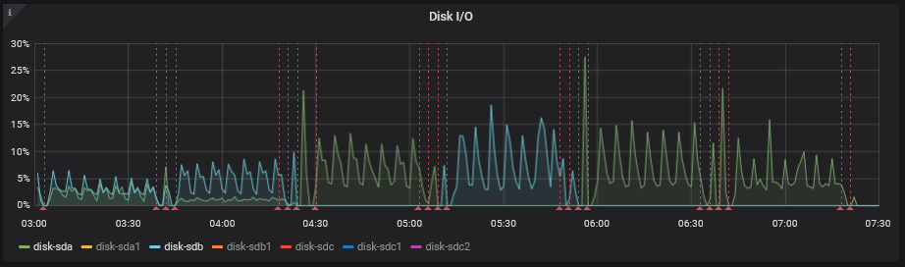
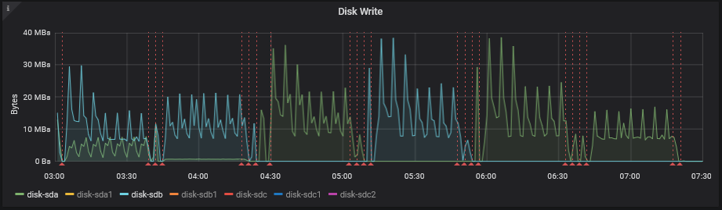
Disk IO / Disk Write
Notes:
Collectd
https://collectd.org/
Graphite
https://github.com/graphite-project/graphite-web
https://github.com/graphite-project/carbon
https://github.com/graphite-project/whisper
Graphite Docs
https://graphite.readthedocs.io/en/stable/
Grafana
https://grafana.com/

Slide 30
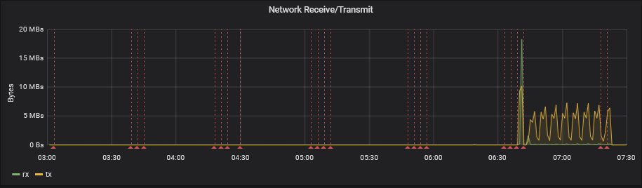
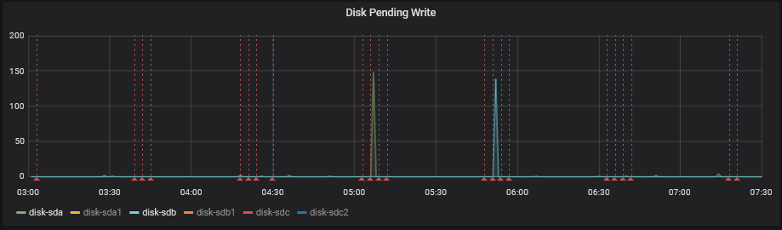
Network / Pending Writes
Notes:
Collectd
https://collectd.org/
Graphite
https://github.com/graphite-project/graphite-web
https://github.com/graphite-project/carbon
https://github.com/graphite-project/whisper
Graphite Docs
https://graphite.readthedocs.io/en/stable/
Grafana
https://grafana.com/

Slide 31
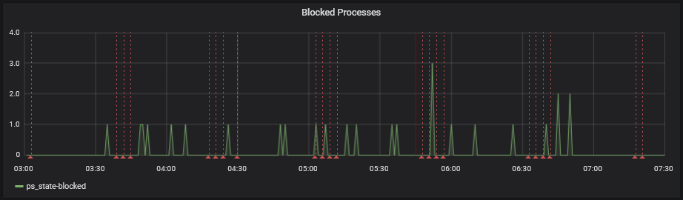
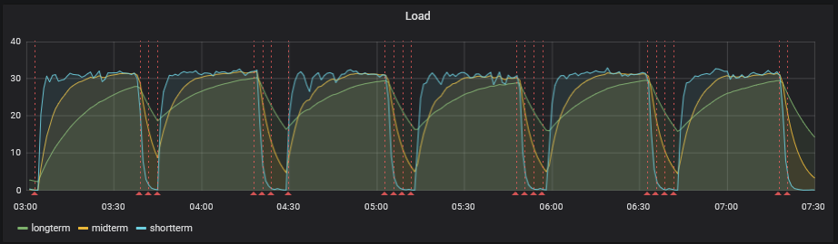
Blocked Processes / Load
Notes:
Collectd
https://collectd.org/
Graphite
https://github.com/graphite-project/graphite-web
https://github.com/graphite-project/carbon
https://github.com/graphite-project/whisper
Graphite Docs
https://graphite.readthedocs.io/en/stable/
Grafana
https://grafana.com/

Slide 32
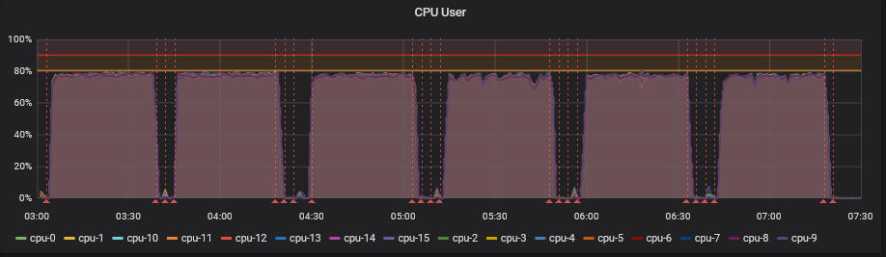
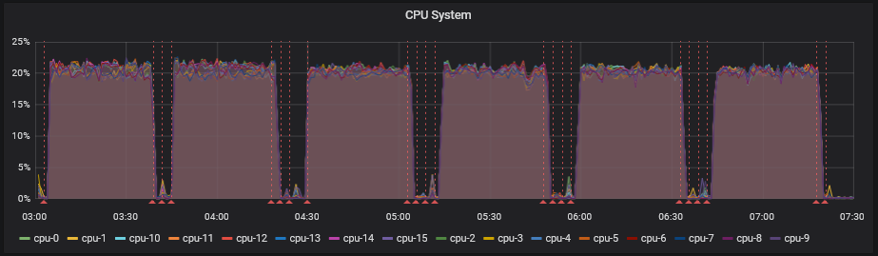
CPU User / CPU System
Notes:
Collectd
https://collectd.org/
Graphite
https://github.com/graphite-project/graphite-web
https://github.com/graphite-project/carbon
https://github.com/graphite-project/whisper
Graphite Docs
https://graphite.readthedocs.io/en/stable/
Grafana
https://grafana.com/

