Slide 1

http://Lloyd.TheAlbins.com/AutoVacuum

Slide 2

AutoVacuum
  By Lloyd Albin
© xkcd.xom (Randall Munroe) under the Creative Commons Attribution-NonCommercial 2.5 License

Slide 3

In this presentation we will cover:
Additional notes in the note section of the slide when you see this icon
( ) in the upper right corner of the slide.
Grafana
  Custom PostgreSQL Queries
  Data from Graphite - collectd
  How to interpret the output of the queries

Slide 4
AutoVacuum
  What to monitor

Slide 5
What to Monitor
Currently running AutoVacuum Process’s
AutoVacuum Thresholds per Table
Active and Idle in Transaction Connections
AutoVacuum Threads in Use
Max AutoVacuum’s
CPU Usage
Disc Read Usage
Disc Write Usage
Disc Pending Write
Write Efficiency
Disc I/O Time
Last AutoVacuum per Table
Disc Free Space
Custom Table Settings Per Table
Granted Locks
AutoVacuum Settings

Slide 6
Currently Running AutoVacuum(s)
  Knowing what is a happening and the speed at which it is happening.
  Requires PostgreSQL 9.6+

Slide 7
Primary / Secondary Query
This query allows us to view the currently running AutoVacuum’s
SELECT current_setting('cluster_name'::text) AS cluster_name,
pspv.datname AS database_name,
CASE
WHEN substr(psa.query, 0, 28) = 'autovacuum: VACUUM ANALYZE '::text
THEN split_part(substr(psa.query, 28), '.'::text, 1)
WHEN substr(psa.query, 0, 20) = 'autovacuum: VACUUM '::text
THEN split_part(substr(psa.query, 20), '.'::text, 1)
WHEN substr(psa.query, 0, 21) = 'autovacuum: ANALYZE '::text
THEN split_part(substr(psa.query, 21), '.'::text, 1)
ELSE NULL::text
END AS schema_name,
CASE
WHEN substr(psa.query, 0, 28) = 'autovacuum: VACUUM ANALYZE '::text
THEN split_part(substr(psa.query, 28), '.'::text, 2)
WHEN substr(psa.query, 0, 20) = 'autovacuum: VACUUM '::text
THEN split_part(substr(psa.query, 20), '.'::text, 2)
WHEN substr(psa.query, 0, 21) = 'autovacuum: ANALYZE '::text
THEN split_part(substr(psa.query, 21), '.'::text, 2)
ELSE NULL::text
END AS table_name,
CASE
WHEN substr(psa.query, 0, 28) = 'autovacuum: VACUUM ANALYZE '::text THEN substr(psa.query, 28)
WHEN substr(psa.query, 0, 20) = 'autovacuum: VACUUM '::text THEN substr(psa.query, 20)
WHEN substr(psa.query, 0, 21) = 'autovacuum: ANALYZE '::text THEN substr(psa.query, 21)
ELSE NULL::text END AS name,
CASE
WHEN substr(psa.query, 0, 28) = 'autovacuum: VACUUM ANALYZE '::text THEN true
WHEN substr(psa.query, 0, 20) = 'autovacuum: VACUUM '::text THEN true
ELSE false END AS vacuum,
CASE
WHEN substr(psa.query, 0, 28) = 'autovacuum: VACUUM ANALYZE '::text
THEN true WHEN substr(psa.query, 0, 21) = 'autovacuum: ANALYZE '::text
THEN true ELSE false END AS "analyze",

Slide 8

Primary / Secondary Query
This query allows us to view the currently running AutoVacuum’s
(date_part('seconds'::text, date_trunc('second'::text, now() - psa.backend_start)) + date_part('minutes'::text, date_trunc('second' ::text, now() - psa.backend_start)) * 60::double precision + date_part('hours'::text, date_trunc('second'::text, now() - psa.backend_start)) * 60::double precision * 60::double precision + date_part('days'::text, date_trunc('second'::text, now() - psa.backend_start)) * 60::double precision * 60::double precision * 24::double precision)::integer AS running_time,
pspv.phase,
pspv.heap_blks_total,
pspv.heap_blks_total * current_setting('block_size'::text)::bigint AS heap_blks_total_size,
pspv.heap_blks_scanned,
pspv.heap_blks_scanned::numeric / pspv.heap_blks_total::numeric AS heap_blks_scanned_pct,
pspv.heap_blks_vacuumed,
pspv.heap_blks_vacuumed::numeric / pspv.heap_blks_total::numeric AS heap_blks_vacuumed_pct,
pspv.index_vacuum_count,
pspv.max_dead_tuples,
pspv.num_dead_tuples,
psa.backend_start,
psa.wait_event_type,
psa.wait_event,
psa.state,
psa.backend_xmin
FROM pg_catalog.pg_stat_progress_vacuum
LEFT JOIN pg_catalog.pg_stat_activity ON pspv.pid = psa.pid;
Notes:
pg_stat_progress_vacuum & Vacuum Phases
https://www.postgresql.org/docs/current/progress-reporting.html
pg_stat_activity
https://www.postgresql.org/docs/current/monitoring-stats.html#PG-STAT-ACTIVITY-VIEW
Wait Events
https://www.postgresql.org/docs/current/monitoring-stats.html#WAIT-EVENT-TABLE

Slide 9
Current Running AutoVacuum(s)
Table Name
  This will be displayed in one of the following formats: Cluster.Database.Schema.Table or Database.Schema.Table or Schema.Table depending on your template settings.
Vacuum / Analyze
  This shows you if vacuum and/or Analyze are going to be happening
Running Time
  How long the AutoVacuum has been running on this specific talbe.
Phase
  Initializing, scanning heap, vacuuming indexes, vacuuming heap, cleaning up indexes, truncating heap, performing final cleanup
Total Pages
  This is the number of pages that needs to be processed. Pages by default are 8K.
Table Size
  This is the heap_blks_read * Yours block/page size giving you the size of your table on disc.
Notes:
pg_stat_progress_vacuum
https://www.postgresql.org/docs/current/progress-reporting.html#VACUUM-PROGRESS-REPORTING
pg_stat_activity
https://www.postgresql.org/docs/current/monitoring-stats.html#PG-STAT-ACTIVITY-VIEW
Vacuum Phases
https://www.postgresql.org/docs/current/progress-reporting.html#VACUUM-PROGRESS-REPORTING
Blocks and Pages interchangeable words.

Slide 10
Current Running AutoVacuum(s)
Pages Scanned
  This is the number of blocks/pages that have been scanned. By watching this, you can tell how fast this part of the process it taking.
Pages Scanned %
  This is the percent of blocks/pages that have been scanned. By watching this, you can tell how fast this part of the process it taking.
Pages Vacuumed
  This is the number of blocks/pages that have been vacuumed. By watching this, you can tell how fast this part of the process it taking.
Pages Vacuumed %
  This is the percent of blocks/pages that have been vacuumed. By watching this, you can tell how fast this part of the process it taking.
Index Vacuum Count
  After the “vacuuming indexes” stage has been processed, it will show you the number of indexes.
Max Dead Records
  This is the max number of records that can be processed before an index vacuum is required.
Notes:
pg_stat_progress_vacuum
https://www.postgresql.org/docs/current/progress-reporting.html#VACUUM-PROGRESS-REPORTING

Slide 11
Current Running AutoVacuum(s)
Dead Records
  Estimated number of dead tuples.
Start Time
  This is when the AutoVacuum started working on this table.
Wait Event Type
  LWLock, Lock, BufferPin, Activity, Extension, Client, IPC, Timeout, IO
Wait Event
  To many to cover here, see https://www.postgresql.org/docs/current/monitoring-stats.html#WAIT-EVENT-TABLE
State
  This should normally read “Active”.
Transaction ID Min
  This is the oldest Transaction ID that could read the table.
Notes:
pg_stat_progress_vacuum
https://www.postgresql.org/docs/current/progress-reporting.html#VACUUM-PROGRESS-REPORTING
pg_stat_activity
https://www.postgresql.org/docs/current/monitoring-stats.html#PG-STAT-ACTIVITY-VIEW
Wait Event Type
https://www.postgresql.org/docs/current/monitoring-stats.html#WAIT-EVENT-TABLE

Slide 12
AutoVacuum Thresholds
  Knowing when a table will be AutoVacuum’ed

Slide 13
AutoVacuum Thresholds Query
This query allows us to view the currently running AutoVacuum’s
SELECT current_setting('cluster_name'::text) AS cluster_name, current_database() AS database_name, av.nspname AS schema_name, av.relname AS table_name, (quote_ident(av.nspname::text) || '.'::text) || quote_ident(av.relname ::text) AS name, av.n_tup_ins, av.n_tup_upd, av.n_tup_del, av.n_live_tup, av.n_dead_tup, av.reltuples, av.av_threshold, av.last_vacuum, av.last_analyze, av.n_dead_tup::double precision > av.av_threshold AS av_neaded, CASE WHEN av.reltuples > 0::double precision THEN av.n_dead_tup::numeric / av.reltuples::numeric ELSE 0::numeric END AS pct_dead FROM ( SELECT pn.nspname, pc.relname, pg_stat_get_tuples_inserted(pc.oid) AS n_tup_ins, pg_stat_get_tuples_updated(pc.oid) AS n_tup_upd, pg_stat_get_tuples_deleted(pc.oid) AS n_tup_del, pg_stat_get_live_tuples(pc.oid) AS n_live_tup, pg_stat_get_dead_tuples(pc.oid) AS n_dead_tup, pc.reltuples, round(COALESCE(cto.autovacuum_vacuum_threshold, current_setting( 'autovacuum_vacuum_threshold'::text))::integer::double precision + COALESCE(cto.autovacuum_vacuum_scale_factor, current_setting('autovacuum_vacuum_scale_factor'::text)):: numeric::double precision * pc.reltuples) AS av_threshold, date_trunc('minute'::text, GREATEST(pg_stat_get_last_vacuum_time (pc.oid), pg_stat_get_last_autovacuum_time(pc.oid))) AS last_vacuum, date_trunc('minute'::text, GREATEST( pg_stat_get_last_analyze_time(pc.oid), pg_stat_get_last_autoanalyze_time(pc.oid))) AS last_analyze FROM pg_class pc LEFT JOIN pg_namespace pn ON pn.oid = pc.relnamespace LEFT JOIN ( SELECT pc_1.oid, split_part(a.reloptions, '='::text, 2) AS autovacuum_vacuum_scale_factor, split_part(b.reloptions, '='::text, 2) AS autovacuum_vacuum_threshold FROM pg_class pc_1 LEFT JOIN ( SELECT a2.oid, a2.reloptions FROM ( SELECT pc_2.oid, unnest(pc_2.reloptions) AS reloptions FROM pg_class pc_2 ) a2 WHERE split_part(a2.reloptions, '='::text, 1) = 'autovacuum_vacuum_scale_factor'::text ) a ON a.oid = pc_1.oid LEFT JOIN ( SELECT b2.oid, b2.reloptions FROM ( SELECT pc_2.oid, unnest(pc_2.reloptions) AS reloptions FROM pg_class pc_2 ) b2 WHERE split_part(b2.reloptions, '='::text, 1) = 'autovacuum_vacuum_threshold'::text ) b ON b.oid = pc_1.oid ) cto ON cto.oid = pc.oid WHERE (pc.relkind = ANY (ARRAY [ 'r'::"char", 't'::"char" ])) AND (pn.nspname <> ALL (ARRAY [ 'pg_catalog'::name, 'information_schema'::name ])) AND pn.nspname !~ '^pg_toast'::text ) av ORDER BY av.n_dead_tup DESC;

Slide 14
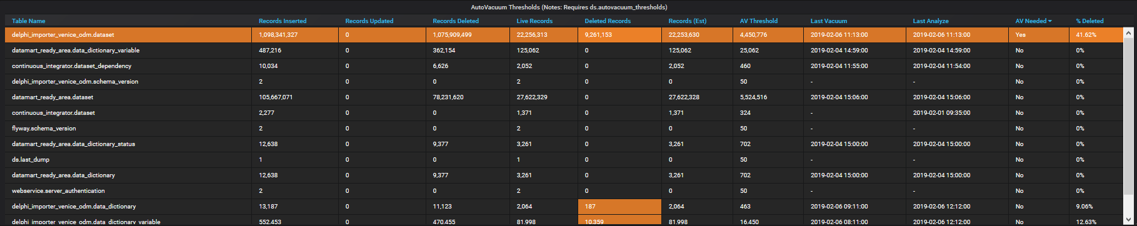
AutoVacuum Thresholds
Table Name
  This will be displayed in one of the following formats: Cluster.Database.Schema.Table or Database.Schema.Table or Schema.Table depending on your template settings.
Records Inserted, Records Updated, Records Deleted
  This is the total number of records inserted, updated and deleted. These numbers will only ever go up.
Live Records, Deleted Records, Record (est)
  This is the estimated number of readable records, deleted records and total records.

Slide 15
AutoVacuum Thresholds
AV Threshold
  This is the number of deleted records needed to kick off the AutoVacuum process for this table.
Last Vacuum, Last Analyze
  These are the Last Vacuum / AutoVacuum and Last Vacuum Analyze or Last AutoVacuum Analyze
AV Needed
  This will show “Yes” if the Deleted Records is more than the AV Threshold
% Deleted
  This shows you the percentage of the table that is deleted.

Slide 16
Active and Idle in Transaction
  Knowing what might be holding locks to prevent AutoVacuum

Slide 17
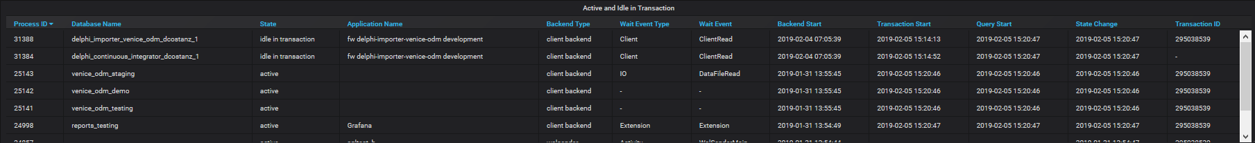
Active and Idle in Transaction
Process ID
  This is the number of deleted records needed to kick off the AutoVacuum process for this table.
Database Name
  These are the Last Vacuum / AutoVacuum and Last Vacuum Analyze or Last AutoVacuum Analyze
State
  This will show “Yes” if the Deleted Records is more than the AV Threshold
Application Name
  This shows you the percentage of the table that is deleted.
Backend Type
  This shows you the percentage of the table that is deleted.

Slide 18
Active and Idle in Transaction
Wait Event Type
  LWLock, Lock, BufferPin, Activity, Extension, Client, IPC, Timeout, IO
Wait Event
  To many to cover here, see https://www.postgresql.org/docs/current/monitoring-stats.html#WAIT-EVENT-TABLE
Backend Start / Transaction Start / Query Start / State Change
  The Backend Start, is when the connection to the server was established.
  The Transaction Start is when you did a BEGIN transaction or started a single item transaction.
  The Query Start is the start of your Query inside of the transaction and will be the same as Transaction Start if running a single item transaction.
  The State Change is the change in state, such as switching from active to “idle” or “idle in transaction”, allowing you to know how long the transaction or connection has been sitting idle.
Transaction ID
  This shows you the percentage of the table that is deleted.

Slide 19
Current Drive Performance
  Monitoring current drive performance

Slide 20
Primary / Secondary Query
This query allows us to see if the server is a Primary or Secondary server or if the secondary server is Disconnected from the primary server.
SET application_name = 'Grafana’;
SELECT COALESCE (
CASE WHEN pg_is_in_recovery() IS FALSE
THEN 'Primary’
ELSE 'Secondary' END,
'Disconnected’
) AS hostname;

Slide 21
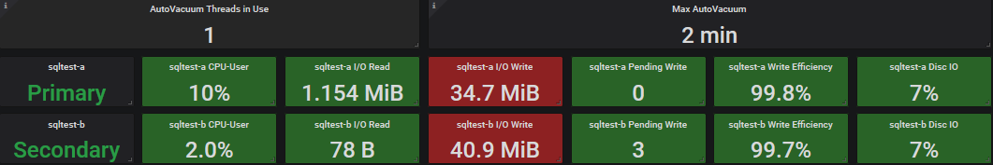
Current Drive Performance
AutoVacuum Threads in Use
  This is the number of AutoVacuum’s threads currently running.
Max AutoVacuum
  This is the longest running AutoVacuum
Server-a / Server-b
  Let’s us know which server is primary vers seconday.
CPU-User
  How much cpu the user, such as user postgres, is currently using.
  servers.virtual.$ServerName-a.aggregation-cpu-average.cpu-user
  servers.virtual.$ServerName-b.aggregation-cpu-average.cpu-user
Notes:
Color coding for I/O Write is set for Random Write, where for high efficiency writes would be > 46 GB Orange, >73 GB Red, 92 GB Max

Slide 22
Current Drive Performance
I/O Read / I/O Write
  Read and Writing in Bytes / KB / MB / GB
  servers.{virtual,physical}.$ServerName-a.disk-xvdb1.disk_octets.read
  servers.{virtual,physical}.$ServerName-b.disk-xvdb1.disk_octets.read
  servers.{virtual,physical}.$ServerName-a.disk-xvdb1.disk_octets.write
  servers.{virtual,physical}.$ServerName-b.disk-xvdb1.disk_octets.write
Pending Writes
  Number of writes that were delayed due to I/O saturation.
  servers.{virtual,physical}.$ServerName-a.disk-xvdb1.pending_operations
  servers.{virtual,physical}.$ServerName-b.disk-xvdb1.pending_operations

Slide 23
Current Drive Performance
Write Efficiency
  Random write is low efficiency, sequential write is high efficiency. We want to see high efficiency.
  offset(scale(asPercent(servers.{virtual,physical}.$ServerName-a.disk-xvdb1.disk_ops.write,servers.{virtual,physical}.$ServerName-a.disk-xvdb1.disk_octets.write),-1),1)
  offset(scale(asPercent(servers.{virtual,physical}.$ServerName-b.disk-xvdb1.disk_ops.write,servers.{virtual,physical}.$ServerName-b.disk-xvdb1.disk_octets.write),-1),1)
Disc I/O
  Disc I/O usage.
  scale(servers.{virtual,physical}.$ServerName-a.disk-xvdb1.disk_io_time.io_time,0.1)
  scale(servers.{virtual,physical}.$ServerName-b.disk-xvdb1.disk_io_time.io_time,0.1)

Slide 24
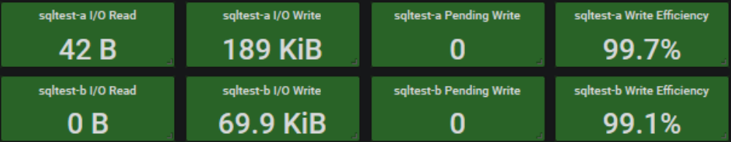
Current Drive Performance
I/O Read / I/O Write Settings
  RAID Type: RAID 6
  Drive Capacity: 146GB
  Single Drive Performance: 6,144 MB/s
  Single Drive Cost: 40
  Number of drives per RAID group: 16
  Number of RAID groups: 1
  Read operations (%): 0 (100% - Write Efficiency, In this case it would be between 0% and 1%)
Online RAID Calculator (See Page Notes)
Percent | MB | KB | B
100% | 92 | 93,696 | 95,944,704
80% | 73 | 74,957 | 76,755,763
50% | 46 | 46,848 | 47,972,352
Drive (Type / RPM) | IOPS (4KB block, random) | IOPS (64KB block, random) | MB/s (64KB block, random) | IOPS (512KB block, random) | MB/s (512KB block, random) | MB/s (large block, sequential)
FC / 15K | 163-178 | 151-169 | 9.7-10.8 | 97-123 | 49.7-63.1 | 73.5-127.5
SAS / 15K | 188-203 | 175-192 | 11.2-12.3 | 115-135 | 58.9-68.9 | 91.5-126.3
FC / 10K | 142-151 | 130-143 | 8.3-9.2 | 80-104 | 40.9-53.1 | 58.1-107.2
SAS / 10K | 142-151 | 130-143 | 8.3-9.2 | 80-104 | 40.9-53.1 | 58.1-107.2
SAS/SATA / 7200 | 73-79 | 69-76 | 4.4-4.9 | 47-63 | 24.3-32.1 | 43.4-97.8
SATA / 5400 | 57 | 55 | 3.5 | 44 | 22.6
SSD | To evaluate SSD RAID performance use the SSD version of the calculator
Notes:
I/O Read / I/O Write
The value you will want to use for your color threshold will be based on your write efficiency.
https://wintelguy.com/raidperf.pl
SSD Calculator
https://wintelguy.com/raidperf.pl/?formid=2
Color coding for I/O Write is set for Random Write, where for high efficiency writes would be > 46 GB Orange, >73 GB Red, 92 GB Max

Slide 25
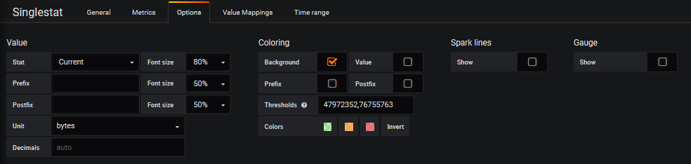
Current Drive Performance
I/O Read / I/O Write Settings
  RAID Type: RAID 6
  Drive Capacity: 146GB
  Single Drive Performance: 6,144 MB/s
  Single Drive Cost: 40
  Number of drives per RAID group: 16
  Number of RAID groups: 1
  Read operations (%): 0 (100% - Write Efficiency, In this case it would be between 0% and 1%)
Percent | MB | KB | B
100% | 92 | 93,696 | 95,944,704
80% | 73 | 74,957 | 76,755,763
50% | 46 | 46,848 | 47,972,352

Slide 26
Performance History
  Monitoring history as thing happen when we are not in front of the monitors.

Slide 27
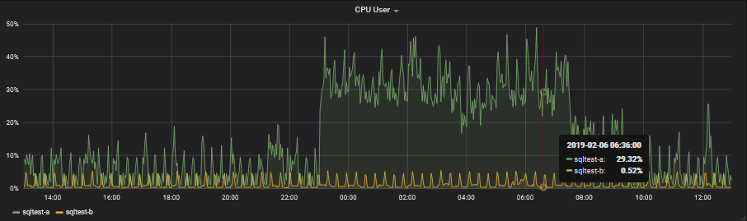
CPU User
We want to make sure that we are not running at full CPU. I try to keep the server below 50% with a max spike of 80%.
aliasByNode(servers.{virtual,physical}.$ServerName-a.aggregation-cpu-average.cpu-user,2)
aliasByNode(servers.{virtual,physical}.$ServerName-b.aggregation-cpu-average.cpu-user,2)

Slide 28
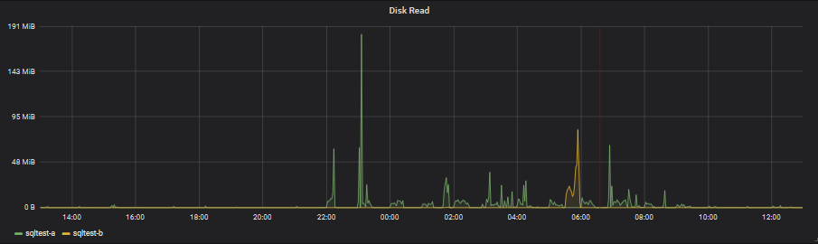
Disk Read
Short duration spikes are OK, as long as there is no real sustained disk reads.
aliasByNode(servers.{virtual,physical}.sqltest-a.disk-xvdb1.disk_octets.read,2)
aliasByNode(servers.{virtual,physical}.sqltest-b.disk-xvdb1.disk_octets.read,2)

Slide 29
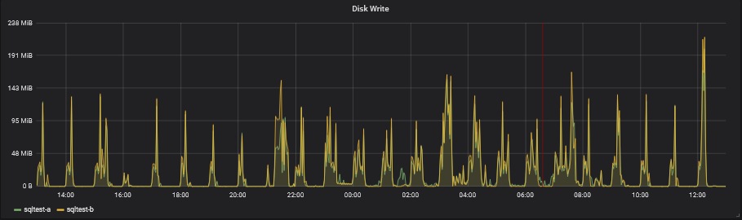
Disk Write
Short duration spikes are OK, as long as there is no real sustained disk writes causing pending writes to build up.
aliasByNode(servers.{virtual,physical}.sqltest-a.disk-xvdb1.disk_octets.write,2)
aliasByNode(servers.{virtual,physical}.sqltest-b.disk-xvdb1.disk_octets.write,2)

Slide 30
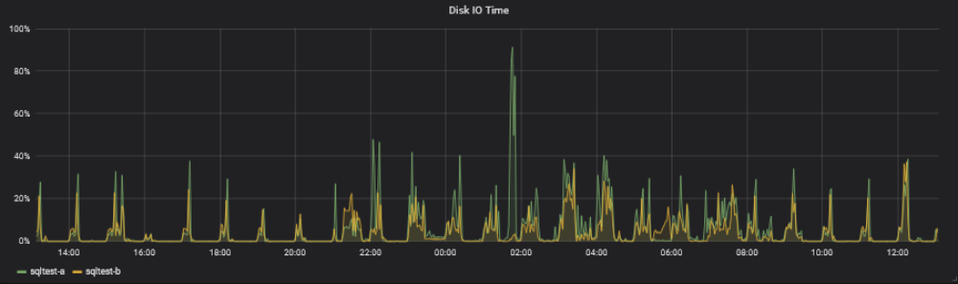
Disk I/O Time
The vacuum spike to 91% is OK, but I will be reducing it to 80% so that other long queries should not be affected as much by the AutoVacuum.
aliasByNode(scale(servers.{virtual,physical}.$ServerName-a.disk-xvdb1.disk_io_time.io_time,0.1),2)
aliasByNode(scale(servers.{virtual,physical}.$ServerName-b.disk-xvdb1.disk_io_time.io_time,0.1),2)

Slide 31
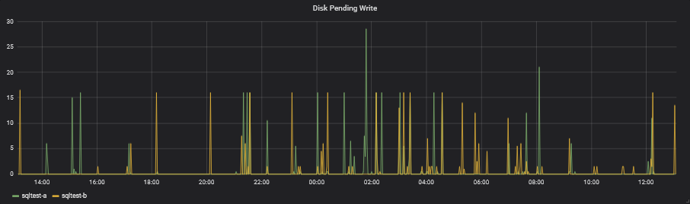
Disk Pending Write
Short pending writes are OK, we just don’t want to see long running pending items.
aliasByNode(servers.{virtual,physical}.$ServerName-a.disk-xvdb1.pending_operations,2)
aliasByNode(servers.{virtual,physical}.$ServerName-b.disk-xvdb1.pending_operations,2)

Slide 32
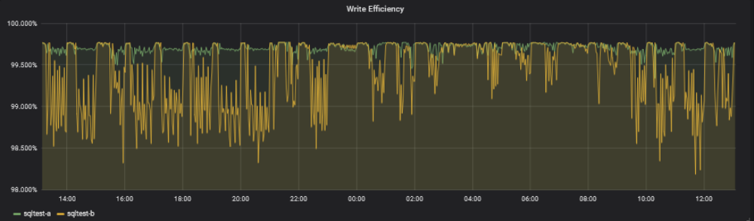
Write Efficiency
Random write is low efficiency, sequential write is high efficiency. We want to see high efficiency.
alias(offset(scale(asPercent(servers.{virtual,physical}.$ServerName-a.disk-xvdb1.disk_ops.write,servers.{virtual,physical}.$ServerName-a.disk-xvdb1.disk_octets.write),-1),1),"$ServerName-a")
alias(offset(scale(asPercent(servers.{virtual,physical}.$ServerName-b.disk-xvdb1.disk_ops.write,servers.{virtual,physical}.$ServerName-b.disk-xvdb1.disk_octets.write),-1),1),"$ServerName-b")

Slide 33
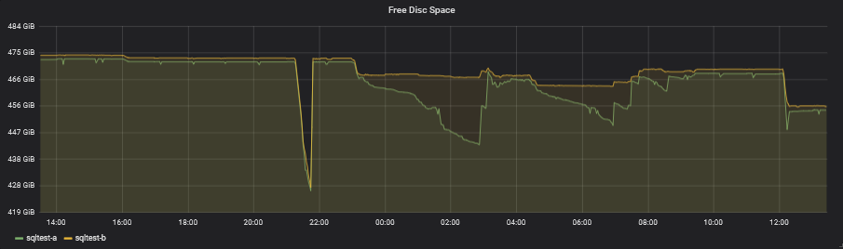
Free Disc Space
We need to make sure that we don’t run the server out of space due to bloating of the tables.
aliasByNode(servers.{virtual,physical}.$ServerName-a.df-pgdata_local.df_complex-free,2)
aliasByNode(servers.{virtual,physical}.$ServerName-b.df-pgdata_local.df_complex-free,2)

Slide 34
Granted Locks
This query allows us to retrieve what locks are being held.
SELECT
current_setting('cluster_name'::text) AS cluster_name,
current_database() AS database_name,
date_part('seconds'::text, now() - psa.xact_start) + date_part( 'minutes'::text, now() - psa.xact_start) * 60::double precision + date_part('hours'::text, now() - psa.xact_start) * 60::double precision * 60::double precision + date_part('days'::text, now() - psa.xact_start) * 60::double precision * 60::double precision * 24:: double precision AS "Time",
psa.pid AS "PG Process ID",
psa.application_name AS "Application Name",
psa.xact_start AS "Transaction Start",
locks."Locks",
CASE WHEN psa.backend_type = 'autovacuum worker'::text
THEN psa.query ELSE NULL::text
END AS "AutoVacuum"
FROM pg_stat_activity psa
LEFT JOIN (
SELECT a.pid,
string_agg((a."Object" || ' - '::text) || a."Mode", '
'::text) AS "Locks"
FROM
(
SELECT psa_1.pid,
(pn.nspname::text || '.'::text) || pc.relname::text AS "Object",
string_agg(pl.mode, ', '::text) AS "Mode"
FROM pg_locks pl
LEFT JOIN pg_stat_activity psa_1 ON pl.pid = psa_1.pid
LEFT JOIN pg_class pc ON pl.relation = pc.oid
LEFT JOIN pg_namespace pn ON pc.relnamespace = pn.oid
WHERE pl.granted = true
GROUP BY psa_1.pid, ((pn.nspname::text || '.'::text) || pc.relname::text)
) a GROUP BY a.pid
) locks USING (pid)
WHERE psa.datname = current_database()
AND locks."Locks" IS NOT NULL;

Slide 35
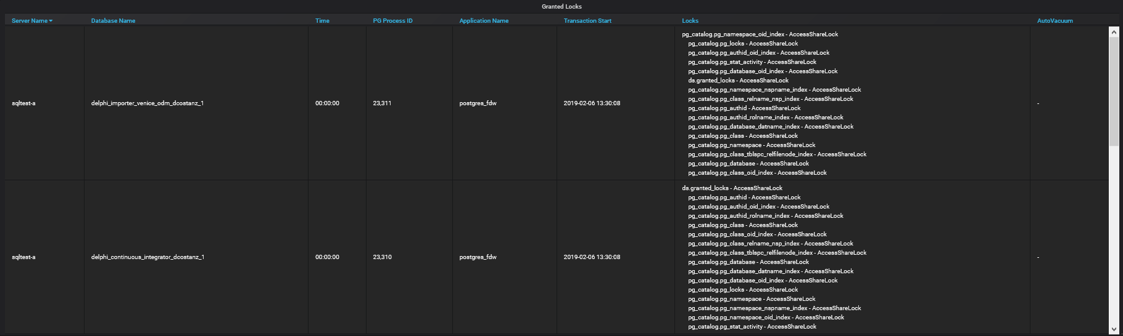
Granted Locks
If a table should be AutoVacuum’ed but is not, it could be because our long running transactions are holding locks on that table. We want to see if there are any Exclusive locks on the tables that should be AutoVacuum’ed.

Slide 36
Custom Table Settings
  Adjusting the AutoVacuum per Table

Slide 37
Custom Table Settings
This query allows us to retrieve all the custom table settings for all tables, excluding the tables located in pg_catalog and the information_schema.
SELECT
current_setting('cluster_name'::text)
AS cluster_name,
current_database() AS database_name,
pn.nspname AS schema_name,
pc.relname AS table_name,
quote_ident(pn.nspname::text) ||
'.'::text ||
quote_ident(pc.relname::text)
AS "Table Name",
unnest(pc.reloptions) AS "Table Setting"
FROM pg_class pc
JOIN pg_namespace pn
ON pn.oid = pc.relnamespace
WHERE pc.reloptions IS NOT NULL
AND (pn.nspname <> ALL (ARRAY [ 'pg_catalog'::name, 'information_schema':: name ]));

Slide 38
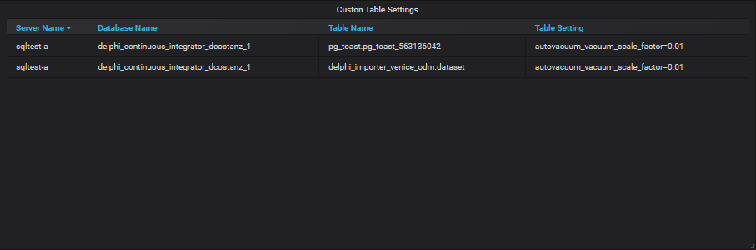
Custom Table Settings
The larger the table, the larger the threshold for AutoVacuum. For very large table we might want to lower this threshold. Instead of doing this for the entire server, we can do it for individual tables.
ALTER TABLE IF EXISTS ONLY delphi_importer_venice_odm.dataset
SET
(
autovacuum_vacuum_scale_factor=0.01,
toast.autovacuum_vacuum_scale_factor=0.01
);

Slide 39
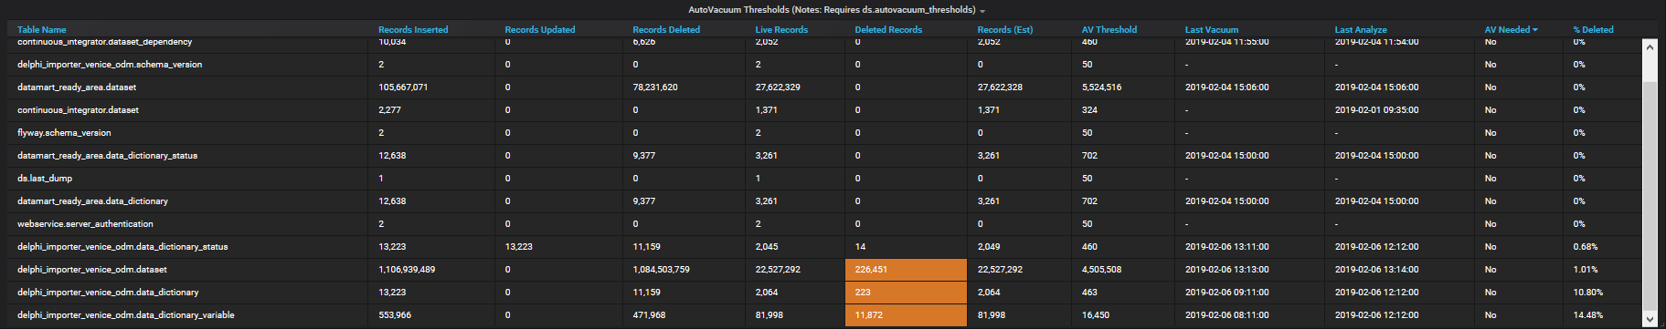
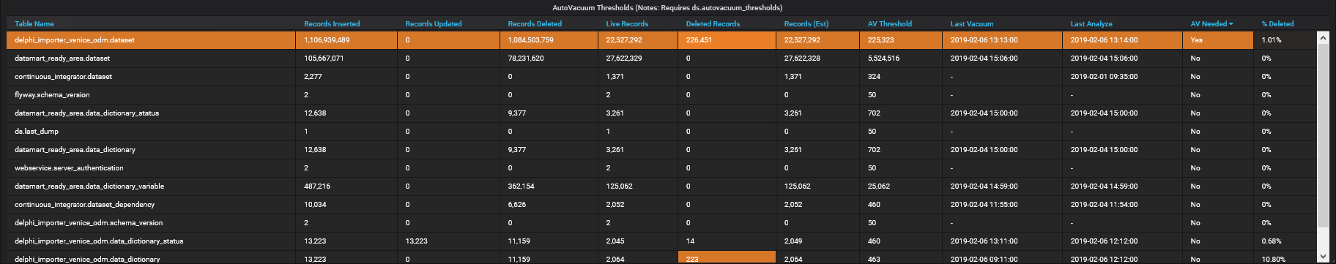
Custom Table Settings
Default
Custom

Slide 40
AutoVacuum Settings
  Viewing the server settings

Slide 41
AutoVacuum Settings
This query allows us to see the settings that PostgreSQL is using and which file they are from.
  postgresql.conf
  postgresql.auto.conf
SELECT
current_setting('cluster_name'::text)
AS cluster_name,
name,
setting,
unit,
category,
short_desc,
extra_desc,
context,
vartype,
source,
min_val,
max_val,
enumvals,
boot_val,
reset_val,
sourcefile,
sourceline,
pending_restart
FROM pg_settings;

Slide 42
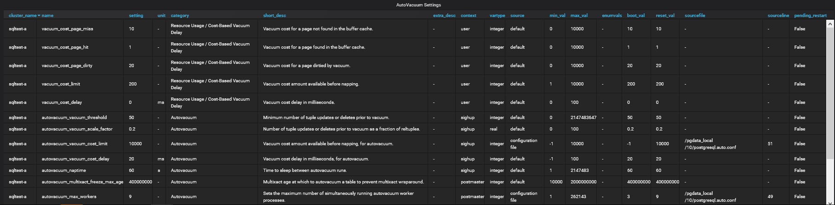
AutoVacuum Settings
This is more informational than anything, but the line will highlight when a restart is required for the change to take effect.

Slide 43
AutoVacuum Logs
  Viewing the log files

Slide 44
AutoVacuum Log Table
Here we create the table that we will place our log files.
CREATE TABLE reports.postgres_log (
cluster_name TEXT NOT NULL,
log_time TIMESTAMP WITH TIME ZONE NOT NULL,
user_name TEXT,
database_name TEXT,
process_id INTEGER,
connection_from TEXT,
session_id TEXT NOT NULL,
session_line_num BIGINT NOT NULL,
command_tag TEXT,
session_start_time TIMESTAMP WITH TIME ZONE,
virtual_transaction_id TEXT,
transaction_id BIGINT,
error_severity TEXT,
sql_state_code TEXT,
message TEXT,
detail TEXT,
hint TEXT,
internal_query TEXT,
internal_query_pos INTEGER,
context TEXT,
query TEXT,
query_pos INTEGER,
location TEXT,
application_name TEXT
) WITH (oids = false);

Slide 45
AutoVacuum Log Table Indexes
How we create the indexes.
CREATE INDEX postgres_logs_idx
ON reports.postgres_log
USING btree (log_time, cluster_name, database_name);
CREATE INDEX postgres_logs_log_time_idx
ON reports.postgres_log
USING btree (log_time DESC);
CREATE INDEX postgres_logs_pkey
ON reports.postgres_log
USING btree (cluster_name, session_id, session_line_num);
ALTER TABLE reports.postgres_log OWNER TO grafana;

Slide 46
Partitioning
It is wise to partition this table by cluster_name.
I am using this on a timescaledb instance.
SELECT create_hypertable
('reports.postgres_log', 'log_time', 'cluster_name');

Slide 47
readlog.sh (logfile rotated hourly)
#!/bin/bash
server=$1
while true; do
LOGFILE=`date -d '1 hour ago' "+/pgdata_local/pg_log/postgresql-%F_%H.csv"`;
logtail $LOGFILE | /usr/local/apps/postgres/current/bin/psql -h kw-prod-e03.pc.scharp.org -d reports -p 30002 -q -c "CREATE TEMP TABLE upload_logs (LIKE reports.postgres_log);ALTER TABLE upload_logs ALTER COLUMN cluster_name SET DEFAULT '$server';COPY upload_logs (log_time,user_name,database_name,process_id,connection_from,session_id,session_line_num,command_tag,session_start_time,virtual_transaction_id,transaction_id,error_severity,sql_state_code,message,detail,hint,internal_query,internal_query_pos,context,query,query_pos,location,application_name) FROM STDIN (FORMAT CSV);INSERT INTO reports.postgres_log SELECT * FROM upload_logs;";
LOGFILE=`date +"/pgdata_local/pg_log/postgresql-%F_%H.csv"`;
logtail $LOGFILE | /usr/local/apps/postgres/current/bin/psql -h kw-prod-e03.pc.scharp.org -d reports -p 30002 -q -c "CREATE TEMP TABLE upload_logs (LIKE reports.postgres_log);ALTER TABLE upload_logs ALTER COLUMN cluster_name SET DEFAULT '$server';COPY upload_logs (log_time,user_name,database_name,process_id,connection_from,session_id,session_line_num,command_tag,session_start_time,virtual_transaction_id,transaction_id,error_severity,sql_state_code,message,detail,hint,internal_query,internal_query_pos,context,query,query_pos,location,application_name) FROM STDIN (FORMAT CSV);INSERT INTO reports.postgres_log SELECT * FROM upload_logs;";
sleep 10;
done

Slide 48
start_readlog.sh
This allows us to start the readlog script and launch it into the background and make it so that when we detach from the SSH that it will keep running.
Note: Need to turn this into a service and init.d scripts.
nohup readlog.sh sqltest-a &

Slide 49
AutoVacuum Log Query
SELECT $__time(log_time),
cluster_name,
split_part(trim(both '"' from substr(split_part(split_part(message, E'\n', 1), ':', 1),27)), '.', 1) AS database_name,
split_part(trim(both '"' from substr(split_part(split_part(message, E'\n', 1), ':', 1),27)), '.', 2) AS schema_name,
split_part(trim(both '"' from substr(split_part(split_part(message, E'\n', 1), ':', 1),27)), '.', 3) AS table_name,
trim(split_part(split_part(message, E'\n', 1), ':', 3))::BIGINT AS index_scans,
split_part(trim(split_part(split_part(split_part(message, E'\n', 2), ':', 2), ',', 1)), ' ', 1)::bigint AS pages_removed,
split_part(trim(split_part(split_part(split_part(message, E'\n', 2), ':', 2), ',', 1)), ' ', 1)::bigint * current_setting('block_size')::bigint AS removed_size,
split_part(trim(split_part(split_part(split_part(message, E'\n', 2), ':', 2), ',', 2)), ' ', 1)::bigint AS pages_remain,
split_part(trim(split_part(split_part(split_part(message, E'\n', 2), ':', 2), ',', 2)), ' ', 1)::bigint * current_setting('block_size')::bigint AS pages_remain_size,
CASE WHEN split_part(trim(split_part(split_part(split_part(message, E'\n', 2), ':', 2), ',', 3)), ' ', 1) = '' THEN NULL::bigint
ELSE split_part(trim(split_part(split_part(split_part(message, E'\n', 2), ':', 2), ',', 3)), ' ', 1)::bigint END AS skipped_due_to_pins,
CASE WHEN split_part(trim(split_part(split_part(split_part(message, E'\n', 2), ':', 2), ',', 4)), ' ', 1) = '' THEN NULL::bigint
ELSE split_part(trim(split_part(split_part(split_part(message, E'\n', 2), ':', 2), ',', 3)), ' ', 1)::bigint END AS skipped_frozen,
split_part(trim(split_part(split_part(split_part(message, E'\n', 3), ':', 2), ',', 1)), ' ', 1)::bigint AS tuples_removed,
split_part(trim(split_part(split_part(split_part(message, E'\n', 3), ':', 2), ',', 2)), ' ', 1)::bigint AS tuples_remain,
split_part(trim(split_part(split_part(split_part(message, E'\n', 3), ':', 2), ',', 3)), ' ', 1)::bigint AS tuples_dead,
CASE WHEN split_part(split_part(message, E'\n', 3), ':', 3) = '' THEN NULL::bigint
ELSE split_part(split_part(message, E'\n', 3), ':', 3)::bigint END AS oldest_xmin,
split_part(trim(split_part(split_part(split_part(message, E'\n', 4), ':', 2), ',', 1)), ' ', 1)::bigint AS buffer_hits,
split_part(trim(split_part(split_part(split_part(message, E'\n', 4), ':', 2), ',', 2)), ' ', 1)::bigint AS buffer_misses,
split_part(trim(split_part(split_part(split_part(message, E'\n', 4), ':', 2), ',', 3)), ' ', 1)::bigint AS buffer_dirtied,
split_part(trim(split_part(split_part(message, E'\n', 5), ':', 2)), ' ', 1)::NUMERIC AS avg_read_rate,
split_part(trim(split_part(split_part(message, E'\n', 5), ':', 3)), ' ', 1)::NUMERIC AS avg_write_rate,
CASE WHEN strpos(split_part(message, E'\n', 6), E'/') > 0
THEN left(split_part(split_part(trim(split_part(split_part(message, E'\n', 6), ':', 2)), ' ', 2), E'/', 1),-1)::numeric
ELSE split_part(trim(split_part(split_part(message, E'\n', 6), ':', 5)), ' ', 1)::numeric END AS cpu_system,
CASE WHEN strpos(split_part(message, E'\n', 6), E'/') > 0
THEN left(split_part(split_part(trim(split_part(split_part(message, E'\n', 6), ':', 2)), ' ', 2), E'/', 2),-1)::numeric
ELSE split_part(trim(split_part(split_part(message, E'\n', 6), ':', 4)), ' ', 1)::numeric END AS cpu_user,
CASE WHEN strpos(split_part(message, E'\n', 6), E'/') > 0
THEN split_part(trim(split_part(split_part(message, E'\n', 6), ':', 2)), ' ', 5)::numeric
ELSE split_part(trim(split_part(split_part(message, E'\n', 6), ':', 6)), ' ', 1)::numeric END AS elasped_seconds
FROM reports.postgres_log
WHERE message LIKE 'automatic vacuum %’
AND $__timeFilter(log_time)
AND cluster_name IN ($ServerName)
AND split_part(trim(both '"' from substr(split_part(split_part(message, E'\n', 1), ':', 1),27)), '.', 1) IN ($DatabaseName)
LIMIT 100000;

Slide 50
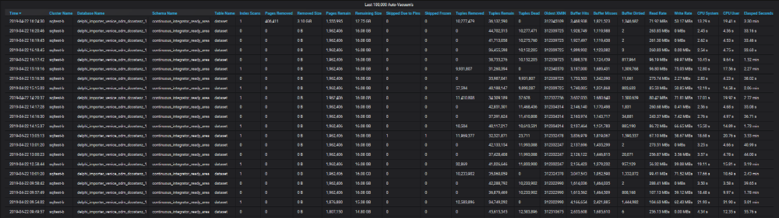
AutoVacuum Logs
Pages Removed / Removed Size – The AutoVacuum was able to reduce the table size.
Tuples Removed – The AutoVaccum was able to remove records.
Tupled Dead – The AutoVacuum was not able to remove these records due to they were created after the Oldest XMIN aka Oldest Transaction ID.

Slide 51
AutoVacuum Logs
((Buffer Hits * vacuum_cost_page_hit) + (Buffer Misses * vacuum_cost_page_miss) + (Buffer Dirtied * vacuum_cost_page_dirty)) = Total Cost
(((Buffer Hits * vacuum_cost_page_hit) + (Buffer Misses * vacuum_cost_page_miss) + (Buffer Dirtied * vacuum_cost_page_dirty)) / autovacuum_ vacuum_cost_limit) = Number of Delay Cycles
(((Buffer Hits * vacuum_cost_page_hit) + (Buffer Misses * vacuum_cost_page_miss) + (Buffer Dirtied * vacuum_cost_page_dirty)) / autovacuum_vacuum_cost_limit) * autovacuum_vacuum_cost_delay = Total Delay’s for Disk IO to Catch up.

Slide 52
pg_stat_activity
Looking at pg_stat_activity, we can see that the long running transaction in a different database is creating the xmin horizon that the autovacuum is using. Only items older than the xmin horizon will be autovacuumed.
backend_xid = Top-level transaction identifier of this backend, if any.
backend_xmin = The current backend's xmin horizon.
The event horizon can also come from a long running transaction on the secondary server due to hot_standby_feedback turn on for streaming replication.
  However, the cleanup situation will be no worse than if the standby queries were running directly on the primary server, and you are still getting the benefit of off-loading execution onto the standby.
datname | pid | usename | application_name | backend_start | xact_start | wait_event_type | wait_event | state | backend_xid | backend_xmin | backend_type
datamart02_dcostanz_1 | 18504 | dcostanz | fw delphi-datamart-renderer development | 4/22/19 1:21 PM | 4/22/19 11:00 PM | Client | ClientRead | idle in transaction | 312352069 |  | client backend
delphi_datamart_renderer_dcostanz_1 | 18493 | dcostanz | fw delphi-datamart-renderer development | 4/22/19 1:21 PM | 4/22/19 11:00 PM | Client | ClientRead | idle in transaction | 312352070 | 312352069 | client backend
developer_datamart_dcostanz_1 | 16478 | dcostanz | fw delphi-datamart-renderer development | 4/23/19 5:50 AM | 4/23/19 8:00 AM | Client | ClientRead | idle in transaction | 312382224 |  | client backend
datamart02_realtime_dcostanz_1 | 16462 | dcostanz | fw delphi-datamart-renderer development | 4/23/19 5:50 AM | 4/23/19 8:00 AM | Client | ClientRead | idle in transaction | 312382225 |  | client backend
delphi_datamart_renderer_dcostanz_1 | 16454 | dcostanz | fw delphi-datamart-renderer development | 4/23/19 5:50 AM | 4/23/19 8:00 AM | Client | ClientRead | idle in transaction | 312382226 | 312352069 | client backend
delphi_datamart_renderer_dcostanz_1 | 16453 | dcostanz | fw delphi-datamart-renderer development | 4/23/19 5:50 AM | 4/23/19 8:00 AM | Client | ClientRead | idle in transaction | 312382227 | 312352069 | client backend
delphi_continuous_integrator_dcostanz_1 | 2772 | dcostanz | fw delphi-continuous-integrator development | 4/22/19 12:30 PM | 4/23/19 10:39 AM | Client | ClientRead | idle in transaction | 312399443 | 312352069 | client backend
delphi_importer_venice_odm_dcostanz_1 | 3925 | dcostanz | fw delphi-importer-venice-odm development | 4/22/19 12:35 PM | 4/23/19 11:00 AM |  |  | active | 312402170 | 312352069 | client backend
datamart02_realtime_testing | 2796 | xapps | fw delphi-datamart-renderer testing | 4/22/19 12:30 PM | 4/23/19 11:07 AM | Client | ClientRead | idle in transaction | 312402304 |  | client backend
developer_datamart_testing | 2889 | xapps | fw delphi-datamart-renderer testing | 4/22/19 12:30 PM | 4/23/19 11:07 AM | IO | DataFileImmediateSync | active | 312402305 | 312352069 | client backend
delphi_datamart_renderer_testing | 2783 | xapps | fw delphi-datamart-renderer testing | 4/22/19 12:30 PM | 4/23/19 11:07 AM | Client | ClientRead | idle in transaction | 312402306 | 312352069 | client backend
delphi_datamart_renderer_testing | 2785 | xapps | fw delphi-datamart-renderer testing | 4/22/19 12:30 PM | 4/23/19 11:07 AM | Client | ClientRead | idle in transaction | 312402307 | 312352069 | client backend
df_repository_demo | 3670 | xapps | fw df-repository demo | 4/22/19 12:34 PM | 4/23/19 11:09 AM | Client | ClientRead | idle in transaction | 312402334 | 312352069 | client backend
df_repository_staging | 3040 | xapps | fw df-repository staging | 4/22/19 12:31 PM | 4/23/19 11:09 AM | Client | ClientRead | idle in transaction | 312402335 | 312352069 | client backend
delphi_importer_venice_odm_dcostanz_1 | 23442 |  |  | 4/23/19 11:03 AM | 4/23/19 11:03 AM |  |  | active |  | 312352069 | autovacuum worker
venice_odm_dcostanz_2 | 24849 |  |  | 4/23/19 11:09 AM | 4/23/19 11:09 AM |  |  | active |  | 312352069 | autovacuum worker
delphi_importer_venice_odm_testing | 23243 |  |  | 4/23/19 11:03 AM | 4/23/19 11:03 AM |  |  | active |  | 312352069 | autovacuum worker
delphi_continuous_integrator_dcostanz_1 | 21980 |  |  | 4/23/19 10:58 AM | 4/23/19 10:58 AM |  |  | active |  | 312352069 | autovacuum worker
delphi_continuous_integrator_dcostanz_1 | 18488 | dcostanz | fw delphi-datamart-renderer development | 4/22/19 1:21 PM | 4/23/19 8:00 AM | Client | ClientRead | idle in transaction |  | 312352069 | client backend
delphi_continuous_integrator_dcostanz_1 | 18490 | dcostanz | fw delphi-datamart-renderer development | 4/22/19 1:21 PM | 4/22/19 11:00 PM | Client | ClientRead | idle in transaction |  | 312347264 | client backend
delphi_continuous_integrator_dcostanz_1 | 16463 | dcostanz | fw delphi-datamart-renderer development | 4/23/19 5:50 AM | 4/23/19 8:00 AM | Client | ClientRead | idle in transaction |  | 312352069 | client backend
delphi_continuous_integrator_testing | 23489 |  |  | 4/23/19 11:04 AM | 4/23/19 11:04 AM | IO | DataFileRead | active |  | 312352069 | autovacuum worker
delphi_continuous_integrator_testing | 2874 | xapps | fw delphi-datamart-renderer testing | 4/22/19 12:30 PM | 4/23/19 11:07 AM | Client | ClientRead | idle in transaction |  | 312352069 | client backend
delphi_continuous_integrator_testing | 2888 | xapps | fw delphi-datamart-renderer testing | 4/22/19 12:30 PM | 4/23/19 11:07 AM | Client | ClientRead | idle in transaction |  | 312352069 | client backend
 | 4767 | postgres | sqltest_a | 4/22/19 8:21 PM |  | Activity | WalSenderMain | active |  | 312352069 | walsender

Slide 53
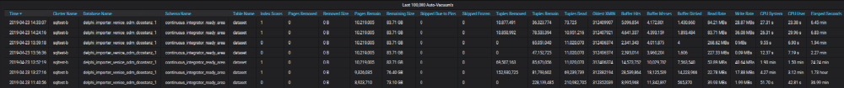
AutoVacuum Logs
You will notice that once the blocking transactions completed that the table went from 228,199,485 records to 36,323,774 records but did not decrease in size.
AutoVacuum:
  Removes empty pages at the end of the table.
  Mark’s old records as reusable space.
  DOES NOT condense pages
  DOES NOT remove empty pages in the middle of the table
This means that once your table is bloated link this, there are only several solutions.
  Vacuum Full
  Cluster
  Truncate and re-insert the data – Truncate cleans up the pages immediately.
This type of bloat will cause sequential table scans to run slowly.

Slide 54
Finding tuple usage on each page within the table
We can find out the used verse unused tuples on each page by running this query.
To be able to run this query you need to load my toolset from https://github.com/LloydAlbin/SCHARP-PG-DBA-Debugging-Tools which uses the pageinspect extension.
SELECT
p,
sum(unused_tuples) AS unused_tuples,
sum(used_tuples) AS used_tuples,
sum(deleted_tuples) AS deleted_tuples
FROM (
SELECT
p,
CASE WHEN (t_xmin IS NULL AND t_xmax IS NULL)
THEN 1
ELSE 0
END AS unused_tuples,
CASE WHEN (t_xmin IS NULL AND t_xmax IS NULL)
THEN 0
ELSE 1
END AS used_tuples
CASE WHEN heap_xmax_committed
THEN 1
ELSE 0
END AS deleted_tuples
FROM tools.heap_page_item_attrs_details('continuous_integrator_ready_area.dataset’)
) a
GROUP BY p
ORDER BY p;

Slide 55
Finding 100% empty pages
If create a view from the previous query and then write it’s output to a table, we can run various queries against the results.
One such query is how many pages are totally blank, this are only recoverable with a VACUUM FULL.
CREATE TABLE tools.dataset_pages AS
SELECT * FROM previous_pages_view;
SELECT
count(*) AS empty_pages,
count(*) * current_setting('block_size')::bigint AS bytes,
pg_size_pretty(count(*) * current_setting('block_size')::bigint)
AS empty_page_size
FROM tools.dataset_pages
WHERE used_tuples = 0;
empty_pages | bytes | empty_page_size
7,568,398 | 62,000,316,416 | 58GB

Slide 56
Seeing the total bloat in tuples
In the first result, I am using the WHERE clause to ignoring the 100% empty pages.
In the second result, I am including the 100% empty pages.
SELECT
sum(used_tuples) AS used_tuples,
sum(unused_tuples) AS unused_tuples,
sum(deleted_tuples) AS deleted_tuples
FROM tools.dataset_pages
WHERE used_tuples > 0;
SELECT
sum(used_tuples) AS used_tuples,
sum(unused_tuples) AS unused_tuples,
sum(deleted_tuples) AS deleted_tuples
FROM tools.dataset_pages;
used_tuples | unused_tuples | deleted_tuples
66,813,680 | 6,280,558 | 39,466,746
66,813,680 | 203,492,055 | 39,466,746

Slide 57
Cause and Effect

Slide 58
Heavy churn on small table
Small table that gets thousands of rows added and deleted. This table is then joined to a large table to view a set of results.
  Effect: Your queries get slower and slower until a query that was 10 ms now takes 5 seconds or more, but if you start and stop your application, then the problem self fixes itself.
  Caused by the AutoAnalyze not updating the stats. This causes the query planner to run slowly and to pick the wrong query plan which causes the query to perform in minutes vers milliseconds. A manual Analyze will fix this issue. This issue can be verified by checking the row count vers the estimated table rows in the stats and/or by monitoring the query planing time.

Slide 59
Heavy churn on large tables
Large table with tens of millions of rows where you are deleting and adding millions of rows per hour.
  Effect: You find that your queries are slowing down and when you look at your AutoVacuum it seems to be AutoVacuum this table 24 hours per day, but if you stop your application for a few day or dump and restore your database it fixes itself.
  Caused by not enough time for the AutoVacuum to complete before the next churn cycle. This make the AutoVacuum take longer and longer to complete with the table bloat getting worse and worse until the AutoVacuum takes over 24 hours to complete. Stopping the Application lets the AutoVacuum catch up and then the queries run fast. This can be fixed by either stopping the churn and doing a manual vacuum/analyze or by increasing your AutoVacuum's I/O rate by increasing the AutoVacuum Cost Limit. This can be verified by watching the currently running AutoVacuum's and the estimated dirty rows in the table stats.
  Caused by a long running transaction on the same server or a long running transaction on the secondary server, via streaming replication, that prevents the autovacuum event horizon from moving forward.

Slide 60
Heavy churn on large table indexs
Large table with tens of millions of rows where you are deleting and then adding millions of rows per hour with the same index values inside of a transaction.
  Effect: Your queries get slower and slower, but if you dump and restore your database, everything is fast again.
  Caused by the deleted records needing to be in the index at the same time as the new records. This means that all the index pages need to be split causing the index to double in size (or more) to allow the new entries to be inserted. The space is not recovered by the AutoVacuum system because it does not do a true vacuum of the index. The AutoVacuum will only vacuum/delete an index page which is 100% empty. The AutoVacuum does not do anything with partially filled pages except to remove deleted index entries. This can be verified by either looking for index bloat or by replacing the index and the query runs fast again.
Notes:
http://lloyd.thealbins.com/IndexBloat

