Slide 1

http://Lloyd.TheAlbins.com/AutoVacuum

Slide 2
AutoVacuum
  By Lloyd Albin

Slide 3

In this presentation we will cover:
Additional notes in the note section of the slide when you see this icon
( ) in the upper right corner of the slide.
Grafana
  Custom PostgreSQL Queries
  Data from Graphite - collectd
  How to interpret the output of the queries

Slide 4
AutoVacuum
  What to monitor

Slide 5
What to Monitor
Currently running AutoVacuum Process’s
AutoVacuum Thresholds per Table
Active and Idle in Transaction Connections
AutoVacuum Threads in Use
Max AutoVacuum’s
CPU Usage
Disc Read Usage
Disc Write Usage
Disc Pending Write
Write Efficiency
Disc I/O Time
Last AutoVacuum per Table
Disc Free Space
Custom Table Settings Per Table
Granted Locks
AutoVacuum Settings

Slide 6
Currently Running AutoVacuum(s)
  Knowing what is a happening and the speed at which it is happening.
  Requires PostgreSQL 9.6+

Slide 7
Primary / Secondary Query
This query allows us to view the currently running AutoVacuum’s
SELECT current_setting('cluster_name'::text) AS cluster_name,
pspv.datname AS database_name,
CASE
WHEN substr(psa.query, 0, 28) = 'autovacuum: VACUUM ANALYZE '::text
THEN split_part(substr(psa.query, 28), '.'::text, 1)
WHEN substr(psa.query, 0, 20) = 'autovacuum: VACUUM '::text
THEN split_part(substr(psa.query, 20), '.'::text, 1)
WHEN substr(psa.query, 0, 21) = 'autovacuum: ANALYZE '::text
THEN split_part(substr(psa.query, 21), '.'::text, 1)
ELSE NULL::text
END AS schema_name,
CASE
WHEN substr(psa.query, 0, 28) = 'autovacuum: VACUUM ANALYZE '::text
THEN split_part(substr(psa.query, 28), '.'::text, 2)
WHEN substr(psa.query, 0, 20) = 'autovacuum: VACUUM '::text
THEN split_part(substr(psa.query, 20), '.'::text, 2)
WHEN substr(psa.query, 0, 21) = 'autovacuum: ANALYZE '::text
THEN split_part(substr(psa.query, 21), '.'::text, 2)
ELSE NULL::text
END AS table_name,
CASE
WHEN substr(psa.query, 0, 28) = 'autovacuum: VACUUM ANALYZE '::text THEN substr(psa.query, 28)
WHEN substr(psa.query, 0, 20) = 'autovacuum: VACUUM '::text THEN substr(psa.query, 20)
WHEN substr(psa.query, 0, 21) = 'autovacuum: ANALYZE '::text THEN substr(psa.query, 21)
ELSE NULL::text END AS name,
CASE
WHEN substr(psa.query, 0, 28) = 'autovacuum: VACUUM ANALYZE '::text THEN true
WHEN substr(psa.query, 0, 20) = 'autovacuum: VACUUM '::text THEN true
ELSE false END AS vacuum,
CASE
WHEN substr(psa.query, 0, 28) = 'autovacuum: VACUUM ANALYZE '::text
THEN true WHEN substr(psa.query, 0, 21) = 'autovacuum: ANALYZE '::text
THEN true ELSE false END AS "analyze",

Slide 8

Primary / Secondary Query
This query allows us to view the currently running AutoVacuum’s
(date_part('seconds'::text, date_trunc('second'::text, now() - psa.backend_start)) + date_part('minutes'::text, date_trunc('second' ::text, now() - psa.backend_start)) * 60::double precision + date_part('hours'::text, date_trunc('second'::text, now() - psa.backend_start)) * 60::double precision * 60::double precision + date_part('days'::text, date_trunc('second'::text, now() - psa.backend_start)) * 60::double precision * 60::double precision * 24::double precision)::integer AS running_time,
pspv.phase,
pspv.heap_blks_total,
pspv.heap_blks_total * current_setting('block_size'::text)::bigint AS heap_blks_total_size,
pspv.heap_blks_scanned,
pspv.heap_blks_scanned::numeric / pspv.heap_blks_total::numeric AS heap_blks_scanned_pct,
pspv.heap_blks_vacuumed,
pspv.heap_blks_vacuumed::numeric / pspv.heap_blks_total::numeric AS heap_blks_vacuumed_pct,
pspv.index_vacuum_count,
pspv.max_dead_tuples,
pspv.num_dead_tuples,
psa.backend_start,
psa.wait_event_type,
psa.wait_event,
psa.state,
psa.backend_xmin
FROM pg_catalog.pg_stat_progress_vacuum
LEFT JOIN pg_catalog.pg_stat_activity ON pspv.pid = psa.pid;
Notes:
pg_stat_progress_vacuum & Vacuum Phases
https://www.postgresql.org/docs/current/progress-reporting.html
pg_stat_activity
https://www.postgresql.org/docs/current/monitoring-stats.html#PG-STAT-ACTIVITY-VIEW
Wait Events
https://www.postgresql.org/docs/current/monitoring-stats.html#WAIT-EVENT-TABLE

Slide 9
Current Running AutoVacuum(s)
Table Name
  This will be displayed in one of the following formats: Cluster.Database.Schema.Table or Database.Schema.Table or Schema.Table depending on your template settings.
Vacuum / Analyze
  This shows you if vacuum and/or Analyze are going to be happening
Running Time
  How long the AutoVacuum has been running on this specific talbe.
Phase
  Initializing, scanning heap, vacuuming indexes, vacuuming heap, cleaning up indexes, truncating heap, performing final cleanup
Total Pages
  This is the number of pages that needs to be processed. Pages by default are 8K.
Table Size
  This is the heap_blks_read * Yours block/page size giving you the size of your table on disc.
Notes:
pg_stat_progress_vacuum
https://www.postgresql.org/docs/current/progress-reporting.html#VACUUM-PROGRESS-REPORTING
pg_stat_activity
https://www.postgresql.org/docs/current/monitoring-stats.html#PG-STAT-ACTIVITY-VIEW
Vacuum Phases
https://www.postgresql.org/docs/current/progress-reporting.html#VACUUM-PROGRESS-REPORTING
Blocks and Pages interchangeable words.

Slide 10
Current Running AutoVacuum(s)
Pages Scanned
  This is the number of blocks/pages that have been scanned. By watching this, you can tell how fast this part of the process it taking.
Pages Scanned %
  This is the percent of blocks/pages that have been scanned. By watching this, you can tell how fast this part of the process it taking.
Pages Vacuumed
  This is the number of blocks/pages that have been vacuumed. By watching this, you can tell how fast this part of the process it taking.
Pages Vacuumed %
  This is the percent of blocks/pages that have been vacuumed. By watching this, you can tell how fast this part of the process it taking.
Index Vacuum Count
  After the “vacuuming indexes” stage has been processed, it will show you the number of indexes.
Max Dead Records
  This is the max number of records that can be processed before an index vacuum is required.
Notes:
pg_stat_progress_vacuum
https://www.postgresql.org/docs/current/progress-reporting.html#VACUUM-PROGRESS-REPORTING

Slide 11
Current Running AutoVacuum(s)
Dead Records
  Estimated number of dead tuples.
Start Time
  This is when the AutoVacuum started working on this table.
Wait Event Type
  LWLock, Lock, BufferPin, Activity, Extension, Client, IPC, Timeout, IO
Wait Event
  To many to cover here, see https://www.postgresql.org/docs/current/monitoring-stats.html#WAIT-EVENT-TABLE
State
  This should normally read “Active”.
Transaction ID Min
  This is the oldest Transaction ID that could read the table.
Notes:
pg_stat_progress_vacuum
https://www.postgresql.org/docs/current/progress-reporting.html#VACUUM-PROGRESS-REPORTING
pg_stat_activity
https://www.postgresql.org/docs/current/monitoring-stats.html#PG-STAT-ACTIVITY-VIEW
Wait Event Type
https://www.postgresql.org/docs/current/monitoring-stats.html#WAIT-EVENT-TABLE

Slide 12
AutoVacuum Thresholds
  Knowing when a table will be AutoVacuum’ed

Slide 13
AutoVacuum Thresholds Query
This query allows us to view the currently running AutoVacuum’s
SELECT current_setting('cluster_name'::text) AS cluster_name, current_database() AS database_name, av.nspname AS schema_name, av.relname AS table_name, (quote_ident(av.nspname::text) || '.'::text) || quote_ident(av.relname ::text) AS name, av.n_tup_ins, av.n_tup_upd, av.n_tup_del, av.n_live_tup, av.n_dead_tup, av.reltuples, av.av_threshold, av.last_vacuum, av.last_analyze, av.n_dead_tup::double precision > av.av_threshold AS av_neaded, CASE WHEN av.reltuples > 0::double precision THEN av.n_dead_tup::numeric / av.reltuples::numeric ELSE 0::numeric END AS pct_dead FROM ( SELECT pn.nspname, pc.relname, pg_stat_get_tuples_inserted(pc.oid) AS n_tup_ins, pg_stat_get_tuples_updated(pc.oid) AS n_tup_upd, pg_stat_get_tuples_deleted(pc.oid) AS n_tup_del, pg_stat_get_live_tuples(pc.oid) AS n_live_tup, pg_stat_get_dead_tuples(pc.oid) AS n_dead_tup, pc.reltuples, round(COALESCE(cto.autovacuum_vacuum_threshold, current_setting( 'autovacuum_vacuum_threshold'::text))::integer::double precision + COALESCE(cto.autovacuum_vacuum_scale_factor, current_setting('autovacuum_vacuum_scale_factor'::text)):: numeric::double precision * pc.reltuples) AS av_threshold, date_trunc('minute'::text, GREATEST(pg_stat_get_last_vacuum_time (pc.oid), pg_stat_get_last_autovacuum_time(pc.oid))) AS last_vacuum, date_trunc('minute'::text, GREATEST( pg_stat_get_last_analyze_time(pc.oid), pg_stat_get_last_autoanalyze_time(pc.oid))) AS last_analyze FROM pg_class pc LEFT JOIN pg_namespace pn ON pn.oid = pc.relnamespace LEFT JOIN ( SELECT pc_1.oid, split_part(a.reloptions, '='::text, 2) AS autovacuum_vacuum_scale_factor, split_part(b.reloptions, '='::text, 2) AS autovacuum_vacuum_threshold FROM pg_class pc_1 LEFT JOIN ( SELECT a2.oid, a2.reloptions FROM ( SELECT pc_2.oid, unnest(pc_2.reloptions) AS reloptions FROM pg_class pc_2 ) a2 WHERE split_part(a2.reloptions, '='::text, 1) = 'autovacuum_vacuum_scale_factor'::text ) a ON a.oid = pc_1.oid LEFT JOIN ( SELECT b2.oid, b2.reloptions FROM ( SELECT pc_2.oid, unnest(pc_2.reloptions) AS reloptions FROM pg_class pc_2 ) b2 WHERE split_part(b2.reloptions, '='::text, 1) = 'autovacuum_vacuum_threshold'::text ) b ON b.oid = pc_1.oid ) cto ON cto.oid = pc.oid WHERE (pc.relkind = ANY (ARRAY [ 'r'::"char", 't'::"char" ])) AND (pn.nspname <> ALL (ARRAY [ 'pg_catalog'::name, 'information_schema'::name ])) AND pn.nspname !~ '^pg_toast'::text ) av ORDER BY av.n_dead_tup DESC;

Slide 14
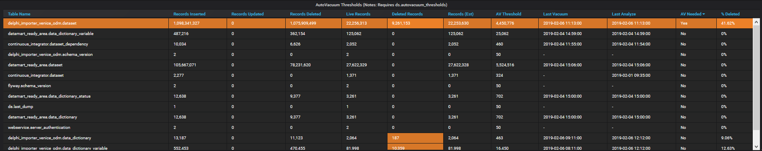
AutoVacuum Thresholds
Table Name
  This will be displayed in one of the following formats: Cluster.Database.Schema.Table or Database.Schema.Table or Schema.Table depending on your template settings.
Records Inserted, Records Updated, Records Deleted
  This is the total number of records inserted, updated and deleted. These numbers will only ever go up.
Live Records, Deleted Records, Record (est)
  This is the estimated number of readable records, deleted records and total records.

Slide 15
AutoVacuum Thresholds
AV Threshold
  This is the number of deleted records needed to kick off the AutoVacuum process for this table.
Last Vacuum, Last Analyze
  These are the Last Vacuum / AutoVacuum and Last Vacuum Analyze or Last AutoVacuum Analyze
AV Needed
  This will show “Yes” if the Deleted Records is more than the AV Threshold
% Deleted
  This shows you the percentage of the table that is deleted.

Slide 16
Active and Idle in Transaction
  Knowing what might be holding locks to prevent AutoVacuum

Slide 17
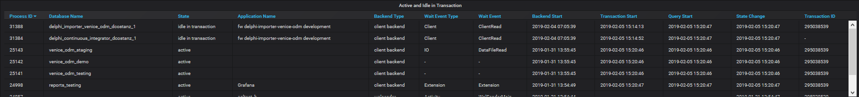
Active and Idle in Transaction
Process ID
  This is the number of deleted records needed to kick off the AutoVacuum process for this table.
Database Name
  These are the Last Vacuum / AutoVacuum and Last Vacuum Analyze or Last AutoVacuum Analyze
State
  This will show “Yes” if the Deleted Records is more than the AV Threshold
Application Name
  This shows you the percentage of the table that is deleted.
Backend Type
  This shows you the percentage of the table that is deleted.

Slide 18
Active and Idle in Transaction
Wait Event Type
  LWLock, Lock, BufferPin, Activity, Extension, Client, IPC, Timeout, IO
Wait Event
  To many to cover here, see https://www.postgresql.org/docs/current/monitoring-stats.html#WAIT-EVENT-TABLE
Backend Start / Transaction Start / Query Start / State Change
  The Backend Start, is when the connection to the server was established.
  The Transaction Start is when you did a BEGIN transaction or started a single item transaction.
  The Query Start is the start of your Query inside of the transaction and will be the same as Transaction Start if running a single item transaction.
  The State Change is the change in state, such as switching from active to “idle” or “idle in transaction”, allowing you to know how long the transaction or connection has been sitting idle.
Transaction ID
  This shows you the percentage of the table that is deleted.

Slide 19
Current Drive Performance
  Monitoring current drive performance

Slide 20
Primary / Secondary Query
This query allows us to see if the server is a Primary or Secondary server or if the secondary server is Disconnected from the primary server.
SET application_name = 'Grafana’;
SELECT COALESCE (
CASE WHEN pg_is_in_recovery() IS FALSE
THEN 'Primary’
ELSE 'Secondary' END,
'Disconnected’
) AS hostname;

Slide 21
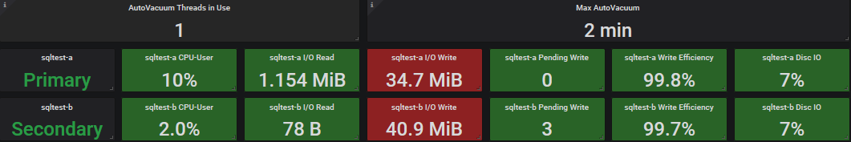
Current Drive Performance
AutoVacuum Threads in Use
  This is the number of AutoVacuum’s threads currently running.
Max AutoVacuum
  This is the longest running AutoVacuum
Server-a / Server-b
  Let’s us know which server is primary vers seconday.
CPU-User
  How much cpu the user, such as user postgres, is currently using.
  servers.virtual.$ServerName-a.aggregation-cpu-average.cpu-user
  servers.virtual.$ServerName-b.aggregation-cpu-average.cpu-user
Notes:
Color coding for I/O Write is set for Random Write, where for high efficiency writes would be > 46 GB Orange, >73 GB Red, 92 GB Max

Slide 22
Current Drive Performance
I/O Read / I/O Write
  Read and Writing in Bytes / KB / MB / GB
  servers.{virtual,physical}.$ServerName-a.disk-xvdb1.disk_octets.read
  servers.{virtual,physical}.$ServerName-b.disk-xvdb1.disk_octets.read
  servers.{virtual,physical}.$ServerName-a.disk-xvdb1.disk_octets.write
  servers.{virtual,physical}.$ServerName-b.disk-xvdb1.disk_octets.write
Pending Writes
  Number of writes that were delayed due to I/O saturation.
  servers.{virtual,physical}.$ServerName-a.disk-xvdb1.pending_operations
  servers.{virtual,physical}.$ServerName-b.disk-xvdb1.pending_operations

Slide 23
Current Drive Performance
Write Efficiency
  Random write is low efficiency, sequential write is high efficiency. We want to see high efficiency.
  offset(scale(asPercent(servers.{virtual,physical}.$ServerName-a.disk-xvdb1.disk_ops.write,servers.{virtual,physical}.$ServerName-a.disk-xvdb1.disk_octets.write),-1),1)
  offset(scale(asPercent(servers.{virtual,physical}.$ServerName-b.disk-xvdb1.disk_ops.write,servers.{virtual,physical}.$ServerName-b.disk-xvdb1.disk_octets.write),-1),1)
Disc I/O
  Disc I/O usage.
  scale(servers.{virtual,physical}.$ServerName-a.disk-xvdb1.disk_io_time.io_time,0.1)
  scale(servers.{virtual,physical}.$ServerName-b.disk-xvdb1.disk_io_time.io_time,0.1)

Slide 24
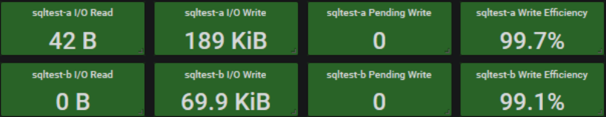
Current Drive Performance
I/O Read / I/O Write Settings
  RAID Type: RAID 6
  Drive Capacity: 146GB
  Single Drive Performance: 6,144 MB/s
  Single Drive Cost: 40
  Number of drives per RAID group: 16
  Number of RAID groups: 1
  Read operations (%): 0 (100% - Write Efficiency, In this case it would be between 0% and 1%)
Percent | MB | KB | B
100% | 92 | 93,696 | 95,944,704
80% | 73 | 74,957 | 76,755,763
50% | 46 | 46,848 | 47,972,352
Drive (Type / RPM) | IOPS (4KB block, random) | IOPS (64KB block, random) | MB/s (64KB block, random) | IOPS (512KB block, random) | MB/s (512KB block, random) | MB/s (large block, sequential)
FC / 15K | 163-178 | 151-169 | 9.7-10.8 | 97-123 | 49.7-63.1 | 73.5-127.5
SAS / 15K | 188-203 | 175-192 | 11.2-12.3 | 115-135 | 58.9-68.9 | 91.5-126.3
FC / 10K | 142-151 | 130-143 | 8.3-9.2 | 80-104 | 40.9-53.1 | 58.1-107.2
SAS / 10K | 142-151 | 130-143 | 8.3-9.2 | 80-104 | 40.9-53.1 | 58.1-107.2
SAS/SATA / 7200 | 73-79 | 69-76 | 4.4-4.9 | 47-63 | 24.3-32.1 | 43.4-97.8
SATA / 5400 | 57 | 55 | 3.5 | 44 | 22.6
SSD | To evaluate SSD RAID performance use the SSD version of the calculator
Notes:
I/O Read / I/O Write
The value you will want to use for your color threshold will be based on your write efficiency.
https://wintelguy.com/raidperf.pl
SSD Calculator
https://wintelguy.com/raidperf.pl/?formid=2
Color coding for I/O Write is set for Random Write, where for high efficiency writes would be > 46 GB Orange, >73 GB Red, 92 GB Max

Slide 25
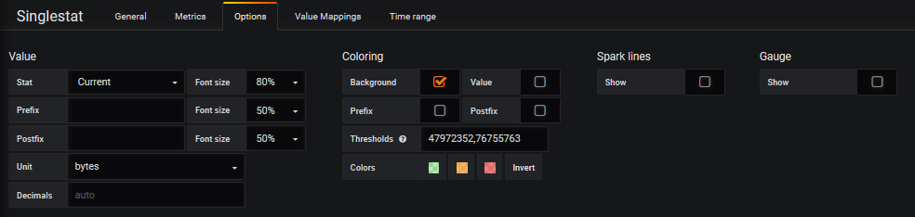
Current Drive Performance
I/O Read / I/O Write Settings
  RAID Type: RAID 6
  Drive Capacity: 146GB
  Single Drive Performance: 6,144 MB/s
  Single Drive Cost: 40
  Number of drives per RAID group: 16
  Number of RAID groups: 1
  Read operations (%): 0 (100% - Write Efficiency, In this case it would be between 0% and 1%)
Percent | MB | KB | B
100% | 92 | 93,696 | 95,944,704
80% | 73 | 74,957 | 76,755,763
50% | 46 | 46,848 | 47,972,352

Slide 26
Performance History
  Monitoring history as thing happen when we are not in front of the monitors.

Slide 27
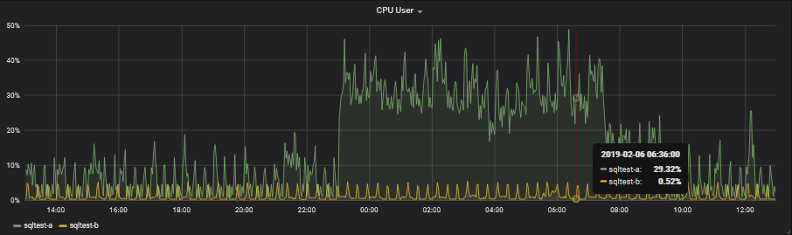
CPU User
We want to make sure that we are not running at full CPU. I try to keep the server below 50% with a max spike of 80%.
aliasByNode(servers.{virtual,physical}.$ServerName-a.aggregation-cpu-average.cpu-user,2)
aliasByNode(servers.{virtual,physical}.$ServerName-b.aggregation-cpu-average.cpu-user,2)

Slide 28
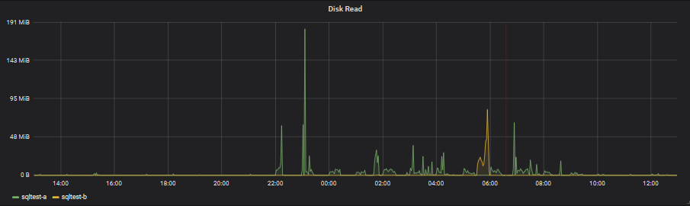
Disk Read
Short duration spikes are OK, as long as there is no real sustained disk reads.
aliasByNode(servers.{virtual,physical}.sqltest-a.disk-xvdb1.disk_octets.read,2)
aliasByNode(servers.{virtual,physical}.sqltest-b.disk-xvdb1.disk_octets.read,2)

Slide 29
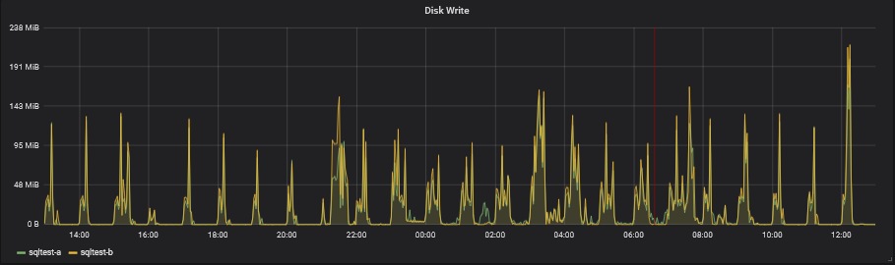
Disk Write
Short duration spikes are OK, as long as there is no real sustained disk reads.
aliasByNode(servers.{virtual,physical}.sqltest-a.disk-xvdb1.disk_octets.write,2)
aliasByNode(servers.{virtual,physical}.sqltest-b.disk-xvdb1.disk_octets.write,2)

Slide 30
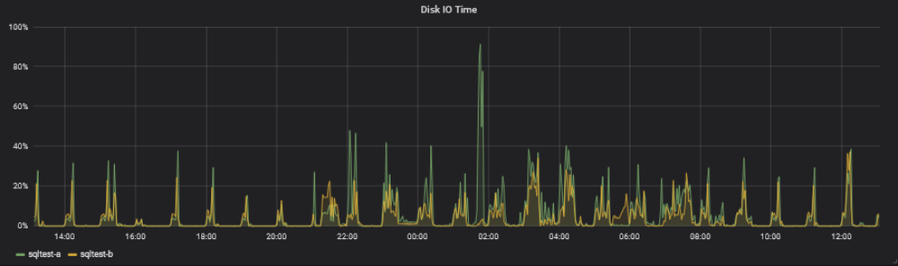
Disk I/O Time
The vacuum spike to 91% is OK, but I will be reducing it to 80% so that other long queries should not be affected as much by the AutoVacuum.
aliasByNode(scale(servers.{virtual,physical}.$ServerName-a.disk-xvdb1.disk_io_time.io_time,0.1),2)
aliasByNode(scale(servers.{virtual,physical}.$ServerName-b.disk-xvdb1.disk_io_time.io_time,0.1),2)

Slide 31
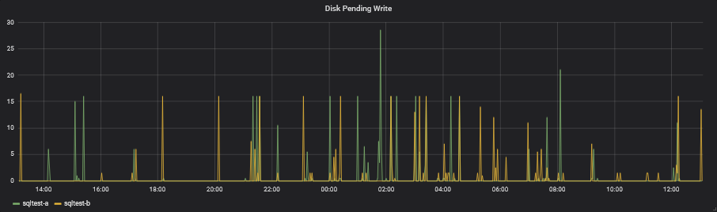
Disk Pending Write
Short pending writes are OK, we just don’t want to see long running pending items.
aliasByNode(servers.{virtual,physical}.$ServerName-a.disk-xvdb1.pending_operations,2)
aliasByNode(servers.{virtual,physical}.$ServerName-b.disk-xvdb1.pending_operations,2)

Slide 32
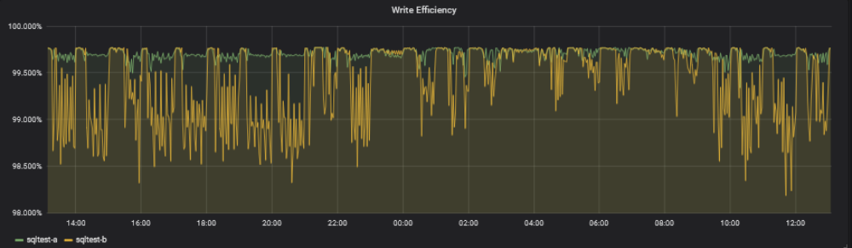
Write Efficiency
Random write is low efficiency, sequential write is high efficiency. We want to see high efficiency.
alias(offset(scale(asPercent(servers.{virtual,physical}.$ServerName-a.disk-xvdb1.disk_ops.write,servers.{virtual,physical}.$ServerName-a.disk-xvdb1.disk_octets.write),-1),1),"$ServerName-a")
alias(offset(scale(asPercent(servers.{virtual,physical}.$ServerName-b.disk-xvdb1.disk_ops.write,servers.{virtual,physical}.$ServerName-b.disk-xvdb1.disk_octets.write),-1),1),"$ServerName-b")

Slide 33
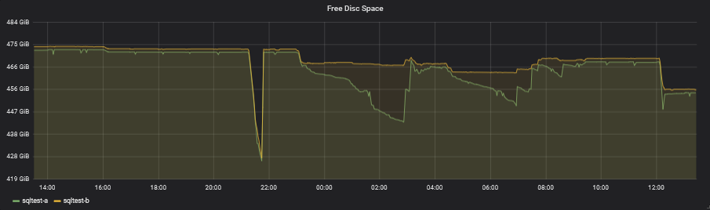
Free Disc Space
We need to make sure that we don’t run the server out of space due to bloating of the tables.
aliasByNode(servers.{virtual,physical}.$ServerName-a.df-pgdata_local.df_complex-free,2)
aliasByNode(servers.{virtual,physical}.$ServerName-b.df-pgdata_local.df_complex-free,2)

Slide 34
Granted Locks
This query allows us to retrieve what locks are being held.
SELECT
current_setting('cluster_name'::text) AS cluster_name,
current_database() AS database_name,
date_part('seconds'::text, now() - psa.xact_start) + date_part( 'minutes'::text, now() - psa.xact_start) * 60::double precision + date_part('hours'::text, now() - psa.xact_start) * 60::double precision * 60::double precision + date_part('days'::text, now() - psa.xact_start) * 60::double precision * 60::double precision * 24:: double precision AS "Time",
psa.pid AS "PG Process ID",
psa.application_name AS "Application Name",
psa.xact_start AS "Transaction Start",
locks."Locks",
CASE WHEN psa.backend_type = 'autovacuum worker'::text
THEN psa.query ELSE NULL::text
END AS "AutoVacuum"
FROM pg_stat_activity psa
LEFT JOIN (
SELECT a.pid,
string_agg((a."Object" || ' - '::text) || a."Mode", '
'::text) AS "Locks"
FROM
(
SELECT psa_1.pid,
(pn.nspname::text || '.'::text) || pc.relname::text AS "Object",
string_agg(pl.mode, ', '::text) AS "Mode"
FROM pg_locks pl
LEFT JOIN pg_stat_activity psa_1 ON pl.pid = psa_1.pid
LEFT JOIN pg_class pc ON pl.relation = pc.oid
LEFT JOIN pg_namespace pn ON pc.relnamespace = pn.oid
WHERE pl.granted = true
GROUP BY psa_1.pid, ((pn.nspname::text || '.'::text) || pc.relname::text)
) a GROUP BY a.pid
) locks USING (pid)
WHERE psa.datname = current_database()
AND locks."Locks" IS NOT NULL;

Slide 35
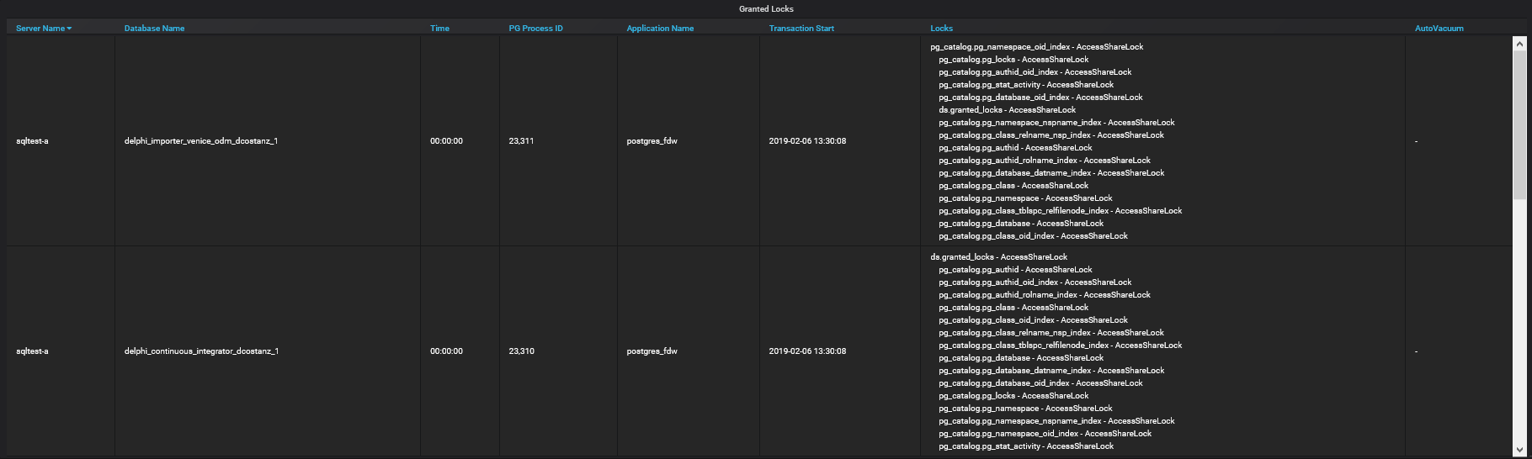
Granted Locks
If a table should be AutoVacuum’ed but is not, it could be because our long running transactions are holding locks on that table. We want to see if there are any Exclusive locks on the tables that should be AutoVacuum’ed.

Slide 36
Custom Table Settings
  Adjusting the AutoVacuum per Table

Slide 37
Custom Table Settings
This query allows us to retrieve all the custom table settings for all tables, excluding the tables located in pg_catalog and the information_schema.
SELECT
current_setting('cluster_name'::text)
AS cluster_name,
current_database() AS database_name,
pn.nspname AS schema_name,
pc.relname AS table_name,
quote_ident(pn.nspname::text) ||
'.'::text ||
quote_ident(pc.relname::text)
AS "Table Name",
unnest(pc.reloptions) AS "Table Setting"
FROM pg_class pc
JOIN pg_namespace pn
ON pn.oid = pc.relnamespace
WHERE pc.reloptions IS NOT NULL
AND (pn.nspname <> ALL (ARRAY [ 'pg_catalog'::name, 'information_schema':: name ]));

Slide 38
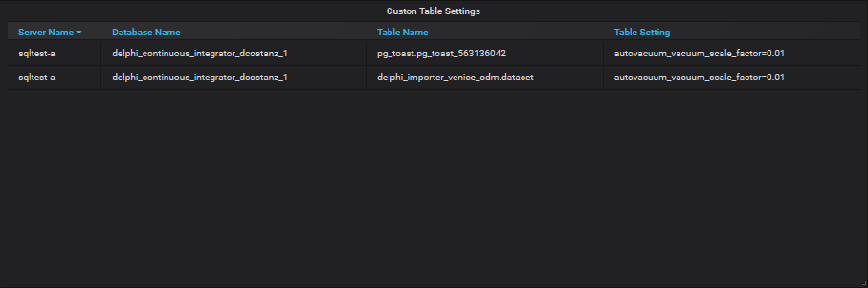
Custom Table Settings
The larger the table, the larger the threshold for AutoVacuum. For very large table we might want to lower this threshold. Instead of doing this for the entire server, we can do it for individual tables.
ALTER TABLE IF EXISTS ONLY delphi_importer_venice_odm.dataset
SET
(
autovacuum_vacuum_scale_factor=0.01,
toast.autovacuum_vacuum_scale_factor=0.01
);

Slide 39
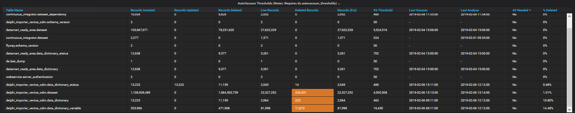
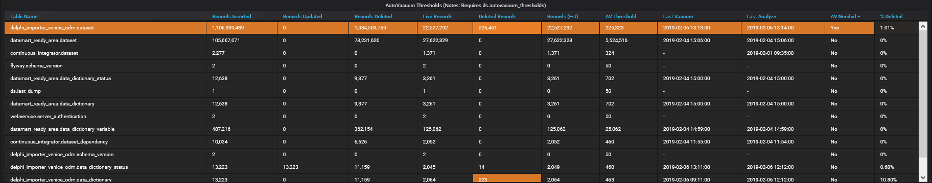
Custom Table Settings
Default
Custom

Slide 40
AutoVacuum Settings
  Viewing the server settings

Slide 41
AutoVacuum Settings
This query allows us to see the settings that PostgreSQL is using and which file they are from.
  postgresql.conf
  postgresql.auto.conf
SELECT
current_setting('cluster_name'::text)
AS cluster_name,
name,
setting,
unit,
category,
short_desc,
extra_desc,
context,
vartype,
source,
min_val,
max_val,
enumvals,
boot_val,
reset_val,
sourcefile,
sourceline,
pending_restart
FROM pg_settings;

Slide 42
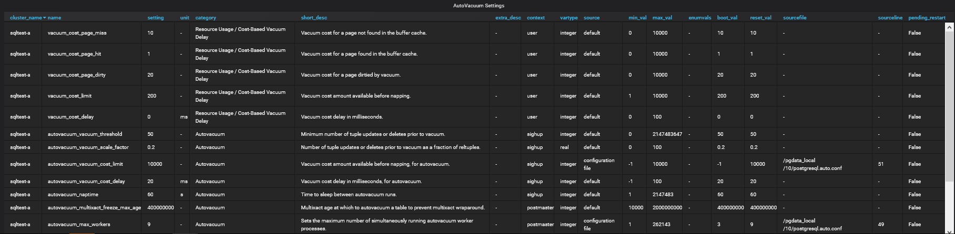
AutoVacuum Settings
This is more informational than anything, but the line will highlight when a restart is required for the change to take effect.

