Slide 1


Slide 2
Index Bloat
  By Lloyd Albin
  Presentation:
  http://lloyd.thealbins.com/IndexBloat

Slide 3
Index Bloat
  What Causes Index Bloat

Slide 4

Causes of Index Bloat
Large churning of data on a table.
  In my case we are doing DELETE and then INSERT. UPDATE’s can have this problem unless they are HOT UPDATE’s.
Every time you vacuum or vacuum analyze a table, this will cause index bloat.
  Vacuum will create new index entries when it moves each tuple/row/record to the new location.
Vacuum does not vacuum the indexes.
  It will remove index pages that are blank, but if there are two pages side by side with one entry apiece, it will do nothing.
Additional notes in the note section of the slide when you see this icon
( ) in the upper right corner of the slide.

Slide 5
Why not autovacuum?
Autovacuum_naptime sets the amount of time between autovacuum runs. The default is 1 minute.
The problem is that you need to hold off for at least the naptime + the amount of time for the vacuum to happen.
Autovacuum’s will be canceled if another process needs to write the table.
Some of our tables are so heavily used that Autovacuum never gets to run.

Slide 6
Monitoring
  Monitoring for Index Bloat

Slide 7

Query to find Bloat
WITH btree_index_atts AS (
SELECT nspname, relname, reltuples, relpages, indrelid, relam,
regexp_split_to_table(indkey::text, ' ')::smallint AS attnum,
indexrelid as index_oid
FROM pg_index
JOIN pg_class ON pg_class.oid=pg_index.indexrelid
JOIN pg_namespace ON pg_namespace.oid = pg_class.relnamespace
JOIN pg_am ON pg_class.relam = pg_am.oid
WHERE pg_am.amname = 'btree’
),
index_item_sizes AS (
SELECT i.nspname, i.relname, i.reltuples, i.relpages, i.relam,
s.starelid, a.attrelid AS table_oid, index_oid,
current_setting('block_size')::numeric AS bs,
/* MAXALIGN: 4 on 32bits, 8 on 64bits (and mingw32 ?) */
CASE
WHEN version() ~ 'mingw32' OR version() ~ '64-bit' THEN 8
ELSE 4
END AS maxalign,
24 AS pagehdr,
/* per tuple header: add index_attribute_bm if some cols are null-able */
CASE WHEN max(coalesce(s.stanullfrac,0)) = 0
THEN 2
ELSE 6
END AS index_tuple_hdr,
/* data len: we remove null values save space using it fractionnal part from stats */
sum( (1-coalesce(s.stanullfrac, 0)) * coalesce(s.stawidth, 2048) ) AS nulldatawidth
FROM pg_attribute AS a
JOIN pg_statistic AS s ON s.starelid=a.attrelid AND s.staattnum = a.attnum
JOIN btree_index_atts AS i ON i.indrelid = a.attrelid AND a.attnum = i.attnum
WHERE a.attnum > 0
GROUP BY 1, 2, 3, 4, 5, 6, 7, 8, 9
),
index_aligned AS (
SELECT maxalign, bs, nspname, relname AS index_name, reltuples,
relpages, relam, table_oid, index_oid,
( 2 + maxalign - CASE /* Add padding to the index tuple header to align on MAXALIGN */
WHEN index_tuple_hdr%maxalign = 0 THEN maxalign
ELSE index_tuple_hdr%maxalign
END + nulldatawidth + maxalign - CASE /* Add padding to the data to align on MAXALIGN */
WHEN nulldatawidth::integer%maxalign = 0 THEN maxalign
ELSE nulldatawidth::integer%maxalign
END
)::numeric AS nulldatahdrwidth, pagehdr
FROM index_item_sizes AS s1 ),
otta_calc AS (
SELECT bs, nspname, table_oid, index_oid, index_name, relpages, coalesce(
ceil((reltuples*(4+nulldatahdrwidth))/(bs-pagehdr::float)) +
CASE WHEN am.amname IN ('hash','btree') THEN 1 ELSE 0 END ,
0 -- btree and hash have a metadata reserved block
) AS otta
FROM index_aligned AS s2
LEFT JOIN pg_am am ON s2.relam = am.oid
),
raw_bloat AS (
SELECT current_database() as dbname, nspname, c.relname AS table_name, index_name,
bs*(sub.relpages)::bigint AS totalbytes,
CASE
WHEN sub.relpages <= otta THEN 0
ELSE bs*(sub.relpages-otta)::bigint
END AS wastedbytes,
CASE
WHEN sub.relpages <= otta THEN 0
ELSE bs*(sub.relpages-otta)::bigint * 100 / (bs*(sub.relpages)::bigint)
END AS realbloat,
pg_relation_size(sub.table_oid) as table_bytes,
stat.idx_scan as index_scans
FROM otta_calc AS sub
JOIN pg_class AS c ON c.oid=sub.table_oid
JOIN pg_stat_user_indexes AS stat ON sub.index_oid = stat.indexrelid
)
SELECT dbname as database_name, nspname as schema_name, table_name, index_name,
round(realbloat, 1) as bloat_pct,
wastedbytes as bloat_bytes,
pg_size_pretty(wastedbytes::bigint) as bloat_size,
totalbytes as index_bytes,
pg_size_pretty(totalbytes::bigint) as index_size,
table_bytes,
pg_size_pretty(table_bytes) as table_size,
index_scans
FROM raw_bloat
WHERE ( realbloat > 50 and wastedbytes > 50000000 )
ORDER BY wastedbytes DESC;
realbloat > 50% & wastedbytes > 50MB
Notes:
https://gist.github.com/jberkus/9923948

Slide 8
realbloat
When we talk about realbloat 50% this means that 50% is the index is the true index and 50% of the index is bloat.
realbloat 99% means that the true index size is 1% of the total index size.
B-Tree index’s when build have 10% bloat for inserting and/or updating records. See fillfactor in the later slides for more information.

Slide 9
Example
Database_name | Schema_name | Table_name | Index_name | Bloat_pct | Bloat_bytes | Bloat_size | Index_bytes | Index_size | Unbloated_bytes | Unbloated_size | Table_bytes | Table_size | Index_scans
df_repository | data | variable_record | variable_record_df_study_number_plate_number_ptid_visit_num_key | 60.2 | 2,900,787,200 | 2766 MB | 4,814,921,728 | 4592 MB | 1,914,134,528 | 1825 MB | 9,836,462,080 | 9381 MB | 202,093,238
df_repository | data | variable_record | variable_record_pkey | 70.1 | 2,492,162,048 | 2377 MB | 3,555,573,760 | 3391 MB | 1,063,411,712 | 1014 MB | 9,836,462,080 | 9381 MB | 403,544,900
df_repository | data | variable_record | variable_record_idx | 54.9 | 1,296,269,312 | 1236 MB | 2,359,681,024 | 2250 MB | 1,063,411,712 | 1014 MB | 9,836,462,080 | 9381 MB | 198,655,034
df_repository | data | plate_record | plate_record_creation_time_modification_time_plate_number_p_key | 58 | 232,210,432 | 221 MB | 400,031,744 | 382 MB | 167,821,312 | 160 MB | 303,726,592 | 290 MB | 240
6.5 GB Bloat
4 GB Un-bloated
10.4 GB Index’s
These four index’s represent about 6.5GB of database bloat.
When I first tested this database the bloat was at 11GB and was 1/3 of the database size.
(2,766 MB + 2,377 MB + 1,236 MB + 221 MB) / 1,024 = 6.44 GB
Un-bloated Size = 4 GB * (2-(90/100)) = Normal Size 4.3 GB with the default fillfactor of 90.

Slide 10
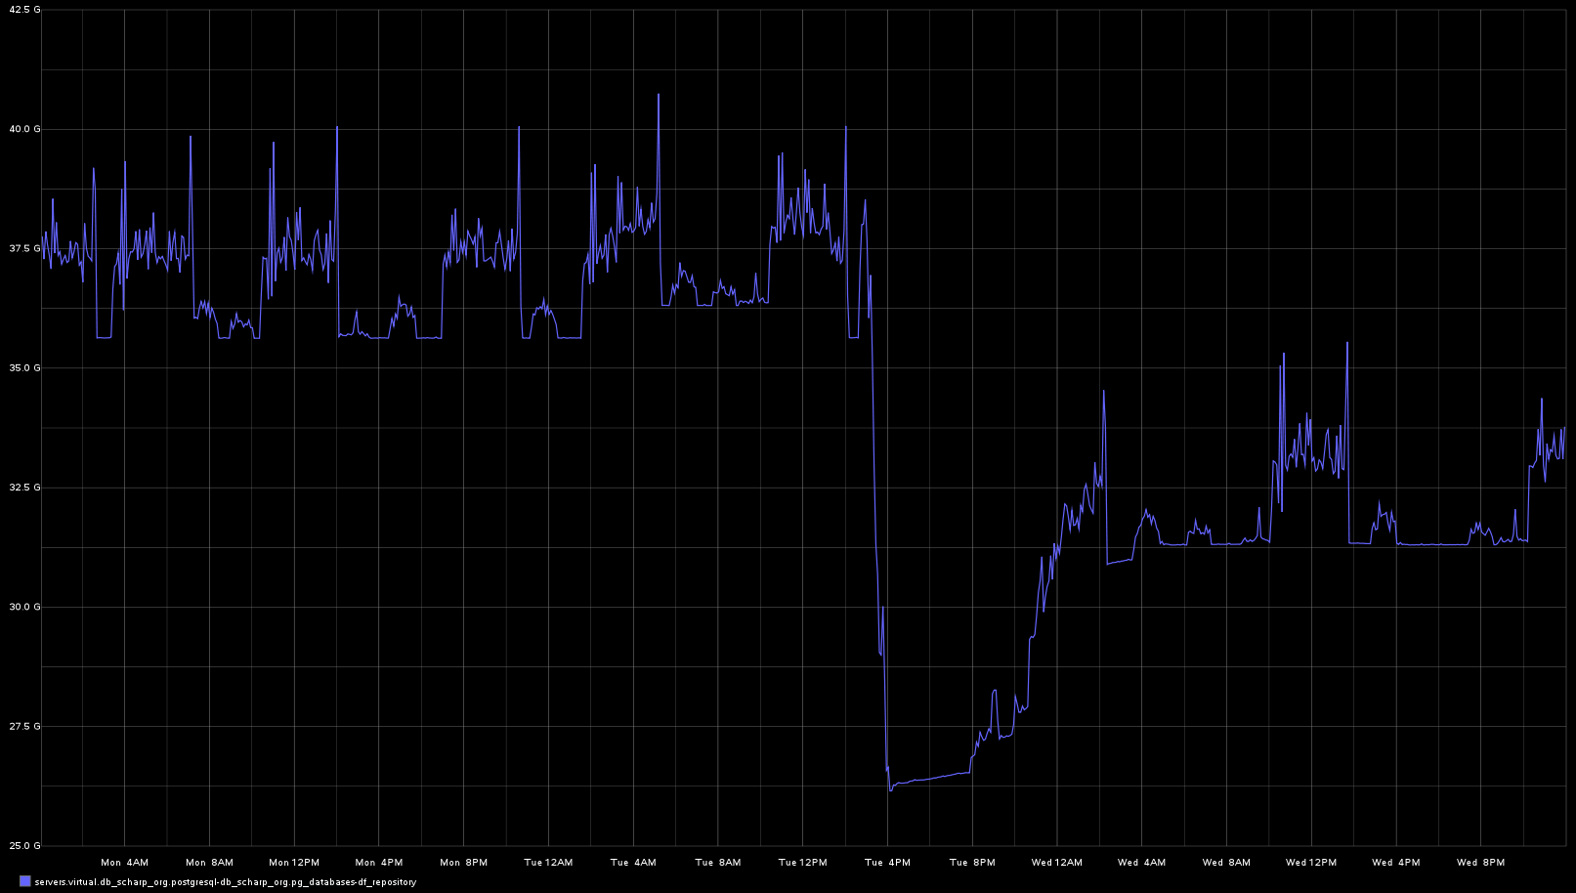
~ 38 GB Before Re-Indexing
5 Index rebuilds between the before and after marks, reclaiming 12 GB of storage
and making the queries run in milliseconds instead of hours.
~ 26 GB After Re-Indexing

Slide 11
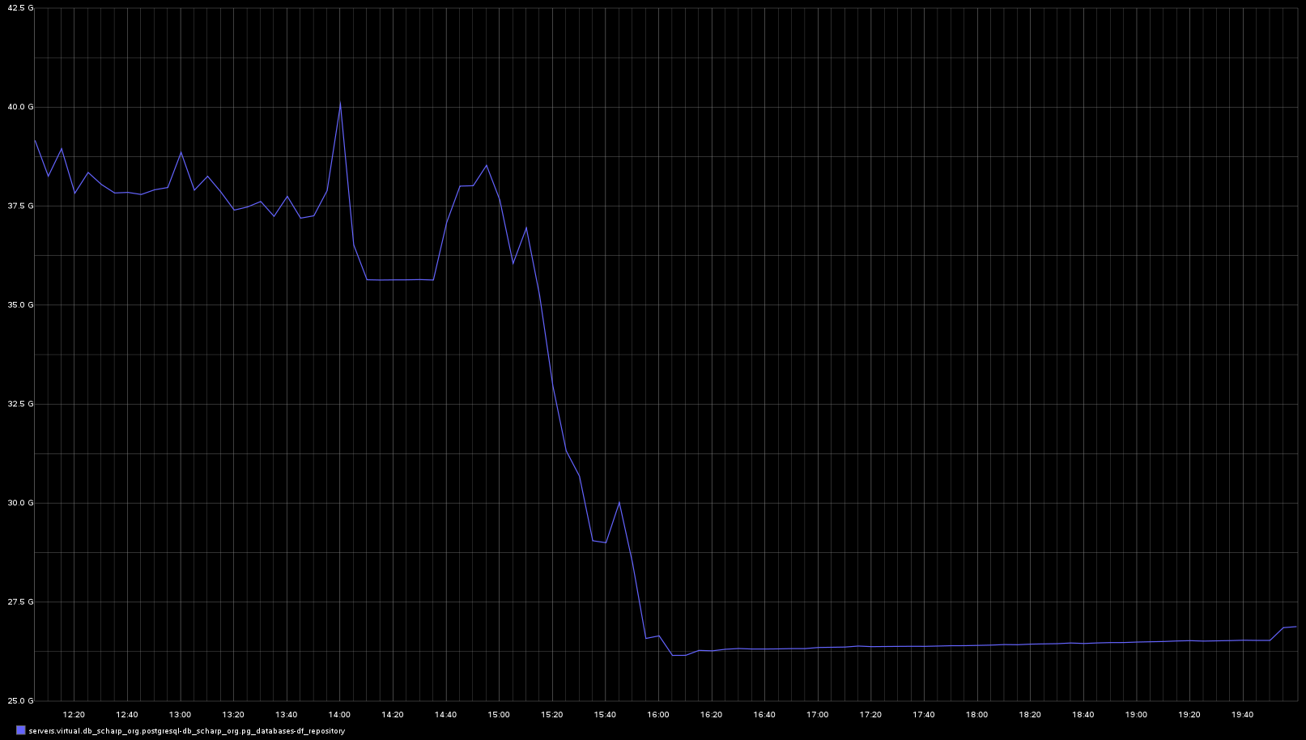
Build Index / Delete Index
Build Index / Delete Index
Build Index / Delete Index
Each uptick is the build of the new index and the down tick is the delete of the old index.
Build Index / Delete Index
Build Index / Delete Index

Slide 12
What we notice here is that the bloat does not stay away. After 12 hours we are to a long term stable growth that will continue until the queries start failing due to the index being too bloated.
12 hours to stabilize into a slow growth stage
Minimal growth for 3 hours

Slide 13
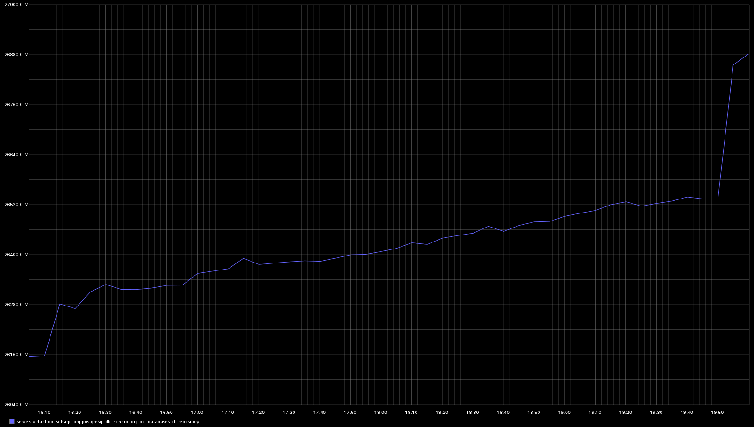
Vacuum’s should fix indexes, right? Not a chance as you can see from these vacuum’s.
Vacuum
Vacuum
Vacuum
Vacuum
Minimal growth for 3 hours.

Slide 14
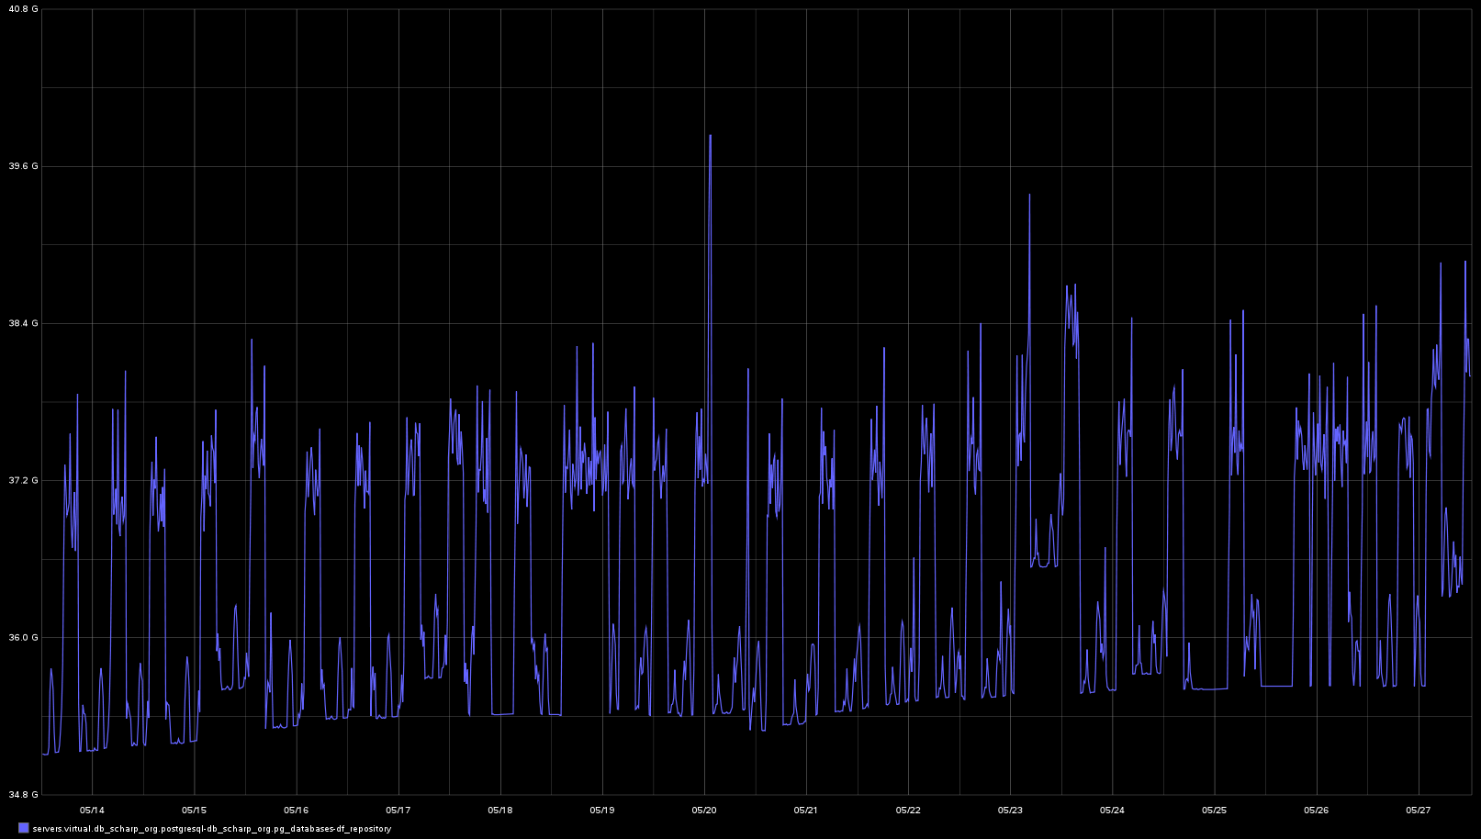
Slow bit continual growth over 2 weeks after the re-index.
About 1 GB per week.
Note: This graph is total database size, not index size.

Slide 15
Re-Create Index

Slide 16
Re-Create Index
DROP INDEX momentarily takes exclusive lock on the parent table, blocking both writes and reads.
The subsequent CREATE INDEX locks out writes but not reads; since the index is not there, no read will attempt to use it, meaning that there will be no blocking but reads will be forced into expensive sequential scans unless there is another index that they can use.
ALTER TABLE
DROP CONSTRAINT variable_record_df_study_number_plate_number_ptid_visit_num_key;
DROP INDEX variable_record_df_study_number_plate_number_ptid_visit_num_key;
ALTER TABLE data.variable_record
ADD CONSTRAINT variable_record_df_study_number_plate_number_ptid_visit_num_key
UNIQUE (df_study_number, plate_number, ptid, visit_number,
variable_number);

Slide 17
ReIndex

Slide 18
ReIndex
REINDEX rebuilds an index using the data stored in the index's table, replacing the old copy of the index.
An index may become "bloated", that it is contains many empty or nearly-empty pages. This can occur with B-tree indexes in PostgreSQL under certain uncommon access patterns.
REINDEX is similar to a drop and recreate of the index in that the index contents are rebuilt from scratch. However, the locking considerations are rather different. REINDEX locks out writes but not reads of the index's parent table. It also takes an exclusive lock on the specific index being processed, which will block reads that attempt to use that index.
REINDEX INDEX
variable_record_df_study_number_plate_number_ptid_visit_num_key;

Slide 19
CREATE INDEX CONCURRENTLY
  Creating an index without halting work

Slide 20
CREATE INDEX CONCURRENTLY
Can’t be done inside of a Transaction
  This just means the swap out code needs to be inside of a Transaction.
Can’t be done inside of a Function
  There went my idea of writing a generic function that could re-create index’s as needed without having any index specific code.
CREATE INDEX CONCURRENTLY and VACUUM can’t be run at the same time because they both want a SHARE UPDATE EXCLUSIVE lock in the table.
  SHARE UPDATE EXCLUSIVE lock is acquired by VACUUM (without FULL), ANALYZE, CREATE INDEX CONCURRENTLY, and some forms of ALTER TABLE.

Slide 21
CREATE INDEX CONCURRENTLY
If you cancel the CREATE INDEX or it fails during applying the constraints, you will be left with a bad index.
  DROP the bad index. This index is also flagged bad and will not be used by the query planner. pg_class.pg_index.indisvalid = false
CREATE PROCEDURE (Postgres 11+)
  Since transactions are allowed inside of procedures, I was hoping this would work, but it does not work.
Notes:
CREATE PROCEDURE
https://www.postgresql.org/docs/current/sql-createprocedure.html
INDEX Fields
https://www.postgresql.org/docs/11/catalog-pg-index.html

Slide 22
Example #1 – Normal Index
In this example we are dealing with a normal index that is not unique.
When using CREATE INDEX CONCURRENTLY, you must not use it inside of a transaction and in fact it creates three separate transactions while executing.
DROP INDEX IF EXISTS data.vr_temp;
CREATE INDEX CONCURRENTLY vr_temp
ON data.variable_change USING btree (df_study_number, plate_number,
variable_number, ptid, visit_number, variable_change_id DESC);
--Query OK, 0 rows affected (execution time: 00:15:30; total time: 00:15:30)
BEGIN;
DROP INDEX data.variable_change_idx;
ALTER INDEX data.vr_temp RENAME TO variable_change_idx;
COMMIT;

Slide 23
Example #2 – Unique Index
In this example we have a unique index.
We are able to drop and replace the constraint as a single command. This means we don’t need to wrap this command inside of a transaction.
DROP INDEX IF EXISTS data.vr_temp;
CREATE UNIQUE INDEX CONCURRENTLY vr_temp
ON data.variable_record (df_study_number, plate_number,
ptid, visit_number, variable_number);
--Query OK, 0 rows affected (execution time: 00:18:53; total time: 00:18:53)
ALTER TABLE data.variable_record
DROP CONSTRAINT
variable_record_df_study_number_plate_number_ptid_visit_num_key,
ADD CONSTRAINT
variable_record_df_study_number_plate_number_ptid_visit_num_key
UNIQUE USING INDEX vr_temp;

Slide 24
Example #3 – Primary Key with Foreign Key
In this example the index is also a primary key that has a foreign key relationship.
You can’t drop the primary key constraint when there is a foreign key constraint on the same field.
DROP INDEX IF EXISTS data.vr_temp;
CREATE UNIQUE INDEX CONCURRENTLY vr_temp
ON data.variable_record (variable_record_id);
--Query OK, 0 rows affected (execution time: 00:03:51; total time: 00:03:51)
BEGIN;
ALTER TABLE data.qc_record
DROP CONSTRAINT qc_record_variable_record_fk;
ALTER TABLE data.variable_record
DROP CONSTRAINT variable_record_pkey
ADD CONSTRAINT variable_record_pkey PRIMARY KEY USING INDEX vr_temp;
ALTER TABLE data.qc_record
ADD CONSTRAINT qc_record_variable_record_fk
FOREIGN KEY (variable_record_id)
REFERENCES data.variable_record(variable_record_id)
ON DELETE NO ACTION
ON UPDATE NO ACTION
DEFERRABLE
INITIALLY DEFERRED;
COMMIT;

Slide 25
WITH (fillfactor = 90)
  Creating bloat on purpose

Slide 26
Fillfactor
The fillfactor for an index is a percentage that determines how full the index method will try to pack index pages. For B-trees, leaf pages are filled to this percentage during initial index build, and also when extending the index at the right (adding new largest key values). If pages subsequently become completely full, they will be split, leading to gradual degradation in the index's efficiency. B-trees use a default fillfactor of 90, but any integer value from 10 to 100 can be selected. If the table is static then fillfactor 100 is best to minimize the index's physical size, but for heavily updated tables a smaller fillfactor is better to minimize the need for page splits. The other index methods use fillfactor in different but roughly analogous ways; the default fillfactor varies between methods.
CREATE UNIQUE INDEX CONCURRENTLY vr_temp
ON data.variable_record (variable_record_id)
WITH (fillfactor = 40);
Notes:
Create Index – Index Storage Parameters – Fill Factor
https://www.postgresql.org/docs/current/sql-createindex.html#SQL-CREATEINDEX-STORAGE-PARAMETERS

Slide 27
What causes Index Bloat
  How to change your SQL patterns to prevent the Index Bloat.

Slide 28
Changing your SQL Pattern
In 2016, I had an evening chat with Anastasia Lubennikova from Postgres Professional in Russia who’s primary interest is indexes.
When you delete a large chuck of data, the tuples (records) are marked deleted in the table but the index is not updated. If you then insert the new records, there will not be enough empty entries on the index pages and the pages will have to be split, doubling the size of the index.
This can be resolved by first deleting the entries and then doing a select on the same table using the same where clause as the delete. This select will cause the index entries to be marked as deleted. Then when you do the insert the deleted index entrees can be overwritten, so that your index does not bloat.
-- This causes the index bloat
DELETE FROM records_table WHERE study = 'study x';
-- Table tuples/rows are flagged as deleted
-- Index tuples/entries have not been flagged as deleted.
INSERT INTO records_table
SELECT * FROM imported_records WHERE study = 'study x';
-- Insert needs to mesh new index entries with existing index entries, causing index page’s to split into multiple pages, thus causing the index bloat.
-- This will keep the index bloat from happening
DELETE FROM records_table WHERE study = 'study x';
-- Index entries have not been flagged as deleted.
SELECT * FROM records_table WHERE study = 'study x';
-- Zero rows will be returned.
-- Flags index entries as deleted when it finds that the table’s tuble/row is flagged as deleted.
INSERT INTO records_table
SELECT * FROM imported_records WHERE study = 'study x';
-- Overwrites index entries flagged as deleted.

Slide 29
Part 2:
B-Tree - explore the heart of PostgreSQL.

Slide 30
Anastasia Lubennikova
  Postgres Professional (Russia)

Slide 31

Anastasia Lubennikova
Anastasia is a graduate of the NRNU MEPhI with a B.S. in Applied Math and Informatics in 2015.
She participated GSoC with PostgreSQL in 2014.
Her primary interests are indexes and optimal data structures.
Anastasia is a developer at Postgres Professional.
Anastasia also coordinates "Hacking PostgreSQL" course, where has lectures about different subsystems, details of their implementation and tips for new developers.
Notes:
http://www.pgcon.org/2016/schedule/speakers/366.en.html

Slide 32
Anastasia Lubennikova
B-tree index is the most common index type. Most if not all of the modern DBMS use it. The data structure and concerned algorithms are really mature, there are about 40 years of development. And PostgreSQL's B-tree is not exception. It's full of complicated optimizations of performance, concurrency and so on. But there're still many ways to improve it. At the conference we'll discuss new features which are already done and ideas for further improvements. Of course it requires deep drive into B-tree internals and I'm going to guide you there.
List of improvements to talk about:
  INCLUDING clause for B-tree indexes. It allows to combine advantages of unique and covering index without any side effects. Besides, it provides a way to extend included columns to store attributes without suitable operator class in index to allow more queries benefit from index-only scan.
  B-tree compression. This long-expected feature includes several improvements. We'll discuss effective storage of duplicates, prefix compression and some related difficulties of implementation.
  Insertion buffer and bulk updates. Some ideas of avoiding crazy I/O traffic by using bulk load.
This presentation is from PGCon 2016.
Anastasia’s Patch for INCLUDING took another two year but has finally made it into Postgres 11!
  Allow B-tree indexes to include columns that are not part of the search key or unique constraint, but are available to be read by index-only scans (Anastasia Lubennikova, Alexander Korotkov, Teodor Sigaev)
  This is enabled by the new INCLUDE clause of CREATE INDEX. It facilitates building “covering indexes” that optimize specific types of queries. Columns can be included even if their data types don't have B-tree support.
Presentation:
  http://www.pgcon.org/2016/schedule/attachments/423_Btree
YouTube Video:
  https://www.youtube.com/watch?v=7g6PG71puX4
Notes:
Slide Share Presentation
https://www.slideshare.net/AnastasiaLubennikova/btree-explore-the-heart-of-postgresql-62191873
PDF Presentation
http://www.pgcon.org/2016/schedule/attachments/423_Btree
YouTube Video
https://www.youtube.com/watch?v=7g6PG71puX4

Slide 33
