Slide 1

http://Lloyd.TheAlbins.com/UsingGISinPostgres

Slide 2
Using GIS in PostgreSQL
  By Lloyd Albin

Slide 3

What we are going to cover
Installing PostGIS
  Cloud Solutions
  From Source
DataSets
  Tiger Data
  World Data
  Hypsometric Tints
Aviation Math
  Airplane Performance
  Great Circle Math
  Taxes
PostGIS Math
  Updating your tables to make GIS faster
Displaying your Data
  QGIS
  Google Maps API
  Bing Maps API
Additional notes in the note section of the slide when you see this icon
( ) in the upper right corner of the slide.

Slide 4
Installing PostGIS
  The many ways to install

Slide 5

What we are going to cover
Binary Installers:
  Windows
    EnterpriseDB’s StackBuilder
    Winnie - Experimental Releases
  OSX
    Postgres.app - Recommended
    KyngChaos
    Homebrew
    OSX PostgreSQL/StackBuilder – Mixed reliability – per PostGIS
  Red Hat / Centos / Scientific Linux
    PostgreSQL YUM/RPM Repositories
  Ubuntu / Debian
    APT Repository
  OpenSUSE and SUSE
    Repository
  Other Installers
    BigSQL
    EnterpriseDB
Notes:
http://postgis.net/install/

Slide 6
PostGIS (Source Code Install)
Download Source:
  http://www.postgis.net/source/
Source Code Install:
  Packages that are also needed to build the source code:
    GEOS – http://trac.osgeo.org/geos
    Proj 4 – https://trac.osgeo.org/proj/
    GDAL – http://gdal.org/
    LibXML2 – http://www.xmlsoft.org/
    JSON-C – https://github.com/json-c/json-c
tar xvzf postgis-2.3.3.tar.gz
cd postgis-2.3.3
./configure
make
make install
Notes:
http://postgis.net/source/

Slide 7
PostGIS (Cloud)
The three big cloud providers all support PostGIS, but they do not all support pgRouting.
Chart data last verified on: 4-18-2018
Cloud Provider | PostGIS | pgRouting
Amazon | 10.1-10.3/2.4.2 9.6.6-9.6.8/2.4.2 9.6.2-9.6.5/2.3.2 9.6.1/2.3.0 9.5.6-9.5.12/2.2.5 9.5.2-9.5.4/2.2.2 9.4.x/2.1.8 9.3.x/2.1.8 | 9.6.6-9.6.8/2.4.2 9.6.5/2.3.2
Google | 2.3 | No
Microsoft | 9.5.7/Yes 9.6.2/Yes | Yes
Notes:
http://docs.aws.amazon.com/AmazonRDS/latest/UserGuide/CHAP_PostgreSQL.html
https://docs.aws.amazon.com/AmazonRDS/latest/UserGuide/PostgreSQL.Concepts.html#PostgreSQL.Concepts.General.FeaturesExtensions
https://forums.aws.amazon.com/tags/pgrouting – Not relevant any longer with RDS Postgres 9.6.5
https://cloud.google.com/sql/docs/postgres/extensions
https://docs.microsoft.com/en-us/azure/postgresql/concepts-supported-versions
https://docs.microsoft.com/en-us/azure/postgresql/concepts-extensions

Slide 8
United States Census Bureau
  Tiger Shapefiles

Slide 9
Tiger Line/Shapefiles
Shapefiles – 2007 to Present (2017)
TIGER/Line ASCII Format – 2006 and earlier.
Here are some of the Tiger Datasets:
  Geographic Areas
    American Indian Area Geography
    Blocks
    Block Groups
    Census Tracts
    Congressional Districts
    Consolidated Cities
    Core Based Statistical Areas
    Counties (and equivalent)
    County Subdivisions
    Estate
    Places
    Public Use Microdata Areas
    School Districts
    States (and equivalent)
    State Legislative Districts
    Subbarrio (SubMinor Civil Division)
    Urban Areas
    ZIP Code Tabulation Areas
  Features
    All Lines
    Coastline
    Landmarks
    Roads
    Rails
    Military Installations
    Water
  Feature Relationships
    Relationship Files
Notes:
https://www.census.gov/geo/maps-data/data/tiger-line.html
https://www.census.gov/cgi-bin/geo/shapefiles/index.php
https://www2.census.gov/geo/pdfs/education/tiger/Downloading_TIGERLine_Shp.pdf
https://www.census.gov/geo/maps-data/data/tiger.html
2017 TIGER/Line Shapefiles
All legal boundaries and names are as of January 1, 2017. Released September 28, 2017.
Another great resource for data is the government catalog of 198,280 downloadable data sets.
122,385 are geospacial
4,116 are Shapefiles.
https://catalog.data.gov/
Many states have their own downloadable datasets:
Washington State – Department of Health
https://www.doh.wa.gov/DataandStatisticalReports/DataSystems/GeographicInformationSystem/DownloadableDataSets

Slide 10
Pre-Requirements
Pre-Requirements:
  wget
  7-zip
Notes:
http://www.7-zip.org/
http://gnuwin32.sourceforge.net/packages/wget.htm - Version 1.11.4
https://eternallybored.org/misc/wget/ -- Version 1.19.1 – This is the one I ended up using.

Slide 11
Edit loader_variables
tiger.loader_variables:
  tiger_year – 2017
  website_root – http://www2.census.gov/geo/tiger/TIGER2017
  staging_folder – Local Directory for Downloads
  data_schema – tiger_data
  staging_schema – tiger_staging
You may wish to update your staging folder aka where the downloads happen.
If you want to download their entire dataset, don’t use http or you will get blacklisted from their website like I did. Change it to ftp to be able to download all the data sets.
Another good program for Windows is WinSCP to be able to download the whole directory structure.
ftp://ftp.census.gov/geo/tiger/TIGER2017/
There is a Shapefile File Name Definition file in the main folder for each year that describes what data is contained in the subfolders.
This table is found in the postgis_23_sample or postgis_24_sample database.
Notes:
https://winscp.net/eng/download.php
Login anonymously and go to ftp://ftp.census.gov/geo/tiger/ and then drag and drop the TIGER2017 directory to your local machine.
ftp://ftp.census.gov/geo/tiger/TIGER2017/2017_TL_Shapefiles_File_Name_Definitions.pdf
You can install the sample database from the EnterpriseDB Stackbuilder application.

Slide 12
Edit loader_platform
tiger.loader_platform:
  Make a copy of the windows or sh record and edit to your needs.
I edited the following sections:
declare_sect
PGBIN (postgres binary location)
PGPORT (Non-Standard port)
PGPASSWORD (My password)
PGDATABASE (My database)
wget (May have not been needed)
This table is found in the postgis_23_sample database.

Slide 13
Loading Shapefiles into PostgreSQL
Convert Shape File:
  shp2pgsql
    -D – Copy format vers Insert format
    -G – Use geography type (requires lon/lat)
      Default is geometry type
    -I – Create spatial index on geocolumn
    -S 4326 – Longitude/Latitude based on WGS 84
    -S 32661 – Meter based on WGS 84
    filename
    schema.table
Loading SQL File:
  Use psql or other app to load sql file.
The bat/sh file takes care of everything for you so that you don’t have to do each part manually such as: download, convert and load into postgres the data in SRID 4269.
"C:\Program Files\PostgreSQL\9.5\bin\psql" -U postgres -h localhost -p 5433 -d postgis_23_sample -A -t -c "SELECT Loader_Generate_Nation_Script('lloyd')" > loader.bat
loader.bat
Notes:
https://postgis.net/docs/using_postgis_dbmanagement.html#shp2pgsql_usage
http://www.spatialreference.org/ref/epsg/4326/
WGS 84 = World Geodetic System dated 1984
shp2pgsql –S defaults to 0
http://www.7-zip.org/
http://gnuwin32.sourceforge.net/packages/wget.htm - Version 1.11.4
https://eternallybored.org/misc/wget/ -- Version 1.19.1

Slide 14
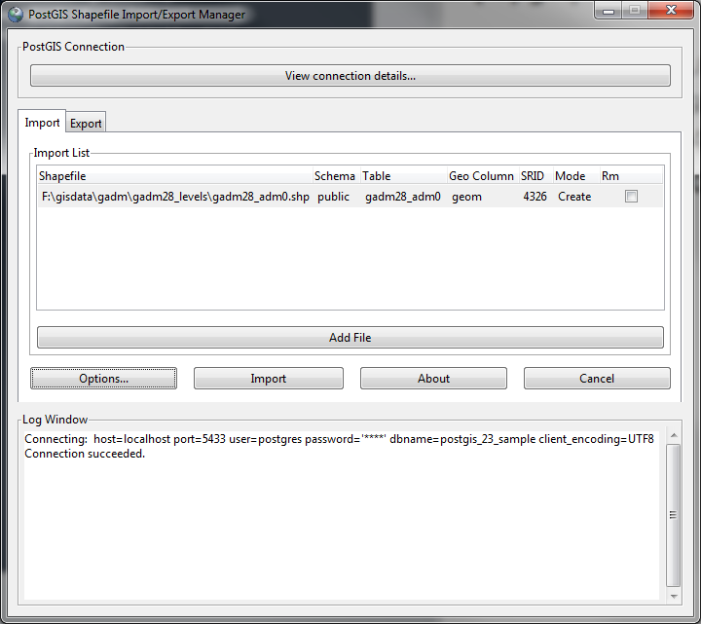
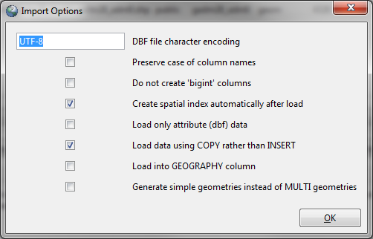
PostGIS 2.0 Shapefile and DBF Loader Exporter
There is a Windows Shapefile loader that come with the EnterpriseDB PostGIS Installation

Slide 15
What county’s are in what state
Here we find out what counties are in Washington State.
There are two different functions that we can use to perform this.
  ST_CoveredBy – Geometry and Geography
  ST_Contains – Geometry Only
SELECT s.stusps, c.*
FROM tiger.state s
LEFT JOIN tiger.county c
ON ST_CoveredBy(c.the_geom,s.the_geom)
WHERE s.stusps = 'WA';
SELECT s.stusps, c.*
FROM tiger.state s
LEFT JOIN tiger.county c
ON ST_Contains(s.the_geom, c.the_geom)
WHERE s.stusps = 'WA';
Notes:
https://postgis.net/docs/ST_CoveredBy.html
https://postgis.net/docs/ST_Contains.html

Slide 16
World Data
  Downloading Country / State / County / and more

Slide 17
World Administrative (Boundry) Data
There are several world shape file website that contain free shape data.
http://www.gadm.org/version2
GADM has been developed by Robert Hijmans, in collaboration with colleagues at the University of California, Berkeley Museum of Vertebrate Zoology, the International Rice Research Institute and the University of California, Davis, and with contributions of many others.
qadm28_levels_adm0 – Country
qadm28_levels_adm1 – State
qadm28_levels_adm2 – County
qadm28_levels_adm3 – Canada, South America, Africa, Europe, & Asia
qadm28_levels_adm4 – Some parts of Africa and Europe
qadm28_levels_adm5 – Some parts of Europe
Notes:
http://www.gadm.org/version2
http://thematicmapping.org/downloads/world_borders.php
GADM - The coordinate reference system is longitude/latitude and theWGS84 datum.
http://www.spatialreference.org/ref/epsg/4326/
WGS 84 = World Geodetic System dated 1984
shp2pgsql –S defaults to 0
This is the same as the SRID (Spatial Reference ID) as the Tiger Datasets.

Slide 18
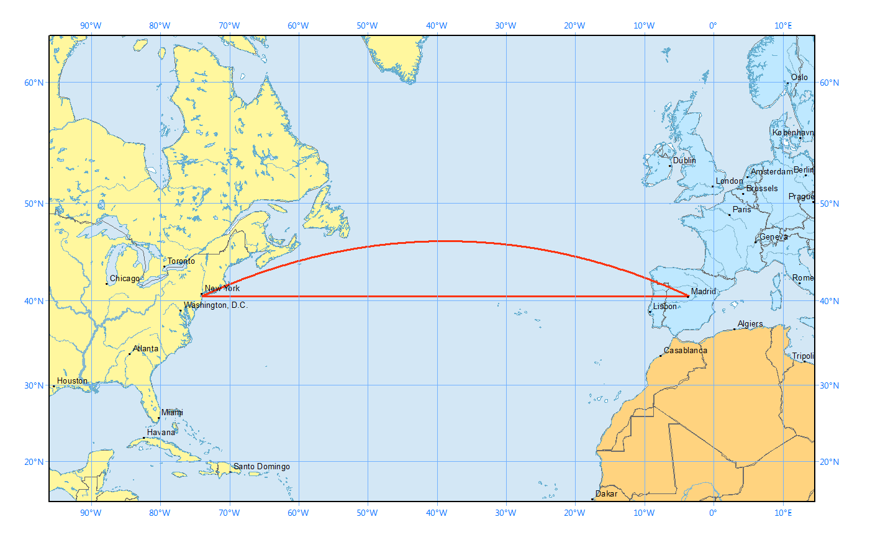
Aviation Math
  Great Circle Calculations
geography
geometry
Notes:
http://gisgeography.com/great-circle-geodesic-line-shortest-flight-path/
However, a straight line in a 2-dimensional map, geometry, is not the same as a straight line on a 3-dimensional globe, geography.

Slide 19
World Administrative (Boundry) Data
The “Spherical Law of Cosines” is the great circle distance d between two points with coordinates {lat1,lon1} and {lat2,lon2} is given by:
d=acos(sin(lat1)*sin(lat2)+cos(lat1)*cos(lat2)*cos(lon1-lon2))
The “Haversine” formula is a mathematically equivalent formula, which is less subject to rounding error for short distances is:
d=2*asin(sqrt((sin((lat1-lat2)/2))^2 + cos(lat1)*cos(lat2)*(sin((lon1-lon2)/2))^2))
The lat/lon need to be specified in Radians. Convert longitude and latitude to radians by multiplying lat/lon by pi/180
The distance (d) is in radians and will need to be converted to nautical miles by multiplying d by 180*60/pi()
Notes:
http://www.movable-type.co.uk/scripts/latlong.html

Slide 20
PostGIS Math
  PostGIS Functions that we will be using.

Slide 21
ST_Distance
ST_Distance:
  For geometry type returns the minimum 2D Cartesian distance between two geometries in projected units (spatial ref units).
    Don’t use this one!
  For geography type defaults to return the minimum geodesic distance between two geographies in meters.
    If use_spheroid is false, a faster sphere calculation is used instead of a spheroid. Earth is a spheroid not a sphere, so we don’t want to change this setting.
ST_Distance() = Meters
m/1000 = Kilometers
km/0.53996 = Nautical Mile
(Degrees) float ST_Distance(geometry g1, geometry g2);
(Meters) float ST_Distance(geography gg1, geography gg2);
(Meters) float ST_Distance(geography gg1, geography gg2, boolean use_spheroid);
ST_Distance(o.geog, d.geog)/1000*0.53996 < 3000
Notes:
https://postgis.net/docs/ST_Distance.html

Slide 22
ST_DWithin
ST_DWithin:
  For geometry units are in those of spatial reference
    Don’t use this one!
  For geography units are in meters.
    If use_spheroid is false, a faster sphere calculation is used instead of a spheroid. Earth is a spheroid not a sphere, so we don’t want to change this setting.
3000 = Nautical Mile
nm*1852 = Meters
ST_DWithin() = Meters
boolean ST_DWithin(geometry g1, geometry g2, double precision distance_of_srid);
boolean ST_DWithin(geography gg1, geography gg2, double precision distance_meters);
boolean ST_DWithin(geography gg1, geography gg2, double precision distance_meters, boolean use_spheroid);
ST_DWithin(o.geog, d.geog, 3000 * 1852)
Notes:
https://postgis.net/docs/ST_DWithin.html

Slide 23
ST_Contains
ST_Contains:
  We use this to find out what state the airport resides within.
  You can also use this against a country or county table to find out what country or county the airport resides within.
boolean ST_Contains(geometry geomA, geometry geomB);
ST_Contains(State_geom, Airport_geom)
Notes:
https://postgis.net/docs/ST_Contains.html

Slide 24
ST_Point
ST_Point:
  We use this to create a Point using the longitude and latitude in the Airport table.
geometry ST_Point(float x, float y);
ST_Point(lon, lat)
Notes:
https://postgis.net/docs/ST_Point.html

Slide 25
ST_MakePoint
ST_MakePoint:
  We use this to create a Point using the longitude and latitude and elevation in the Airport table.
geometry ST_MakePoint(double x, double y, double z);
ST_MakePoint(lon, lat, elev)
Notes:
https://postgis.net/docs/ST_MakePoint.html
You can use the ST_MakePoint to make set the geometry with altitude and then use the ST_3DDistance to get the distance. The problem is that this still uses the Cartesian distance instead of the Spherical distance.
https://postgis.net/docs/ST_3DDistance.html

Slide 26
ST_SetSRID
ST_SetSRID:
  We use this to set the SRID (Spatial Reference System Identifier) meta data to say which type of point we are using.
  4326 is the WGS 84 (World Geodetic System dated 1984) Standard.
  4269 is the NAD83 (North American Datum of 1983) Standard.
  You can use ST_Transform to convert between SRID’s.
North American Datum 1983 and WGS 84
  One fundamental difference is that NAD 83 is defined to remain essentially constant over time for points on the North American Plate, whereas WGS 84 is defined with respect to the average of stations all over the world. Thus there is a change over time as to the difference between the systems. For much of the United States the relative rate is on the order of 1 to 2 cm per year.
geometry ST_SetSRID(geometry geom, integer srid);
ST_SetSRID(Airport_geom, 4326)::geography;
ST_SetSRID(Airport_geom, 4269);
Notes:
https://postgis.net/docs/ST_SetSRID.html
http://www.spatialreference.org/ref/epsg/4326/
WGS 84 = World Geodetic System dated 1984
http://www.spatialreference.org/ref/epsg/4269/
NAD83 = North American Datum of 1983
https://en.wikipedia.org/wiki/North_American_Datum#North_American_Datum_of_1983

Slide 27
Airport Table

Slide 28
Airports Table
The basic airport table that I loaded includes these fields that we will be using in our queries.
Airportname | Identifier | lat | lon | AvGas | jet | Elev | Sectional | runwaylength | Rural
Austin/-Bergstrom Intl,TX | KAUS | 30.194528 | 97.669889 | 1 | 1 | 542 | SAN ANTONIO | 12248 | 0

Slide 29
Airports Table
Using ST_Contains you want to use Geometry instead of the Geography that is used by the ST_DWithin and ST_Distance. This is why you may want both a geog and a geom field in your airports database.
Casting between geography and geometry will slow down your query.
Double check your data, it took me hours to figure out that the longitude was inverted. This is not a problem when calculating distances, but is a problem if you want to see what state/county/county the airport is within.
The elevation is not required for any of the work that we are going to perform, it is just here for reference as it was part of the original dataset.
ALTER TABLE flights.airports
ADD COLUMN geog public.geography(pointz);
UPDATE flights.airports
SET geog = ST_SetSRID(ST_MakePoint(0-lon, lat,
"Elev" * 0.3048), 4326)::geography;
CREATE INDEX airports_geog_idx ON flights.airports USING gist (geog);
ALTER TABLE flights.airports
ADD COLUMN geom public.geometry(point, 4269);
UPDATE flights.airports
SET geom =
ST_SetSRID(ST_Point(0-lon, lat), 4269);
CREATE INDEX airports_geom_idx
ON flights.airports USING gist (geom);
Notes:
"Elev" * 0.3048 converts from Feet to Meters.
Adding the index’s will speed up your queries, especially if you are asking for what airports are within a state or county.
The “0-” in the “ST_Point(0-lon, lat)” is specific to the dataset that I used. This will not be normal for most uses.
You can find out what tables have geography or geometry fields and their SRID’s and Data Types by using one of these two queries.
SELECT * FROM geography_columns;
SELECT * FROM geometry_columns;
Unless you specify POINT for geography or geometry, it will be set to Geometry in these views.
Unless you specify the SRID for geometry, it will be set to 0 in these views.
You can also update some of this information after the fact by using UpdateGeometrySRID
https://postgis.net/docs/UpdateGeometrySRID.html

Slide 30
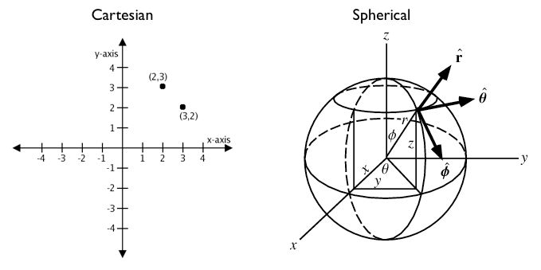
Geometry vs Geography
You can treat geographic coordinates as approximate Cartesian coordinates and continue to do spatial calculations. However, measurements of distance, length and area will be nonsensical. Since spherical coordinates measure angular distance, the units are in “degrees.” Further, the approximate results from indexes and true/false tests like intersects and contains can become terribly wrong. The distance between points get larger as problem areas like the poles or the international dateline are approached.
Notes:
http://workshops.boundlessgeo.com/postgis-intro/geography.html
When you use geometery, your result is in degrees. On a sphere, the size of one “degree square” is quite variable, becoming smaller as you move away from the equator. Think of the meridians (vertical lines) on the globe getting closer to each other as you go towards the poles. So, a distance of 121 degrees doesn’t mean anything. It is a nonsense number.

Slide 31
Aircraft Performance
  The Basics

Slide 32
Aircraft Performance
You need to understand aircraft performance to be able to generate a quote. Such as:
  How fast does it fly?
  How far can it fly?
  What is max number of people it can fly?
  What is the max weight it can fly?
  How much does it cost to fly per hour or per nautical mile?
  What type of fuel does it use?
  Minimum runway length required?

Slide 33

Max Fuel Range (nm) | Max Payload Range (nm) | Long Range Cruise Speed (nmph) | Min Runway Length (ft) | Fuel | Max Pax | Rate (hr)
3,370 | 2,182 | 425 | 2,850 | Jet A | 12 | $10,000
Notes:
http://www.controller.com/listingsdetail/aircraft-for-sale/BOMBARDIER-CHALLENGER-601-3A-ER/1991-BOMBARDIER-CHALLENGER-601-3A-ER/1271959.htm
http://e-ditionsbyfry.com/ActiveMagazine/getBook.asp?Path=WAC/2008/07/01&BookCollection=WAC&ReaderStyle=Gray&page=92
Runway length can vary based on temperature and weight. Sedona, AZ airport, while can support this aircraft, you can not take off during the heat of the day for a long flight.
Charter rate is from 2009.

Slide 34
Taxes
  Federal Excise and Passenger Segment Tax’s

Slide 35
Taxes
IRS Publication 720 :
  Transportation of persons by air (IRS No. 26). For calendar year 2018, the tax on the amount paid for each domestic segment of taxable air transportation is increased to $4.10. The tax is increased to $9.10 per person for domestic segments that begin or end in Alaska or Hawaii (applies only to departures). See Air Transportation Taxes, later.
  Use of international air travel facilities (IRS No. 27). For calendar year 2018, the section 4261 tax on the amount paid for international flights is increased to $18.30 per person for flights that begin or end in the United States.
  Rural airports. If a segment is to or from a rural airport, the domestic segment tax does not apply.
  Federal Excise Tax. The percentage tax is 7.5% of amounts paid for taxable transportation of persons by air.
  There are other taxes in this publication if you are doing cargo flights, etc.
Notes:
http://www.irs.gov/pub/irs-pdf/i720.pdf
Section: Air Transportation Taxes
Transportation of Persons by Air (IRS No. 26)
Use of International Air Travel Facilities (IRS No. 27)

Slide 36
Quering the Airports
  Creating our Postgres Queries

Slide 37
Standard Query - “Spherical Law of Cosines”
This is the “Spherical Law of Cosines” query.
Instead of using an aircraft table, you will notice some hand coding of numbers for the Challenger 601.
  Flight Speed: 400nmph
  Cost per Hour: $10,000
  Has Jet Fuel: 1 (Need to be able to refuel)
  Min Runway Length: 5,000 feet
  Max Distance: 3,000nm (Nautical Miles)
SELECT d.airportname, d.identifier,
acos(sin(o.lat*pi()/180)*sin(d.lat*pi()/180)+cos(o.lat*pi()/180)*cos(d.lat*pi()/180)*cos((o.lon*pi()/180)-(d.lon*pi()/180)))*180*60/pi() AS distance_nm,
(acos(sin(o.lat*pi()/180)*sin(d.lat*pi()/180)+cos(o.lat*pi()/180)*cos(d.lat*pi()/180)*cos((o.lon*pi()/180)-(d.lon*pi()/180)))*180*60/pi())/400 AS hours,
(acos(sin(o.lat*pi()/180)*sin(d.lat*pi()/180)+cos(o.lat*pi()/180)*cos(d.lat*pi()/180)*cos((o.lon*pi()/180)-(d.lon*pi()/180)))*180*60/pi())/400*10000 AS rate
FROM flights.airports AS o, flights.airports AS d
WHERE o.identifier = 'KSEA'
AND d.identifier <> 'KSEA'
AND d.jet = 1
AND d.runwaylength > 5000
AND (acos(sin(o.lat*pi()/180)*sin(d.lat*pi()/180)+cos(o.lat*pi()/180)*cos(d.lat*pi()/180)*cos((o.lon*pi()/180)-(d.lon*pi()/180)))*180*60/pi()) < 3000
ORDER BY 3
airportname | identifier | distance_nm | hours | rate
Las Vegas/Mc Carran Intl,NV | KLAS | 752.888418549542 | 1.88222104637386 | 18822.2104637386
Notes:
ORDER BY can use ordinal (left-to-right) position of the output columns. This way you don’t have to enter the math into the ORDER BY.

Slide 38
Standard Query - “Haversine”
This is the “Haversine” query.
Instead of using an aircraft table, you will notice some hand coding of numbers for the Challenger 601.
  Flight Speed: 400nmph
  Cost per Hour: $10,000
  Has Jet Fuel: 1 (Need to be able to refuel)
  Min Runway Length: 5,000 feet
  Max Distance: 3,000nm (Nautical Miles)
SELECT d.airportname, d.identifier,
(2*asin(sqrt((sin(((o.lat*pi()/180)-(d.lat*pi()/180))/2))^2+cos((o.lat*pi()/180))*cos((d.lat*pi()/180))*(sin(((o.lon*pi()/180)-(d.lon*pi()/180))/2))^2)))*180*60/pi() AS distance_nm,
((2*asin(sqrt((sin(((o.lat*pi()/180)-(d.lat*pi()/180))/2))^2+cos((o.lat*pi()/180))*cos((d.lat*pi()/180))*(sin(((o.lon*pi()/180)-(d.lon*pi()/180))/2))^2)))*180*60/pi())/400 AS hours,
((2*asin(sqrt((sin(((o.lat*pi()/180)-(d.lat*pi()/180))/2))^2+cos((o.lat*pi()/180))*cos((d.lat*pi()/180))*(sin(((o.lon*pi()/180)-(d.lon*pi()/180))/2))^2)))*180*60/pi())/400*10000 AS rate
FROM flights.airports AS o, flights.airports AS d
WHERE o.identifier = 'KSEA'
AND d.identifier <> 'KSEA'
AND d.jet = 1
AND d.runwaylength > 5000
AND (2*asin(sqrt((sin(((o.lat*pi()/180)-(d.lat*pi()/180))/2))^2+cos((o.lat*pi()/180))*cos((d.lat*pi()/180))*(sin(((o.lon*pi()/180)-(d.lon*pi()/180))/2))^2)))*180*60/pi() < 3000
ORDER BY 3
airportname | identifier | distance_nm | hours | rate
Las Vegas/Mc Carran Intl,NV | KLAS | 752.888418549542 | 1.88222104637386 | 18822.2104637386

Slide 39
GIS Query – ST_Distance
Here is how simple the GIS Query can be.
Instead of using an aircraft table, you will notice some hand coding of numbers for the Challenger 601.
  Meters to Kilometers: * 1000
  Kilometers to Nautical Miles: *0.53996
  Flight Speed: 400nmph
  Cost per Hour: $10,000
  Max Distance: 3,000nm (Nautical Miles)
  Nautical Miles to Meters: * 1852
  Has Jet Fuel: 1 (Need to be able to refuel)
  Min Runway Length: 5,000 feet
SELECT d.airportname, d.identifier,
ST_Distance(o.geog, d.geog)/1000 AS distance_km,
ST_Distance(o.geog, d.geog)/1000*0.53996 AS distance_nm,
ST_Distance(o.geog, d.geog)/1000*0.53996/400 AS hours,
round((ST_Distance(o.geog,d.geog)/
1000*0.53996/400*10000)::numeric,2) AS rate
FROM flights.airports AS o
LEFT JOIN flights.airports AS d
ON o.identifier != d.identifier
AND ST_Distance(o.geog, d.geog)/1000*0.53996
< 3000
AND d.jet = 1
AND d.runwaylength > 5000
WHERE o.identifier = 'KSEA' -- Starting Airport
ORDER BY 4;
airportname | identifier | distance_nm | hours | rate
Las Vegas/Mc Carran Intl,NV | KLAS | 753.05257312732 | 1.8826314328183 | 18826.31

Slide 40
GIS Query – ST_DWithin
Change the ST_Distance to use ST_DWithin.
Instead of using an aircraft table, you will notice some hand coding of numbers for the Challenger 601.
  Meters to Kilometers: * 1000
  Kilometers to Nautical Miles: *0.53996
  Flight Speed: 400nmph
  Cost per Hour: $10,000
  Max Distance: 3,000nm (Nautical Miles)
  Nautical Miles to Meters: * 1852
  Has Jet Fuel: 1 (Need to be able to refuel)
  Min Runway Length: 5,000 feet
SELECT d.airportname, d.identifier,
ST_Distance(o.geog, d.geog)/1000 AS distance_km,
ST_Distance(o.geog, d.geog)/1000*0.53996 AS distance_nm,
ST_Distance(o.geog, d.geog)/1000*0.53996/400 AS hours,
round((ST_Distance(o.geog,d.geog)/
1000*0.53996/400*10000)::numeric,2) AS rate
FROM flights.airports AS o
LEFT JOIN flights.airports AS d
ON o.identifier != d.identifier
AND ST_DWithin(o.geog, d.geog, 3000 * 1852)
AND d.jet = 1
AND d.runwaylength > 5000
WHERE o.identifier = 'KSEA' -- Starting Airport
ORDER BY 4;
airportname | identifier | distance_nm | hours | rate
Las Vegas/Mc Carran Intl,NV | KLAS | 753.05257312732 | 1.8826314328183 | 18826.31

Slide 41
GIS Query
Adding all the taxes to get total cost.
Instead of using an aircraft table, you will notice some hand coding of numbers for the Challenger 601.
  Meters to Kilometers: * 1000
  Kilometers to Nautical Miles: *0.53996
  Flight Speed: 400nmph
  Cost per Hour: $10,000
  Federal Excise Tax: 7.5%
  Domestic Excise Tax: $4.10 – Excluding Hawaii & Alaska
  Domestic Excise Tax: $9.10 – Hawaii & Alaska
  International Excise Tax: $18.30
  Max Distance: 3,000nm (Nautical Miles)
  Nautical Miles to Meters: * 1852
  Has Jet Fuel: 1 (Need to be able to refuel)
  Min Runway Length: 5,000 feet
SELECT d.airportname, d.identifier,
ST_Distance(o.geog, d.geog)/1000 AS distance_km,
ST_Distance(o.geog, d.geog)/1000*0.53996 AS distance_nm,
ST_Distance(o.geog, d.geog)/1000*0.53996/400 AS hours,
round((ST_Distance(o.geog, d.geog)/
1000*0.53996/400*10000)::numeric,2) AS rate,
CASE WHEN d."Rural" = '1' THEN 0
ELSE round(round((ST_Distance(o.geog, d.geog)/
1000*0.53996/400*10000)::numeric,2)*.075,2)
END AS fet,
12 * CASE WHEN s.stusps IN ('AK', 'HI') THEN 9.10
WHEN s.stusps IS NOT NULL THEN 4.10
ELSE 18.30 END AS dst,
(round((ST_Distance(o.geog, d.geog)/
1000*0.53996/400*10000)::numeric,2)) +
(CASE WHEN d."Rural" = '1' THEN 0 ELSE
round(round((ST_Distance(o.geog, d.geog)/
1000*0.53996/400*10000)::numeric,2)*.075,2) END) +
(12 * CASE WHEN s.stusps IN ('AK', 'HI') THEN 9.10
WHEN s.stusps IS NOT NULL THEN 4.10 ELSE 18.30 END)
AS total
FROM flights.airports AS o
LEFT JOIN flights.airports AS d
ON o.identifier != d.identifier
AND ST_DWithin(o.geog, d.geog, 3000 * 1852)
AND d.jet = 1
AND d.runwaylength > 5000
LEFT JOIN tiger_data.state_4326 s
ON ST_Contains(s.the_geom, d.geom)
WHERE o.identifier = 'KSEA' -- Starting US Airport
ORDER BY 4;
airportname | identifier | distance_km
Las Vegas/Mc Carran Intl,NV | KLAS | 1394.64510913275
distance_nm | hours | rate
753.05257312732 | 1.8826314328183 | $18,826.31
fet | dst | total
$1,411.97 | $49.20 | $20,287.48
Notes:
Please Note: The ST_Contains you wish to use the Geometry instead of the Geography that is used by the ST_DWithin and ST_Distance.

Slide 42
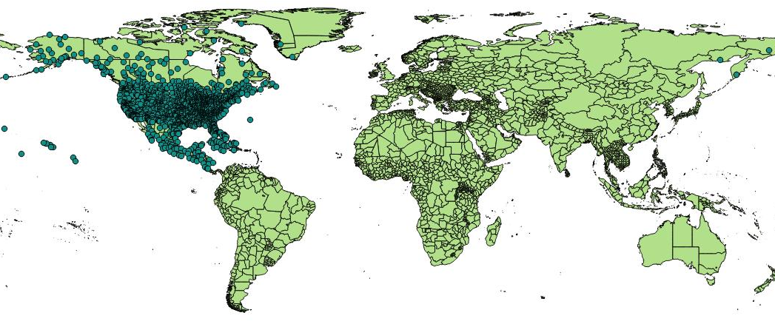
GIS Query – Visualized using QGis
This map shows the state level outlines and can be generated using either Tiger State or Word Data Admin Level 1 data sets.

Slide 43
QGis
  A Free and Open Source Geographic Information System to display your data

Slide 44
QGis
A Free and Open Source Geographic Information System
http://www.qgis.org/
Create, edit, visualise, analyse and publish geospatial information.
Load Shapefile or ZIP files containing the Shapefiles.
Hooks into Postgres and other databases.
You can view other properties about the record, such as text fields.
If you are accessing a table instead of a view, you can edit the data in QGis and QGis will update the record in Postgres.
Windows 32-bit / 64-bit
Mac OS X
Linux
  Debian/Ubuntu
  Fedora
  openSUSE
  RHEL,
  CentOS,
  Etc.
BSD
Android (Experimental version available in the Play Store)
Notes:
http://www.qgis.org/en/site/forusers/download.html

Slide 45
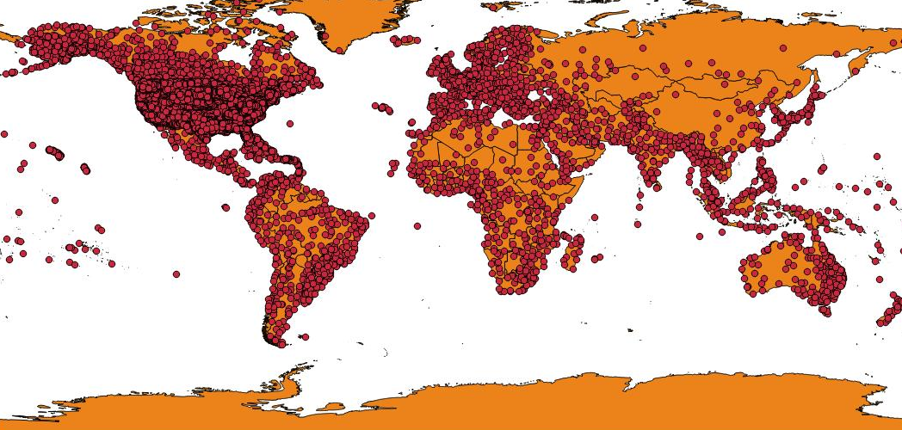
Using QGIS – The World
Airport Table
gadm28_levels_adm0 – Country geom’s

Slide 46
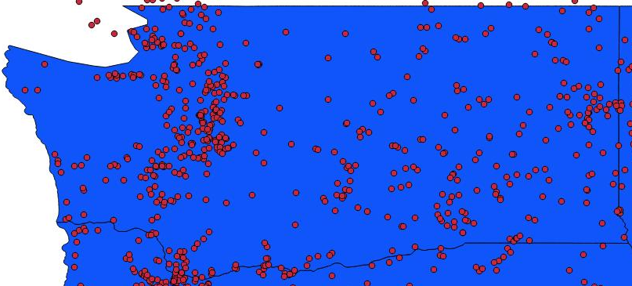
Using QGIS – Washington State
Airport Table
Tiger State Data (Shown) or gadm28_levels_adm1 (Would exclude the Puget Sound)

Slide 47
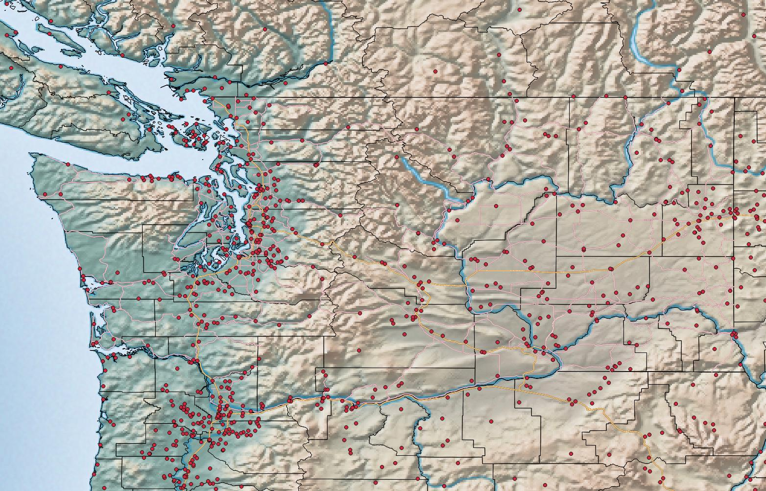
Using QGIS – Washington State
Airport Table
gadm28_levels_adm2 – County
Tiger – Primary Roads
Tiger – Secondary Roads
Cross Blended Hypso with Shaded Relief, Water, and Drainages
Notes:
Natural Earth is a public domain map dataset available at 1:10m, 1:50m, and 1:110 million scales. Featuring tightly integrated vector and raster data, with Natural Earth you can make a variety of visually pleasing, well-crafted maps with cartography or GIS software.
The map, “Cross Blended Hypso with Shaded Relief, Water, and Drainages”, is from Natural Earth.
Hypsometric Tints
http://www.naturalearthdata.com/
http://www.naturalearthdata.com/downloads/10m-raster-data/
http://www.naturalearthdata.com/downloads/10m-raster-data/10m-cross-blend-hypso/

Slide 48
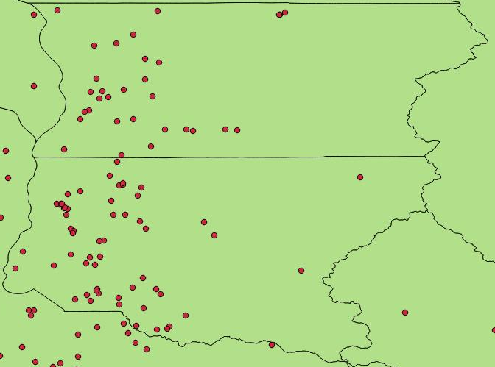
Using QGIS – King & Snohomish County
Airport Table
Tiger County or gadm28_levels_adm2

Slide 49
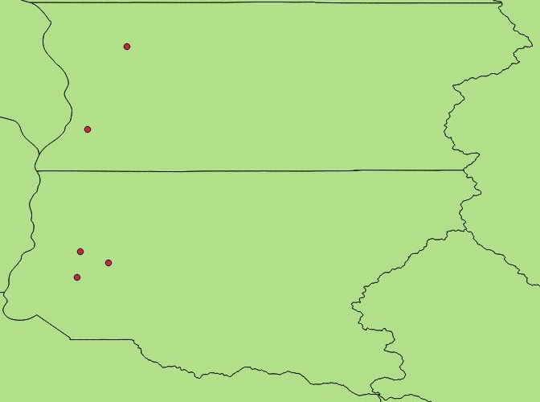
Using QGIS – King & Snohomish County
Airport Table
Tiger County or gadm28_levels_adm2
Filtered by JetA Fuel and Runways over 5,000 feet

Slide 50
Google Maps API

Slide 51
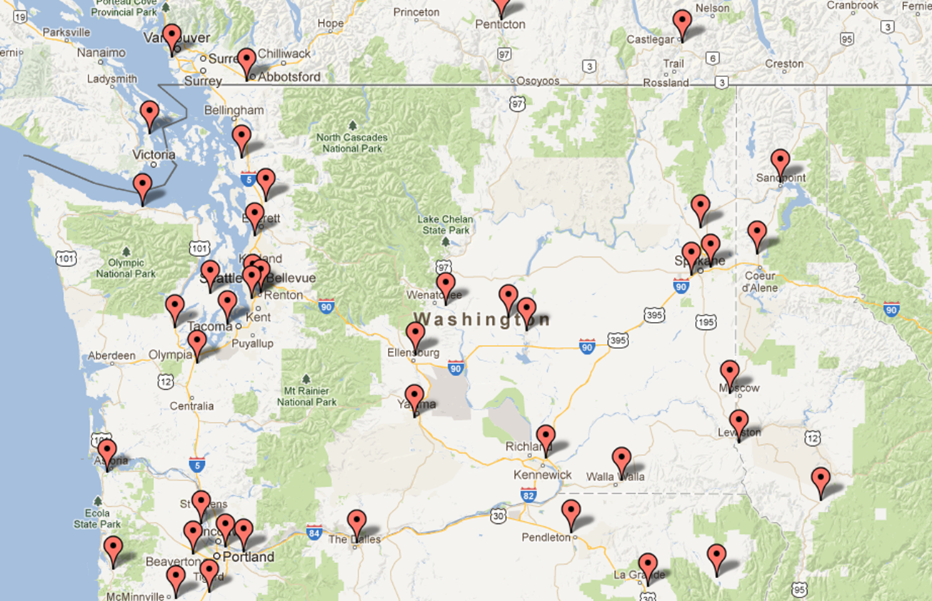
Google Maps API
Google Maps APIs are available for Android, iOS, web browsers and via HTTP web services.
Airports within Washington State, excluding Bellingham with JetA and runway length >= 5,000 feet
Notes:
https://developers.google.com/maps/

Slide 52
Microsoft Bing Maps API

Slide 53
Microsoft Bing Map API
Microsoft Bing Maps also has an API that you can use.
Example to be added, but see the notes for the links on how to get started with the Bing Maps API.
Notes:
Explore the different map APIs available
https://www.microsoft.com/en-us/maps/choose-your-bing-maps-api
Getting Started with Bing Maps
https://msdn.microsoft.com/en-us/library/ff428643.aspx
or
https://msdn.microsoft.com/en-us/library/dd877180.aspx
Geocoding with Microsoft Excel and Bing Maps API
http://grindgis.com/software/microsoft-excel/geocoding-excel-and-bing

Slide 54
Books
The selection of books shown here are not endorsed by me. They are just part of the annual Mapt service that I subscribe too, that allows me to read all books published Packt Publishing.
Notes:
https://www.packtpub.com/
https://mapt.io/
https://mapt.io/#pricing
https://mapt.io/annual-pricing-plans/
You can also get a Safari subscription that includes all these publishers:
O’Reilly, Pearson, Wiley, Packt, Harvard Business Review, and Wharton Digital Press.
https://www.safaribooksonline.com/
https://www.safaribooksonline.com/pricing/
Safair Books Online contains all the books that I showed, but also includes the following:
https://www.safaribooksonline.com/library/view/postgis-in-action/9781935182269/ - First Edition
https://www.safaribooksonline.com/library/view/postgis-in-action/9781617291395/ - Second Edition

Slide 55
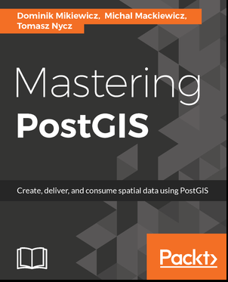
Mastering PostGIS
Write efficient GIS applications using PostGIS - from data creation to data consumption.
Table of Contents
  Importing Spatial Data
  Spatial Data Analysis
  Data Processing - Vector Ops
  Data Processing - Raster Ops
  Exporting Spatial Data
  ETL Using Node.js
  PostGIS – Creating Simple WebGIS Applications
  PostGIS Topology
  pgRouting
Notes:
https://www.packtpub.com/big-data-and-business-intelligence/mastering-postgis
Book Description
PostGIS is open source extension onf PostgreSQL object-relational database system that allows GIS objects to be stored and allows querying for information and location services. The aim of this book is to help you master the functionalities offered by PostGIS- from data creation, analysis and output, to ETL and live edits.
The book begins with an overview of the key concepts related to spatial database systems and how it applies to Spatial RMDS. You will learn to load different formats into your Postgres instance, investigate the spatial nature of your raster data, and finally export it using built-in functionalities or 3th party tools for backup or representational purposes.
Through the course of this book, you will be presented with many examples on how to interact with the database using JavaScript and Node.js. Sample web-based applications interacting with backend PostGIS will also be presented throughout the book, so you can get comfortable with the modern ways of consuming and modifying your spatial data.
Table of Contents
1: Importing Spatial Data
2: Spatial Data Analysis
3: Data Processing - Vector Ops
4: Data Processing - Raster Ops
5: Exporting Spatial Data
6: ETL Using Node.js
7: PostGIS – Creating Simple WebGIS Applications
8: PostGIS Topology
9: pgRouting
What You Will Learn
Refresh your knowledge of the PostGIS concepts and spatial databases
Solve spatial problems with the use of SQL in real-world scenarios
Practical walkthroughs of application development examples using Postgis, GeoServer and OpenLayers.
Extract, transform and load your spatial data
Expose data directly or through web services.
Consume your data in both desktop and web clients

Slide 56
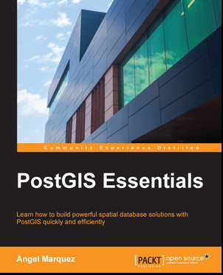
PostGIS Essentials
Learn how to build powerful spatial database solutions with PostGIS quickly and efficiently.
Table of Contents
  Introducing PostGIS and Setting it Up
  Creating Your First Spatial Database
  Inserting GIS Objects
  Selecting and Filtering GIS Queries
  Displaying GIS Data Graphically
  Management of Vectorial and Raster Data with PostGIS
  Performance Tuning
  Developing a GIS Web Application
  Developing a Desktop GIS Application
Notes:
https://www.packtpub.com/big-data-and-business-intelligence/postgis-essentials
Book Description
PostGIS is one of the world's leading spatial databases, created as a geographic extension for PostgreSQL. With it, users are able to manipulate and visualize spatial data incredibly effectively and efficiently.
PostGIS Essentials introduces you to the fundamentals of PostGIS, giving you easy access to one of the most popular and powerful spatial databases available today. You will begin by learning how to install and successfully set up PostGIS before covering how to create your first spatial database. The book will then help you to develop your skills further as you will learn how to insert GIS objects as well as how to select and filter GIS queries with clear and practical information. You will then learn how to display GIS data graphically and create effective visualizations. The book concludes with tips, tricks, and techniques to help you optimize PostGIS and improve the performance of your database.
Table of Contents
1: Introducing PostGIS and Setting it Up
2: Creating Your First Spatial Database
3: Inserting GIS Objects
4: Selecting and Filtering GIS Queries
5: Displaying GIS Data Graphically
6: Management of Vectorial and Raster Data with PostGIS
7: Performance Tuning
8: Developing a GIS Web Application
9: Developing a Desktop GIS Application
What You Will Learn
Install and configure PostGIS and other useful open source tools such as QGIS and GDAL for working with spatial data
Create spatial databases and tables from scratch and develop spatial queries through practical examples
Obtain useful spatial data from public and free sources and insert and manage this data to be useful with your data tables
Familiarize yourself with the fundamental concepts in PostGIS and spatial databases
Visualize the data stored in your tables and combine it with other data sources to create beautiful graphical solutions using QGIS
Use the GDAL spatial library to transform and reproject from a wide range of data formats such as vectorial and raster geospatial data formats
Develop a complete GIS application from scratch by implementing the concepts learned in the book

Slide 57
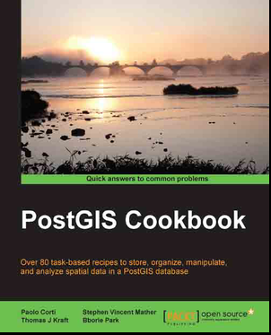
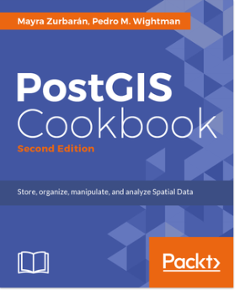
PostGIS Cookbook
For web developers and software architects this book will provide a vital guide to the tools and capabilities available to PostGIS spatial databases. Packed with hands-on recipes and powerful concepts.
Table of Contents
  Moving Data In and Out of PostGIS
  Structures that Work
  Working with Vector Data – The Basics
  Working with Vector Data – Advanced Recipes
  Working with Raster Data
  Working with pgRouting
  Into the Nth Dimension
  PostGIS Programming
  PostGIS and the Web
  Maintenance, Optimization, and Performance Tuning
  Using Desktop Clients
Second Edition to be published: April 2018
Notes:
https://www.packtpub.com/big-data-and-business-intelligence/postgis-cookbook
https://www.packtpub.com/application-development/postgis-cookbook-second-edition
Second Edition to be published: April 2018
Book Description
PostGIS is a spatial database that integrates advanced storage and analysis of vector and raster data, and is remarkably flexible and powerful. PostGIS provides support for geographic objects to the PostgreSQL object-relational database and is currently the most popular open source spatial databases. If you want to explore the complete range of PostGIS techniques and expose the related extensions, this book is a must-have.
This book is a deep-dive into the full range of PostGIS topics, with practical applications of the concepts and code. It is a comprehensive guide on PostGIS tools and concepts which are required to manage, manipulate, and analyse spatial data in PostGIS. This book is packed with systematic instructions of hands-on examples and in-depth explanations. Even for experienced users, this book will serve as a great source of reference by providing new ways of working with PostGIS through the book's easy-to-follow approach.
This hands-on guide looks at key spatial data manipulation tasks, explaining not only how each task is performed, but also why. It provides practical guidance allowing you to safely take advantage of the advanced technology in PostGIS in order to simplify your spatial database administration tasks.
This practical book will help you take advantage of basic and advanced vector, raster, and routing approaches. You will learn to use the concepts of data maintenance, optimization, and performance, which will help you to integrate these into a large ecosystem of desktop and web tools.
With this comprehensive guide, you will be armed with all the tools and instructions you need to both manage the spatial database system and make better decisions as your project's requirements evolve.
Table of Contents
1: Moving Data In and Out of PostGIS
2: Structures that Work
3: Working with Vector Data – The Basics
4: Working with Vector Data – Advanced Recipes
5: Working with Raster Data
6: Working with pgRouting
7: Into the Nth Dimension
8: PostGIS Programming
9: PostGIS and the Web
10: Maintenance, Optimization, and Performance Tuning
11: Using Desktop Clients
What You Will Learn
Import and export geographic data from the PostGIS database using the available tools
Structure spatial data using the functionality provided by the combination of PostgreSQL and PostGIS
Work with a set of PostGIS functions to perform basic and advanced vector analyses
Connect PostGIS with Python
Learn to use programming frameworks around PostGIS
Maintain, optimize, and fine-tune spatial data for long-term viability
Explore the 3D capabilities of PostGIS, including LiDAR point clouds and point clouds derived from Structure from Motion (SfM) techniques
Distribute 3D models through the Web using the X3D standard
Use PostGIS to develop powerful GIS web applications using Open Geospatial Consortium web standards
Master PostGIS Raster

Slide 58
References

Slide 59

References
There are too many references to go here. If you have the PowerPoint version of this slide, there are many more references and comments in the notes section for any slide containing the note icon ( ) in the upper right corner of the slide.
>>> This Presentation <<<
http://Lloyd.TheAlbins.com/UsingGISinPostgres
Aircraft Photo
http://www.controller.com/listingsdetail/aircraft-for-sale/BOMBARDIER-CHALLENGER-601-3A-ER/1991-BOMBARDIER-CHALLENGER-601-3A-ER/1271959.htm
Aircraft Specifications
http://e-ditionsbyfry.com/ActiveMagazine/getBook.asp?Path=WAC/2008/07/01&BookCollection=WAC&ReaderStyle=Gray&page=92
Great Circle Math and other aircraft related math
http://williams.best.vwh.net/avform.htm#Dist
http://www.gcmap.com/faq/gccalc
Airport Database
http://www.chartersuitesoftware.com/updateairports.htm
Spatial Reference: EPSG Projection 4326 - WGS 84
http://www.spatialreference.org/ref/epsg/4326/
IRS Publication 720 – Flight Taxes
http://www.irs.gov/pub/irs-pdf/i720.pdf

