Slide 1


Slide 2
Using GIS in PostgreSQL
  By Lloyd Albin

Slide 3
What we are going to cover
Installing PostGIS
  Cloud Solutions
  From Source
Aviation Math
  Airplane Performance
  Great Circle Math
PostGIS Math
  Updating your tables to make GIS faster
  Oh how easy it is to read and write GIS
Taxes
  Adding per Passenger Taxes
  Adding Airport Taxes
References
  Tiger Data
  World Data
  QGis
  Also see slide notes for even more.

Slide 4
Installing PostGIS
  The many ways to install

Slide 5
PostGIS (Installers)
Binary Installers:
  Windows
    EnterpriseDB’s StackBuilder
    Winnie - Experimental Releases
  OSX
    Postgres.app - Recommended
    KyngChaos
    Homebrew
    OSX PostgreSQL/StackBuilder – Mixed reliability – per PostGIS
  Red Hat / Centos / Scientific Linux
    PostgreSQL YUM/RPM Repositories
  Ubuntu / Debian
    APT Repository
  OpenSUSE and SUSE
    Repository
  Other Installers
    BigSQL
    EnterpriseDB
Notes:
http://postgis.net/install/

Slide 6
PostGIS (Source Code Install)
Download Source:
  http://www.postgis.net/source/
Source Code Install:
  Packages that are also needed to build the source code:
    GEOS – http://trac.osgeo.org/geos
    Proj 4 – https://trac.osgeo.org/proj/
    GDAL – http://gdal.org/
    LibXML2 – http://www.xmlsoft.org/
    JSON-C – https://github.com/json-c/json-c
tar xvzf postgis-2.3.3.tar.gz
cd postgis-2.3.3
./configure
make
make install
Notes:
http://postgis.net/source/

Slide 7
PostGIS (Cloud)
The three big cloud providers all support PostGIS, but they do not all support pgRouting.
Cloud Provider | PostGIS | pgRouting
Amazon | 9.6.2-9.6.5/2.3.2 9.6.1/2.3.0 9.5.6/2.2.5 9.4.x/2.1.8 9.3.x/2.1.8 | 9.6.5
Google | 2.3 | No
Microsoft | 9.5.7/Yes 9.6.2/Yes | Yes
Notes:
http://docs.aws.amazon.com/AmazonRDS/latest/UserGuide/CHAP_PostgreSQL.html
https://forums.aws.amazon.com/tags/pgrouting
https://cloud.google.com/sql/docs/postgres/extensions
https://docs.microsoft.com/en-us/azure/postgresql/concepts-supported-versions
https://docs.microsoft.com/en-us/azure/postgresql/concepts-extensions

Slide 8
United States Census Bureau
  Tiger Shapefiles

Slide 9
Tiger Line/Shapefiles
Shapefiles – 2007 to Present (2016)
TIGER/Line ASCII Format – 2006 and earlier.
Here are some of the Tiger Datasets:
  Geographic Areas
    American Indian Area Geography
    Blocks
    Block Groups
    Census Tracts
    Congressional Districts
    Consolidated Cities
    Core Based Statistical Areas
    Counties (and equivalent)
    County Subdivisions
    Estate
    Places
    Public Use Microdata Areas
    School Districts
    States (and equivalent)
    State Legislative Districts
    Subbarrio (SubMinor Civil Division)
    Urban Areas
    ZIP Code Tabulation Areas
  Features
    All Lines
    Coastline
    Landmarks
    Roads
    Rails
    Military Installations
    Water
  Feature Relationships
    Relationship Files
Notes:
https://www.census.gov/geo/maps-data/data/tiger-line.html
https://www.census.gov/cgi-bin/geo/shapefiles/index.php
https://www2.census.gov/geo/pdfs/education/tiger/Downloading_TIGERLine_Shp.pdf
https://www.census.gov/geo/maps-data/data/tiger.html

Slide 10
Pre-Requirements
Pre-Requirements:
  wget
  7-zip
Notes:
http://www.7-zip.org/
http://gnuwin32.sourceforge.net/packages/wget.htm - Version 1.11.4
https://eternallybored.org/misc/wget/ -- Version 1.19.1

Slide 11
Edit loader_variables
loader_variables:
  tiger_year – 2016
  website_root – http://www2.census.gov/geo/tiger/TIGER2016
  staging_folder – Local Directory for Downloads
  data_schema – tiger_data
  staging_schema – tiger_staging
You may wish to update your staging folder aka where the downloads happen.
If you want to download their entire dataset, don’t use http or you will get blacklisted from their website like I did. Change it to ftp to be able to download all the data sets.

Slide 12
Edit loader_platform
loader_platform:
  Make a copy of windows or sh record and edit to your needs.
I edited the following sections:
declare_sect
postgres version
port
password
database
wget

Slide 13
Loading Shapefiles into PostgreSQL
Convert Shape File:
  shp2pgsql
    -D – Copy format vers Insert format
    -G – Use geography type (requires lon/lat)
      Default is geometry type
    -I – Create spatial index on geocolumn
    -S 4326 – Longitude/Latitude based on WGS 84
    -S 32661 – Meter based on WGS 84
    filename
    schema.table
Loading SQL File:
  Use psql or other app to load sql file.
The bat/sh file takes care of everything for you so that you don’t have to do each part manually such as: download, convert and load into postgres the data in SRID 4269.
"C:\Program Files\PostgreSQL\9.5\bin\psql" -U postgres -h localhost -p 5433 -d postgis_23_sample -A -t -c "SELECT Loader_Generate_Nation_Script('lloyd')" > loader.bat
loader.bat
Notes:
https://postgis.net/docs/using_postgis_dbmanagement.html#shp2pgsql_usage
http://www.spatialreference.org/ref/epsg/4326/
WGS 84 = World Geodetic System dated 1984
shp2pgsql –S defaults to 0
http://www.7-zip.org/
http://gnuwin32.sourceforge.net/packages/wget.htm - Version 1.11.4
https://eternallybored.org/misc/wget/ -- Version 1.19.1

Slide 14
What county’s are in what state
Here we find out what counties are in Washington State.
There are two different functions that we can use to perform this.
  ST_CoveredBy – Geometry and Geography
  ST_Contains – Geometry Only
SELECT s.stusps, c.*
FROM tiger.state s
LEFT JOIN tiger.county c
ON ST_CoveredBy(c.the_geom,s.the_geom)
WHERE s.stusps = 'WA';
SELECT s.stusps, c.*
FROM tiger.state s
LEFT JOIN tiger.county c
ON ST_Contains(s.the_geom, c.the_geom)
WHERE s.stusps = 'WA';
Notes:
https://postgis.net/docs/ST_CoveredBy.html
https://postgis.net/docs/ST_Contains.html

Slide 15
World Data
  Downloading County/State/County/Hypsometric Tints

Slide 16
World Administrative (Boundry) Data
There are several world shape file website that contain free shape data.
http://www.gadm.org/version2
GADM has been developed by Robert Hijmans, in collaboration with colleagues at the University of California, Berkeley Museum of Vertebrate Zoology, the International Rice Research Institute and the University of California, Davis, and with contributions of many others.
qadm28_levels_adm0 – Country
qadm28_levels_adm1 – State
qadm28_levels_adm2 – County
qadm28_levels_adm3 – Canada, South America, Africa, Europe, & Asia
qadm28_levels_adm4 – Some parts of Africa and Europe
qadm28_levels_adm5 – Some parts of Europe
Notes:
http://www.gadm.org/version2
http://thematicmapping.org/downloads/world_borders.php
http://www.naturalearthdata.com/

Slide 17
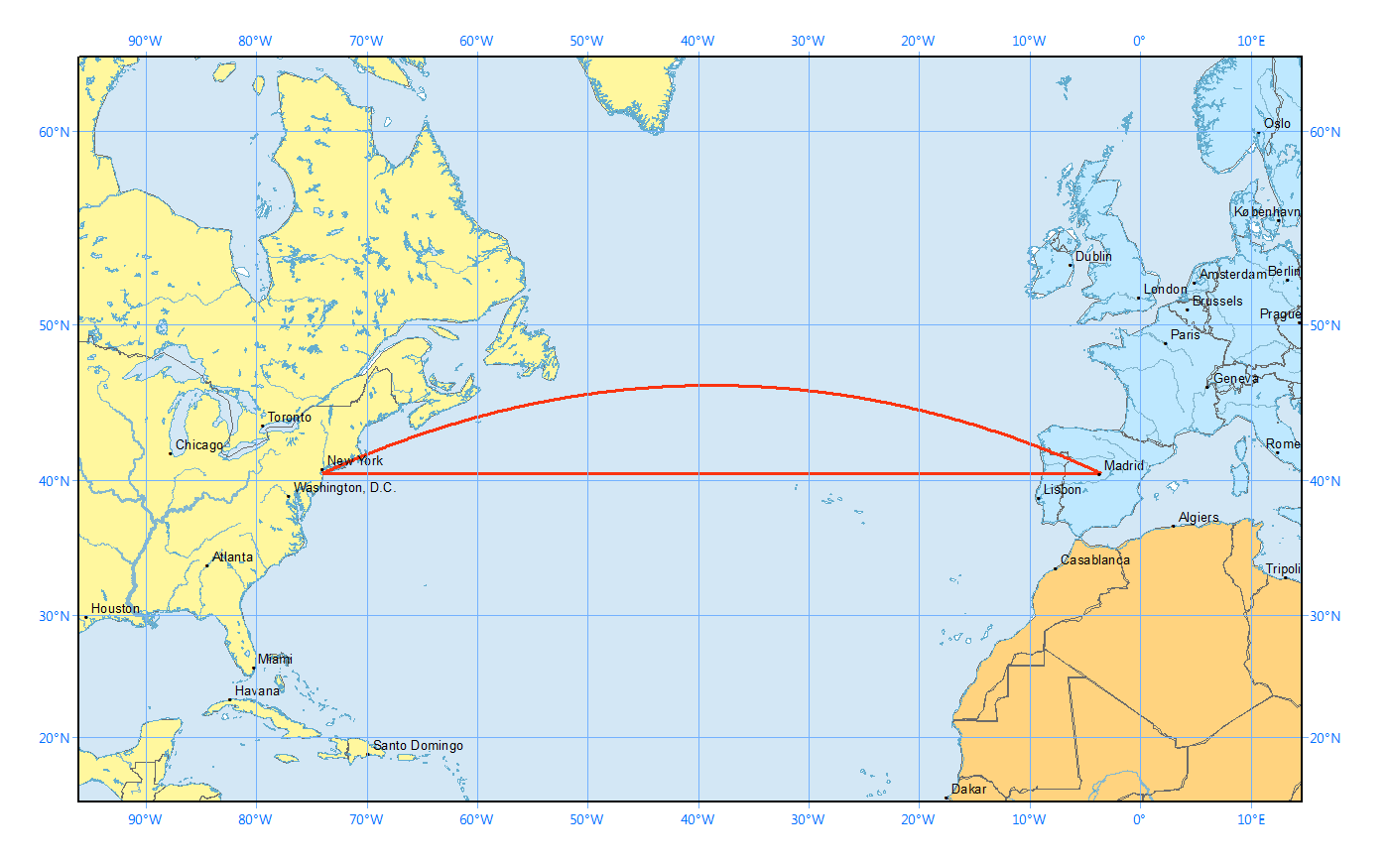
Aviation Math
  Great Circle Calculations
Notes:
http://gisgeography.com/great-circle-geodesic-line-shortest-flight-path/
However, a straight line in a 2-dimensional map is not the same as a straight line on a 3-dimensional globe.

Slide 18
The Math
The “Spherical Law of Cosines” is the great circle distance d between two points with coordinates {lat1,lon1} and {lat2,lon2} is given by:
d=acos(sin(lat1)*sin(lat2)+cos(lat1)*cos(lat2)*cos(lon1-lon2))
The “Haversine” formula is a mathematically equivalent formula, which is less subject to rounding error for short distances is:
d=2*asin(sqrt((sin((lat1-lat2)/2))^2 +
cos(lat1)*cos(lat2)*(sin((lon1-lon2)/2))^2))
The lat/lon need to be specified in Radians. Convert longitude and latitude to radians by multiplying lat/lon by pi/180
The distance (d) is in radians and will need to be converted to nautical miles by multiplying d by 180*60/pi()
Notes:
http://www.movable-type.co.uk/scripts/latlong.html

Slide 19
Visual Flight Rules (VFR)
Between 3,000 feet Above Ground Level (AGL) and 18,000 feet Mean Sea Level (MSL).
On a magnetic course of 0-179 degrees shall fly at an odd thousand ft MSL altitude +500 feet (e.g., 3,500, 5,500, or 7,500 ft); or
On a magnetic course of 180-359 degrees shall fly at an even thousand ft MSL altitude +500 feet (e.g., 4,500, 6,500, or 8,500 ft).
Part 91 Federal Aviation Regulations (FAR)

Slide 20
Instrument Flight Rules (IFR)
Between 3,000 feet Above Ground Level (AGL) and 18,000 feet Mean Sea Level (MSL).
On a magnetic course of 0-179 degrees shall fly at an odd thousand ft MSL altitude +500 feet (e.g., 3,500, 5,500, or 7,500 ft); or
On a magnetic course of 180-359 degrees shall fly at an even thousand ft MSL altitude +500 feet (e.g., 4,500, 6,500, or 8,500 ft).
Part 91 Federal Aviation Regulations (FAR)

Slide 21
PostGIS Math
  PostGIS Functions that we will be using.

Slide 22
ST_Distance
ST_Distance:
  For geometry type returns the minimum 2D Cartesian distance between two geometries in projected units (spatial ref units).
    Don’t use this one!
  For geography type defaults to return the minimum geodesic distance between two geographies in meters.
    If use_spheroid is false, a faster sphere calculation is used instead of a spheroid. Earth is a spheroid not a sphere, so we don’t want to change this setting.
ST_Distance() = Meters
m/1000 = Kilometers
km/0.53996 = Nautical Mile
float ST_Distance(geometry g1, geometry g2);
float ST_Distance(geography gg1, geography gg2);
float ST_Distance(geography gg1, geography gg2, boolean use_spheroid);
ST_Distance(o.geog, d.geog)/1000*0.53996 < 3000
Notes:
https://postgis.net/docs/ST_Distance.html

Slide 23
ST_DWithin
ST_DWithin:
  For geometry units are in those of spatial reference
    Don’t use this one!
  For geography units are in meters.
    If use_spheroid is false, a faster sphere calculation is used instead of a spheroid. Earth is a spheroid not a sphere, so we don’t want to change this setting.
3000 = Nautical Mile
nm*1852 = Meters
ST_DWithin() = Meters
boolean ST_DWithin(geometry g1, geometry g2, double precision distance_of_srid);
boolean ST_DWithin(geography gg1, geography gg2, double precision distance_meters);
boolean ST_DWithin(geography gg1, geography gg2, double precision distance_meters, boolean use_spheroid);
ST_DWithin(o.geog, d.geog, 3000 * 1852)
Notes:
https://postgis.net/docs/ST_DWithin.html

Slide 24
ST_Contains
ST_Contains:
  We use this to find out what state the airport resides within.
  You can also use this against a country or county table to find out what country or county the airport resides within.
boolean ST_Contains(geometry geomA, geometry geomB);
ST_Contains(State_geom, Airport_geom)
Notes:
https://postgis.net/docs/ST_Contains.html

Slide 25
ST_Point
ST_Point:
  We use this to create a Point using the longitude and latitude in the Airport table.
geometry ST_Point(float x_lon, float y_lat);
ST_Point(lon, lat)
Notes:
https://postgis.net/docs/ST_Point.html

Slide 26
ST_SetSRID
ST_SetSRID:
  We use this to set the SRID (Spatial Reference System Identifier) meta data to say which type of point we are using.
  4326 is the WGS 84 (World Geodetic System dated 1984) Standard.
  4269 is the NAD83 (North American Datum of 1983) Standard.
  You can use ST_Transform to convert between SRID’s.
North American Datum 1983 and WGS 84
  One fundamental difference is that NAD 83 is defined to remain essentially constant over time for points on the North American Plate, whereas WGS 84 is defined with respect to the average of stations all over the world. Thus there is a change over time as to the difference between the systems. For much of the United States the relative rate is on the order of 1 to 2 cm per year.
geometry ST_SetSRID(geometry geom, integer srid);
ST_SetSRID(Airport_geom, 4326)::geography;
ST_SetSRID(Airport_geom, 4269);
Notes:
https://postgis.net/docs/ST_SetSRID.html
http://www.spatialreference.org/ref/epsg/4326/
WGS 84 = World Geodetic System dated 1984
http://www.spatialreference.org/ref/epsg/4269/
NAD83 = North American Datum of 1983
https://en.wikipedia.org/wiki/North_American_Datum#North_American_Datum_of_1983

Slide 27
Airports Table
Inside ST_Contains you want to use Geometry instead of the Geography that is used by the ST_DWithin and ST_Distance. This is why you may want both a geog and a geom field in your airports database.
Casting between geography and geometry will slow down your query.
Double check your data, it took me hours to figure out that the longitude was inverted. This is not a problem when calculating distances, but is a problem if you want to see what state/county/county the airport is within.
ALTER TABLE flights.airports
ADD COLUMN geog public.geography;
UPDATE flights.airports
SET geog =
ST_SetSRID(ST_Point(0-lon, lat),4326)
::geography;
ALTER TABLE flights.airports
ADD COLUMN geom public.geometry;
UPDATE flights.airports
SET geom =
ST_SetSRID(ST_Point(0-lon, lat),4269);

Slide 28
Aircraft Performance
  The Basics

Slide 29
Aircraft Performance
You need to understand aircraft performance to be able to generate a quote. Such as:
  How fast does it fly?
  How far can it fly?
  What is max number of people it can fly?
  What is the max weight it can fly?
  How much does it cost to fly per hour or per nautical mile?
  What type of fuel does it use?
  Minimum runway length required?

Slide 30

Challenger 601-3A - Performance
Max Fuel Range (nm) | Max Payload Range (nm) | Long Range Cruise Speed (nmph) | Min Runway Length (ft) | Fuel | Max Pax | Rate (hr)
3,370 | 2,182 | 425 | 2,850 | Jet A | 12 | $10,000
Notes:
http://www.controller.com/listingsdetail/aircraft-for-sale/BOMBARDIER-CHALLENGER-601-3A-ER/1991-BOMBARDIER-CHALLENGER-601-3A-ER/1271959.htm
http://e-ditionsbyfry.com/ActiveMagazine/getBook.asp?Path=WAC/2008/07/01&BookCollection=WAC&ReaderStyle=Gray&page=92
Runway length can vary based on temperature and weight. Sedona, AZ airport, while can support this aircraft, you can not take off during the heat of the day for a long flight.
Charter rate is from 2009.

Slide 31
Taxes
  Federal Excise and Passenger Segment Tax’s

Slide 32
Taxes
IRS Publication 720 :
  Transportation of persons by air (IRS No. 26). For calendar year 2017, the tax on the amount paid for each domestic segment of taxable air transportation is increased to $4.10. The tax is increased to $9 per person for domestic segments that begin or end in Alaska or Hawaii (applies only to departures). See Air Transportation Taxes, later.
  Use of international air travel facilities (IRS No. 27). For calendar year 2017, the section 4261 tax on the amount paid for international flights is increased to $18 per person for flights that begin or end in the United States.
  Rural airports. If a segment is to or from a rural airport, the domestic segment tax does not apply.
  Federal Excise Tax. The percentage tax is 7.5% of amounts paid for taxable transportation of persons by air.
  There are other taxes in this publication if you are doing cargo flights, etc.
Notes:
http://www.irs.gov/pub/irs-pdf/i720.pdf

Slide 33
Quering the Airports
  Creating our Postgres Queries

Slide 34
Standard Query - “Spherical Law of Cosines”
This is the “Spherical Law of Cosines” query.
Instead of using an aircraft table, you will notice some hand coding of numbers for the Challenger 601.
  Flight Speed: 400nmph
  Cost per Hour: $10,000
  Has Jet Fuel: 1 (Need to be able to refuel)
  Min Runway Length: 5,000 feet
  Max Distance: 3,000nm (Nautical Miles)
SELECT d.airportname, d.identifier,
acos(sin(o.lat*pi()/180)*sin(d.lat*pi()/180)+cos(o.lat*pi()/180)*cos(d.lat*pi()/180)*cos((o.lon*pi()/180)-(d.lon*pi()/180)))*180*60/pi() AS distance_nm,
(acos(sin(o.lat*pi()/180)*sin(d.lat*pi()/180)+cos(o.lat*pi()/180)*cos(d.lat*pi()/180)*cos((o.lon*pi()/180)-(d.lon*pi()/180)))*180*60/pi())/400 AS hours,
(acos(sin(o.lat*pi()/180)*sin(d.lat*pi()/180)+cos(o.lat*pi()/180)*cos(d.lat*pi()/180)*cos((o.lon*pi()/180)-(d.lon*pi()/180)))*180*60/pi())/400*10000 AS rate
FROM flights.airports AS o, flights.airports AS d
WHERE o.identifier = 'KSEA'
AND d.identifier <> 'KSEA'
AND d.jet = 1
AND d.runwaylength > 5000
AND (acos(sin(o.lat*pi()/180)*sin(d.lat*pi()/180)+cos(o.lat*pi()/180)*cos(d.lat*pi()/180)*cos((o.lon*pi()/180)-(d.lon*pi()/180)))*180*60/pi()) < 3000
ORDER BY 3
airportname | identifier | distance_nm | hours | rate
Las Vegas/Mc Carran Intl,NV | KLAS | 752.888418549542 | 1.88222104637386 | 18822.2104637386
Notes:
ORDER BY can use ordinal (left-to-right) position of the output columns. This way you don’t have to enter the math into the ORDER BY.

Slide 35
Standard Query - “Haversine”
This is the “Haversine” query.
Instead of using an aircraft table, you will notice some hand coding of numbers for the Challenger 601.
  Flight Speed: 400nmph
  Cost per Hour: $10,000
  Has Jet Fuel: 1 (Need to be able to refuel)
  Min Runway Length: 5,000 feet
  Max Distance: 3,000nm (Nautical Miles)
SELECT d.airportname, d.identifier,
(2*asin(sqrt((sin(((o.lat*pi()/180)-(d.lat*pi()/180))/2))^2+cos((o.lat*pi()/180))*cos((d.lat*pi()/180))*(sin(((o.lon*pi()/180)-(d.lon*pi()/180))/2))^2)))*180*60/pi() AS distance_nm,
((2*asin(sqrt((sin(((o.lat*pi()/180)-(d.lat*pi()/180))/2))^2+cos((o.lat*pi()/180))*cos((d.lat*pi()/180))*(sin(((o.lon*pi()/180)-(d.lon*pi()/180))/2))^2)))*180*60/pi())/400 AS hours,
((2*asin(sqrt((sin(((o.lat*pi()/180)-(d.lat*pi()/180))/2))^2+cos((o.lat*pi()/180))*cos((d.lat*pi()/180))*(sin(((o.lon*pi()/180)-(d.lon*pi()/180))/2))^2)))*180*60/pi())/400*10000 AS rate
FROM flights.airports AS o, flights.airports AS d
WHERE o.identifier = 'KSEA'
AND d.identifier <> 'KSEA'
AND d.jet = 1
AND d.runwaylength > 5000
AND (2*asin(sqrt((sin(((o.lat*pi()/180)-(d.lat*pi()/180))/2))^2+cos((o.lat*pi()/180))*cos((d.lat*pi()/180))*(sin(((o.lon*pi()/180)-(d.lon*pi()/180))/2))^2)))*180*60/pi() < 3000
ORDER BY 3
airportname | identifier | distance_nm | hours | rate
Las Vegas/Mc Carran Intl,NV | KLAS | 752.888418549542 | 1.88222104637386 | 18822.2104637386

Slide 36
GIS Query – ST_Distance
Here is how simple the GIS Query can be.
Instead of using an aircraft table, you will notice some hand coding of numbers for the Challenger 601.
  Meters to Kilometers: * 1000
  Kilometers to Nautical Miles: *0.53996
  Flight Speed: 400nmph
  Cost per Hour: $10,000
  Max Distance: 3,000nm (Nautical Miles)
  Nautical Miles to Meters: * 1852
  Has Jet Fuel: 1 (Need to be able to refuel)
  Min Runway Length: 5,000 feet
SELECT d.airportname, d.identifier,
ST_Distance(o.geog, d.geog)/1000 AS distance_km,
ST_Distance(o.geog, d.geog)/1000*0.53996 AS distance_nm,
ST_Distance(o.geog, d.geog)/1000*0.53996/400 AS hours,
round((ST_Distance(o.geog,d.geog)/
1000*0.53996/400*10000)::numeric,2) AS rate
FROM flights.airports AS o
LEFT JOIN flights.airports AS d
ON o.identifier != d.identifier
AND ST_Distance(o.geog, d.geog)/1000*0.53996
< 3000
AND d.jet = 1
AND d.runwaylength > 5000
WHERE o.identifier = 'KSEA' -- Starting Airport
ORDER BY 4;
airportname | identifier | distance_nm | hours | rate
Las Vegas/Mc Carran Intl,NV | KLAS | 753.05257312732 | 1.8826314328183 | 18826.31

Slide 37
GIS Query – ST_DWithin
Change the ST_Distance to use ST_DWithin.
Instead of using an aircraft table, you will notice some hand coding of numbers for the Challenger 601.
  Meters to Kilometers: * 1000
  Kilometers to Nautical Miles: *0.53996
  Flight Speed: 400nmph
  Cost per Hour: $10,000
  Max Distance: 3,000nm (Nautical Miles)
  Nautical Miles to Meters: * 1852
  Has Jet Fuel: 1 (Need to be able to refuel)
  Min Runway Length: 5,000 feet
SELECT d.airportname, d.identifier,
ST_Distance(o.geog, d.geog)/1000 AS distance_km,
ST_Distance(o.geog, d.geog)/1000*0.53996 AS distance_nm,
ST_Distance(o.geog, d.geog)/1000*0.53996/400 AS hours,
round((ST_Distance(o.geog,d.geog)/
1000*0.53996/400*10000)::numeric,2) AS rate
FROM flights.airports AS o
LEFT JOIN flights.airports AS d
ON o.identifier != d.identifier
AND ST_DWithin(o.geog, d.geog, 3000 * 1852)
AND d.jet = 1
AND d.runwaylength > 5000
WHERE o.identifier = 'KSEA' -- Starting Airport
ORDER BY 4;
airportname | identifier | distance_nm | hours | rate
Las Vegas/Mc Carran Intl,NV | KLAS | 753.05257312732 | 1.8826314328183 | 18826.31

Slide 38
GIS Query
Adding all the taxes to get total cost.
Instead of using an aircraft table, you will notice some hand coding of numbers for the Challenger 601.
  Meters to Kilometers: * 1000
  Kilometers to Nautical Miles: *0.53996
  Flight Speed: 400nmph
  Cost per Hour: $10,000
  Federal Excise Tax: 7.5%
  Domestic Excise Tax: $4.10 – Excluding Hawaii & Alaska
  Domestic Excise Tax: $9.00 – Hawaii & Alaska
  International Excise Tax: $18.00
  Max Distance: 3,000nm (Nautical Miles)
  Nautical Miles to Meters: * 1852
  Has Jet Fuel: 1 (Need to be able to refuel)
  Min Runway Length: 5,000 feet
SELECT d.airportname, d.identifier,
ST_Distance(o.geog, d.geog)/1000 AS distance_km,
ST_Distance(o.geog, d.geog)/1000*0.53996 AS distance_nm,
ST_Distance(o.geog, d.geog)/1000*0.53996/400 AS hours,
round((ST_Distance(o.geog, d.geog)/
1000*0.53996/400*10000)::numeric,2) AS rate,
CASE WHEN d."Rural" = '1' THEN 0
ELSE round(round((ST_Distance(o.geog, d.geog)/
1000*0.53996/400*10000)::numeric,2)*.075,2)
END AS fet,
12 * CASE WHEN s.stusps IN ('AK', 'HI') THEN 9.00
WHEN s.stusps IS NOT NULL THEN 4.10
ELSE 18.00 END AS dst,
(round((ST_Distance(o.geog, d.geog)/
1000*0.53996/400*10000)::numeric,2)) +
(CASE WHEN d."Rural" = '1' THEN 0 ELSE
round(round((ST_Distance(o.geog, d.geog)/
1000*0.53996/400*10000)::numeric,2)*.075,2) END) +
(12 * CASE WHEN s.stusps IN ('AK', 'HI') THEN 9.00
WHEN s.stusps IS NOT NULL THEN 4.10 ELSE 18.00 END)
AS total
FROM flights.airports AS o
LEFT JOIN flights.airports AS d
ON o.identifier != d.identifier
AND ST_DWithin(o.geog, d.geog, 3000 * 1852)
AND d.jet = 1
AND d.runwaylength > 5000
LEFT JOIN tiger_data.state_4326 s
ON ST_Contains(s.the_geom, d.geom)
WHERE o.identifier = 'KSEA' -- Starting US Airport
ORDER BY 4;
airportname | identifier | distance_km
Las Vegas/Mc Carran Intl,NV | KLAS | 1394.64510913275
airportname | identifier | distance_km | distance_nm | hours | rate | fet | dst | total
Las Vegas/Mc Carran Intl,NV | KLAS | 1394.64510913275 | 753.05257312732 | 1.8826314328183 | $18,826.31 | $1,411.97 | $49.20 | $20,287.48
distance_nm | hours | rate
753.05257312732 | 1.8826314328183 | $18,826.31
fet | dst | total
$1,411.97 | $49.20 | $20,287.48
Notes:
Please Note: The ST_Contains you wish to use the Geometry instead of the Geography that is used by the ST_DWithin and ST_Distance.

Slide 39
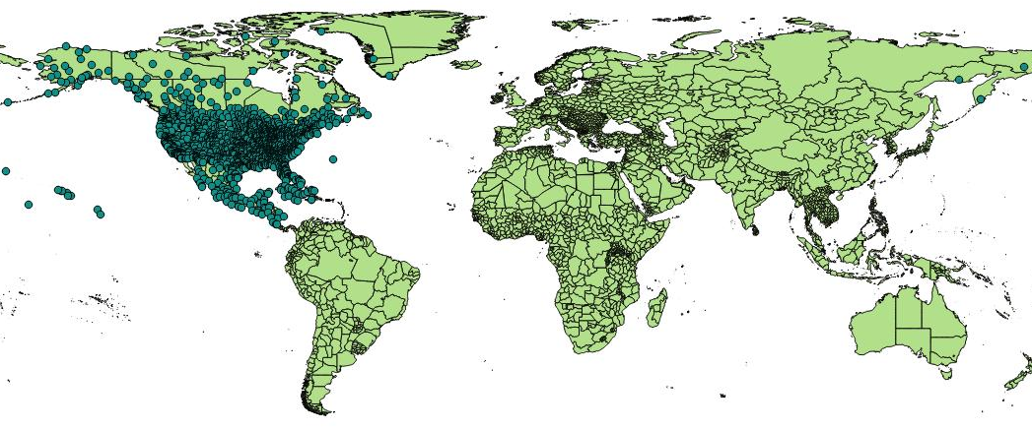
GIS Query – Visualized using QGis
This map shows the state level outlines and can be generated using either Tiger State or Word Data Admin Level 1 data sets.

Slide 40
QGis
  A Free and Open Source Geographic Information System
  to display your data

Slide 41
QGis
A Free and Open Source Geographic Information System
http://www.qgis.org/
Create, edit, visualise, analyse and publish geospatial information.
Load Shapefile or ZIP files containing the Shapefiles.
Hooks into Postgres and other databases.
You can view other properties about the record, such as text fields.
If you are accessing a table instead of a view, you can edit the data in QGis and QGis will update the record in Postgres.
Windows 32-bit / 64-bit
Mac OS X
Linux
  Debian/Ubuntu
  Fedora
  openSUSE
  RHEL,
  CentOS,
  Etc.
BSD
Android (Experimental version available in the Play Store)
Notes:
http://www.qgis.org/en/site/forusers/download.html

Slide 42
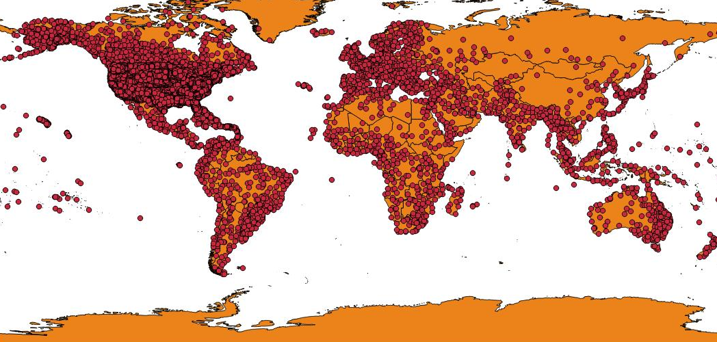
Using QGIS – The World
Airport Table
gadm28_levels_adm0 – Country geom’s

Slide 43
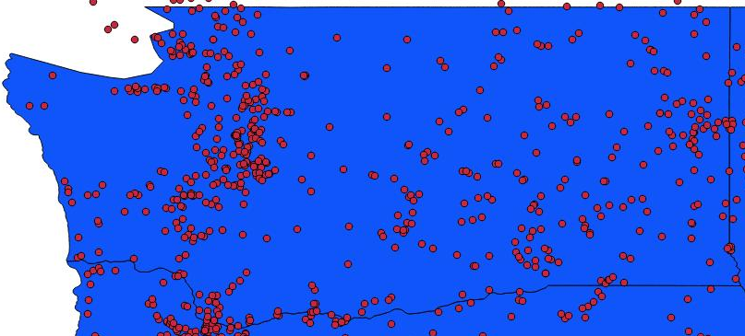
Using QGIS – Washington State
Airport Table
Tiger State Data (Shown) or gadm28_levels_adm1 (Would exclude the Puget Sound)

Slide 44
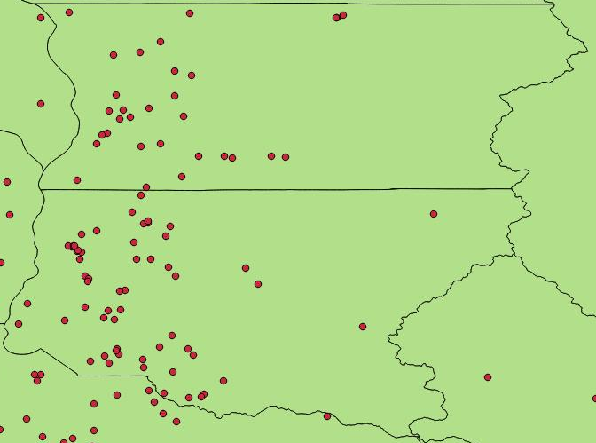
Using QGIS – King & Snohomish County
Airport Table
Tiger County or gadm28_levels_adm2

Slide 45
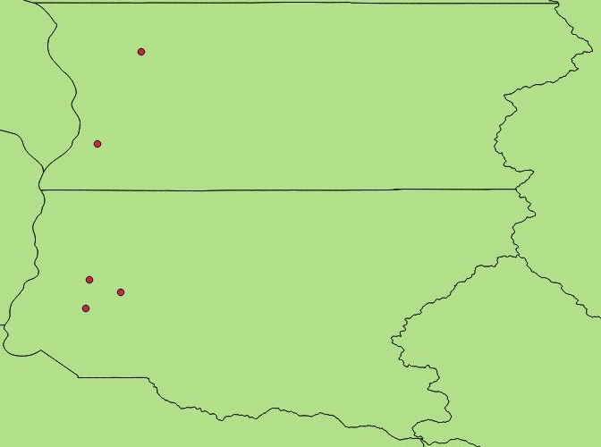
Using QGIS – King & Snohomish County
Airport Table
Tiger County or gadm28_levels_adm2
Filtered by JetA Fuel and Runways over 5,000 feet

Slide 46
Google Map API

Slide 47
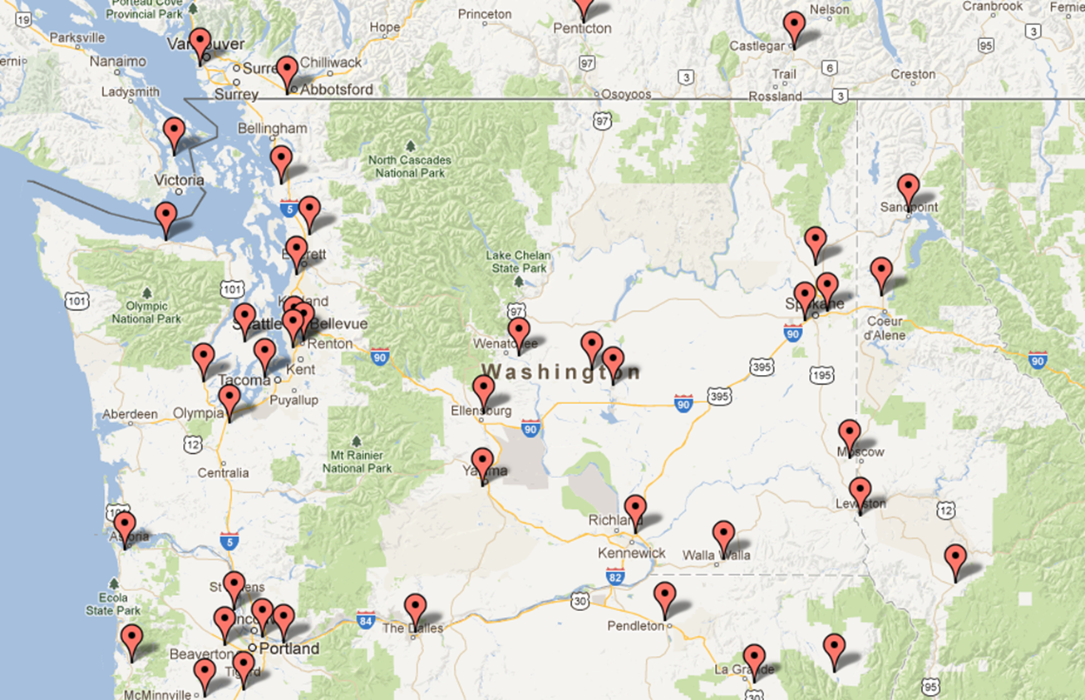
Google Map API
Google Maps APIs are available for Android, iOS, web browsers and via HTTP web services.
Airports within Washington State, excluding Bellingham with JetA and runway length >= 5,000 feet
Notes:
https://developers.google.com/maps/

Slide 48
Microsoft Bing Maps API

Slide 49
Microsoft Bing Map API
Microsoft Bing Maps also has an API that you can use.
Microsoft has another product that you can purchase get that gives you their mapping capabilities in your standalone applications.
No sample at this time. I am hopping to get time to add this for the PgConf Local: Austin Presentation.
Notes:
https://msdn.microsoft.com/en-us/library/dd877180.aspx

Slide 50
References

Slide 51
References
There are too many references to go here. If you have the PowerPoint version of this slide, there are many more references in the notes section for each slide.
>>> This Presentation <<<
http://Lloyd.TheAlbins.com/UsingGISinPostgres
Aircraft Photo
http://www.controller.com/listingsdetail/aircraft-for-sale/BOMBARDIER-CHALLENGER-601-3A-ER/1991-BOMBARDIER-CHALLENGER-601-3A-ER/1271959.htm
Aircraft Specifications
http://e-ditionsbyfry.com/ActiveMagazine/getBook.asp?Path=WAC/2008/07/01&BookCollection=WAC&ReaderStyle=Gray&page=92
Great Circle Math and other aircraft related math
http://williams.best.vwh.net/avform.htm#Dist
http://www.gcmap.com/faq/gccalc
Airport Database
http://www.chartersuitesoftware.com/updateairports.htm
Spatial Reference: EPSG Projection 4326 - WGS 84
http://www.spatialreference.org/ref/epsg/4326/
IRS Publication 720 – Flight Taxes
http://www.irs.gov/pub/irs-pdf/i720.pdf

