Slide 1


Slide 2
Writing PostgreSQL Functions
and how to debug them
  By Lloyd Albin

Slide 3
What we are going to cover
Function Basics
  Procedural Languages
  Function Behavior
  NULL INPUT
  Security
  Syntax
  Inline (Function) Syntax
Basic Example Functions
  Functional Indexes
  Real World Example of Functional Indexes
  Case Insensitive Indexes
Advanced Example Functions
  Working with View Definitions
Inline Example Functions
  Counting all the rows for all tables
Debugging Functions
  Debugging your Function

Slide 4
The Basics
  Procedural Languages

Slide 5
Procedural Languages (pl)
Pre-Installed Languages:
  SQL * ** ***
  C
  internal
Installable Languages that come with Postgres:
  plpgsql * ** ***
  plperl *
  plperlu
  pltcl *
  plpython
Other Downloadable Languages:
  pljava
  plphp
  plpy
  plr
  plruby
  plscheme
  plsh
  plv8 *
  plcoffee * (Coffee Script)
  plls * (LiveScript)
Cloud Support
  * Supported by Amazon
  ** Supported by Google
  *** Supported by Microsoft
Notes:
LiveScript is a language which compiles to JavaScript. It has a straightforward mapping to JavaScript and allows you to write expressive code devoid of repetitive boilerplate. While LiveScript adds many features to assist in functional style programming, it also has many improvements for object oriented and imperative programming.
LiveScript is a fork of Coco and an indirect descendant of CoffeeScript, with which it has much compatibility. http://livescript.net/
CoffeeScript is a little language that compiles into JavaScript. Underneath that awkward Java-esque patina, JavaScript has always had a gorgeous heart. CoffeeScript is an attempt to expose the good parts of JavaScript in a simple way.
The golden rule of CoffeeScript is: “It’s just JavaScript”. The code compiles one-to-one into the equivalent JS, and there is no interpretation at runtime. You can use any existing JavaScript library seamlessly from CoffeeScript (and vice-versa). The compiled output is readable, pretty-printed, and tends to run as fast or faster than the equivalent handwritten JavaScript.
http://coffeescript.org/

Slide 6
What Languages can be Installed
With this query you are able to find out the languages that can be installed in your database.
This is a good query to know if you are not the dba and need to find out what the server supports.
Some of these may only be installable by the dba or superuser. See the next slide for one what may be installed by the database owner.
SELECT name, comment
FROM pg_available_extensions
WHERE comment LIKE '%language%';
Name | Comment
plperl | PL/Perl procedural language
plpgsql | PL/pgSQL procedural language

Slide 7
What Languages can be Installed by the Database Owner
This query will list the languages that may be installed by the database owner.
SELECT tmplname
FROM pg_pltemplate
WHERE tmpldbacreate IS TRUE;
tmplname
plperl
plpgsql

Slide 8
How to Install a Language
Since Postgres 9.1 most, if not all, languages have been made into “extensions’ and can use the “CREATE EXTENSION’ command.
CREATE EXTENSION plperl;
CREATE EXTENSION plpgsql;

Slide 9
How to UnInstall a Language
Since Postgres 9.1 most, if not all, languages have been made into “extensions’ and can use the “DROP EXTENSION’ command.
DROP EXTENSION plperl;
DROP EXTENSION plpgsql;

Slide 10
Function Volatility
  The Basics

Slide 11
Immutable
IMMUTABLE indicates that the function cannot modify the database and always returns the same result when given the same argument values; that is, it does not do database lookups or otherwise use information not directly present in its argument list.
If this option is given, any call of the function with all-constant arguments can be immediately replaced with the function value.
What this means is these types of functions can be used as a type converter or indexer.

Slide 12
Stable
STABLE indicates that the function cannot modify the database, and that within a single table scan it will consistently return the same result for the same argument values, but that its result could change across SQL statements.
This is the appropriate selection for functions whose results depend on database lookups, parameter variables (such as the current time zone), etc.
It is inappropriate for AFTER triggers that wish to query rows modified by the current command.
Also note that the current_timestamp family of functions qualify as stable, since their values do not change within a transaction.

Slide 13
Volatile
VOLATILE indicates that the function value can change even within a single table scan, so no optimizations can be made.
Relatively few database functions are volatile in this sense; some examples are random(), currval(), timeofday().
But note that any function that has side-effects must be classified volatile, even if its result is quite predictable, to prevent calls from being optimized away; some example are random(), currval(), timeofday()

Slide 14
NULL Input
  The Basics

Slide 15
What to do with NULL?
CALLED ON NULL INPUT – This is the default if you don’t say anything. You will need to handle the NULL’s within your code.
RETURNS NULL ON NULL INPUT or STRICT – This will cause the function to return NULL when any of the input values are NULL. The body of the function is never executed.

Slide 16
Security
  The Basics

Slide 17
Security
SECURITY INVOKER – This is the default. The function is to be executed with the privileges of the user that calls it.
SECURITY DEFINER – This specifies that the function is to be executed with the privileges of the user that created it. This could be used to have a function update a table that the calling user does not have permissions to access, etc.

Slide 18
Syntax
  The Basics

Slide 19
Create Function Syntax
This is the basic Syntax for a Function.
CREATE OR REPLACE FUNCTION (
argname text
)
RETURNS numeric AS
$body$
…
$body$
LANGUAGE 'sql'
IMMUTABLE | STABLE | VOLATILE
RETURNS NULL ON NULL INPUT
SECURITY DEFINER
;

Slide 20
Additional Return Types
void – This is for when the trigger should not return anything. It is just doing some background process for you.
trigger – This must be set for all trigger functions.
boolean, text, etc – This is for a single values being passed back.
SET OF schema.table – This is for returning multiple rows of data. This can either point to an existing table or a composite type to get the table/field layout.

Slide 21
Inline Syntax
  Bulk Delete part of the Table

Slide 22
Inline Function Syntax
Inline functions are the same as normal functions that have no input parameters and returns void.
But if you want to send input or output you can get around the issues by read/writing tables, even if they are temp tables.
DO $body$
…
$body$;
DO $body$
DECLARE
…
BEGIN
…
END
$body$
LANGUAGE 'plpgsql'
;
Notes:
https://www.postgresql.org/docs/9.4/static/sql-do.html

Slide 23
Functional Indexes
  Basic Example

Slide 24
The Problem
We receive faxes that are multi-page TIFF’s. The TIFF file name are called the raster id. We have data where we have the full path of the file name, the raster id and the raster id with page number.
Examples:
  0000/000000
  0000/0000001111
  /studydata/studyname/0000/000000

Slide 25
Finding the Raster ID
The first thing to do, is to be able to find the Raster ID, no matter which format is supplied.
IMMUTABLE is required to be able to use this function as part of an index.
This function was written to fit on this page. Some of the other items to put inside the real function would be:
  We should check the return to make sure a ‘/’ is in the correct spot and through an error if it is not. “R” is also valid.
  If the raster is less then 23 characters to return an error, except for when it is 11 or 15 in length.
CREATE FUNCTION find_raster (raster varchar)
RETURNS VARCHAR(11) AS
$$
BEGIN
CASE length(raster)
WHEN 11 THEN
-- Format: 1234/567890
-- Returns: 1234/567890
RETURN raster;
WHEN 15 THEN
-- Format: 1234/5678901234
-- Returns: 1234/567890
RETURN substr(raster, 1, 11);
ELSE
-- Format: /study_data/study_name/1234/567890
-- Returns: 1234/567890
RETURN substr(raster, length(raster)-10, 11);
END CASE;
END;
$$
LANGUAGE plpgsql
IMMUTABLE
RETURNS NULL ON NULL INPUT;

Slide 26
Examples of the find_raster Function
-- Test returning of Raster ID when Submitting Raster ID
SELECT find_raster('1234/567890');
-- Returns: 1234/567890
-- Test returning of Raster ID when Submitting Raster ID with 4 Digit Page Number
SELECT find_raster('1234/5678901234');
-- Returns: 1234/567890
-- Test returning of Raster ID when Submitting Filename that includes Raster ID
SELECT find_raster('/study_data/study_name/1234/567890');
-- Returns: 1234/567890

Slide 27
Create Tables for Testing
In the real tables there would much more data, this is just the minimum amount for showing off this feature.
-- Format: 0000/000000
CREATE TABLE raster (
raster VARCHAR(11)
);
-- Format: 0000/0000000000
CREATE TABLE raster_page (
raster VARCHAR(15)
);
-- Format: /study_data/study_name/0000/0000000000
CREATE TABLE raster_file (
raster VARCHAR
);

Slide 28
Creating Test Data
We have real data, but to actually be able to demo this live and not show real data, we can use the microseconds for each command to create data for us. Creating two tables with 100,000 records and one table with 500,000 takes about a minute.
-- Now lets create a function to create a lot of data.
CREATE OR REPLACE FUNCTION create_data ()
RETURNS INTEGER AS
$$
DECLARE
count integer;
r raster%rowtype;
BEGIN
count := 0;
LOOP
INSERT INTO raster
VALUES (to_char(clock_timestamp(), '0MS/US'));
count := count + 1;
EXIT WHEN count >= 100000;
END LOOP;
INSERT INTO raster_file
SELECT '/study_data/study_name/' || raster.raster
FROM raster;
count := 5;
LOOP
INSERT INTO raster_page
SELECT raster.raster ||
substr(to_char(count, '0009'),2,4) FROM raster;
count := count - 1;
EXIT WHEN count = 0;
END LOOP;
RETURN 1;
END;
$$
LANGUAGE plpgsql;
SELECT create_data();

Slide 29
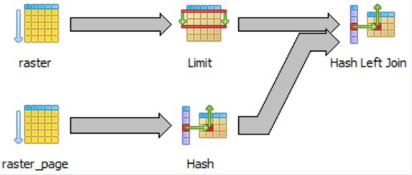
What a Normal Join Looks Like: raster_page
Hash Left Join (cost=12430.05..23339.48 rows=140556 width=88) (actual time=4334.613..4980.760 rows=540 loops=1)
Hash Cond: ((public.raster.raster)::text = substr((raster_page.raster)::text, 1, 11))
-> Limit (cost=931.03..932.90 rows=100 width=40) (actual time=117.630..118.284 rows=100 loops=1)
-> Seq Scan on raster (cost=0.00..1060.56 rows=56956 width=40) (actual time=0.025..65.829 rows=50100 loops=1)
-> Hash (cost=5514.12..5514.12 rows=281112 width=48) (actual time=4215.010..4215.010 rows=500000 loops=1)
-> Seq Scan on raster_page (cost=0.00..5514.12 rows=281112 width=48) (actual time=0.028..1001.646 rows=500000 loops=1)
Total runtime: 4982.527 ms
Total runtime: 4.982527 s
SELECT raster.*, raster_page.*
FROM (
SELECT * FROM raster OFFSET 50000 LIMIT 100
) raster
LEFT JOIN raster_page
ON raster.raster = substr(raster_page.raster, 1, 11);

Slide 30
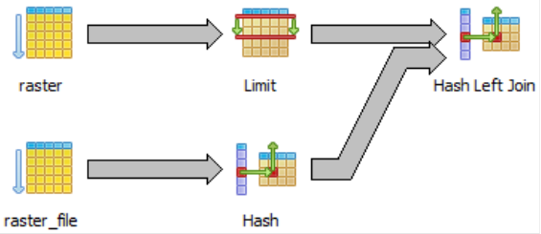
What a Normal Join Looks Like: raster_file
Hash Left Join (cost=4516.50..10754.24 rows=50000 width=75) (actual time=1309.087..1445.892 rows=109 loops=1)
Hash Cond: ((public.raster.raster)::text = substr((raster_file.raster)::text, (length((raster_file.raster)::text) - 10), 11))
-> Limit (cost=745.50..746.99 rows=100 width=12) (actual time=128.356..129.015 rows=100 loops=1)
-> Seq Scan on raster (cost=0.00..1491.00 rows=100000 width=12) (actual time=0.025..75.858 rows=50100 loops=1)
-> Hash (cost=1788.00..1788.00 rows=100000 width=35) (actual time=1180.239..1180.239 rows=100000 loops=1)
-> Seq Scan on raster_file (cost=0.00..1788.00 rows=100000 width=35) (actual time=0.141..222.528 rows=100000 loops=1)
Total runtime: 1446.589 ms
Total runtime: 1.446589 s
SELECT raster.*, raster_file.*
FROM (
SELECT * FROM raster OFFSET 50000 LIMIT 100
) raster
LEFT JOIN raster_file
ON raster.raster = substr(raster_file.raster,
length(raster_file.raster)-10, 11);

Slide 31
Adding the Indexes
CREATE INDEX [ name ] ON table ( expression )
expression
An expression based on one or more columns of the table. The expression usually must be written with surrounding parentheses, as shown in the syntax. However, the parentheses can be omitted if the expression has the form of a function call.
CREATE INDEX raster_raster_idx
ON raster find_raster(raster);
CREATE INDEX raster_file_raster_idx
ON raster_file find_raster(raster);
CREATE INDEX raster_page_raster_idx
ON raster_page find_raster(raster);

Slide 32
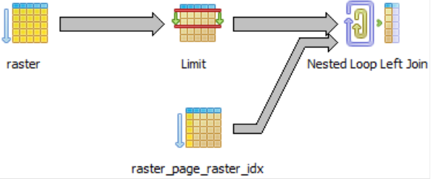
What the New Join Looks Like: raster_page
Nested Loop Left Join (cost=745.75..84448.59 rows=250000 width=88) (actual time=117.717..140.916 rows=540 loops=1)
-> Limit (cost=745.50..746.99 rows=100 width=40) (actual time=116.171..116.685 rows=100 loops=1)
-> Seq Scan on raster (cost=0.00..1491.00 rows=100000 width=40) (actual time=0.026..65.717 rows=50100 loops=1)
-> Index Scan using raster_page_raster_idx on raster_page (cost=0.25..180.76 rows=2500 width=48) (actual time=0.168..0.204 rows=5 loops=100)
Index Cond: ((public.raster.raster)::text = (find_raster(raster_page.raster))::text)
Total runtime: 141.809 ms
Total runtime: 0.141809 s
35 Times Faster
Before Indexes:
Total runtime: 4982.527 ms
Total runtime: 4.982527 s
SELECT raster.*, raster_page.*
FROM (
SELECT * FROM raster OFFSET 50000 LIMIT 100
) raster
LEFT JOIN raster_page
ON raster.raster = find_raster(raster_page.raster);

Slide 33

What the New Join Looks Like: raster_file
Nested Loop Left Join (cost=745.75..18567.32 rows=50000 width=75) (actual time=117.587..128.616 rows=109 loops=1)
-> Limit (cost=745.50..746.99 rows=100 width=12) (actual time=116.578..117.111 rows=100 loops=1)
-> Seq Scan on raster (cost=0.00..1491.00 rows=100000 width=12) (actual time=0.022..65.574 rows=50100 loops=1)
-> Index Scan using raster_file_raster_idx on raster_file (cost=0.25..46.94 rows=500 width=35) (actual time=0.091..0.102 rows=1 loops=100)
Index Cond: ((public.raster.raster)::text = (find_raster(raster_file.raster))::text)
Total runtime: 129.261 ms
Total runtime: 0.129261 s
11 Times Faster
Before Indexes:
Total runtime: 1446.589 ms
Total runtime: 1.446589 s
SELECT raster.*, raster_file.*
FROM (
SELECT * FROM raster OFFSET 50000 LIMIT 100
) raster
LEFT JOIN raster_file
ON raster.raster = find_raster(raster_file.raster);

Slide 34
Real Word Example
  Real World Example of Functional Indexes

Slide 35
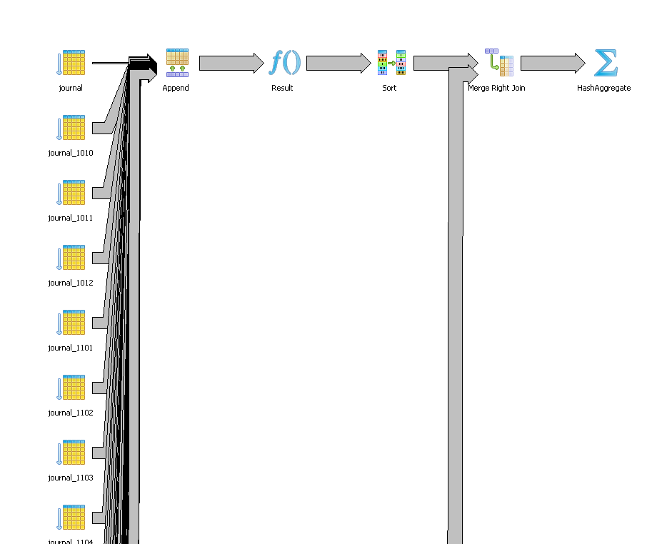
Joins between Journal & Faxlog
Journal used in testing is 10/1997 to 4/2012, more than the 18 months on production.
Total runtime: 197813.222 ms
Total runtime: 197.813222 s
Total runtime: 3.296887033 m
Journal – 16,384,930 Rows of Data
Faxlog – 1,244,754 Rows of Data
SELECT DISTINCT journal.username
FROM protimp.faxlog
LEFT JOIN protimp.journal
ON substring(faxlog.fax_loc FROM LENGTH(faxlog.fax_loc)
- 8) = substring(journal.dfraster from 1 for 9)
WHERE faxlog.fax_time >= '1/1/2012'
AND faxlog.fax_time < '1/2/2012';

Slide 36
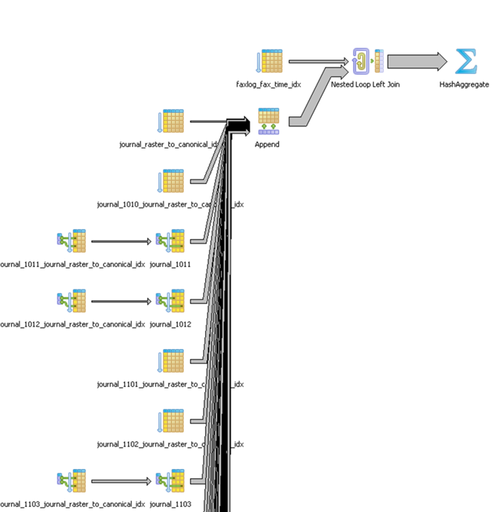
Joins between Journal & Faxlog
Total runtime: 22.368 ms
Before Indexes: 197813.222 ms
Before Indexes: 3.296887033 m
Journal – 16,384,930 Rows of Data
Faxlog – 1,244,754 Rows of Data
8,844 Times Faster
You will notice that we used individual functions instead of a combined function. This allowed us to write the functions in pure sql and remove the logic from each function making the functions faster, which is needed with big data.
SELECT DISTINCT journal.username
FROM protimp.faxlog
LEFT JOIN protimp.journal
ON ist.faxlog_raster_to_canonical(faxlog.fax_loc)
= ist.journal_raster_to_canonical(journal.dfraster)
WHERE faxlog.fax_time >= '1/1/2012'
AND faxlog.fax_time < '1/2/2012';

Slide 37
Case Insensitive Indexes
  Bulk Inserting from another Table/Query

Slide 38
Making your queries case insensitive
What if you want to search for an employee like “deForest”. Many people will mistype this last name and a simple “=” will miss finding this employee. You may fix this by creating a lower case index and then using “= lower(‘deForest’)”. This will make finding this employee much faster since the conversions for the table are in the index and only the one conversion needs to be performed.
SELECT *
FROM public.name_test
WHERE lower(name) = lower('deForest');

Slide 39
Making a unique case insensitive index
By default indexes are case sensitive. You could run into problems if one person enters “deForest” and another person enters “DeForest”.
A case insensitive unique index solves this problem.
CREATE TABLE public.name_test (
name TEXT
) WITHOUT OIDS;
CREATE UNIQUE INDEX name_test_idx ON public.name_test
USING (lower(name));
INSERT INTO public.name_test VALUES ('deForest');
Query OK, 1 rows affected (execution time: 0 ms; total time: 15 ms)
INSERT INTO public.name_test VALUES ('DeForest');
ERROR: duplicate key value violates unique constraint "name_test_idx"
DETAIL: Key (lower(name))=(deforest) already exists.

Slide 40
Working with View Definitions
  Refactoring a database

Slide 41
View Definitions
Here is a basic query that will return all queries, including system queries. You may want to exclude the system and temp queries from your results.
SELECT
definition,
schemaname,
viewname
FROM pg_catalog.pg_views;
definition | schemaname | viewname
SELECT definition, schemaname, viewname FROM pg_catalog.pg_views; | public | test_view

Slide 42
Basic Function
The problem is what happens when the view fails to execute.
EXECUTE will run the view and ignore the results (data).
When updating a table, sometimes you will need to drop and re-create the views. If you do this as two loop, the first one to write the view defs into a text[] and then a second one to loop through the text[] and re-create the views.
DECLARE
view_failures INTEGER;
check_views RECORD;
BEGIN
view_failures = 0;
FOR check_views IN
SELECT definition, schemaname, viewname
FROM pg_catalog.pg_views
LOOP
EXECUTE check_views.definition;
END LOOP;
IF view_failures > 0 THEN
RAISE NOTICE '% VIEWS FAILED', view_failures
USING HINT = 'You must update these views before continuing the transformation script.';
END IF;
END;

Slide 43
Handling Errors
The problem is what happens when the view fails to execute.
There are bugs in certain versions of PostgreSQL that the view definition will not execute even though the view works. I found these bugs and they are fixed in the latest versions of PostgreSQL.
…
LOOP
BEGIN
--SET ROLE finance;
EXECUTE check_views.definition;
--RAISE NOTICE 'View Passed: %.%', check_views.schemaname, check_views.viewname;
EXCEPTION
WHEN invalid_schema_name THEN
view_failures = view_failures + 1;
RAISE NOTICE 'View Failed - Invalid Schema Name: %.%', check_views.schemaname, check_views.viewname;
WHEN OTHERS THEN
view_failures = view_failures + 1;
RAISE NOTICE E'View Failed: %.%\nFailure Reason: % - %', check_views.schemaname, check_views.viewname, SQLSTATE, SQLERRM;
END;
--RESET ROLE;
END LOOP;
…

Slide 44
Counting all the rows for all tables
  Usable with SELECT permissions only

Slide 45
Setting up the Inline Function
Here we setup the basic inline function.
We will need the following variables:
  r for looping through a list of the tables.
  insert_sql_code for the base INSERT statement and we will add our values to for each row of data.
  sql_code as a reusable variable for our SQL statements that we are going to execute.
  temp_table for the name of our temp table. This is so you can easily change the name of the table.
DO $$
DECLARE
r record;
insert_sql_code TEXT;
sql_code TEXT;
temp_table TEXT;
BEGIN
…
END LOOP;
END $$;
Notes:
Update and Insert as a Single Command. The CREATE TABLE Query grabs the existing keys and adds keys to new rows.

Slide 46
The Body of the Function
We setup some basic variables at the start of the function.
Truncate the temp table in case you run this function more than once on the same connection.
Loop through the tables, excluding foreign tables, views, temp tables, system tables, etc.
Generate the INSERT INTO and count as a single statement and the execute the statement.
…
temp_table := 'xxxx';
insert_sql_code := 'INSERT INTO ' ||
quote_ident(temp_table) || ' ';
sql_code := 'CREATE TEMP TABLE IF NOT EXISTS ' ||
quote_ident(temp_table) || ' (
table_catalog information_schema.sql_identifier,
table_schema information_schema.sql_identifier,
table_name information_schema.sql_identifier,
"count" bigint)';
EXECUTE sql_code;
sql_code := 'TRUNCATE TABLE ' ||
quote_ident(temp_table);
EXECUTE sql_code;
FOR r IN SELECT * FROM information_schema.tables
WHERE table_schema NOT IN ('pg_catalog', 'information_schema')
AND table_schema NOT LIKE 'pg_temp%'
AND table_type = 'BASE TABLE'
LOOP
sql_code := insert_sql_code || 'SELECT ' || quote_literal(r.table_catalog) || ', ' || quote_literal(r.table_schema) || ', ' || quote_literal(r.table_name) || ', count(*) FROM ' || quote_ident(r.table_schema) || '.' || quote_ident(r.table_name);
EXECUTE sql_code;
END LOOP;
…
Notes:
Update and Insert as a Single Command. The CREATE TABLE Query grabs the existing keys and adds keys to new rows.

Slide 47
Viewing the Results
Now we can just query the temp table for a list of the tables and their row count.
SELECT * FROM xxxx ORDER BY table_schema, table_name;
Notes:
Update and Insert as a Single Command. The CREATE TABLE Query grabs the existing keys and adds keys to new rows.

Slide 48
Debugging your Functions
  Text Here

Slide 49
Write code in sections
Write code in sections and setting a variable to let you know what section the code was in when it fails.
Turn on/off debugging that is helpful for your debugging.
DECLARE
error_stage TEXT;
debug_on BOOLEAN;
BEGIN
debug_on := TRUE;
error_stage := 'Counting Duplicate Variables';
IF debug_on THEN
RAISE NOTICE 'Counting Duplicate Variables';
END IF;

Slide 50
Catching Errors
When you don’t know what error you need to catch, use the WHEN OTHERS.
Don’t ignore any errors within the error handler, if possible.
EXCEPTION WHEN OTHERS THEN
-- End Time
end_time := clock_timestamp();
BEGIN
UPDATE status.plate SET
plate_data_load_start_time = now(),
up_to_date = FALSE
WHERE plate.study_id = study_number
AND plate.plate_number = plate_no;
EXCEPTION WHEN OTHERS THEN
-- Skip erroring when already inside the 1st error handler
END;
-- Return status
RETURN QUERY VALUES (df_study_no, plate_no, NULL::BIGINT, NULL::BIGINT, NULL::BIGINT, NULL::BIGINT, NULL::BIGINT, NULL::BIGINT, NULL::BIGINT, NULL::BIGINT, FALSE, SQLSTATE, SQLERRM, error_stage, end_time, (end_time - start_time), file_path_name);

Slide 51
Write an error log
Write all your errors to a table with in the function or via the return on the function.
INSERT INTO tools.load_status
SELECT * FROM tools.load_from_file('study202.plate511.20140123.1221.csv');

Slide 52
Temp vers Unlogged
Temp tables are great for speeding of large queries but bad for tuning queries inside of functions.
Unlogged tables are great for debugging. They are left behind once your function ends and you can then run explain queries against them.
  They are not in the WAL files and so are not streaming replicated.
  If your server crashes and restarts, they are dropped.
  A perfect solution in place of temp tables while debugging and then change to temp for production.

Slide 53
Index's
Don’t forget to add Index’s, Primary Keys, Unique Keys, etc to your Temp/Unlogged tables.
You need these for optimizing the use of these tables in your queries, just like with normal tables.

Slide 54
Transactions
A function is a single transaction, by default.
You may create sub transactions within your function if you wish.
If you wrap your function in an outer function. Everything is covered by the outer functions transaction. This means if your outer function calls the inner function 5 times and you cancel it on the 4th time, no data from any of the completed inner functions will show up.

Slide 55
Dynamic Queries
When you need to make dynamic queries, it is best to save them into a variable, so you may export them via RAISE NOTICE.
DECLARE
sql TEXT;
degug_on BOOLEAN;
BEGIN
debug_on := TRUE;
sql := 'CREATE TABLE x AS SELECT * FROM pg_stat_activity;';
IF debug_on THEN
RAISE NOTICE 'Create Query: %', sql;
END IF;
EXECUTE sql;

Slide 56
Number of rows affected
Sometimes you may want to log how may rows are being inserted, updated and/or deleted within your function.
DECLARE
sql TEXT;
num_of_rows bigint;
BEGIN
sql := 'CREATE TABLE x AS SELECT * FROM pg_stat_activity;';
EXECUTE sql;
GET DIAGNOSTICS num_of_rows = ROW_COUNT;

Slide 57
Hiding Auto Notices
For some actions, there are notices raised. You may hide these by changing the client_min_messages around that specific line of code.
DROP TABLE IF EXISTS is one that I like to wrap in this style.
insert_plate_record_sql := 'ALTER TABLE
temp_current_variable_change_' || df_study_no || '_' || plate_no || '
ADD CONSTRAINT temp_current_variable_change_' || df_study_no || '_' || plate_no || '_idx
PRIMARY KEY (df_study_number, plate_number, variable_number, ptid, visit_number);';
SET client_min_messages = WARNING;
EXECUTE insert_plate_record_sql;
RESET client_min_messages;

Slide 58
Code time?
How long does each section of code take?
Add a clock_timestamp().
IF debug_on THEN
RAISE NOTICE 'Generating Temp Data: %', clock_timestamp();
END IF;
IF debug_on THEN
RAISE NOTICE 'Finished Generating Temp Data: %', clock_timestamp();
END IF;

Slide 59
Functions calling Functions
While you might be tempted to split large functions into a lot of small functions for debugging purposes, don’t.
Every time you call a function there is a start up overhead. This is especially bad for plperl and other non-sql languages.
Each sub-function becomes it’s own sub-transaction.
Compounds logging issues.

