Slide 1
Postgres and LDAP
By Lloyd Albin

Slide 2
How Postgres works with LDAP

Slide 3

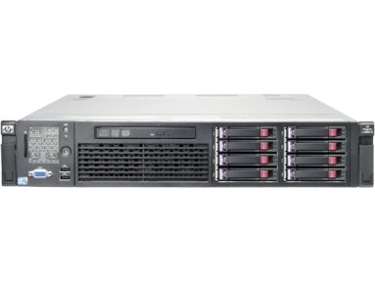

Non-LDAP Postgres Configuration
Authentication of Accounts
Postgres DBA Creates
Accounts/Groups
Postgres Server
pg_hba.conf
Creating Postgres Groups

Slide 4
Postgres with LDAP Authentication
DBA Creates Users and Groups
Application Support Specialist
Creates LDAP Users
Authentication of Accounts
Postgres Server
pg_hba.conf
SCHARP LDAP Server

Slide 5
pg_hba.conf
Configuring the File

Slide 6
pg_hba.conf
Local | Database | User |  |  |  | Auth-method | [Auth-options]
Host | Database | User | Address |  |  | Auth-method | [Auth-options]
HostSSL | Database | User | Address |  |  | Auth-method | [Auth-options]
HostNoSSL | Database | User | Address |  |  | Auth-method | [Auth-options]
Host | Database | User |  | IP-Address | IP-Mask | Auth-method | [Auth-options]
HostSSL | Database | User |  | IP-Address | IP-Mask | Auth-method | [Auth-options]
HostNoSSL | Database | User |  | IP-Address | IP-Mask | Auth-method | [Auth-options]
Auth-method many DBA’s setup as md5 but there are many more values: trust, reject, password, gss, sspi, ident, peer, ldap, radius, cert, and pam

Slide 7
Databases
All – This is what most people use.
Sameuser – Tries to connect to a database that is exactly the same name as the user who is logging into the server. User does not need to specify database in their connection string.
Database name – Specify a specific database
@dbs – This allows you to file containing a list located at $PGDATA/dbs.
@/etc/dbs@ – This allows you to file containing a list located at /etc/dbs.
This may be a comma separated list.

Slide 8
Users
All – This is what most people use.
User name – Specify a specific user.
@admins – This allows you to file containing a list located at $PGDATA/admins.
@/etc/admins@ – This allows you to file containing a list located at /etc/admins.
+support – This allows you to specify a specific group of users who are allowed to log in.
This may be a comma separated list.

Slide 9
Auth-Method’s
trust – No Password needed.
reject - Reject All Connections.
md5 – Passwords are stored inside of Postgres using a MD5 Hash.
password – Clear text password, both sending and storage inside of Postgres.
gss – Use GSSAPI to authenticate the TCP/IP user.
sspi – Only available on Windows Servers.
ident – For TCP/IP connections, obtain the user name by contacting the ident server on the client. If local connection automatically use peer instead.
peer – For local connections, obtain the client's operating system user name.
ldap – LDAP Server.
radius - RADIUS Server.
cert – Uses SSL Certificates. Each users has their owned signed certificate which as an expiration date built into the certificate.
pam - Pluggable Authentication Modules (PAM).

Slide 10
Address
127.0.0.1/32 – IPv4 Loopback adapter
::1/128 – IPv6 Loopback adapter.
Localhost – Uses the host name of the server, for local connections only.
192.168.93.0/24 – C-Block of IPv4 addresses aka 192.168.3.x
192.168.12.10/32 – Single IPv4 Address
.example.com – All hosts from *.example.com
0.0.0.0/0 – Allow Everybody

Slide 11
IP-Address / IP-Mask
127.0.0.1 255.255.255.255 – IPv4 Loopback adapter
192.168.12.10 255.255.255.255 – Single IPv4 Address
192.168.93.0 255.255.255.0 – C-Block of IPv4 addresses aka 192.168.3.x

Slide 12
Line Order
The pg_hba.conf file processes the lines in order and uses the first match. For example:
Host all +ldap_users 0.0.0.0/0 ldap [ldap options here]
Host all all 0.0.0.0/0 md5
Any user who is part of the group ldap_users will use the ldap authentication. Any user who is NOT part of the group ldap_users will use the md5 authentication.
You can’t specify two types of authentication for the same database without something else being different on pg_hba.conf line.

Slide 13
pg_hba.conf
Authenticating Users via LDAP/AD

Slide 14
Testing LDAP – ldapsearch
In this example we are using user ldapuser to log into ldapint to look for users within the ou, organizational unit, people and retrieve their uid, user id.
–W will cause it to ask for a password to be entered.
ldapsearch -W -h ldapint.pc.scharp.org -D "uid=ldapuser,ou=people,dc=scharp,dc=org" -b “ou=people,dc=scharp,dc=org" uid
  Returns a list of users:
  # username, People, scharp.org
  dn: uid=username,ou=people,dc=scharp,dc=org
  uid: username

Slide 15
Testing LDAP – ldapsearch vs pg_hba.conf
ldapsearch -W -h ldapint.pc.scharp.org -D "uid=ldapuser,ou=people,dc=scharp,dc=org" -b "ou=people,dc=scharp,dc=org" uid
ldap ldapserver="ldapint.pc.scharp.org ldap2-b.pc.scharp.org" ldapbinddn=" uid=ldapuser,ou=people,dc=scharp,dc=org" ldapbindpasswd="xxxx" ldapbasedn= "ou=people,dc=scharp,dc=org" ldapsearchattribute="uid"

Slide 16
Testing LDAP – ldapsearch
In this example we are using simple authentication instead of SASL. This allows us to skip the username and password and then ldapint to look for users within the ou, organizational unit, people and retrieve their uid, user id.
ldapsearch -x -h ldapint.pc.scharp.org -b “ou=people,dc=scharp,dc=org" uid
  Returns a list of users:
  # username, People, scharp.org
  dn: uid=username,ou=people,dc=scharp,dc=org
  uid: username

Slide 17
Testing LDAP – ldapsearch vs pg_hba.conf
ldapsearch -x -h ldapint.pc.scharp.org -b "ou=people,dc=scharp,dc=org" uid
ldap ldapserver="ldapint.pc.scharp.org ldap2-b.pc.scharp.org" ldapbinddn="" ldapbindpasswd="" ldapbasedn=“ou=people,dc=scharp,dc=org" ldapsearchattribute="uid"

Slide 18
Testing Microsoft AD Server – ldapsearch
In this example we are using user aduser to log into dc, AD server, to look for users within the ou, organizational unit, people and retrieve their cn, common name.
–W will cause it to ask for a password to be entered.
ldapsearch -W -h dc.fhcrc.org -D "aduser@fhcrc.org" -b "ou=USERS,ou=SCHARP,ou=VIDD,DC=fhcrc,DC=org " uid
  Returns a list of users:
  # username, Users, SCHARP, VIDD, fhcrc.org
  dn: CN=username,OU=Users,OU=SCHARP,OU=VIDD,DC=fhcrc,DC=org
  uid: username
  # username, Users, SCHARP, VIDD, fhcrc.org
  dn: CN= username,OU=Users,OU=SCHARP,OU=VIDD,DC=fhcrc,DC=org
  sAMAccountName: username

Slide 19
Testing Microsoft AD Server
– ldapsearch vs pg_hba.conf
ldapsearch -W -h dc.fhcrc.org -D "aduser@fhcrc.org" -b "ou=USERS,ou=SCHARP,ou=VIDD,DC=fhcrc,DC=org" uid
ldap ldapserver="dc.fhcrc.org dc-yale.fhcrc.org" ldapbinddn=“aduser@fhcrc.org" ldapbindpasswd=xxxx ldapbasedn="ou=USERS,ou=SCHARP,ou=VIDD,DC=fhcrc,DC=org" ldapsearchattribute="uid"

Slide 20
State of our Server

Slide 21
We are now at this state!!!
DBA Creates Users and Groups
Application Support Specialist
Creates LDAP Users
Authentication of Accounts
Postgres Server
pg_hba.conf
SCHARP LDAP Server

Slide 22
What we would really like!!!
Application Support Specialist
Creates LDAP Users and Groups
Authentication of Accounts
Postgres Server
pg_hba.conf
SCHARP LDAP Server
Creating Postgres Accounts
Creating Postgres Groups

Slide 23

Postgres combined with LDAP
Application Support Specialist
Creates LDAP Users and Groups
Authentication of Accounts
Postgres Server
pg_hba.conf
SCHARP LDAP Server
Creating Postgres Accounts
pg_ldap_sync
Creating Postgres Groups

Slide 24
pg_ldap_sync
Configuring and Running

Slide 25
pg_ldap_sync
This script will add ldap users/group into your Postgres server.
  https://github.com/larskanis/pg-ldap-sync
Test Mode
  pg_ldap_sync -c my_config.yaml -vvvv -t
Production Mode
  pg_ldap_sync -c my_config.yaml -vvvv

Slide 26
Yaml Config File – LDAP Config
Connection parameters to LDAP server
  # see also: http://net-ldap.rubyforge.org/Net/LDAP.html#method-c-new
  ldap_connection:
  host: ldapint.pc.scharp.org
  port: 636
  # auth:
  # method: :simple
  # username: uid=ldapuser,ou=people,dc=scharp,dc=org
  # password: xxxx
  encryption:
  method: :simple_tls

Slide 27
Yaml Config File – LDAP Users
Search parameters for LDAP users which should be synchronized
  ldap_users:
  base: ou=people,dc=scharp,dc=org
  # LDAP filter (according to RFC 2254)
  # defines to users in LDAP to be synchronized
  #filter: (&(objectClass=person)(objectClass=organizationalPerson)(givenName=*)(sn=*)(sAMAccountName=*))
  filter: (&(!(loginshell=/bin/false))(uid=*))
  # this attribute is used as PG role name
  name_attribute: uid
  # lowercase name for use as PG role name
  lowercase_name: true

Slide 28
Yaml Config File – LDAP Groups
Search parameters for LDAP groups which should be synchronized
  ldap_groups:
  base: ou=eagroups,dc=scharp,dc=org
  filter: cn=*
  # this attribute is used as PG role name
  name_attribute: cn
  # lowercase name for use as PG role name
  lowercase_name: true
  # this attribute must reference to all member DN's of the given group
  member_attribute: member

Slide 29
Yaml Config File – Postgres Connection
Connection parameters to PostgreSQL server
  pg_connection:
  host: sqltest-alt
  dbname: postgres
  user: pguser
  # password: xxxx

Slide 30
Yaml Config File – Postgres Users
Search parameters for LDAP generated users in the Postgres database.
  pg_users:
  # It's the WHERE-condition to "SELECT rolname, oid FROM pg_roles“
  filter: oid IN (SELECT pam.member FROM pg_auth_members pam JOIN pg_roles pr ON pr.oid=pam.roleid WHERE pr.rolname='ldap_users')
  # Options for CREATE RULE statements
  create_options: LOGIN IN ROLE ldap_users

Slide 31
Yaml Config File – Postgres Groups
Search parameters for LDAP generated groups in the Postgres database.
  pg_groups:
  # It's the WHERE-condition to "SELECT rolname, oid FROM pg_roles“
  filter: oid IN (SELECT pam.member FROM pg_auth_members pam JOIN pg_roles pr ON pr.oid=pam.roleid WHERE pr.rolname='ldap_groups')
  # Options for CREATE RULE statements
  create_options: NOLOGIN IN ROLE ldap_groups
  grant_options:

Slide 32
Verbose Example
If you turn on -vvvv, Verbose, logging you will get messages like these:
  I, [2016-08-30T13:27:50.063060 #16636] INFO -- : found user-dn: uid=user1,ou=people,dc=scharp,dc=org
  I, [2016-08-30T13:27:50.063060 #16636] INFO -- : found user-dn: uid=user2,ou=people,dc=scharp,dc=org
  I, [2016-08-30T13:27:50.063060 #16636] INFO -- : found user-dn: uid=user3,ou=people,dc=scharp,dc=org
  I, [2016-08-30T13:27:50.213591 #16636] INFO -- : found group-dn: cn=group1,ou=eaGroups,dc=scharp,dc=org
  I, [2016-08-30T13:27:50.213591 #16636] INFO -- : found group-dn: cn=group2,ou=eaGroups,dc=scharp,dc=org
  I, [2016-08-30T13:27:50.260667 #16636] INFO -- : SQL: CREATE ROLE "user1" LOGIN IN ROLE ldap_users
  I, [2016-08-30T13:27:50.260667 #16636] INFO -- : SQL: CREATE ROLE "user2" LOGIN IN ROLE ldap_users
  I, [2016-08-30T13:27:50.260667 #16636] INFO -- : SQL: CREATE ROLE "user3" LOGIN IN ROLE ldap_users
  I, [2016-08-30T13:27:50.260706 #16636] INFO -- : SQL: CREATE ROLE "group1" NOLOGIN IN ROLE ldap_groups
  I, [2016-08-30T13:27:50.260706 #16636] INFO -- : SQL: CREATE ROLE "group2" NOLOGIN IN ROLE ldap_groups
  I, [2016-08-30T13:27:50.293820 #16636] INFO -- : SQL: GRANT "group1" TO "user1","user2","user3"
  I, [2016-08-30T13:27:50.293820 #16636] INFO -- : SQL: GRANT "group2" TO "user2","user3"

Slide 33
Postgres and ODBC
By Lloyd Albin

Slide 34
The Problem

Slide 35
The Problem
We are creating a new data warehouse that has hundreds of schemas, but a individual user will only have access to a dozen schema’s at the most.
How to we allow standard tools to use the database without seeing these hundreds of schemas?
We could not find any solution until we searched the ODBC source code and found a setting that could be set to filter the list to only items the user has rights to use.

Slide 36
has_???_privilege
The internal code uses the has_table_privilege, etc functions to determine if the user has rights to see this object.
This uses built in functions like has_table_privilege(c.oid, 'select')
https://www.postgresql.org/docs/current/static/functions-info.html#FUNCTIONS-INFO-ACCESS-TABLE

Slide 37
ODBC
Configuring

Slide 38
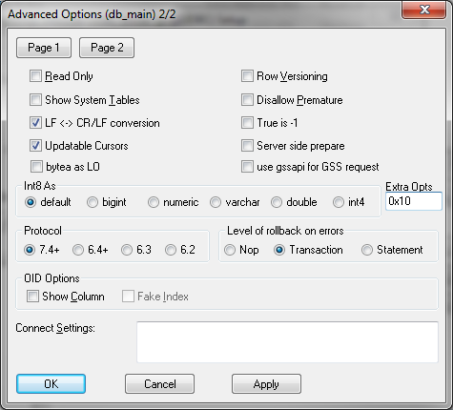
Configuration
By default the “Extra Opts” is set to “0x0”.
To make the ODBC connection filter by only objects that you have access to, change the “Extra Opts” to “0x10”

Slide 39
Postgres and JDBC
By Lloyd Albin

Slide 40
The Problem

Slide 41
The Problem
We are creating a new data warehouse that has hundreds of schemas, but a individual user will only have access to a dozen schema’s at the most.
How to we allow standard tools to use the database without seeing these hundreds of schemas?
The only solution that we came up with, was to modify the JDBC driver to have the same functionality that the ODBC Driver has. One of our programmers, Scott Langley, asked about making this modification to the people who approve patches for the JDBC driver and got good feedback, so we made the change and have submitted the patch.
https://github.com/pgjdbc/pgjdbc

Slide 42
has_???_privilege
There is now a switch that makes the internal code uses the has_table_privilege, etc functions to determine if the user has rights to see this object.
This uses built in functions like has_table_privilege(c.oid, 'select')
https://www.postgresql.org/docs/current/static/functions-info.html#FUNCTIONS-INFO-ACCESS-TABLE

Slide 43
JDBC
Configuring

Slide 44
JDBC Version’s
Current JDBC Version
  9.4.1211
    postgresql-9.4.1211.jar
Our Code, JDBC Version
  9.4.1212-SNAPSHOT
    postgresql-9.4.1212-SNAPSHOT.jar
    We are happy to email you a copy if this new driver.

Slide 45
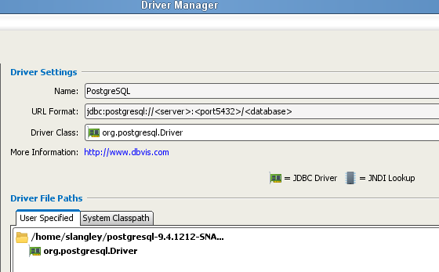
Using the Driver – DBVis Add Driver
Tools -> Driver Manager
Add the new PostgreSQL Driver.

Slide 46
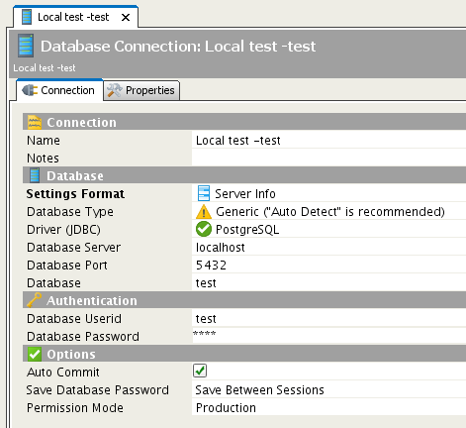
Using the Driver – DBVis Connection
Add the New Connection
Select the new PostgreSQL Driver, but don’t use the PostgreSQL Database Type, instead use the Generic type.
The PostgreSQL Type overrides the built in driver queries and queries the pg_catalog directly.
DBVis is the only program we have found where you need to set Database Type, the rest work automatically.

Slide 47
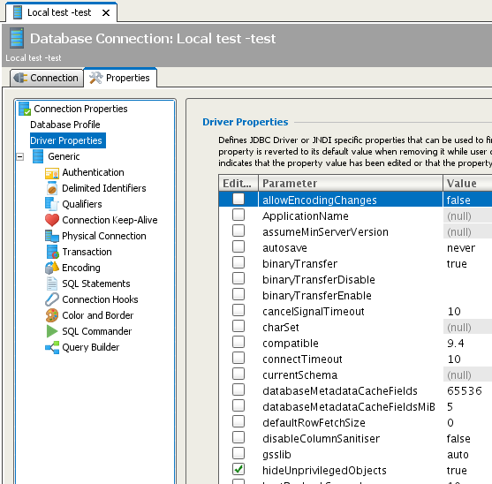
Using the Driver – DBVis Connection Properties
Click on the Properties Tab
Check the new setting:
  hideUnprivilegedObjects

Slide 48
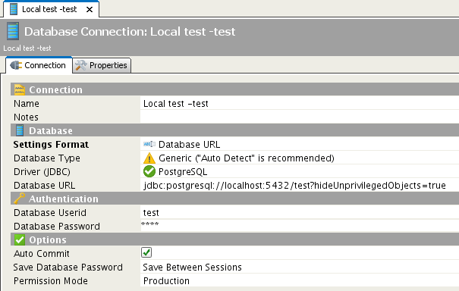
Using the Driver – URL DBVis/Code Example
Some interfaces do not give you a list of the properties to be set.
You may set the hideUnprivilegedObjects via the JDBC url line.

