Slide 1
Index Bloat
By Lloyd Albin

Slide 2
Index Bloat
What causes

Slide 3
Causes of Index Bloat
Large churning of data on a table.
Every time you vacuum or analyze a table, this will cause index bloat.
Vacuum does not vacuum the indexes.

Slide 4
Why not autovacuum?
Autovacuum_naptime sets the amount of time between autovacuum runs. The default is 1 minute.
The problem is that you need to hold off for at least the naptime + the amount of time for the vacuum to happen.
Autovacuum’s will be canceled if another process needs to write the table.

Slide 5
Index Bloat
Monitoring for

Slide 6
Query to find Bloat
WITH btree_index_atts AS (
SELECT nspname, relname, reltuples, relpages, indrelid, relam,
regexp_split_to_table(indkey::text, ' ')::smallint AS attnum,
indexrelid as index_oid
FROM pg_index
JOIN pg_class ON pg_class.oid=pg_index.indexrelid
JOIN pg_namespace ON pg_namespace.oid = pg_class.relnamespace
JOIN pg_am ON pg_class.relam = pg_am.oid
WHERE pg_am.amname = 'btree'
),
index_item_sizes AS (
SELECT
i.nspname, i.relname, i.reltuples, i.relpages, i.relam,
s.starelid, a.attrelid AS table_oid, index_oid,
current_setting('block_size')::numeric AS bs,
/* MAXALIGN: 4 on 32bits, 8 on 64bits (and mingw32 ?) */
CASE
WHEN version() ~ 'mingw32' OR version() ~ '64-bit' THEN 8
ELSE 4
END AS maxalign,
24 AS pagehdr,
/* per tuple header: add index_attribute_bm if some cols are null-able */
CASE WHEN max(coalesce(s.stanullfrac,0)) = 0
THEN 2
ELSE 6
END AS index_tuple_hdr,
/* data len: we remove null values save space using it fractionnal part from stats */
sum( (1-coalesce(s.stanullfrac, 0)) * coalesce(s.stawidth, 2048) ) AS nulldatawidth
FROM pg_attribute AS a
JOIN pg_statistic AS s ON s.starelid=a.attrelid AND s.staattnum = a.attnum
JOIN btree_index_atts AS i ON i.indrelid = a.attrelid AND a.attnum = i.attnum
WHERE a.attnum > 0
GROUP BY 1, 2, 3, 4, 5, 6, 7, 8, 9
),
index_aligned AS (
SELECT maxalign, bs, nspname, relname AS index_name, reltuples,
relpages, relam, table_oid, index_oid,
( 2 +
maxalign - CASE /* Add padding to the index tuple header to align on MAXALIGN */
WHEN index_tuple_hdr%maxalign = 0 THEN maxalign
ELSE index_tuple_hdr%maxalign
END
+ nulldatawidth + maxalign - CASE /* Add padding to the data to align on MAXALIGN */
WHEN nulldatawidth::integer%maxalign = 0 THEN maxalign
ELSE nulldatawidth::integer%maxalign
END
)::numeric AS nulldatahdrwidth, pagehdr
FROM index_item_sizes AS s1
),
otta_calc AS (
SELECT bs, nspname, table_oid, index_oid, index_name, relpages, coalesce(
ceil((reltuples*(4+nulldatahdrwidth))/(bs-pagehdr::float)) +
CASE WHEN am.amname IN ('hash','btree') THEN 1 ELSE 0 END , 0 -- btree and hash have a metadata reserved block
) AS otta
FROM index_aligned AS s2
LEFT JOIN pg_am am ON s2.relam = am.oid
),
raw_bloat AS (
SELECT current_database() as dbname, nspname, c.relname AS table_name, index_name,
bs*(sub.relpages)::bigint AS totalbytes,
CASE
WHEN sub.relpages <= otta THEN 0
ELSE bs*(sub.relpages-otta)::bigint END
AS wastedbytes,
CASE
WHEN sub.relpages <= otta
THEN 0 ELSE bs*(sub.relpages-otta)::bigint * 100 / (bs*(sub.relpages)::bigint) END
AS realbloat,
pg_relation_size(sub.table_oid) as table_bytes,
stat.idx_scan as index_scans
FROM otta_calc AS sub
JOIN pg_class AS c ON c.oid=sub.table_oid
JOIN pg_stat_user_indexes AS stat ON sub.index_oid = stat.indexrelid
)
SELECT dbname as database_name, nspname as schema_name, table_name, index_name,
round(realbloat, 1) as bloat_pct,
wastedbytes as bloat_bytes, pg_size_pretty(wastedbytes) as bloat_size,
totalbytes as index_bytes, pg_size_pretty(totalbytes) as index_size,
totalbytes - wastedbytes as unbloated_bytes, pg_size_pretty(totalbytes - wastedbytes) AS unbloated_size,
table_bytes, pg_size_pretty(table_bytes) as table_size,
index_scans
FROM raw_bloat
WHERE ( realbloat > 50 and wastedbytes > 50000000 )
ORDER BY wastedbytes DESC
realbloat > 50% & wastedbytes > 50MB

Slide 7
realbloat
When we talk about realbloat 50% this means that 50% is the index is the true index and 50% of the index is bloat.
realbloat 99% means that the true index size is 1% of the total index size.

Slide 8
Example
Database_name | Schema_name | Table_name | Index_name | Bloat_pct | Bloat_bytes | Bloat_size | Index_bytes | Index_size | Unbloated_bytes | Unbloated_size | Table_bytes | Table_size | Index_scans
df_repository | data | variable_record | variable_record_df_study_number_plate_number_ptid_visit_num_key | 60.2 | 2,900,787,200 | 2766 MB | 4,814,921,728 | 4592 MB | 1,914,134,528 | 1825 MB | 9,836,462,080 | 9381 MB | 202,093,238
df_repository | data | variable_record | variable_record_pkey | 70.1 | 2,492,162,048 | 2377 MB | 3,555,573,760 | 3391 MB | 1,063,411,712 | 1014 MB | 9,836,462,080 | 9381 MB | 403,544,900
df_repository | data | variable_record | variable_record_idx | 54.9 | 1,296,269,312 | 1236 MB | 2,359,681,024 | 2250 MB | 1,063,411,712 | 1014 MB | 9,836,462,080 | 9381 MB | 198,655,034
df_repository | data | plate_record | plate_record_creation_time_modification_time_plate_number_p_key | 58 | 232,210,432 | 221 MB | 400,031,744 | 382 MB | 167,821,312 | 160 MB | 303,726,592 | 290 MB | 240
These four index’s represent about 6.5GB of database bloat.
When I first tested this database the bloat was at 11GB and was 1/3 of the database size.

Slide 9
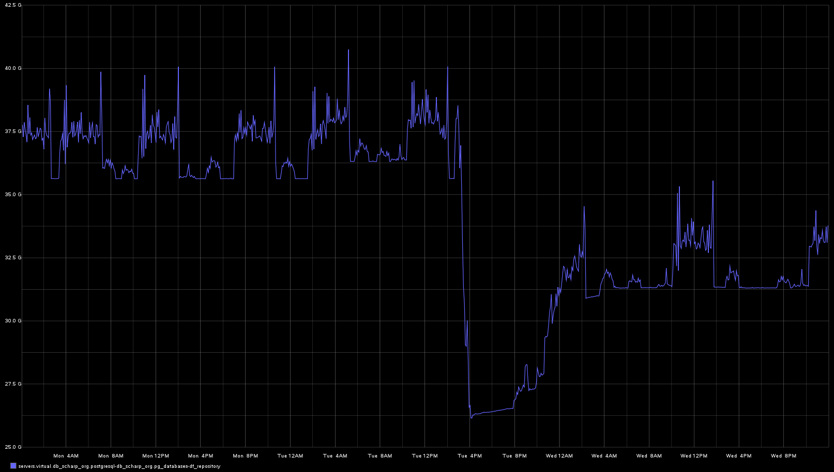

Slide 10
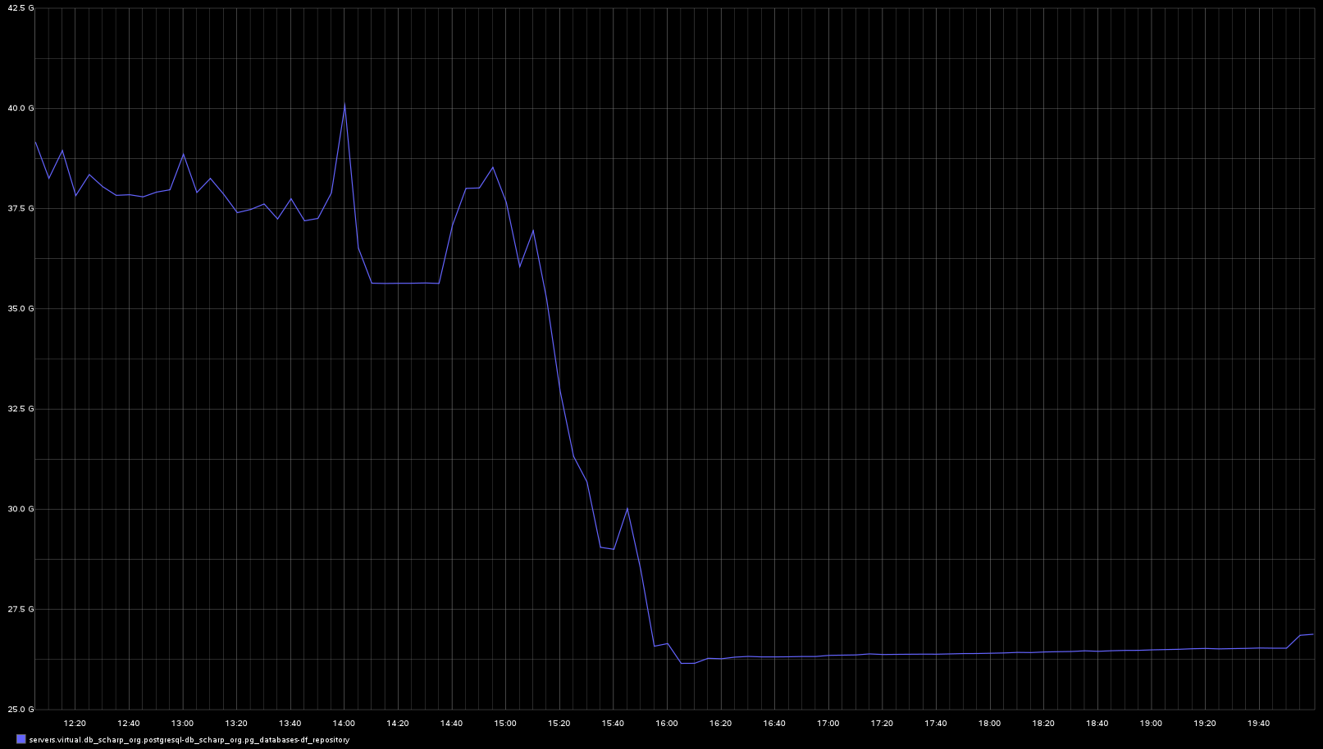
Build Index / Delete Index
Build Index / Delete Index
Build Index / Delete Index
Build Index / Delete Index
Build Index / Delete Index

Slide 11
12 hours to stabilize into a slow growth stage
Minimal growth for 3 hours

Slide 12
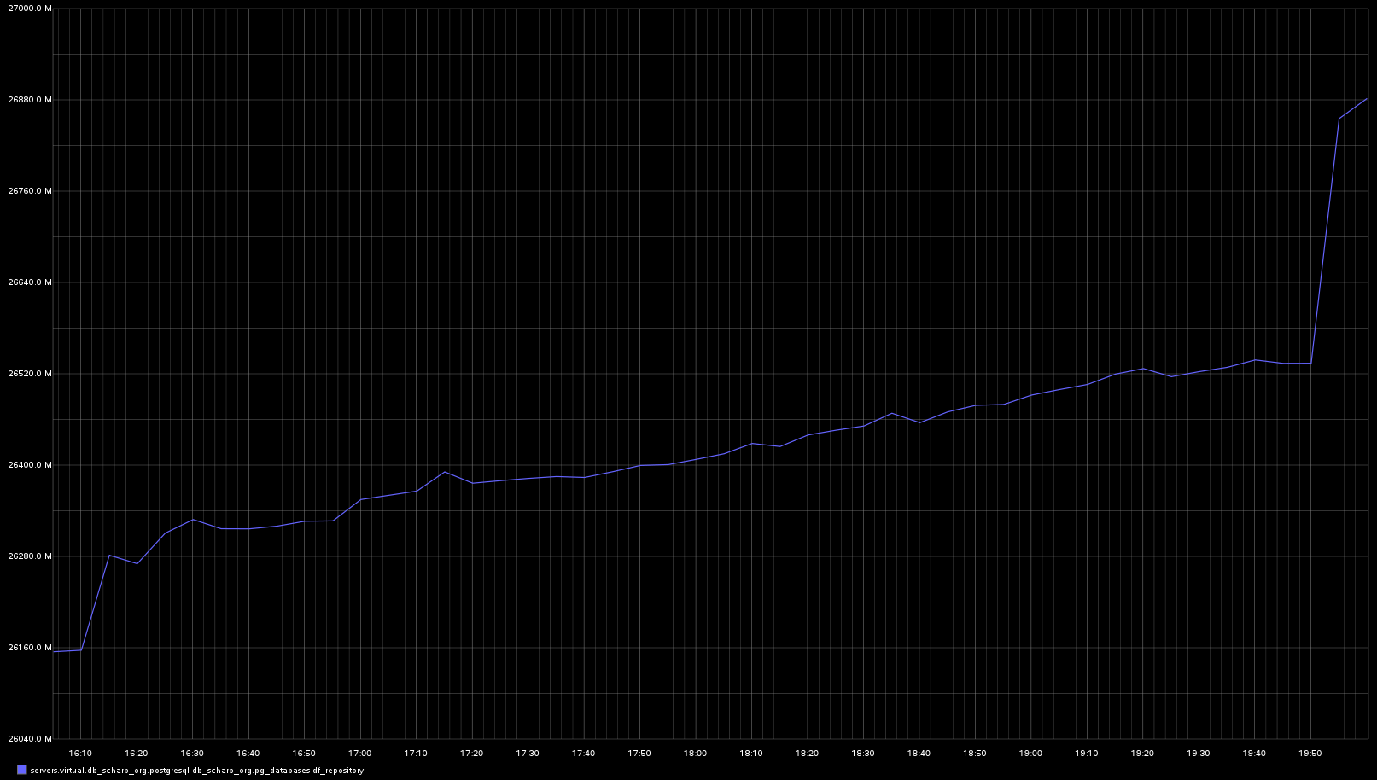
Vacuum
Vacuum
Vacuum
Vacuum
Minimal growth for 3 hours

Slide 13
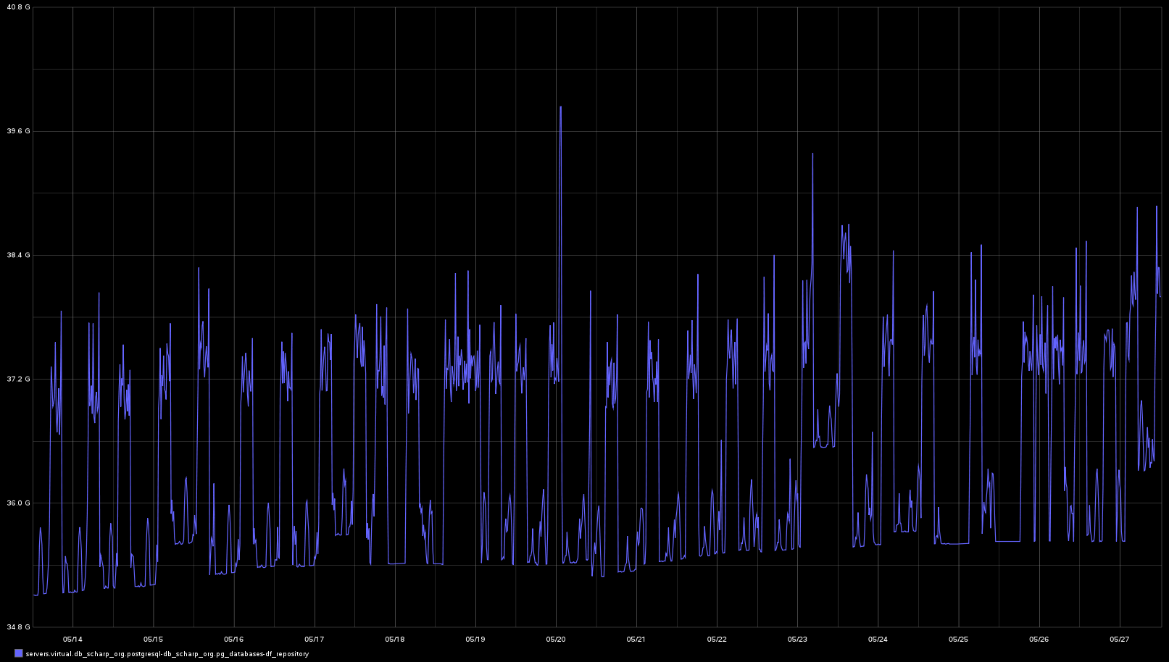
Slow but continual growth over 2 weeks

Slide 14
Re-create Index

Slide 15
Re-create index
DROP INDEX momentarily takes exclusive lock on the parent table, blocking both writes and reads.
The subsequent CREATE INDEX locks out writes but not reads; since the index is not there, no read will attempt to use it, meaning that there will be no blocking but reads might be forced into expensive sequential scans.
ALTER TABLE
DROP CONSTRAINT
variable_record_df_study_number_plate_number_ptid_visit_num_key;
DROP INDEX
variable_record_df_study_number_plate_number_ptid_visit_num_key;
ALTER TABLE data.variable_record
ADD CONSTRINT
variable_record_df_study_number_plate_number_ptid_visit_num_key
UNIQUE (df_study_number, plate_number, ptid, visit_number,
variable_number);

Slide 16
REINDEX
To re-index use

Slide 17
Reindex
REINDEX rebuilds an index using the data stored in the index's table, replacing the old copy of the index.
An index may become "bloated", that it is contains many empty or nearly-empty pages. This can occur with B-tree indexes in PostgreSQL under certain uncommon access patterns.
REINDEX is similar to a drop and recreate of the index in that the index contents are rebuilt from scratch. However, the locking considerations are rather different. REINDEX locks out writes but not reads of the index's parent table. It also takes an exclusive lock on the specific index being processed, which will block reads that attempt to use that index.
REINDEX INDEX
variable_record_df_study_number_plate_number_ptid_visit_num_key;

Slide 18
CREATE INDEX CONCURRENTLY
Creating an index without halting work

Slide 19
CREATE INDEX CONCURRENTLY
Can’t be inside of a Transaction
  This just means the swap out code needs to be inside of a Transaction.
Can’t be inside of a Function
  There went my idea of writing a generic function that could re-create index’s as needed without having any index specific code.
CREATE INDEX CONCURRENTLY and VACUUM can’t be run at the same time because they both want a SHARE UPDATE EXCLUSIVE lock in the table.
  SHARE UPDATE EXCLUSIVE lock is acquired by VACUUM (without FULL), ANALYZE, CREATE INDEX CONCURRENTLY, and some forms of ALTER TABLE.
If you cancel the CREATE INDEX or it fails during applying the constraints, you will be left with a bad index.
  DROP the bad index. This index is also flagged bad and will not be used by the query planner.

Slide 20
Example #1
In this example we are dealing with a normal index that is not unique.
When using CREATE INDEX CONCURRENTLY, you must not use it inside of a transaction and in fact it creates three separate transactions while executing.
DROP INDEX IF EXISTS data.vr_temp;
CREATE INDEX CONCURRENTLY vr_temp
ON data.variable_change USING btree (df_study_number, plate_number,
variable_number, ptid, visit_number, variable_change_id DESC);
--Query OK, 0 rows affected (execution time: 00:15:30; total time: 00:15:30)
BEGIN;
DROP INDEX data.variable_change_idx;
ALTER INDEX data.vr_temp RENAME TO variable_change_idx;
COMMIT;

Slide 21
Example #2
In this example we have a unique index.
We are able to drop and replace the constraint as a single command. This means we don’t need to wrap this command inside of a transaction.
DROP INDEX IF EXISTS data.vr_temp;
CREATE UNIQUE INDEX CONCURRENTLY vr_temp
ON data.variable_record (df_study_number, plate_number, ptid,
visit_number, variable_number);
--Query OK, 0 rows affected (execution time: 00:18:53; total time: 00:18:53)
ALTER TABLE data.variable_record
DROP CONSTRAINT
variable_record_df_study_number_plate_number_ptid_visit_num_key,
ADD CONSTRAINT
variable_record_df_study_number_plate_number_ptid_visit_num_key
UNIQUE USING INDEX vr_temp;

Slide 22
Example #3
In this example the index is also a primary key that has a foreign key relationship.
You can’t drop the primary key constraint when there is a foreign key constraint on the same field.
DROP INDEX IF EXISTS data.vr_temp;
CREATE UNIQUE INDEX CONCURRENTLY vr_temp
ON data.variable_record (variable_record_id);
-- Query OK, 0 rows affected (execution time: 00:03:51; total time: 00:03:51)
BEGIN;
ALTER TABLE data.qc_record
DROP CONSTRAINT qc_record_variable_record_fk;
ALTER TABLE data.variable_record
DROP CONSTRAINT variable_record_pkey,
ADD CONSTRAINT variable_record_pkey PRIMARY KEY USING INDEX vr_temp;
ALTER TABLE data.qc_record
ADD CONSTRAINT qc_record_variable_record_fk
FOREIGN KEY (variable_record_id)
REFERENCES data.variable_record(variable_record_id)
ON DELETE NO ACTION
ON UPDATE NO ACTION
DEFERRABLE
INITIALLY DEFERRED;
COMMIT;

Slide 23
WITH (fillfactor = 90)
Creating bloat on purpose

Slide 24
Fillfactor
The fillfactor for an index is a percentage that determines how full the index method will try to pack index pages. For B-trees, leaf pages are filled to this percentage during initial index build, and also when extending the index at the right (adding new largest key values). If pages subsequently become completely full, they will be split, leading to gradual degradation in the index's efficiency. B-trees use a default fillfactor of 90, but any integer value from 10 to 100 can be selected. If the table is static then fillfactor 100 is best to minimize the index's physical size, but for heavily updated tables a smaller fillfactor is better to minimize the need for page splits. The other index methods use fillfactor in different but roughly analogous ways; the default fillfactor varies between methods.
CREATE UNIQUE INDEX CONCURRENTLY vr_temp
ON data.variable_record (variable_record_id) WITH (fillfactor = 50);

