Slide 1
Using R inside your data warehouse
By Lloyd Albin

Slide 2
The Problem
This table is adding 100,000+ rows of data an hour. We have created a view on this data that reduces the data to one row per day, but that means that after 10 days worth of data we have hit Excel’s row limit of 1,048,576 rows and can no longer use the pivot table and graphing in Excel.
This left me with a problem of how to look at this data when I did not have an application that could deal with this much data.
In reading some presentations on Data Warehousing and Postgres, I saw people adding R into the Data Warehouse.
SELECT pg_table_size('ist.index_bloat'::regclass), pg_size_pretty(pg_table_size('ist.index_bloat'::regclass));
pg_table_size | pg_size_pretty
95516532736 | 89 GB

Slide 3
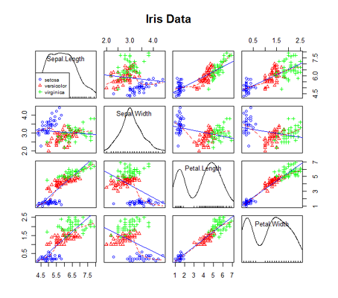
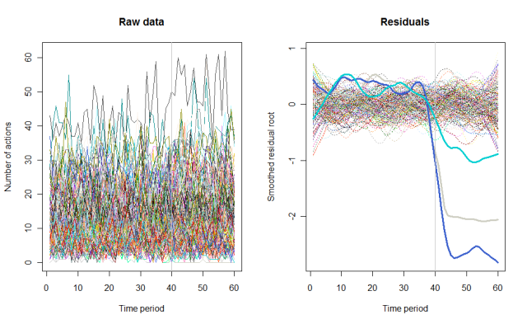
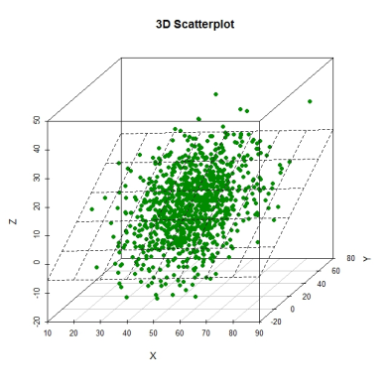
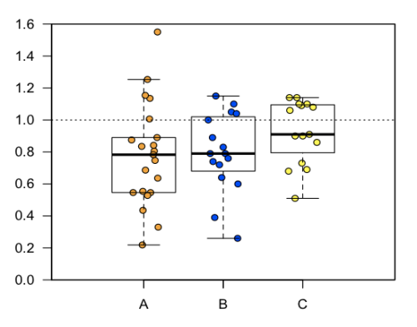
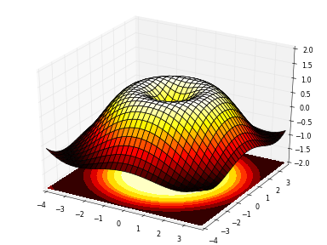
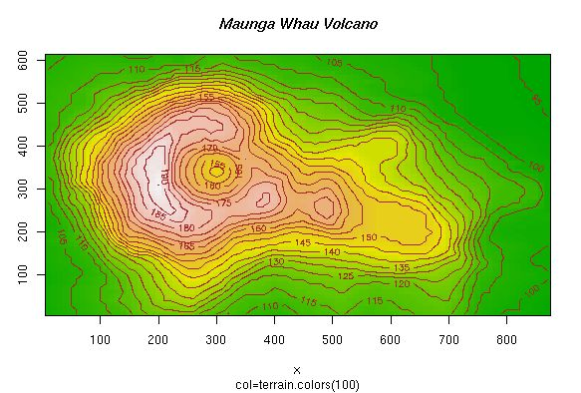
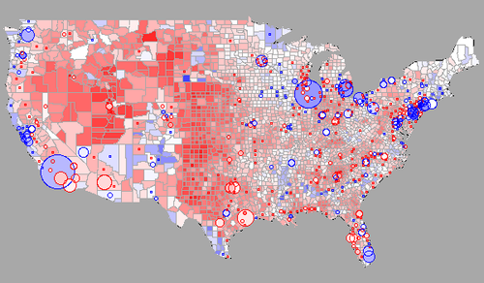
R Graph Examples

Slide 4
Setting up R

Slide 5
Downloading & Installing R
Because I don’t have this in production use yet, I set this up on my Windows Desktop using a foreign data table into the view.
Current Version 3.2.2 (32/64 bit)
Just run the windows installer that comes inside the download.
https://cran.r-project.org/bin/windows/base/

Slide 6
Downloading plr
You will need to download the DLL for windows, RPM for some Linux machines for the Source Code.
The current releases are:
plr-8.3.0.16 for PostgreSQL 8.3 & higher
plr-8.2.0.10 for PostgreSQL 8.2
Available in both 32bit or 64bit. Download or compile the correct edition to match the version of Postgres you are running.
http://www.joeconway.com/plr/

Slide 7
Installing plr
In the instructions below:
PostgreSQL is installed to <pgdir>
R is installed to <rdir>
For example, these directories might be:
<pgdir> = C:\PostgreSQL\9.4
<rdir> = C:\R\R-3.1.2
I recommend you ensure there are no spaces in the pathname to either <pgdir> or <rdir>.
Correct quoting of pathnames with spaces is left as an exercise for the reader ;-)
The following files are contained in this zip file:
---------------------------------------------------
README.txt: place in <pgdir>\doc\extension
plr.dll: place in <pgdir>\lib
plr.sql: place in <pgdir>\share\extension
plr.control: place in <pgdir>\share\extension
plr--8.3.0.14.sql place in <pgdir>\share\extension
plr--unpackaged--8.3.0.16.sql place in <pgdir>\share\extension
Ensure the following environment variables are set *prior* to starting PostgreSQL:
---------------------------------------------------
PATH=<pgdir>\bin;<pgdir>\lib;<rdir>\bin\x64;$PATH
R_HOME=<rdir>

Slide 8
Adding plr to Postgres
Now we are ready to add plr to Postgres.
Once you add the extension, the basic R language is available to you along with any built in libraries.
CREATE EXTENSION plr;

Slide 9
Adding R libraries
If you want to add R libraries, it is best to do so through the R console. This is especially true for the RGtk2 library as it needs to install another library for it to work.
In my configuration, I also need to run the console as a Super User so that it can write the libraries into the Program Files directory.
> library(quantmod)
Loading required package: xts
Loading required package: zoo
Attaching package: ‘zoo’
The following objects are masked from ‘package:base’:
as.Date, as.Date.numeric
Loading required package: TTR
Version 0.4-0 included new data defaults. See ?getSymbols.

Slide 10
Here is a basic R function
Here is a very simplistic R function to get you used to the language.
Some good resources for writing in R are:
  https://cran.r-project.org/doc/manuals/r-release/R-intro.html
  http://ww2.coastal.edu/kingw/statistics/R-tutorials/graphs.html
  http://www.joeconway.com/web/guest/pl/r/-/wiki/Main/Bytea+Graphing+Example
  http://harding.edu/fmccown/r/
CREATE OR REPLACE FUNCTION r_max (integer, integer) RETURNS integer AS '
if (arg1 > arg2)
return(arg1)
else
return(arg2)
' LANGUAGE 'plr' STRICT;
SELECT r_max(3,6);
-- Returns 6
SELECT r_max(8,2);
-- Returns 8
DROP FUNCTION r_max (integer, integer);

Slide 11
Setting up our Graphing Function
We will want to create a graph for a specific index. Due to the way I have the indexes setup, we need to supply server, database, table, and index.
I also specify the height and width of the graph. This is nice for when you have more data, you can make the graph wider.
Graph Type, see next slide.
CREATE OR REPLACE FUNCTION public.f_graph3 (
in_server name,
in_database name,
in_table name,
in_index name,
height integer,
width integer,
graph_type varchar
)
RETURNS bytea AS
$body$
………
$body$
LANGUAGE 'plr'
VOLATILE
CALLED ON NULL INPUT
SECURITY INVOKER
COST 100;

Slide 12
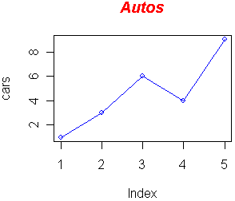
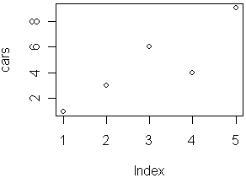
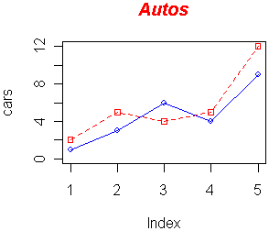
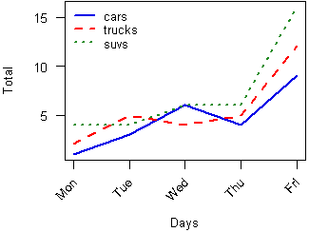
Graph Type
"p" for points
"l" for lines
"b" for both
"c" for the lines part alone of "b"
"o" for both “overplotted”
"h" for “histogram” like (or “high-density”) vertical lines
"s" for stair steps
"S" for other steps, see Details below
"n" for no plotting

Slide 13
Adding the libraries
For my installation, I did not need all the libraries that were in the example I based my code on. I have commented out the ones that I did not need.
I did notice that some require GTK+ and this can only be installed via the console. So I would use the console to install the libraries before I used them inside the function.
## necessary libraries
library(quantmod)
#require(lattice)
require(cairoDevice)
#require(RColorBrewer)
require(RGtk2)

Slide 14
Creating a blank image
gdkPixmapNew creates an image of the specific dimensions and color depth specified.
Cairo graphics device that can be use to create high-quality vector (PDF, PostScript and SVG) and bitmap output (PNG,JPEG,TIFF), and high-quality rendering in displays (X11 and Win32). Since it uses the same back-end for all output, copying across formats is WYSIWYG. Files are created without the dependence on X11 or other external programs. This device supports alpha channel (semi-transparent drawing) and resulting images can contain transparent and semi-transparent regions. It is ideal for use in server environments (file output) and as a replacement for other devices that don't have Cairo's capabilities such as alpha support or anti-aliasing. Backends are modular such that any subset of backends is supported.
pixmap <- gdkPixmapNew(w=width, h=height, depth=24);
asCairoDevice(pixmap);

Slide 15
The query
sql <- paste("SELECT
bloat_date AS y,
CASE b.max
WHEN 1 THEN bloat_bytes_max
ELSE bloat_bytes_max/power(1024,b.max-1)
END AS xmax,
CASE b.max
WHEN 1 THEN bloat_bytes_min
ELSE bloat_bytes_min/power(1024,b.max-1)
END AS xmin,
index_name,
CASE b.max
WHEN 1 THEN 'Bytes'
WHEN 2 THEN 'KB'
WHEN 3 THEN 'MB'
WHEN 4 THEN 'GB'
WHEN 5 THEN 'TB'
ELSE '> TB'
END AS bytes
FROM
index_bloat_min_max,
(SELECT max(length(bloat_bytes_max::text)::INTEGER/3::INTEGER)
FROM index_bloat_min_max
WHERE (server_name = '",in_server,"' OR length('",in_server,"') = 0) AND
(database_name = '",in_database,"' OR length('",in_database,"') = 0) AND
(table_name = '",in_table,"' OR length('",in_table,"') = 0) AND
(index_name = '",in_index,"' OR length('",in_index,"') = 0)) AS b
WHERE (server_name = '",in_server,"' OR length('",in_server,"') = 0) AND
(database_name = '",in_database,"' OR length('",in_database,"') = 0) AND
(table_name = '",in_table,"' OR length('",in_table,"') = 0) AND
(index_name = '",in_index,"' OR length('",in_index,"') = 0)
ORDER BY bloat_date;",sep="");

Slide 16
Executing the Query inside of R
The first line we execute the query and get the results back.
The second line, we convert field y to an R Date.
str <- pg.spi.exec(sql);
str$y <- as.Date(str$y);

Slide 17
Setting Variables
At this point, we set the values for variables that we are going to use in the plot command.
str[1,5] means row 1 column 5 which is the bytes.
There is a great R Color Chart what you can look at.
  http://research.stowers-institute.org/efg/R/Color/Chart/index.htm
  I prefer to download the PDF from the above page, because it also gives the color names, hex values, RGB, values and much more. For example 81 is darkgreen or #006400 or 0-100-0
mymain <- "Daily Index Bloat";
myxlab <- "Date";
myylab <- paste("Bloat in ",str[1,5],sep="");
# more space for the labels
op <- par(mar = c(8,4,4,2) + 0.1)
# Colors
min_color = colors()[81];
max_color = "red";
background_line_color = "grey";

Slide 18
The basic Plot
Plot generates the basic plot.
ldw = line width
xact = print x access titles (y/n)
las = labels are parallel (=0) or perpendicular(=2) to axis
Date Format, I am using “%b %d %y” which is “Dec 01 2015”, you could also do “%m/%d/%Y” for “12/01/2015”.
plot(x=str$y, y=str$xmax, type=graph_type, col=max_color, main=mymain, xlab="", ylab=myylab, lwd=1, xaxt = "n", las=2);
lines(x=str$y, y=str$xmin, type=graph_type, col=min_color);
title(xlab=myxlab, line = 7)
axis.Date(1, at = str$y, labels=TRUE, format="%b %d %Y", las=2)

Slide 19
Show background lines
This will generate optional background lines. I don’t want to generate these for all graph types.
# Show vertical background line for each sample day
if (graph_type == "l")
{
abline(v = str$y, col=background_line_color, lwd=0.5)
}

Slide 20
Setting up the Legend in the upper left
str[1,4] means row 1 column 4 which is the index_name.
Side
  1=bottom, 2=left, 3=top, 4=right
legend("topleft",col=c(max_color,min_color),lty=1,legend=c("Max","Min"))
mymtext <- paste("Index: ",str[1,4],sep="");
mtext(mymtext,side=3);
par(op) ## reset margin

Slide 21
Generating the Image from the pixmap
gdkPixbufGetFromDrawable transfers image data from a GdkDrawable and converts it to an RGB(A) representation inside a GdkPixbuf. In other words, copies image data from a server-side drawable to a client-side RGB(A) buffer. This allows you to efficiently read individual pixels on the client side.
NULL for new destination or plotPixbuf if adding to an existing destination.
The 0,0,0,0 is src.x,src.y,dest.x,dest.y,
The output types to the buffer can be:
  jpeg, tiff, png, icp, or bmp
dev.off() turns off the Cairo Device.
plotPixbuf <- gdkPixbufGetFromDrawable(NULL, pixmap, pixmap$getColormap(), 0, 0, 0, 0, width, height);
buffer <- gdkPixbufSaveToBufferv(plotPixbuf, 'jpeg', character(0), character(0))$buffer;
dev.off();
return (buffer);

Slide 22
Calling the function from SQL
You need to wrap the graph with the plr_get_raw() function, so that it will return just the raw image. This will make the image work properly with web pages, etc.
SELECT plr_get_raw(f_graph3(
'sqltest',
'clinical_profile_demo',
'value',
'value_variable_id_visit_number_ptid_key',
480,
1200,
'l'));
-- 1 rows returned (execution time: 11.419 sec; total time: 11.435 sec)

Slide 23
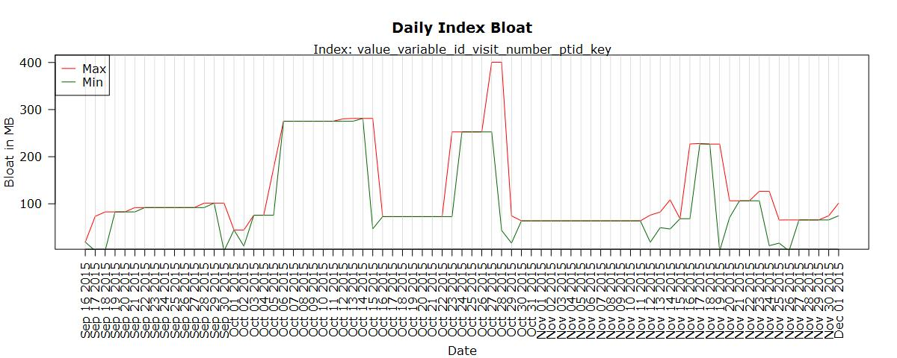
Finished Graph – Type l

Slide 24
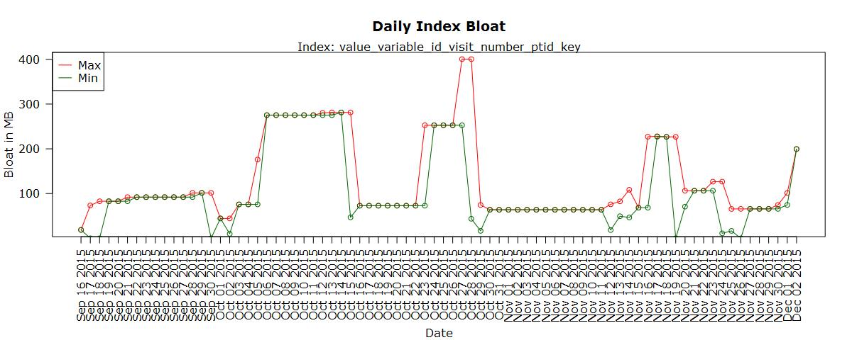
Finished Graph – Type o

Slide 25
Debugging your functions
Save your data.frame, then use the R console and load the saved data.frame. This way you can test your manipulation of the data in the R console debugger.
You may also generate Postgres Notices that will appear on screen via some tools plus into the log files.
as.Date is used in this example, due to the fact that this example is before I converted y with the as.Date function.
save(str, file="RData");
str = load("RData");
write.table(str, file = “data.csv", sep = ",", col.names = NA,
qmethod = "double")
str = read.table(“data.csv", header = TRUE, sep = ",", row.names = 1)
write.csv(str, file="data.csv");
str = read.csv("data.csv");
pg.thrownotice(paste("Min Date: ",min(as.Date(str$y))));
pg.thrownotice(paste("Max Date: ",max(as.Date(str$y))));

