Slide 1
Using Grafana to show Postgres Statistics
By Lloyd Albin

Slide 2
collectd
The system statistics collection daemon

Slide 3
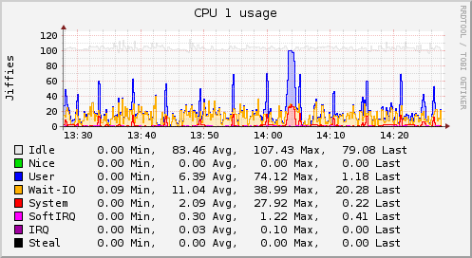
collectd – The system statistics collection daemon
collectd is a daemon which collects system performance statistics periodically and provides mechanisms to store the values in a variety of ways, for example in RRD or Whisper files.
What does collectd do?
collectd gathers statistics about the system it is running on and stores this information. Those statistics can then be used to find current performance bottlenecks (i.e. performance analysis) and predict future system load (i.e. capacity planning). Or if you just want pretty graphs of your private server and are fed up with some homegrown solution you're at the right place, too ;).
Usually one graph says more than a thousand words, so here's a graph showing the CPU utilization of a system over the last 60 minutes:
https://collectd.org/

Slide 4
Graphite
Scalable Realtime Graphing

Slide 5
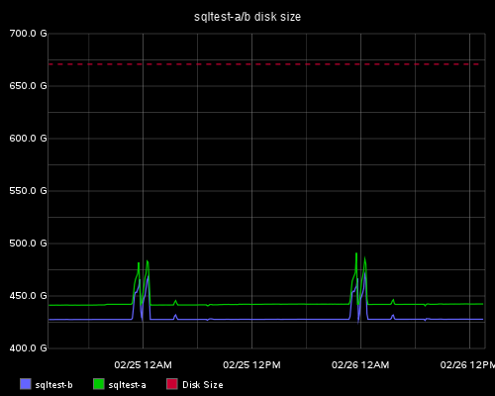
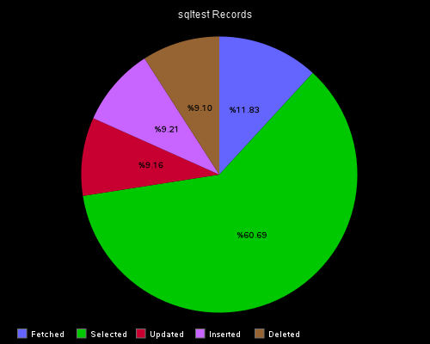
Graphite - Scalable Realtime Graphing
What Graphite is and is not
  Graphite does two things:
    Store numeric time-series data
    Render graphs of this data on demand
  What Graphite does not do is collect data for you, however there are some tools out there that know how to send data to graphite. Even though it often requires a little code, sending data to Graphite is very simple.
Documentation:
http://graphite.readthedocs.org/en/latest/index.html
Download Page:
https://launchpad.net/graphite/+download

Slide 6
Grafana
Graphite and InfluxDB Dashboard and graph composer

Slide 7
Grafana Version 1.91
What does Grafana give me over Graphite?
  The ability to create templates.
  Single Stat Dashboards with color coding for thresholds.
  Pull data from more than just Graphite. InfluxDB and OpenTSDB are also supported.
  Combine more than one graph style.
  Text panels.
  Multi-Graph cursor.
  Does not give you pie charts.
  Limited to 2 thresholds.
  Edit through JSON files or GUI Interface.
  Understanding of Y value types such as bytes, seconds, etc. So that seconds, minutes, hours, days will show up with using seconds.
  Graph overrides for specific data
  Annotations, aka showing events.
  Pull data from more than one graphite server into a single display.
  Collapsible Sections.

Slide 8
Grafana Version 2.0 (Currently in Beta)
Nagios like notification support.
User logins with settable permissions: View, Edit & Admin.
Panel time override
Dashboard List Panel
Logarithmic Scales: Log Base 10, 32, & 1024
Built in webserver.

Slide 9
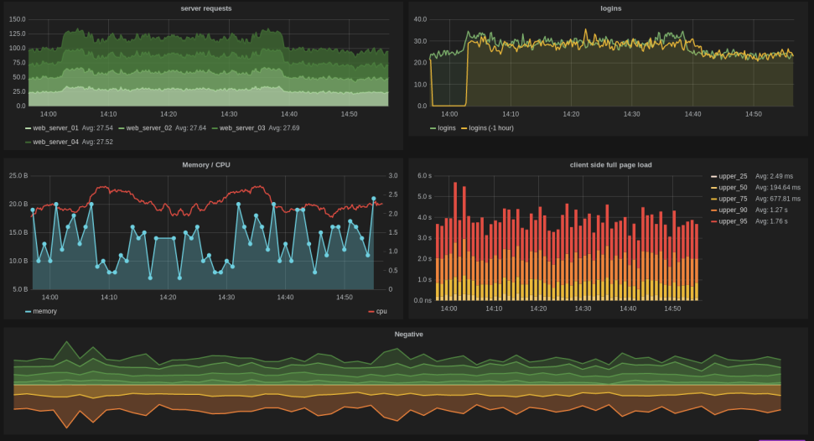
Rich graphing
Fast and flexible client side graphs with a multitude of options.
Click and select region to zoom
Multiple Y-Axes
Bars, Lines, Points
Grid thresholds
Y-axis formats (bytes, milliseconds, etc)
Graphite PNG render option
View or edit graph in fullscreen

Slide 10
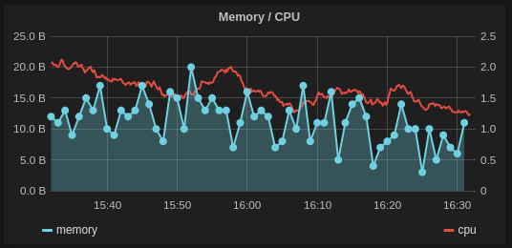
Mixed styling
Full control for how each series should be drawn
Mix lines, bars and points
Mix stacked series with isolated series

Slide 11
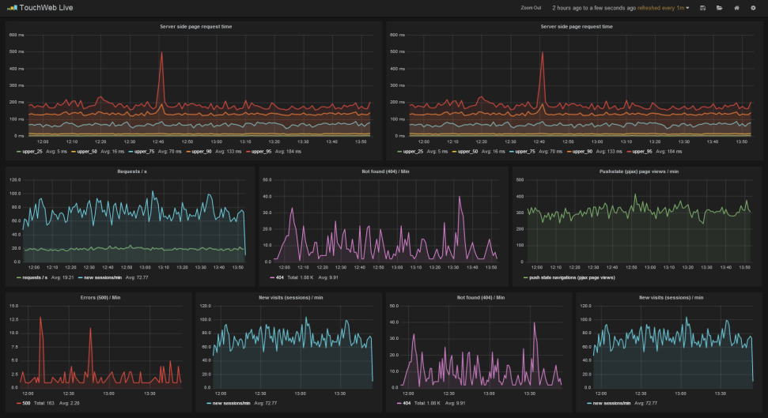
Dashboards
Drag and drop panels, change row and panel width easily.
Instant dashboard search based on title or tags
Templated dashboards
Scripted dashboards
Dashboard playlist
Save / Load from ElasticSearch
Save / Load from json file

Slide 12
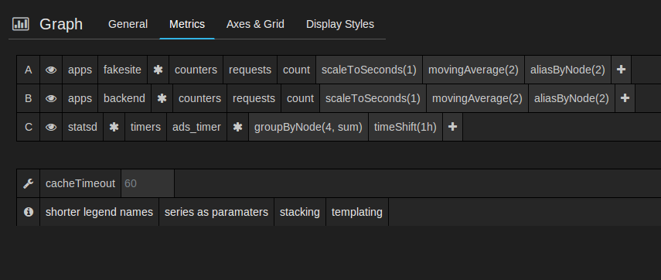
Graphite query editor
Grafana includes a built in Graphite query parser that takes writing graphite metric expressions to a whole new level. Expressions are easier to read and faster to edit than ever.
Click on any metric segment to change it
Quickly add functions (search, typeahead)
Click on a function parameter to change it
Move function order to the left or right
Direct link to Graphite function documentation

Slide 13
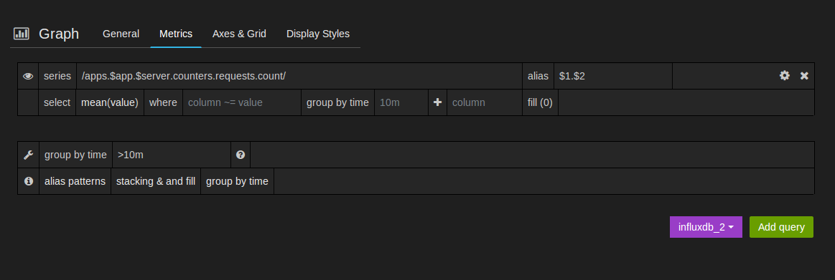
InfluxDB query editor
Series name and column auto complete
Automatic handling of group by time
Options for fill(0) and fill(null)
Alias patterns for short readable series names

Slide 14
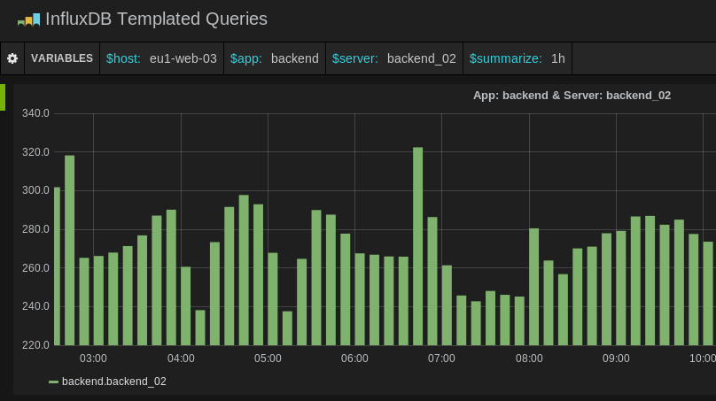
Templated dashboards
Any metric path can be replaced with a template variable. This allows you to create generic dashboards that can quickly be changed to show stats for a specific cluster, server, application or experiment.

Slide 15
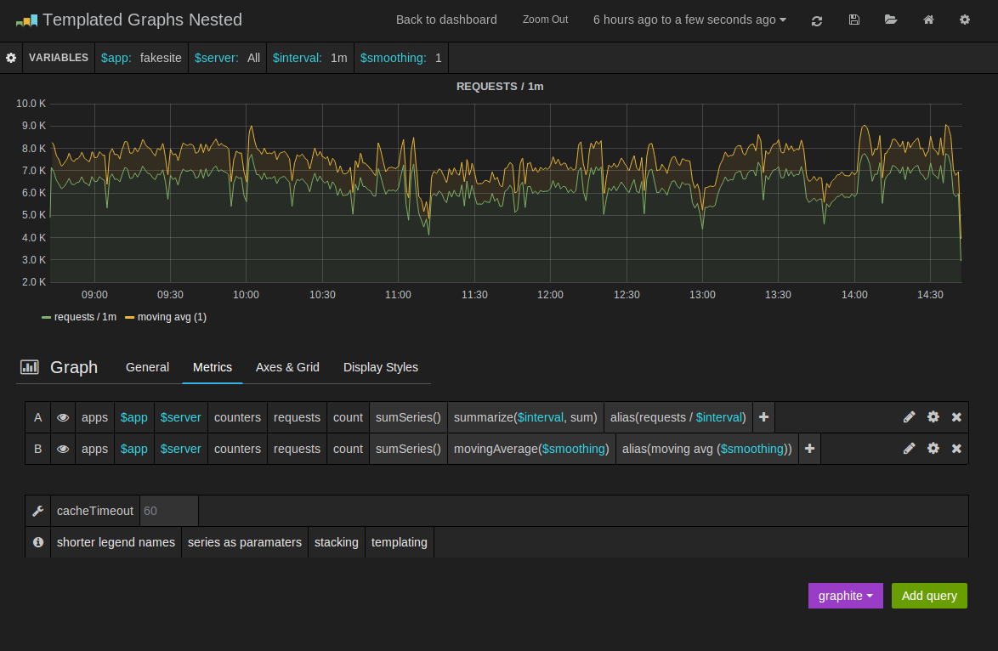
Templated queries
Variables values defined with a metric key query
Interval variables, like 10min, 1h, 1d
Use variable in metric path
Use variables in graph titles
Use variable as a function parameter

Slide 16
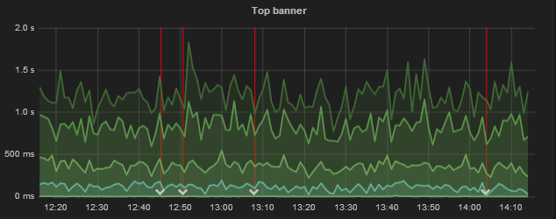
Annotations
Annotate graphs with rich events from different data sources. Hover over events shows you the full event metadata.
Fetch annotations from Elasticsearch
Fetch annotations from Graphite Events and Metrics
Fetch annotations from InfluxDB

Slide 17
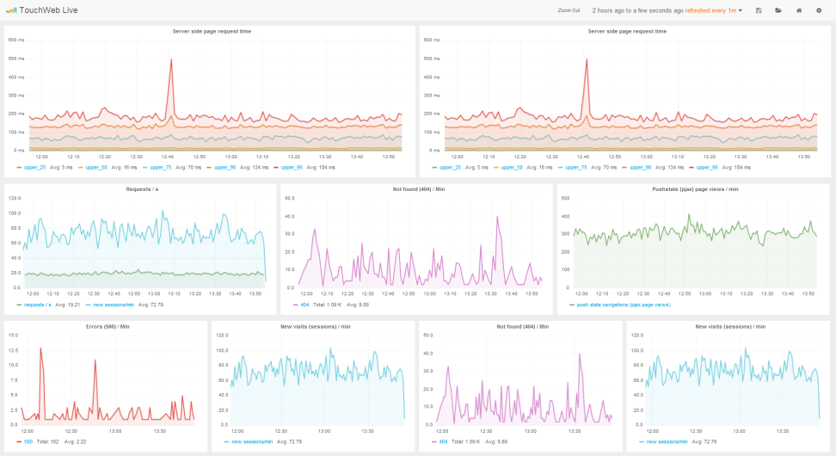
Dark and Light theme
If you do not prefer the default dark theme you can switch to a light theme.

Slide 18
Multiple data sources
You can define multiple graphite servers or InfluxDB servers and switch between them. It is even possible to show graphs from different data sources & servers on the same dashboard.

Slide 19
SCHARP’s Implementation

Slide 20
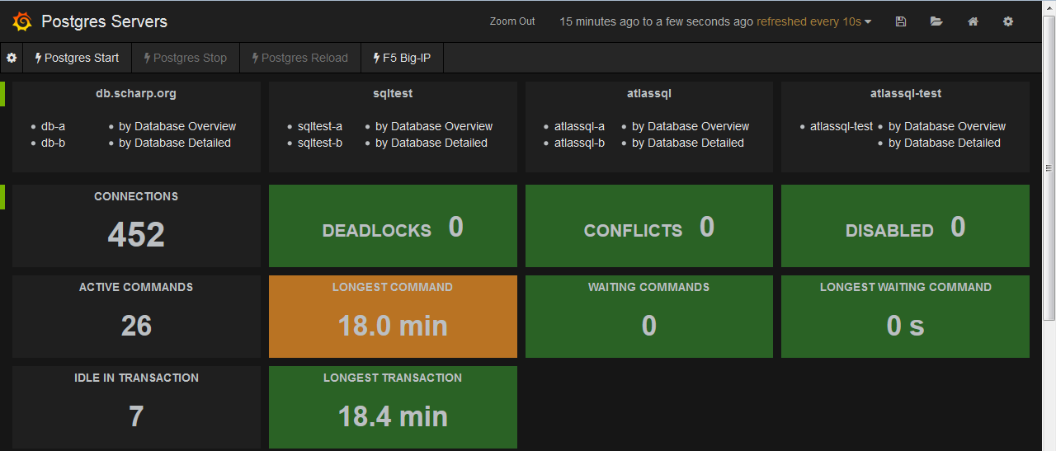
Overview Section
We can toggle events/annotations on/off at the top
We use a quick list at the top to get to specific servers/pages.
We use a cross server overview at the top of the page.

Slide 21
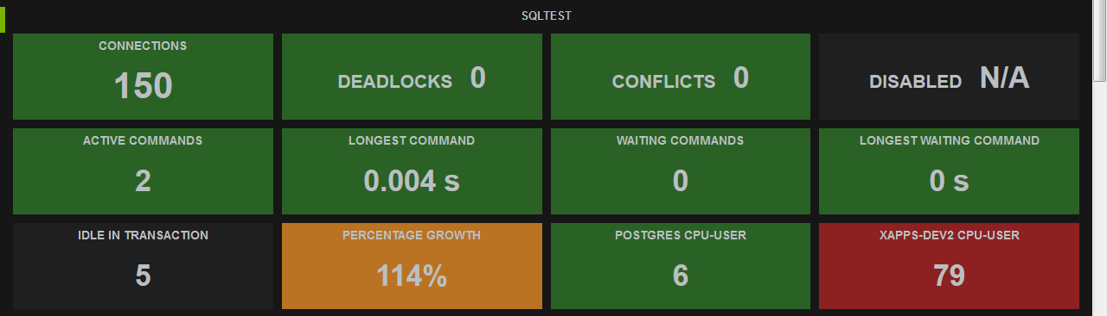
Simple Dashboards
Simple dashboards for Non-DBA’s to be able to know the status of the servers.
The green and black backgrounds say that everything is OK.
The orange background is a warning.
The red background is a critical warning.
You can clock on the header bar to shrink or expand the section.
Deadlocks & Conflicts only happen for a split second, so these graphs show the number over the time period being shown.
The rest of the graphs are showing the current value.

Slide 22
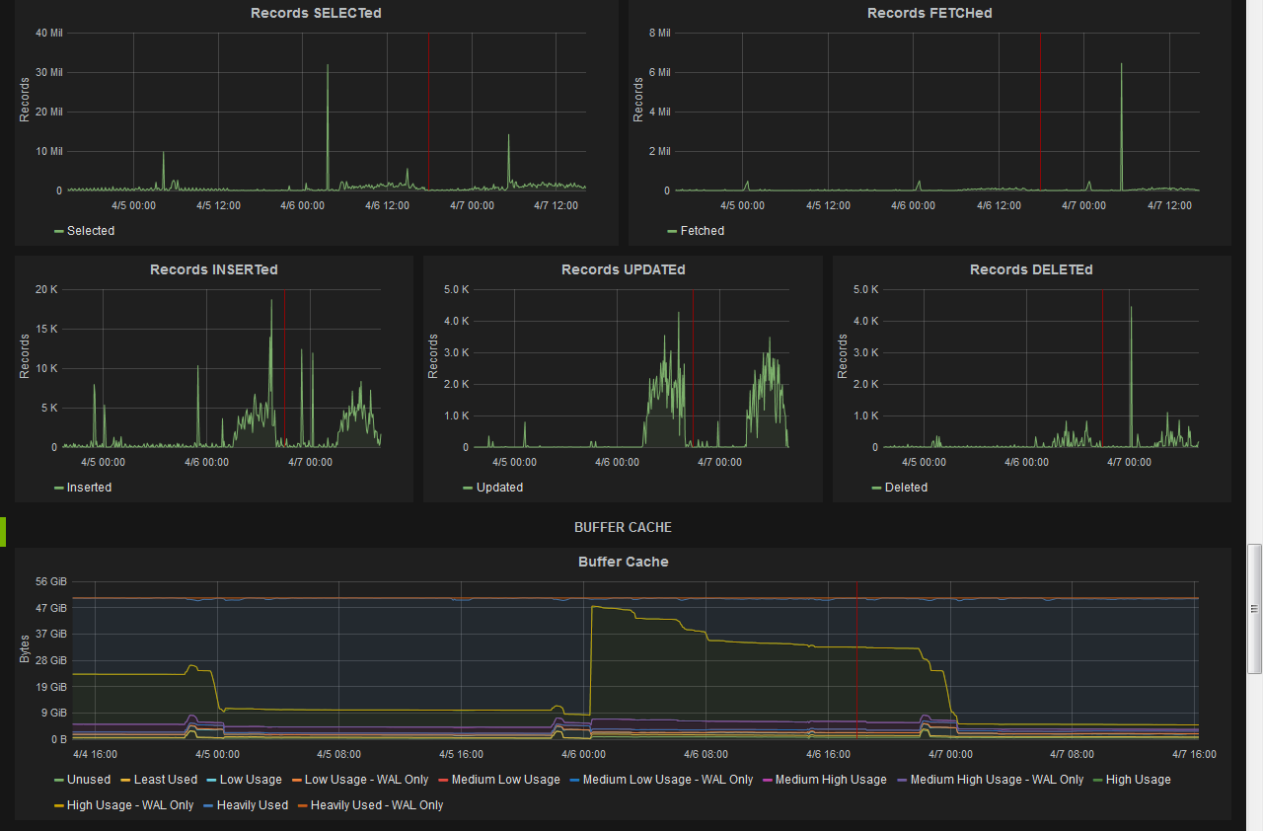
Different Sized Graphs
Here we can see different sized graphs, but all with the same scale.
I have turned on shared crosshairs, this is the red vertical line which is the current location of my cursor across all graphs.

Slide 23
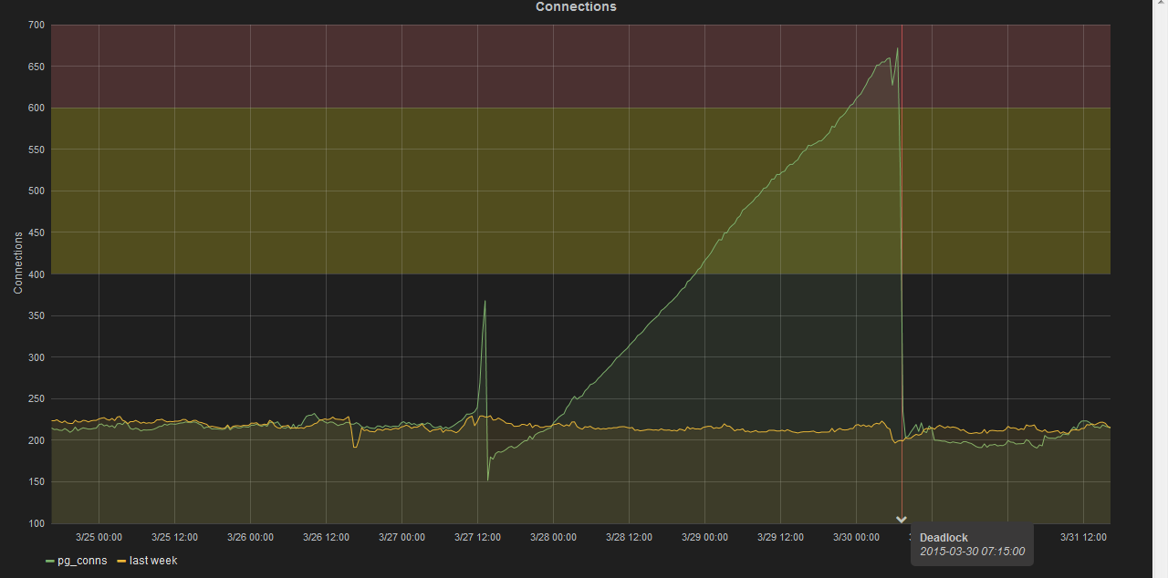
Events / Annotations
On this graph you can see a deadlock event.
When you scroll over the white arrow you can see which event and when the event happened.
You can set two threshholds. On this graph I have them set for 400 & 600.
THP – Transparent Huge Pages, has anyone ever disabled them?

Slide 24
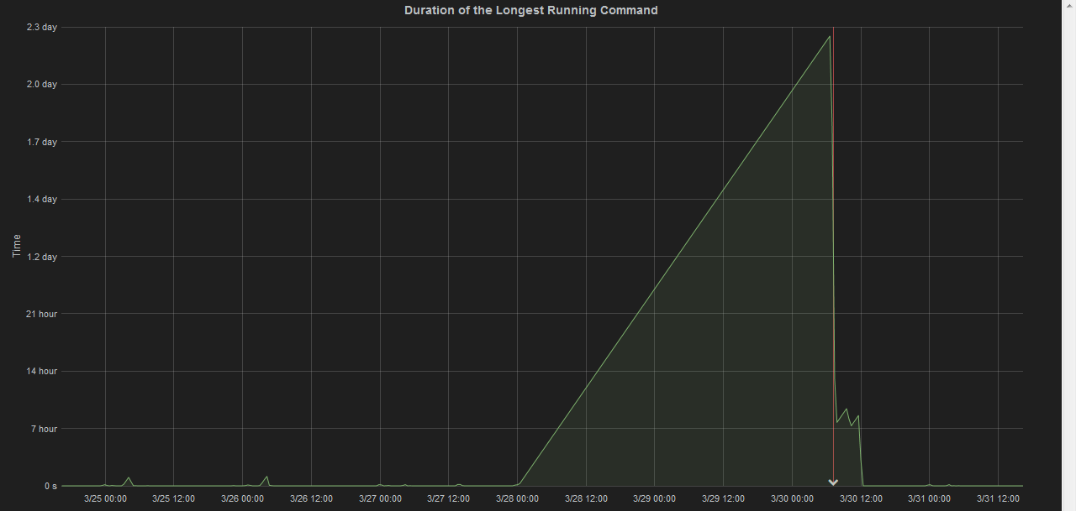
Time Scale
One of the great features of Grafana is the ability to go from seconds -> minutes -> hours -> days.
Grafana supports scales for both seconds and milliseconds.

Slide 25
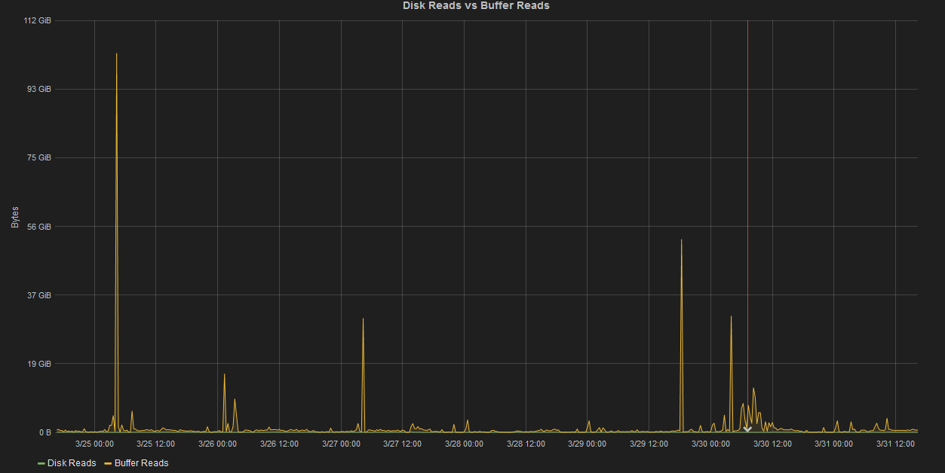
Bytes Scale
Grafana is also does great with the bytes scale going from bytes -> KB -> MB -> GB, etc.

Slide 26
Graph Setup

Slide 27
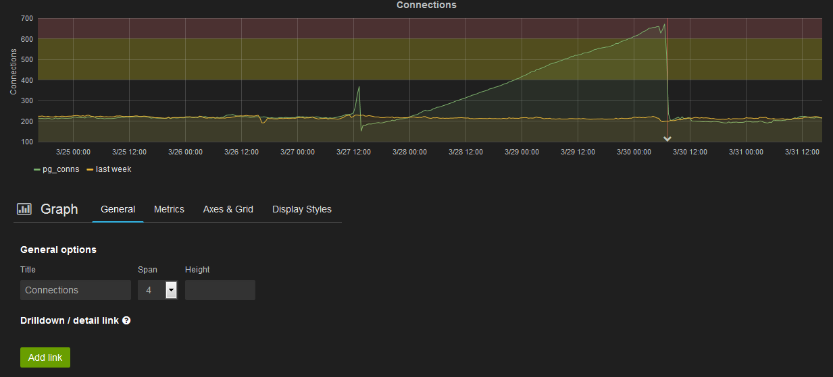
General Graph Settings
Span allows you to set the width out of 12. This means in this example it is 4 out of 12. This means that you can have 3 graphs that are a width of 4 in a row.

Slide 28
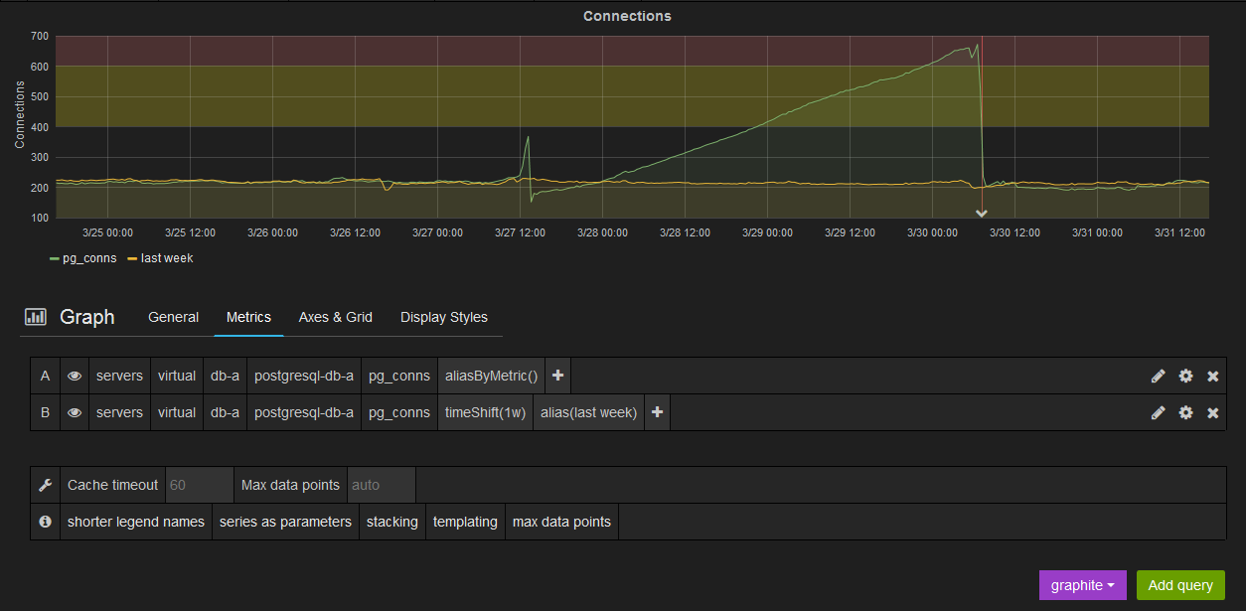
Metrics Graph Settings
With timeShift(time period) you can display different times at the same time. In this example the green is shows this week and the yellow is showing last week.

Slide 29
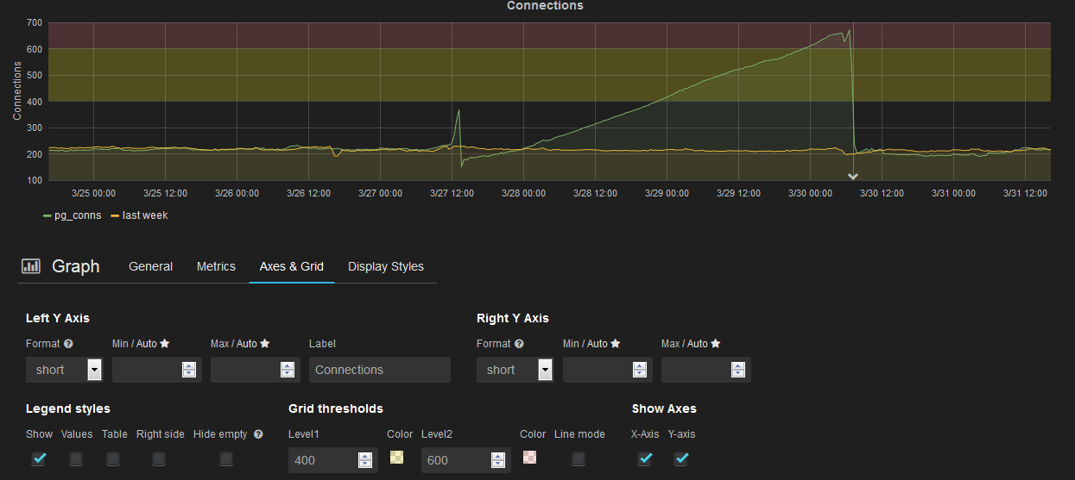
Axes & Grid Graph Settings
Format allows you to pick none, short, bytes, bits, bps, s, ms, μs, ns, percent
Set thresholds and colors.

Slide 30
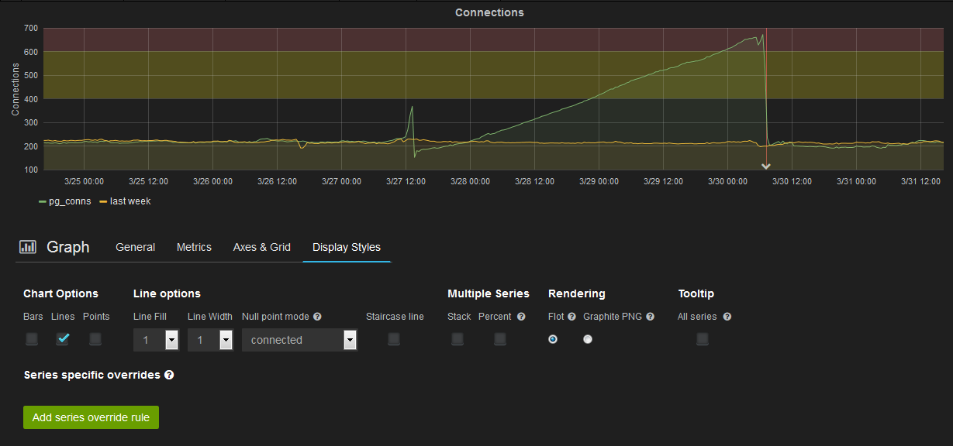
Display Styles Graph Settings
By using the override, you can set last weeks to be bars, points, different line width or fill, etc.

Slide 31
Singlestat Setup

Slide 32
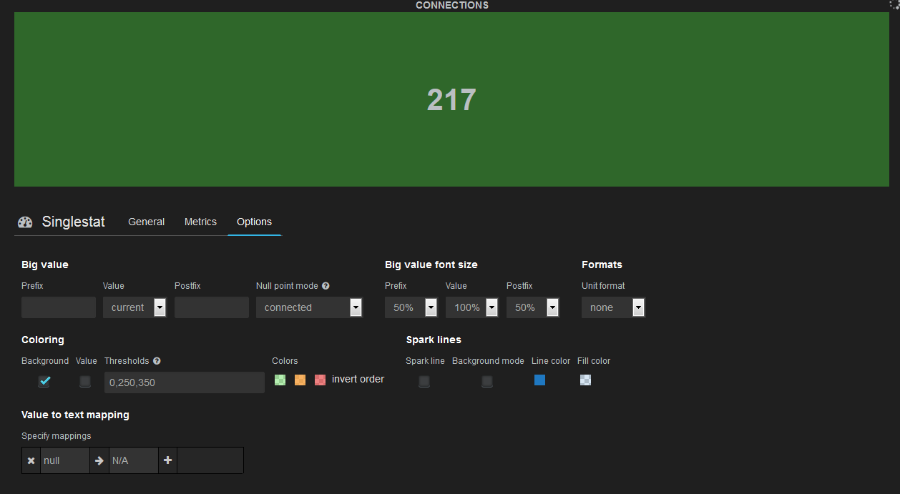
Options Singlestat Settings
Value can be set to Min, Max, Avg, Total, or Current.
You can also set your thresholds and their colors.
Either the background or the text color can be changed.
If you select your unit format of S or bytes it will automatically take care of the postfix for you.
Spark line creates a graph in the background of the singlestat for the current timeperiod.

Slide 33
Events / Annotations

Slide 34
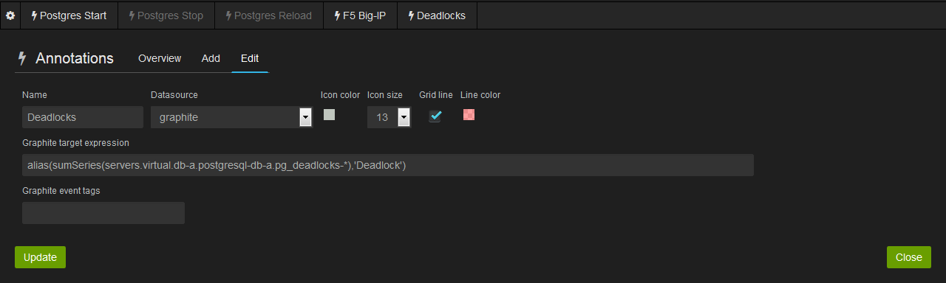
Annotations
Add / Edit Annotations

Slide 35
Templating

Slide 36
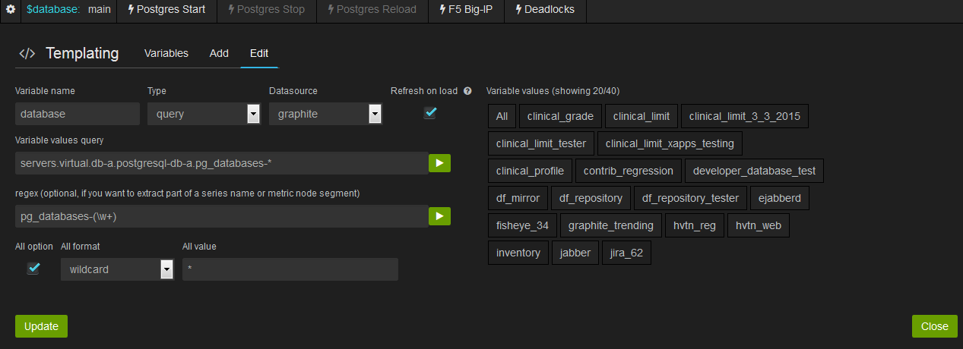
Creating a template variable
By adding the wildcard, it will add “All” to the list.
The query allows us to point to a graphite location to get all of the names.
Regex allows us to use just part of the name returned.
w+ matches any word character one or more times.

Slide 37
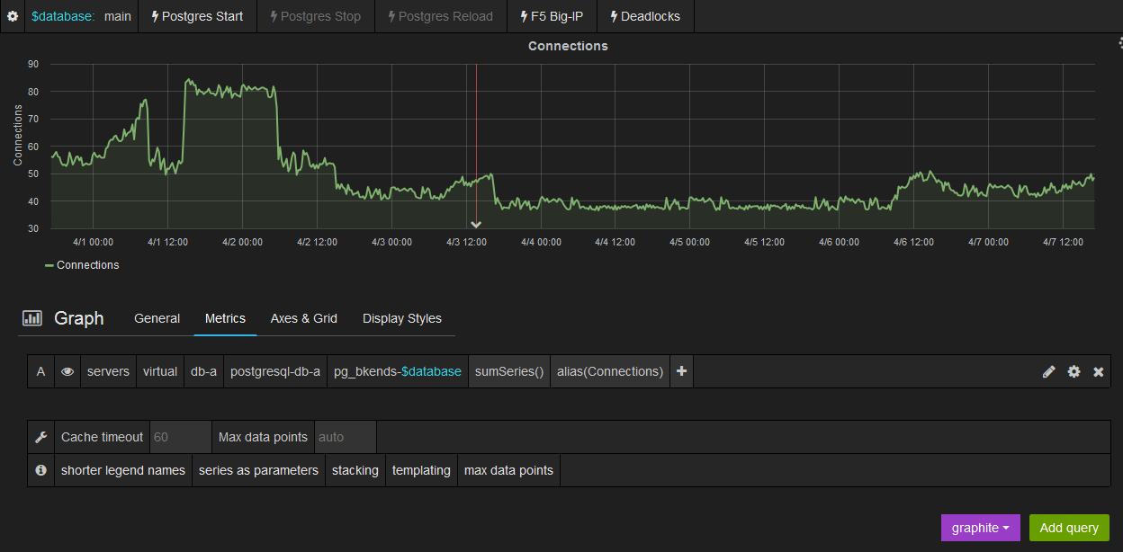
Using your variable(s) in a graph
We used the $database variable within the query used for the graph.
If you used the wildcard setting, you will most likely need to use sumSeries() or maxSeries() for when people select the “All” setting otherwise you will get one line per database instead of a combined line for all the databases.
The annotation's can also use the variables. In this case the deadlock is showing on the main database, but if we switch to any other one, it will not show any deadlocks.
You can also daisy chain your variables, such as have a $server variable that finds the servers and then the $database variable uses the $server variable within it’s query.

