Slide 1
Functional Indexes
By Lloyd Albin

Slide 2
Functional Indexs

Slide 3
The Problem
We receive faxes that are multi-page TIFF’s. The TIFF file name are called the raster id. We have data where we have the full path of the file name, the raster id and the raster id with page number.
Examples:
0000/000000
0000/0000001111
/studydata/studyname/0000/000000

Slide 4
Finding the Raster ID
The first thing to do, is to be able to find the Raster ID, no matter which format is supplied.
IMMUTABLE is required to be able to use this function as part of an index.
This function was written to fit on this page. Some of the other items to put inside the real function would be:
We should check the return to make sure a ‘/’ is in the correct spot and through an error if it is not. “R” is also valid.
If the raster is less then 23 characters to return an error, except for when it is 11 or 15 in length.
CREATE FUNCTION find_raster (raster varchar)
RETURNS VARCHAR(11) AS
$$
BEGIN
CASE length(raster)
WHEN 11 THEN
-- Format: 1234/567890
-- Returns: 1234/567890
RETURN raster;
WHEN 15 THEN
-- Format: 1234/5678901234
-- Returns: 1234/567890
RETURN substr(raster, 1, 11);
ELSE
-- Format: /study_data/study_name/1234/567890
-- Returns: 1234/567890
RETURN substr(raster, length(raster)-10, 11);
END CASE;
END;
$$
LANGUAGE plpgsql
IMMUTABLE
RETURNS NULL ON NULL INPUT;

Slide 5
Function Volatility Category
IMMUTABLE
STABLE
VOLATILE
These attributes inform the query optimizer about the behavior of the function. At most one choice can be specified. If none of these appear, VOLATILE is the default assumption.
IMMUTABLE indicates that the function cannot modify the database and always returns the same result when given the same argument values; that is, it does not do database lookups or otherwise use information not directly present in its argument list. If this option is given, any call of the function with all-constant arguments can be immediately replaced with the function value.
STABLE indicates that the function cannot modify the database, and that within a single table scan it will consistently return the same result for the same argument values, but that its result could change across SQL statements. This is the appropriate selection for functions whose results depend on database lookups, parameter variables (such as the current time zone), etc. (It is inappropriate for AFTER triggers that wish to query rows modified by the current command.) Also note that the current_timestamp family of functions qualify as stable, since their values do not change within a transaction.
VOLATILE indicates that the function value can change even within a single table scan, so no optimizations can be made. Relatively few database functions are volatile in this sense; some examples are random(), currval(), timeofday(). But note that any function that has side-effects must be classified volatile, even if its result is quite predictable, to prevent calls from being optimized away; an example is setval().
For additional details see Section 35.6.
VOLATILE is the default assumption but we need IMMUTABLE for indexing purposes.

Slide 6
Examples of the find_raster Function
-- Test returning of Raster ID when Submitting Raster ID
SELECT find_raster('1234/567890');
-- Returns: 1234/567890
-- Test returning of Raster ID when Submitting Raster ID with 4 Digit Page Number
SELECT find_raster('1234/5678901234');
-- Returns: 1234/567890
-- Test returning of Raster ID when Submitting Filename that includes Raster ID
SELECT find_raster('/study_data/study_name/1234/567890');
-- Returns: 1234/567890

Slide 7
Create Tables for Testing
In the real tables there would much more data, this is just the minimum amount for showing off this feature.
-- Format: 0000/000000
CREATE TABLE raster (
raster VARCHAR(11)
);
-- Format: 0000/0000000000
CREATE TABLE raster_page (
raster VARCHAR(15)
);
-- Format: /study_data/study_name/0000/0000000000
CREATE TABLE raster_file (
raster VARCHAR
);

Slide 8
Creating Test Data
We have real data, but to actually be able to demo this live and not show real data, we can use the microseconds for each command to create data for us. Creating two tables with 100,000 records and one table with 500,000 takes about a minute.
-- Now lets create a function to create a lot of data.
CREATE OR REPLACE FUNCTION create_data ()
RETURNS INTEGER AS
$$
DECLARE
count integer;
r raster%rowtype;
BEGIN
count := 0;
LOOP
INSERT INTO raster VALUES (to_char(clock_timestamp(), '0MS/US'));
count := count + 1;
EXIT WHEN count >= 100000;
END LOOP;
INSERT INTO raster_file SELECT '/study_data/study_name/' || raster.raster FROM raster;
count := 5;
LOOP
INSERT INTO raster_page SELECT raster.raster || substr(to_char(count, '0009'),2,4) FROM raster;
count := count - 1;
EXIT WHEN count = 0;
END LOOP;
RETURN 1;
END;
$$
LANGUAGE plpgsql;
SELECT create_data();

Slide 9
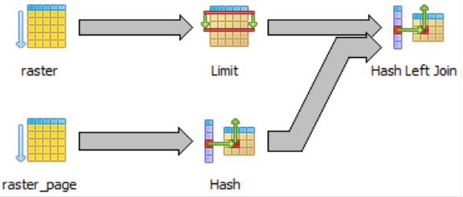
What a Normal Join Looks Like: raster_page
Hash Left Join (cost=12430.05..23339.48 rows=140556 width=88) (actual time=4334.613..4980.760 rows=540 loops=1)
Hash Cond: ((public.raster.raster)::text = substr((raster_page.raster)::text, 1, 11))
-> Limit (cost=931.03..932.90 rows=100 width=40) (actual time=117.630..118.284 rows=100 loops=1)
-> Seq Scan on raster (cost=0.00..1060.56 rows=56956 width=40) (actual time=0.025..65.829 rows=50100 loops=1)
-> Hash (cost=5514.12..5514.12 rows=281112 width=48) (actual time=4215.010..4215.010 rows=500000 loops=1)
-> Seq Scan on raster_page (cost=0.00..5514.12 rows=281112 width=48) (actual time=0.028..1001.646 rows=500000 loops=1)
Total runtime: 4982.527 ms
Total runtime: 4.982527 s
SELECT raster.*, raster_page.*
FROM (
SELECT * FROM raster OFFSET 50000 LIMIT 100
) raster
LEFT JOIN raster_page
ON raster.raster = substr(raster_page.raster, 1, 11);

Slide 10
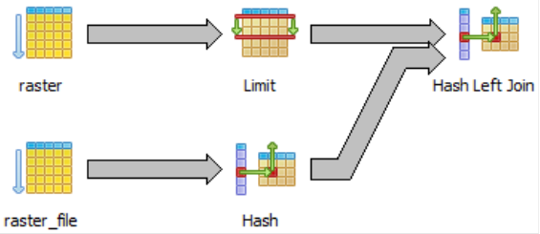
What a Normal Join Looks Like: raster_file
Hash Left Join (cost=4516.50..10754.24 rows=50000 width=75) (actual time=1309.087..1445.892 rows=109 loops=1)
Hash Cond: ((public.raster.raster)::text = substr((raster_file.raster)::text, (length((raster_file.raster)::text) - 10), 11))
-> Limit (cost=745.50..746.99 rows=100 width=12) (actual time=128.356..129.015 rows=100 loops=1)
-> Seq Scan on raster (cost=0.00..1491.00 rows=100000 width=12) (actual time=0.025..75.858 rows=50100 loops=1)
-> Hash (cost=1788.00..1788.00 rows=100000 width=35) (actual time=1180.239..1180.239 rows=100000 loops=1)
-> Seq Scan on raster_file (cost=0.00..1788.00 rows=100000 width=35) (actual time=0.141..222.528 rows=100000 loops=1)
Total runtime: 1446.589 ms
Total runtime: 1.446589 s
SELECT raster.*, raster_file.*
FROM (
SELECT * FROM raster OFFSET 50000 LIMIT 100
) raster
LEFT JOIN raster_file
ON raster.raster = substr(raster_file.raster,
length(raster_file.raster)-10, 11);

Slide 11
Adding the Indexes
CREATE INDEX [ name ] ON table ( expression )
expression
An expression based on one or more columns of the table. The expression usually must be written with surrounding parentheses, as shown in the syntax. However, the parentheses can be omitted if the expression has the form of a function call.
CREATE INDEX raster_raster_idx
ON raster find_raster(raster);
CREATE INDEX raster_file_raster_idx
ON raster_file find_raster(raster);
CREATE INDEX raster_page_raster_idx
ON raster_page find_raster(raster);

Slide 12
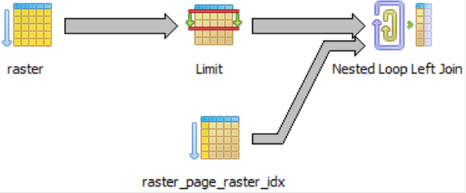
What the New Join Looks Like: raster_page
Nested Loop Left Join (cost=745.75..84448.59 rows=250000 width=88) (actual time=117.717..140.916 rows=540 loops=1)
-> Limit (cost=745.50..746.99 rows=100 width=40) (actual time=116.171..116.685 rows=100 loops=1)
-> Seq Scan on raster (cost=0.00..1491.00 rows=100000 width=40) (actual time=0.026..65.717 rows=50100 loops=1)
-> Index Scan using raster_page_raster_idx on raster_page (cost=0.25..180.76 rows=2500 width=48) (actual time=0.168..0.204 rows=5 loops=100)
Index Cond: ((public.raster.raster)::text = (find_raster(raster_page.raster))::text)
Total runtime: 141.809 ms
Total runtime: 0.141809 s
35 Times Faster
Before Indexes:
Total runtime: 4982.527 ms
Total runtime: 4.982527 s
SELECT raster.*, raster_page.*
FROM (
SELECT * FROM raster OFFSET 50000 LIMIT 100
) raster
LEFT JOIN raster_page
ON raster.raster = find_raster(raster_page.raster);

Slide 13

What the New Join Looks Like: raster_file
Nested Loop Left Join (cost=745.75..18567.32 rows=50000 width=75) (actual time=117.587..128.616 rows=109 loops=1)
-> Limit (cost=745.50..746.99 rows=100 width=12) (actual time=116.578..117.111 rows=100 loops=1)
-> Seq Scan on raster (cost=0.00..1491.00 rows=100000 width=12) (actual time=0.022..65.574 rows=50100 loops=1)
-> Index Scan using raster_file_raster_idx on raster_file (cost=0.25..46.94 rows=500 width=35) (actual time=0.091..0.102 rows=1 loops=100)
Index Cond: ((public.raster.raster)::text = (find_raster(raster_file.raster))::text)
Total runtime: 129.261 ms
Total runtime: 0.129261 s
11 Times Faster
Before Indexes:
Total runtime: 1446.589 ms
Total runtime: 1.446589 s
SELECT raster.*, raster_file.*
FROM (
SELECT * FROM raster OFFSET 50000 LIMIT 100
) raster
LEFT JOIN raster_file
ON raster.raster = find_raster(raster_file.raster);

Slide 14
Real Word Example

Slide 15
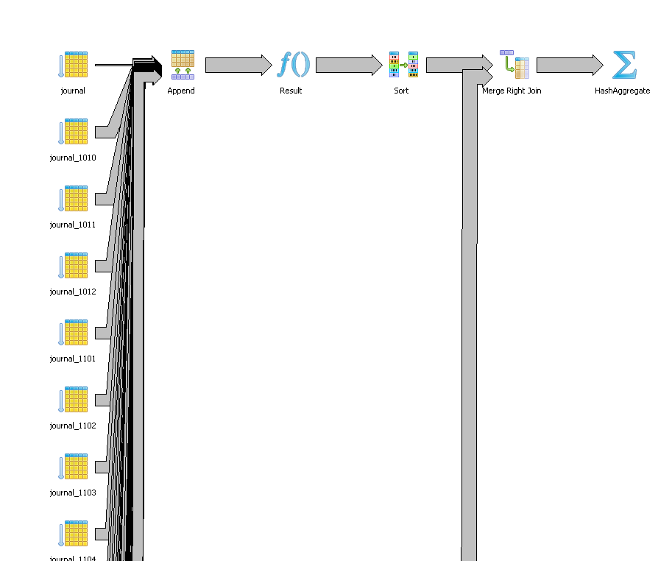
Joins between Journal & Faxlog
Journal used in testing is 10/1997 to 4/2012, more than the 18 months on production.
Total runtime: 197813.222 ms
Total runtime: 197.813222 s
Total runtime: 3.296887033 m
Journal – 16,384,930 Rows of Data
Faxlog – 1,244,754 Rows of Data
SELECT DISTINCT journal.username
FROM protimp.faxlog
LEFT JOIN protimp.journal
ON substring(faxlog.fax_loc from length(faxlog.fax_loc) - 8) = substring(journal.dfraster from 1 for 9)
WHERE faxlog.fax_time >= '1/1/2012' AND faxlog.fax_time < '1/2/2012';

Slide 16
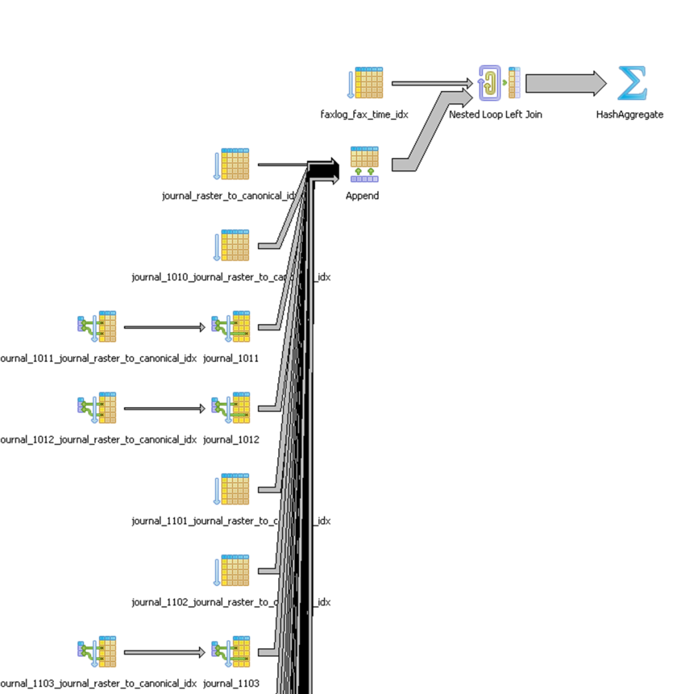
Joins between Journal & Faxlog
Total runtime: 22.368 ms
Before Indexes: 197813.222 ms
Before Indexes: 3.296887033 m
Journal – 16,384,930 Rows of Data
Faxlog – 1,244,754 Rows of Data
8,844 Times Faster
You will notice that we used individual functions instead of a combined function. This allowed us to write the functions in pure sql and remove the logic from each function making the functions faster, which is needed with big data.
SELECT DISTINCT journal.username
FROM protimp.faxlog
LEFT JOIN protimp.journal
ON ist.faxlog_raster_to_canonical(faxlog.fax_loc) = ist.journal_raster_to_canonical(journal.dfraster)
WHERE faxlog.fax_time >= '1/1/2012' AND faxlog.fax_time < '1/2/2012';

Slide 17
Other Purposes

Slide 18
Making your queries case insensitive
What if you want to search for an employee like “deForest”. Many people will mistype this last name and a simple “=” will miss finding this employee. You may fix this by creating a lower case index and then using “= lower(‘deForest’)”. This will make finding this employee much faster since the conversions for the table are in the index and only the one conversion needs to be performed.
SELECT *
FROM public.name_test
WHERE lower(name) = lower('deForest');

Slide 19
Making a unique case insensitive index
By default indexes are case sensitive. You could run into problems if one person enters “deForest” and another person enters “DeForest”.
A case insensitive unique index solves this problem.
CREATE TABLE public.name_test (
name TEXT
) WITHOUT OIDS;
CREATE UNIQUE INDEX name_test_idx ON public.name_test
USING (lower(name));
INSERT INTO public.name_test VALUES ('deForest');
Query OK, 1 rows affected (execution time: 0 ms; total time: 15 ms)
INSERT INTO public.name_test VALUES ('DeForest');
ERROR: duplicate key value violates unique constraint "name_test_idx"
DETAIL: Key (lower(name))=(deforest) already exists.

Slide 20
Database Security?
Storing decoded information only in the indexes.

Slide 21
Security
White Hat Security did a presentation recently where they talked about using encrypted fields with decrypted indexes.
This way you can search on the decrypted information which is faster than decrypting every row to find the matching records.
The index contains the full credit card decoded.
CREATE INDEX order_payment_credit_card_idx
ON order_payment
USING (pgp_pub_decrypt(credit_card, key));
SELECT * FROM order_payment
WHERE pgp_pub_decrypt (credit_card, key)
= '0000-0000-0000-0000';

Slide 22
Security – partially decoded
Maybe your extra paranoid and even want none of the credit card decrypted in the table such as the last 4 numbers that everybody asks for.
The index only contains the last 4 numbers of the credit card decoded.
CREATE INDEX order_payment_credit_card_idx
ON order_payment
USING (substr(pgp_pub_decrypt(credit_card, key),16,4));
SELECT * FROM order_payment
WHERE substr(pgp_pub_decrypt(credit_card, key),16,4)
= '0000';

