Slide 1
Collectd & Graphite to show Postgres Statistics
By Lloyd Albin

Slide 2
Collectd
The system statistics collection daemon

Slide 3
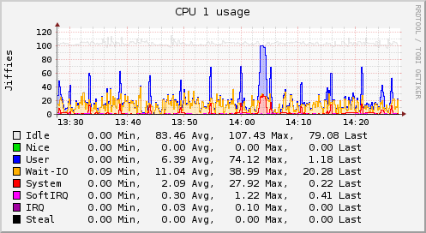
collectd – The system statistics collection daemon
collectd is a daemon which collects system performance statistics periodically and provides mechanisms to store the values in a variety of ways, for example in RRD or Whisper files.
What does collectd do?
collectd gathers statistics about the system it is running on and stores this information. Those statistics can then be used to find current performance bottlenecks (i.e. performance analysis) and predict future system load (i.e. capacity planning). Or if you just want pretty graphs of your private server and are fed up with some homegrown solution you're at the right place, too ;).
Usually one graph says more than a thousand words, so here's a graph showing the CPU utilization of a system over the last 60 minutes:
https://collectd.org/

Slide 4
Why collectd?
Why should you use collectd? There are some key differences we think set collectd apart. For one, it's written in C for performance and portability, allowing it to run on systems without scripting language or cron daemon, such as embedded systems. At the same time it includes optimizations and features to handle hundreds of thousands of data sets. It comes with over 90 plugins, https://collectd.org/wiki/index.php/Table_of_Plugins, which range from standard cases to very specialized and advanced topics. It provides powerful networking features and is extensible in numerous ways. Last but not least: collectd is actively developed and supported and well documented. A more complete list of features is available at https://collectd.org/features.shtml.

Slide 5
Plugins
AMQP plugin Read, Write
Apache plugin Read
APC UPS plugin Read
Apple Sensors plugin Read
Aquaero plugin Read
Ascent plugin Read
Battery plugin Read
BIND plugin Read
Carbon plugin Write
cgroups plugin Read
ConnTrack plugin Read
ContextSwitch plugin Read
CPU plugin Read
CPUFreq plugin Read
CSV plugin Write
cURL plugin Read
cURL-JSON plugin Read
cURL-XML plugin Read
DBI plugin Read
DF plugin Read
Disk plugin Read
DNS plugin Read
E-Mail plugin Read
Entropy plugin Read
Ethstat plugin Read
Exec plugin Read
FileCount plugin Read
FSCache plugin Read
GenericJMX plugin Read
gmond plugin Read
HDDTemp plugin Read
Interface plugin Read
IPMI plugin Read
IPTables plugin Read
IPVS plugin Read
IRQ plugin Read
Java plugin Binding
libvirt plugin Read
Load plugin Read
LogFile plugin Logging
LPAR plugin Read
LVM plugin Read
MadWifi plugin Read
MBMon plugin Read
MD plugin Read
memcachec plugin Read
memcached plugin Read
Memory plugin Read
MIC plugin Read
Modbus plugin Read
Monitorus plugin Read
Multimeter plugin Read
MySQL plugin Read
NetApp plugin Read
Netlink plugin Read
Network plugin Read, Write
NFS plugin Read
nginx plugin Read
Notify Desktop plugin Notification
Notify Email plugin Notification
NTPd plugin Read
numa plugin Read
NUT plugin Read
olsrd plugin Read
OneWire plugin Read
OpenVPN plugin Read
OpenVZ plugin Read
Oracle plugin Read
Perl plugin Binding
Pinba plugin Read
Ping plugin Read
PostgreSQL plugin Read
PowerDNS plugin Read
Processes plugin Read
Protocols plugin Read
Python plugin Binding
Redis plugin Read
RouterOS plugin Read
RRDCacheD plugin Write
RRDtool plugin Write
Sensors plugin Read
Serial plugin Read
sigrok plugin Read
SNMP plugin Read
StatsD plugin Read
Swap plugin Read
SysLog plugin Logging
Table plugin Read
Tail plugin Read
Tail-CSV plugin Read
Tape plugin Read
TCPConns plugin Read
TeamSpeak2 plugin Read
TED plugin Read
thermal plugin Read
TokyoTyrant plugin Read
UnixSock plugin Read, Write
Uptime plugin Read
Users plugin Read
UUID plugin Other
Varnish plugin Read
vmem plugin Read
VServer plugin Read
Wireless plugin Read
XMMS plugin Read
Write Graphite plugin Write
Write HTTP plugin Write
Write MongoDB plugin Write
Write Redis plugin Write
Write Riemann plugin Write
ZFS ARC plugin Read

Slide 6
Postgres Plugin
Collectd

Slide 7
Postgres Plugin
postgresql_default.conf
We were not able to get this default configuration file to be usable within our custom configuration file, so we have ignored it.
It does have some good queries to use as a starting point.
The ones we wrote are more in depth and don’t require special setup when a new database comes online, just a new server.

Slide 8
Default Postgres Plugin Commands
Backends – Connections by Specified Database
Transactions – Commit/Rollback By Specified Database
Queries – Records Inserted/Updated/Deleted for the entire Server
Queries by Table – For all tables in the scanned database
Query Plans – Records Read from Disk, Index Scans, Records Fetched
Table States – Live/Dead Records
Query Plans by Table – For all tables in the scanned database
Table States by Table – For all tables in the scanned database
Disk IO – Reading of Disk vs Heap/RAM for Records/Indexs/Toast Tables/Toast Table Indexs
Disk IO by Table – For all tables in the scanned database
Disk Usage – Size by Specified Database

Slide 9
Graphite
Scalable Realtime Graphing

Slide 10
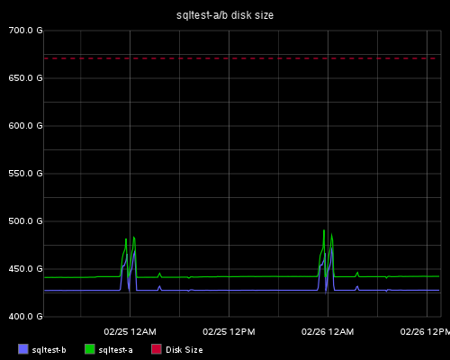
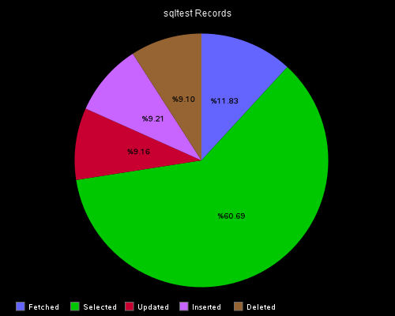
Graphite - Scalable Realtime Graphing
What Graphite is and is not
  Graphite does two things:
    Store numeric time-series data
    Render graphs of this data on demand
  What Graphite does not do is collect data for you, however there are some tools out there that know how to send data to graphite. Even though it often requires a little code, sending data to Graphite is very simple.
Documentation:
http://graphite.readthedocs.org/en/latest/index.html
Download Page:
https://launchpad.net/graphite/+download

Slide 11
Differences Between Whisper and RRD
RRD can not take updates to a time-slot prior to its most recent update
  This means that there is no way to back-fill data in an RRD series. Whisper does not have this limitation, and this makes importing historical data into Graphite much more simple and easy
RRD was not designed with irregular updates in mind
  In many cases (depending on configuration) if an update is made to an RRD series but is not followed up by another update soon, the original update will be lost. This makes it less suitable for recording data such as operational metrics (e.g. code pushes)
Whisper requires that metric updates occur at the same interval as the finest resolution storage archive
  This pushes the onus of aggregating values to fit into the finest precision archive to the user rather than the database. It also means that updates are written immediately into the finest precision archive rather than being staged first for aggregation and written later (during a subsequent write operation) as they are in RRD.
http://graphite.readthedocs.org/en/latest/whisper.html

Slide 12
Capabilities
Functions
  http://graphite.readthedocs.org/en/latest/functions.html
Render URL API
  http://graphite.readthedocs.org/en/latest/render_api.html
Dashboard
  http://graphite.readthedocs.org/en/latest/dashboard.html

Slide 13
Our Custom Plugin

Slide 14
Our Custom Postgres Plugin Commands
Connections – Connections by Database
Connection States – Number of connections by state (idle, idle in transaction, active) and waiting/blocked
Concurrent Txns – Number of connections by database and waiting/blocked
Connection State – Number of connections by state (locked/waiting/blocked, active, idle, idle in transaction, unknown)
Connection State by Database – Number of connections by database by state (locked/waiting/blocked, active, idle, idle in transaction, unknown)
Database Size – Size of Database by Database
Transactions – Sum to Commited and Rolled back transactions.
Buffercache – Usage of the Buffers by level and is dirty (WAL file only)
Buffercache Database – Usage of the Buffers by level and is dirty (WAL file only) by Database
Database Commit Ratio by Database – Ratio of Commit vs Rollback by Database
Database Commit Ratio – Ratio of Commit vs Rollback by Specified Database
Database Stats – Records Read from Disk, Index Scans, Records Fetched, Reading of Disk vs Heap/RAM for Records/Indexs/Toast Tables/Toast Table Indexs by Server
Database Stats by Database – Save as above but by Database
xLog – Count of Log Files
Trig Disabled – Count of Disabled Triggers, in our databases this should always be 0.
Hit Ratio – This is the Reading of Disk vs RAM ratio
Conflicts – These are the reasons for automatically canceled commands on the B Server.
A Server Location – xLog location/position on the A Server
B Server Location – xLog receive and replay location/position on the B Server
Query Length – Longest running command by Database
Query Length Server – Longest running command on the Server
Due to the length of the presentation,
we will only be covering the items in bold.

Slide 15
Connection State

Slide 16
types.postgres.db
We need to create the collectd/types.postgres.db in the collectd directory. This is where we define custom types for the data we will be collecting.
The format is type_name field:type:min:max
Type can be: absolute, counter, derive, or gauge. For postgres you only need to use the following:
  Gauge would be used for a speedometer.
  Counter would be used for a odometer.
Min and/or Max can be set to U or unknown.
pg_connections locked:gauge:0:U, active:gauge:0:U, idle:gauge:0:U, idle_transaction:gauge:0:U, unknown:gauge:0:U

Slide 17
postgresql.conf
We need to create the etc/conf.d/postgresql.conf file in the collectd directory.
To keep from having to add passwords to this file, we made a copy of collectd that runs as user postgres.
LoadPlugin postgresql
<Plugin postgresql>
<Query connection_state>
Statement "SELECT a.count as locked, b.count as active, c.count as idle, d.count as idle_transaction, e.count AS unknown FROM (SELECT count(*) FROM pg_stat_activity WHERE waiting) AS a,(SELECT count(*) FROM pg_stat_activity WHERE state = 'active') AS b,(SELECT count(*) FROM pg_stat_activity WHERE state = 'idle') AS c,(SELECT count(*) FROM pg_stat_activity WHERE state = 'idle in transaction') AS d,(SELECT count(*) FROM pg_stat_activity WHERE state != 'idle in transaction' AND state != 'idle' AND state != 'active') AS e;"
<Result>
Type pg_connections
ValuesFrom locked active idle idle_transaction unknown
</Result>
</Query>
<Database postgres>
Instance "sqltest-a"
Host "sqltest-a"
Port "5432"
User "postgres"
Query connection_state
</Database>
</Plugin>

Slide 18
collectd.conf
This file is were we setup the services we are going to monitor, writing to graphite, errors to syslog, specifying our custom postgres types and collection routines.
#
# Config file for collectd(1).
# Please read collectd.conf(5) for a list of options.
# http://collectd.org/
#
##############################################################################
# Global #
#----------------------------------------------------------------------------#
# Global settings for the daemon. #
##############################################################################
#Hostname "localhost"
FQDNLookup false
BaseDir "/usr/local/collectd-current/var/lib/collectd"
PIDFile "/usr/local/collectd-postgres/var/run/collectd.pid"
PluginDir "/usr/local/collectd-current/lib/collectd"
# Default types DB:
TypesDB "/usr/local/collectd-current/collectd/types.db"
# Our custom types are defined here:
TypesDB "/usr/local/collectd-current/collectd/types.scharp.db"
TypesDB "/usr/local/collectd-postgres/collectd/types.postgres.db"
#----------------------------------------------------------------------------#
# Interval at which to query values. This may be overwritten on a per-plugin #
# base by using the 'Interval' option of the LoadPlugin block: #
# <LoadPlugin foo> #
# Interval 60 #
# </LoadPlugin> #
#----------------------------------------------------------------------------#
Interval 15
Timeout 2
ReadThreads 5
Include "/usr/local/collectd-current/etc/conf.d/write_graphite.conf"
Include "/usr/local/collectd-postgres/collectd/postgresql_default.conf"
Include "/usr/local/collectd-postgres/etc/conf.d/postgresql.conf"
Include "/usr/local/collectd-postgres/etc/conf.d/syslog.conf"

Slide 19
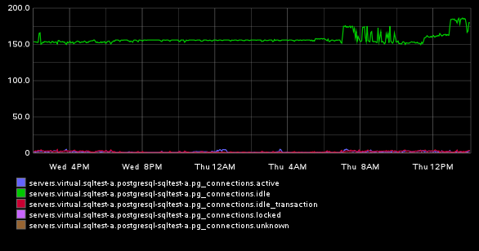
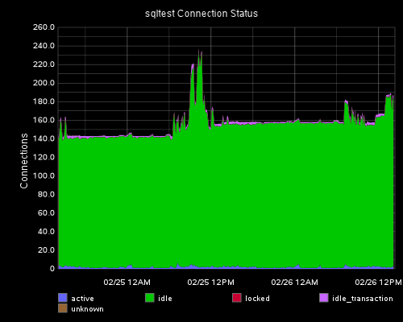
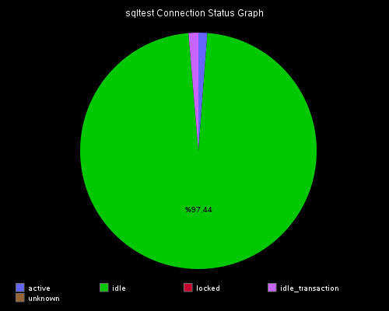
Graphite
After you reload/start collectd you will need to wait a few minutes to the data to appear and be ready to use. Go to your graphite server and select your data to graph. In this example they can be found in:
  Metrics -> servers -> virtual -> sqltest-a -> postgresql-sqltest-a -> pg_connections

Slide 20
Database Size

Slide 21
types.postgres.db
We need to add to the the collectd/types.postgres.db in the collectd directory.
This is where we have previously defined custom types for the data we will be collecting.
pg_databases size:gauge:0:U

Slide 22
postgresql.conf
Here we add code to the postgresql.conf file to collect the current database size for every database. In our case, we want to exclude our temporary database that have random names that change daily. These would clog up graphite if we were to report them.
<Query database_size>
Statement "SELECT pg_database.datname AS database, pg_database_size(pg_database.oid) AS size FROM pg_database WHERE datname NOT LIKE 'tmp_%' ORDER BY pg_database.datname;"
<Result>
Type pg_databases
InstancesFrom "database"
ValuesFrom size
</Result>
</Query>
<Database postgres>
Instance "sqltest-a"
Host "sqltest-a"
Port "5432"
User "postgres"
Query database_size
</Database>
</Plugin>

Slide 23
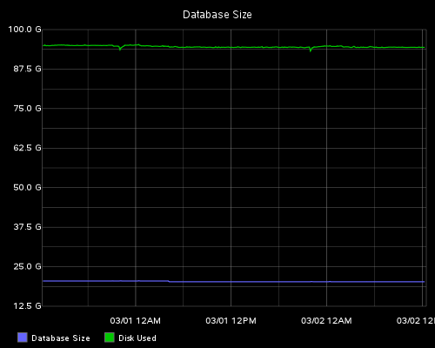
Database Size vs Disk Used
http://graphite/dashboard
Dashboard -> Edit Dashboard
Add something like the following code.
[
{
"title": "Database Size",
"target": [
"alias(servers.virtual.db-a.postgresql-db-a.pg_databases-main,\"Database Size\")",
"alias(servers.physical.dbsrv3-a.df-pgdata_local.df_complex-used,\"Disk Used\")"
]
}
]

Slide 24
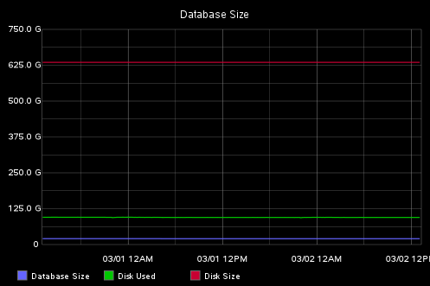
Database Size vs Disk Size
http://graphite/dashboard
Dashboard -> Edit Dashboard
Add something like the following code.
[
{
"title": "Database Size",
"target": [
"alias(servers.virtual.db-a.postgresql-db-a.pg_databases-main,\"Database Size\")",
"alias(servers.physical.dbsrv3-a.df-pgdata_local.df_complex-used,\"Disk Used\")",
"alias(sumSeries(servers.physical.dbsrv3-a.df-pgdata_local.df_complex-*),\"Disk Size\")"
]
}
]

Slide 25
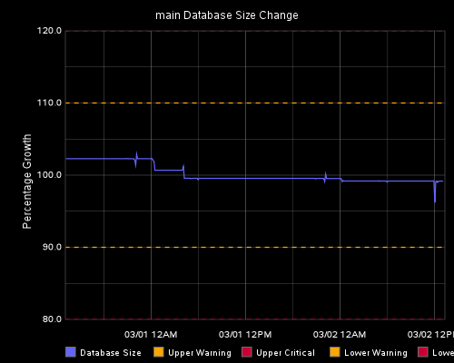
Percent Change
http://graphite/dashboard
Dashboard -> Edit Dashboard
Add something like the following code.
[
{
"vtitle": "Percentage Growth",
"target": [
"alias(asPercent(summarize(servers.virtual.db-a.postgresql-db-a.pg_databases-main,\"1min\"),timeShift(summarize(servers.virtual.db-a.postgresql-db-a.pg_databases-main,\"1min\"),\"1w\")),\"Database Size\")",
"alias(color(dashed(threshold(110)),\"orange\"),\"Upper Warning\")",
"alias(color(dashed(threshold(120)),\"red\"),\"Upper Critical\")",
"alias(color(dashed(threshold(90)),\"orange\"),\"Lower Warning\")",
"alias(color(dashed(threshold(80)),\"red\"),\"Lower Critical\")"
],
"title": "main Database Size Change"
}
]

Slide 26
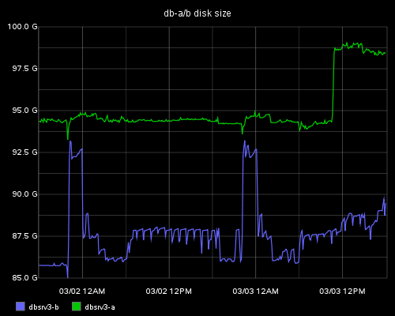
A vs B Server
Note the aliasByNode which counts the dotted sections starting with 0 to get the alias.
This data comes from a different collectd plugin.
[
{
"title": "db-a/b disk size",
"target": [
"aliasByNode(servers.physical.dbsrv3-[ab].df-pgdata_local.df_complex-used,2)"
]
}
]

Slide 27
Buffer Cache

Slide 28
types.postgres.db
We need to add to the the collectd/types.postgres.db in the collectd directory.
This is where we have previously defined custom types for the data we will be collecting.
pg_buffercache_databases size:gauge:0:U

Slide 29
postgresql.conf
Here we add code to the postgresql.conf file to collect the buffer usage by database. In our case, we want to exclude our temporary database that have random names that change daily. These would clog up graphite if we were to report them.
<Query buffercache_databases>
Statement "SELECT
CASE
WHEN pg_database.datname IS NULL THEN 'Free Space'::name
ELSE pg_database.datname
END AS datname,
count(*) *((
SELECT pg_settings.setting::bigint AS setting
FROM pg_settings
WHERE pg_settings.name = 'block_size'::text
)) AS shared_buffers
FROM pg_buffercache
LEFT JOIN pg_database ON pg_buffercache.reldatabase = pg_database.oid
WHERE pg_database.datname NOT LIKE 'temp_%'
GROUP BY pg_database.datname
ORDER BY pg_database.datname;"
<Result>
Type pg_buffercache_databases
InstancesFrom "datname"
ValuesFrom shared_buffers
</Result>
</Query>
<Database postgres>
Instance "sqltest-a"
Host "sqltest-a"
Port "5432"
User "postgres"
Query buffercache_databases
</Database>
</Plugin>

Slide 30
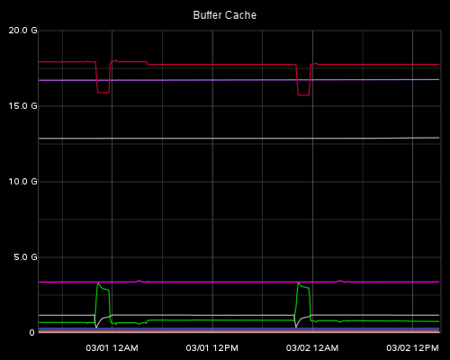
Buffer Cache Graph
http://graphite/dashboard
Dashboard -> Edit Dashboard
Add something like the following code.
[
{
"title": "Buffer Cache",
"target": [
“aliasByMetric(servers.virtual.db-a.postgresql-db-a.pg_buffercache_databases-*)"
]
}
]

Slide 31
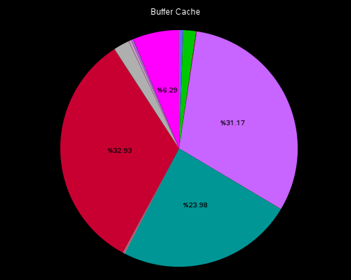
Buffer Cache Pie Chart
http://graphite/dashboard
Dashboard -> Edit Dashboard
Add something like the following code.
[
{
"title": "Buffer Cache",
"hideLegend": "true",
"graphType": "pie",
"target": [
"servers.virtual.db-a.postgresql-db-a.pg_buffercache_databases-*"
]
}
]

Slide 32
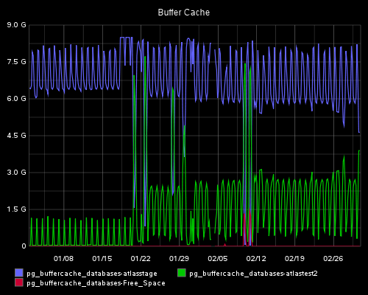
Buffer Cache Graph
http://graphite/dashboard
Dashboard -> Edit Dashboard
Add something like the following code.
[
{
"title": "Buffer Cache",
"graphType": "pie",
"target": [
“aliasByMetric(servers.virtual.atlassql-test.postgresql-atlassql-test.pg_buffercache_databases-*)"
]
}
]

Slide 33
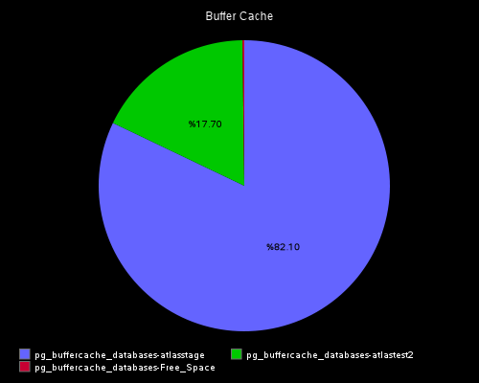
Buffer Cache Pie Chart
http://graphite/dashboard
Dashboard -> Edit Dashboard
Add something like the following code.
[
{
"title": "Buffer Cache",
"hideLegend": “false",
"graphType": "pie",
"target": [
“aliasByMetric(servers.virtual.atlassql-test.postgresql-atlassql-test.pg_buffercache_databases-*)"
]
}
]

Slide 34
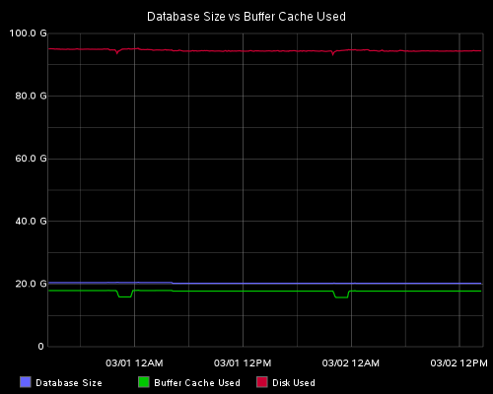
Database Size vs Buffer Cache
http://graphite/dashboard
Dashboard -> Edit Dashboard
Add something like the following code.
[
{
"title": "Database Size vs Buffer Cache Used",
"target": [
"alias(servers.virtual.db-a.postgresql-db-a.pg_databases-main,\"Database Size\")",
"alias(servers.virtual.db-a.postgresql-db-a.pg_buffercache_databases-main,\"Buffer Cache Used\")",
"alias(servers.physical.dbsrv3-a.df-pgdata_local.df_complex-used,\"Disk Used\")"
]
}
]

Slide 35
Longest Running Command

Slide 36
types.postgres.db
We need to add to the the collectd/types.postgres.db in the collectd directory.
This is where we have previously defined custom types for the data we will be collecting.
pg_query_length query_length:gauge:0:U
pg_query_length_min query_length:gauge:0:U
pg_query_length_hour query_length:gauge:0:U

Slide 37
postgresql.conf
Here we add code to the postgresql.conf file.
Please Note: These are approximate. The timings reported in the log file are the definitive timings.
<Query query_length_server>
Statement "SELECT COALESCE(b.query_length,0) AS seconds, COALESCE(ROUND(b.query_length)/60,0) AS minutes, COALESCE(ROUND(b.query_length)/60/60,0) AS hours
FROM (
SELECT EXTRACT(EPOCH FROM max(clock_timestamp()-query_start)) AS query_length
FROM pg_stat_activity
WHERE state='active' AND datname NOT LIKE 'tmp_%'
) b"
<Result>
Type pg_query_length
ValuesFrom seconds
</Result>
<Result>
Type pg_query_length_min
ValuesFrom minutes
</Result>
<Result>
Type pg_query_length_hour
ValuesFrom hours
</Result>
</Query>
<Database postgres>
Instance "sqltest-a"
Host "sqltest-a"
Port "5432"
User "postgres"
Query query_length_server
</Database>
</Plugin>

Slide 38
postgresql.conf
Here we add code to the postgresql.conf file.
Please Note: These are approximate. The timings reported in the log file are the definitive timings.
<Query query_length>
Statement "SELECT a.datname, COALESCE(b.query_length,0) AS seconds, COALESCE(ROUND(b.query_length)/60,0) AS minutes, COALESCE(ROUND(b.query_length)/60/60,0) AS hours
FROM pg_database a
LEFT JOIN (
SELECT datname, EXTRACT(EPOCH FROM max(clock_timestamp()-query_start)) AS query_length
FROM pg_stat_activity
WHERE state='active' AND datname NOT LIKE 'tmp_%' GROUP BY datname
) b ON a.datname = b.datname
WHERE a.datname NOT LIKE 'tmp_%'"
<Result>
Type pg_query_length
InstancesFrom "datname"
ValuesFrom seconds
</Result>
<Result>
Type pg_query_length_min
InstancesFrom "datname"
ValuesFrom minutes
</Result>
<Result>
Type pg_query_length_hour
InstancesFrom "datname"
ValuesFrom hours
</Result>
</Query>
<Database postgres>
Instance "sqltest-a"
Host "sqltest-a"
Port "5432"
User "postgres"
Query query_length_server
</Database>
</Plugin>

Slide 39
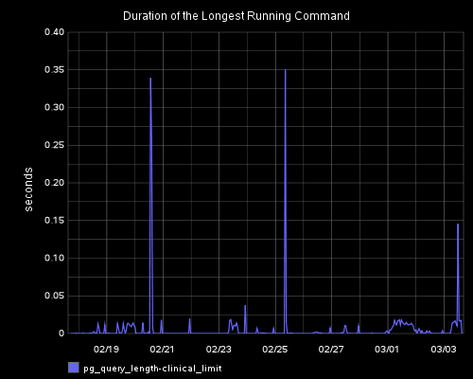
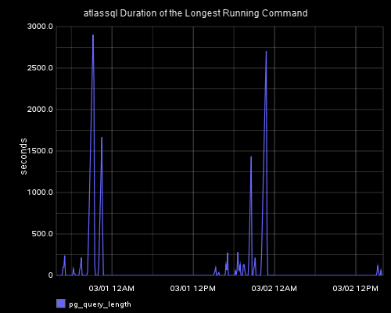
Longest Running Command - Seconds
http://graphite/dashboard
Dashboard -> Edit Dashboard
Add something like the following code.
yMax allows you to view the fine details of 0 to your maximum, this is especially helpful when you have some long running queries and you want to look at only the fast running queries.
[
{
"title": "atlassql Duration of the Longest Running Command“,
"vtitle": "seconds",
"target": [
"aliasByMetric(servers.virtual.atlassql-a.postgresql-atlassql-a.pg_query_length)"
]
}
]
[
{
"title": "atlassql Duration of the Longest Running Command“,
"vtitle": "seconds",
“yMax": “120",
"target": [
"aliasByMetric(servers.virtual.atlassql-a.postgresql-atlassql-a.pg_query_length)"
]
}
]

Slide 40
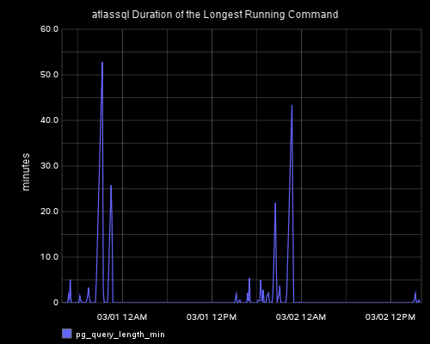
Longest Running Command - Minutes
http://graphite/dashboard
Dashboard -> Edit Dashboard
Add something like the following code.
[
{
"title": "atlassql Duration of the Longest Running Command“,
"vtitle": “minutes",
"target": [
"aliasByMetric(servers.virtual.atlassql-a.postgresql-atlassql-a.pg_query_length_min)"
]
}
]

Slide 41
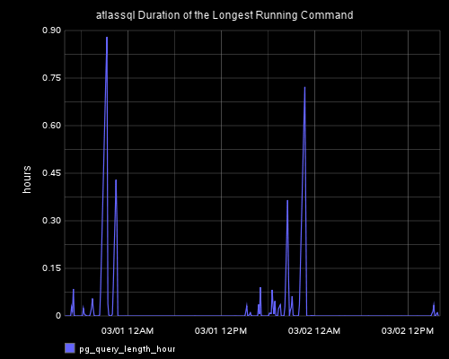
Longest Running Command - Hours
http://graphite/dashboard
Dashboard -> Edit Dashboard
Add something like the following code.
[
{
"title": "atlassql Duration of the Longest Running Command“,
"vtitle": “hours",
"target": [
"aliasByMetric(servers.virtual.atlassql-a.postgresql-atlassql-a.pg_query_length_hour)"
]
}
]

Slide 42
A vs B Server Staus

Slide 43
types.postgres.db
pg_a_location location:counter:0:U
pg_b_location receive:counter:0:U, replay:counter:0:U

Slide 44
postgresql.conf
The reason for all the math is that the location is in this format: “1BC3/416B19E0”
So we need to turn this number into a bigint that can be tracked.
The A server we monitor the current location within the log file.
The B Server we monitor the replay location within the log file. The difference between these two number is how far out of date the B Server is from the A Server.
The B Server we monitor the receive location. This is the highest point in the xLog file that has been received by the B Server, even if it has not been replayed yet.
<Query a_server_location>
# For A Servers Only
Statement "SELECT
('x00000000FF000000'::bit(64)::bigint *
('x' || lpad(split_part(pg_current_xlog_location, '/', 1),16,'0'))::bit(64)::bigint) +
('x' || lpad(split_part(pg_current_xlog_location, '/', 2),16,'0'))::bit(64)::bigint AS location
FROM pg_current_xlog_location()"
<Result>
Type pg_a_location
ValuesFrom location
</Result>
</Query>
<Query b_server_location>
# For B Servers Only
Statement "SELECT
('x00000000FF000000'::bit(64)::bigint *
('x' || lpad(split_part(pg_last_xlog_receive_location, '/', 1),16,'0'))::bit(64)::bigint) +
('x' || lpad(split_part(pg_last_xlog_receive_location, '/', 2),16,'0'))::bit(64)::bigint AS receive,
('x00000000FF000000'::bit(64)::bigint *
('x' || lpad(split_part(pg_last_xlog_replay_location, '/', 1),16,'0'))::bit(64)::bigint) +
('x' || lpad(split_part(pg_last_xlog_replay_location, '/', 2),16,'0'))::bit(64)::bigint AS replay
FROM pg_last_xlog_receive_location(), pg_last_xlog_replay_location()"
<Result>
Type pg_b_location
ValuesFrom receive replay
</Result>
</Query>

Slide 45
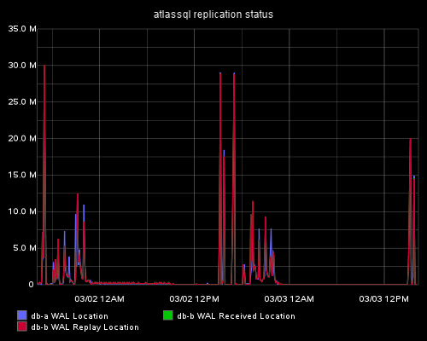
Replication Status
We can see in Blue the A Server and in Red the B Server. These lines should be very close together.
[
{
"title": "atlassql replication status",
"target": [
"alias(servers.virtual.atlassql-a.postgresql-atlassql-a.pg_a_location,\"db-a WAL Location\")",
"alias(servers.virtual.atlassql-b.postgresql-atlassql-b.pg_b_location.receive,\"db-b WAL Received Location\")",
"alias(servers.virtual.atlassql-b.postgresql-atlassql-b.pg_b_location.replay,\"db-b WAL Replay Location\")"
]
},
]

Slide 46
Disk Reads vs HEAP/RAM Reads

Slide 47
types.postgres.db
Read is Disk Activity
Hit is Heap/RAM Activity
Tup is Tuple/Record
Returned is Selected
Fetch is Fetched using a Cursor
Block Read Write time if track_io_timing is enabled, otherwise zero
pg_bkends backends:gauge:0:U
pg_xact_commit commits:counter:0:U
pg_xact_rollback rollbacks:counter:0:U
pg_blks_read read:counter:0:U
pg_blks_hit hit:counter:0:U
pg_idx_scan idxscan:counter:0:U
pg_idx_tup_read idxtupread:counter:0:U
pg_idx_tup_fetch idxtupfetch:counter:0:U
pg_idx_blks_read idxblksread:counter:0:U
pg_idx_blks_hit idxblkshit:counter:0:U
pg_seq_scan seqscan:counter:0:U
pg_seq_tup_read seqtupread:counter:0:U
pg_tup_returned ret:counter:0:U
pg_tup_fetched fetch:counter:0:U
pg_tup_inserted ins:counter:0:U
pg_tup_updated upd:counter:0:U
pg_tup_deleted del:counter:0:U
pg_deadlocks deadlocks:counter:0:U
pg_blk_read_time blk_read_time:gauge:0:U
pg_blk_write_time blk_write_time:gauge:0:U

Slide 48
postgresql.conf
<Query database_stats_by_database>
Statement "SELECT datname,
numbackends AS backends,xact_commit AS commits,xact_rollback AS rollbacks,
blks_read AS read, blks_hit AS hit
,(SELECT SUM(idx_scan) FROM pg_stat_user_indexes) AS idxscan
,COALESCE((SELECT SUM(idx_tup_read) FROM pg_stat_user_indexes),0) AS idxtupread
,COALESCE((SELECT SUM(idx_tup_fetch) FROM pg_stat_user_indexes),0) AS idxtupfetch
,COALESCE((SELECT SUM(idx_blks_read) FROM pg_statio_user_indexes),0) AS idxblksread
,COALESCE((SELECT SUM(idx_blks_hit) FROM pg_statio_user_indexes),0) AS idxblkshit
,COALESCE((SELECT SUM(seq_scan) FROM pg_stat_user_tables),0) AS seqscan
,COALESCE((SELECT SUM(seq_tup_read) FROM pg_stat_user_tables),0) AS seqtupread
,tup_returned AS ret, tup_fetched AS fetch, tup_inserted AS ins
,tup_updated AS upd, tup_deleted AS del, deadlocks, blk_read_time, blk_write_time
FROM pg_stat_database WHERE datname NOT LIKE 'tmp_%';"
<Result>
Type pg_bkends
InstancesFrom "datname"
ValuesFrom backends
</Result>
<Result>
Type pg_xact_commit
InstancesFrom "datname"
ValuesFrom commits
</Result>
<Result>
Type pg_xact_rollback
InstancesFrom "datname"
ValuesFrom rollbacks
</Result>
<Result>
Type pg_blks_read
InstancesFrom "datname"
ValuesFrom read
</Result>
<Result>
Type pg_blks_hit
InstancesFrom "datname"
ValuesFrom hit
</Result>
<Result>
Type pg_idx_scan
InstancesFrom "datname"
ValuesFrom idxscan
</Result>
<Result>
Type pg_idx_tup_read
InstancesFrom "datname"
ValuesFrom idxtupread
</Result>

Slide 49
postgresql.conf
<Result>
Type pg_idx_tup_fetch
InstancesFrom "datname"
ValuesFrom idxtupfetch
</Result>
<Result>
Type pg_idx_blks_read
InstancesFrom "datname"
ValuesFrom idxblksread
</Result>
<Result>
Type pg_idx_blks_hit
InstancesFrom "datname"
ValuesFrom idxblkshit
</Result>
<Result>
Type pg_seq_scan
InstancesFrom "datname"
ValuesFrom seqscan
</Result>
<Result>
Type pg_seq_tup_read
InstancesFrom "datname"
ValuesFrom seqtupread
</Result>
<Result>
Type pg_tup_returned
InstancesFrom "datname"
ValuesFrom ret
</Result>
<Result>
Type pg_tup_fetched
InstancesFrom "datname"
ValuesFrom fetch
</Result>
<Result>
Type pg_tup_inserted
InstancesFrom "datname"
ValuesFrom ins
</Result>
<Result>
Type pg_tup_updated
InstancesFrom "datname"
ValuesFrom upd
</Result>
<Result>
Type pg_tup_deleted
InstancesFrom "datname"
ValuesFrom del
</Result>
<Result>
Type pg_deadlocks
InstancesFrom "datname"
ValuesFrom deadlocks
</Result>

Slide 50
postgresql.conf
<Result>
# if track_io_timing is enabled, otherwise zero
Type pg_blk_read_time
InstancesFrom "datname"
ValuesFrom blk_read_time
</Result>
<Result>
# if track_io_timing is enabled, otherwise zero
Type pg_blk_write_time
InstancesFrom "datname"
ValuesFrom blk_write_time
</Result>
</Query>

Slide 51
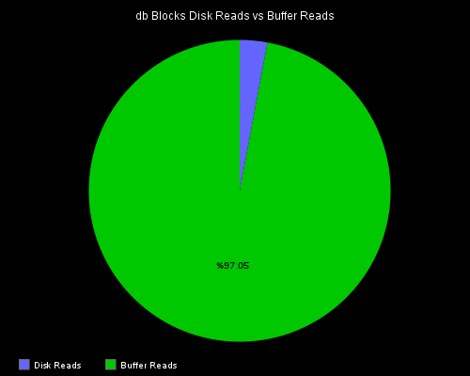
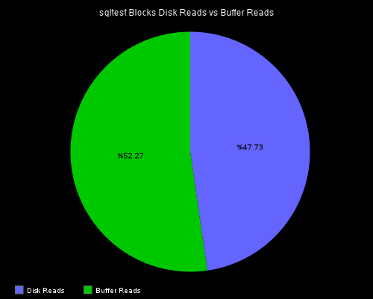
The top example we have a production database with a 50GB’s of shared buffers.
The bottom example we have a test server with 8GB’s of shared buffers.
[
{
"title": "db Blocks Disk Reads vs Buffer Reads",
"graphType": "pie",
"target": [
"alias(sumSeries(servers.virtual.db-a.postgresql-db-a.pg_blks_read-*),\"Disk Reads\")",
"alias(sumSeries(servers.virtual.db-a.postgresql-db-a.pg_blks_hit-*),\"Buffer Reads\")"
]
}
]

Slide 52
Record Activity

Slide 53
postgresql.conf, types.postgres.db
The Disk Reads vs HEAP/RAM Reads has the information for these sections.

Slide 54
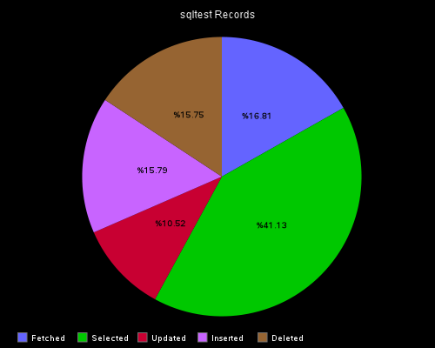
Record Activity
Fetched Records are Read from a Cursor.
[
{
"title": "sqltest Records",
"graphType": "pie",
"target": [
"alias(sumSeries(servers.virtual.sqltest-a.postgresql-sqltest-a.pg_tup_fetched-*),\"Fetched\")",
"alias(sumSeries(servers.virtual.sqltest-a.postgresql-sqltest-a.pg_tup_returned-*),\"Selected\")",
"alias(sumSeries(servers.virtual.sqltest-a.postgresql-sqltest-a.pg_tup_updated-*),\"Updated\")",
"alias(sumSeries(servers.virtual.sqltest-a.postgresql-sqltest-a.pg_tup_inserted-*),\"Inserted\")",
"alias(sumSeries(servers.virtual.sqltest-a.postgresql-sqltest-a.pg_tup_deleted-*),\"Deleted\")"
]
}
]

Slide 55
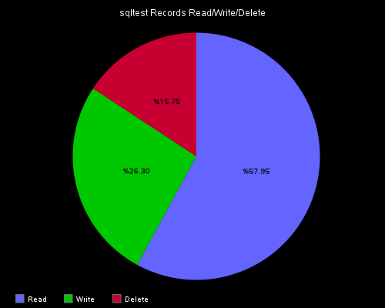
Simplified Record Activity
Here I wanted to create Read / Write / Delete categories to simplify the pie chart for developer usage.
[
{
"title": "sqltest Records Read/Write/Delete",
"graphType": "pie",
"target": [
"alias(sumSeries(servers.virtual.sqltest-a.postgresql-sqltest-a.pg_tup_fetched-*,servers.virtual.sqltest-a.postgresql-sqltest-a.pg_tup_returned-*),\"Read\")",
"alias(sumSeries(servers.virtual.sqltest-a.postgresql-sqltest-a.pg_tup_updated-*,servers.virtual.sqltest-a.postgresql-sqltest-a.pg_tup_inserted-*),\"Write\")",
"alias(sumSeries(servers.virtual.sqltest-a.postgresql-sqltest-a.pg_tup_deleted-*),\"Delete\")"
]
},
]

Slide 56
Concurrent Transactions

Slide 57
types.postgres.db
pg_concurrent_txns txns:gauge:0:U

Slide 58
postgresql.conf
We want to monitor all connections that are not idle.
We are grouping on database and waiting.
Waiting means that the current transaction is blocked by another current transaction.
<Query concurrent_txns>
Statement "SELECT datname, waiting, count(*) AS txns FROM pg_stat_activity WHERE state != 'idle' AND datname NOT LIKE 'tmp_%' GROUP BY datname, waiting;"
<Result>
Type pg_concurrent_txns
InstancesFrom "datname" "waiting"
ValuesFrom txns
</Result>
</Query>

Slide 59
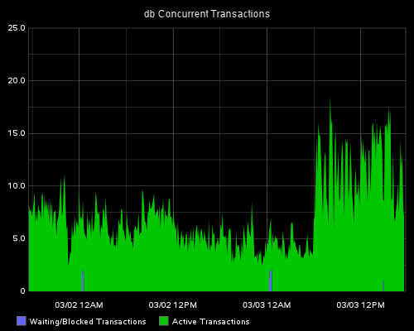
Concurrent Transactions
The Blue Transaction are blocked/waiting transactions.
This is ok is they are narrow, but if they are wide, this is a bad thing.
[
{
"title": "db Concurrent Transactions",
"areaMode": "stacked",
"target": [
"alias(sumSeries(servers.virtual.db-a.postgresql-db-a.pg_concurrent_txns-*-t),\"Waiting/Blocked Transactions\")",
"alias(sumSeries(servers.virtual.db-a.postgresql-db-a.pg_concurrent_txns-*-f),\"Active Transactions\")"
]
},
]

Slide 60
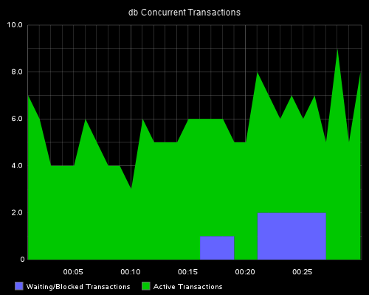
Dead of Night
During the middle of the night we do many Data Warehouse type work and to do massive data loads.
We can see these block only for a few minutes which is ok for a script but would not be ok if this was normal user access.

Slide 61
Shared Buffer Usage

Slide 62
types.postgres.db
pg_buffercache size:gauge:0:U

Slide 63
postgresql.conf
Usagecount runs from 0 to 5.
0 = Just loaded or just about to be removed.
5 = Heavily used.
<Query buffercache>
Statement "SELECT CASE pg_buffercache.usagecount
WHEN 0 THEN 'Just Read - Least Used'
WHEN 1 THEN 'Low Usage'
WHEN 2 THEN 'Medium Low Usage'
WHEN 3 THEN 'Medium High Usage'
WHEN 4 THEN 'High Usage'
WHEN 5 THEN 'Heavily Used'
ELSE 'Unused'
END AS usage,
CASE pg_buffercache.isdirty
WHEN TRUE THEN 'WAL Only'
ELSE 'Normal'
END AS written,
count(*) *((
SELECT pg_settings.setting::bigint AS setting
FROM pg_settings
WHERE pg_settings.name = 'block_size'::text
)) AS size
FROM pg_buffercache
GROUP BY pg_buffercache.usagecount,
pg_buffercache.isdirty
ORDER BY pg_buffercache.isdirty,
pg_buffercache.usagecount;"
<Result>
Type pg_buffercache
InstancesFrom "usage", "written"
ValuesFrom size
</Result>
</Query>

Slide 64
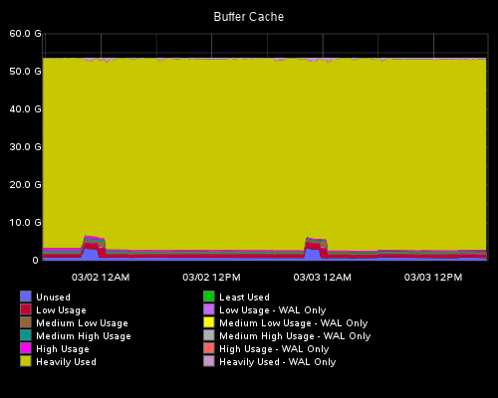
Shared Buffer Cache
At this time we see that most of the data in the shared buffers is being heavily used.
WAL Only means that the records have been inserted, updated, or deleted and in the WAL/xLog for not committed to the Tables yet.
[
{
"title": "Buffer Cache",
"hideLegend": "false",
"areaMode": "stacked",
"target": [
"alias(servers.virtual.db-a.postgresql-db-a.pg_buffercache-Unused-Normal,\"Unused\")",
"alias(servers.virtual.db-a.postgresql-db-a.pg_buffercache-Just_Read_-_Least_Used-Normal,\"Least Used\")",
"alias(servers.virtual.db-a.postgresql-db-a.pg_buffercache-Just_Read_-_Least_Used-WAL_Only,\"Least Used - WAL Only\")",
"alias(servers.virtual.db-a.postgresql-db-a.pg_buffercache-Low_Usage-Normal,\"Low Usage\")",
"alias(servers.virtual.db-a.postgresql-db-a.pg_buffercache-Low_Usage-WAL_Only,\"Low Usage - WAL Only\")",
"alias(servers.virtual.db-a.postgresql-db-a.pg_buffercache-Medium_Low_Usage-Normal,\"Medium Low Usage\")",
"alias(servers.virtual.db-a.postgresql-db-a.pg_buffercache-Medium_Low_Usage-WAL_Only,\"Medium Low Usage - WAL Only\")",
"alias(servers.virtual.db-a.postgresql-db-a.pg_buffercache-Medium_High_Usage-Normal,\"Medium High Usage\")",
"alias(servers.virtual.db-a.postgresql-db-a.pg_buffercache-Medium_High_Usage-WAL_Only,\"Medium High Usage - WAL Only\")",
"alias(servers.virtual.db-a.postgresql-db-a.pg_buffercache-High_Usage-Normal,\"High Usage\")",
"alias(servers.virtual.db-a.postgresql-db-a.pg_buffercache-High_Usage-WAL_Only,\"High Usage - WAL Only\")",
"alias(servers.virtual.db-a.postgresql-db-a.pg_buffercache-Heavily_Used-Normal,\"Heavily Used\")",
"alias(servers.virtual.db-a.postgresql-db-a.pg_buffercache-Heavily_Used-WAL_Only,\"Heavily Used - WAL Only\")"
]
}
]

Slide 65
Disk Activity

Slide 66
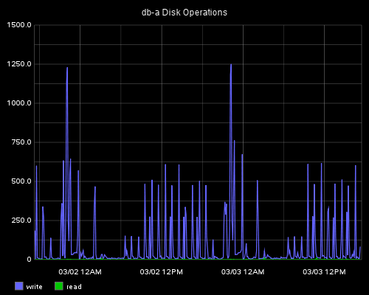
Disk Operations
This is data collection done by other collectd plugins that we also monitor.
Since this server has 50GB of shared buffers, you can see makes this server write heavy.
[
{
"title": "db-a Disk Operations",
"target": [
"aliasByMetric(servers.physical.dbsrv3-a.disk-sda2.disk_ops.*)"
]
}
]

Slide 67
Network Activity

Slide 68
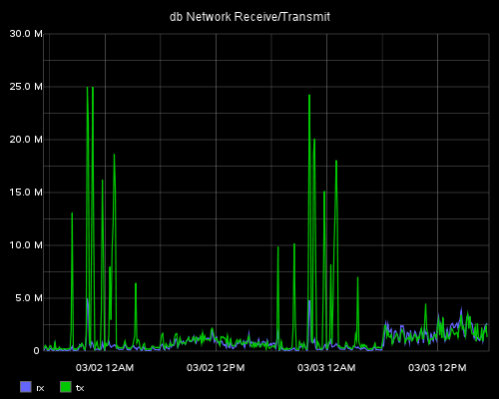
Network Activity
This is data collection done by other collectd plugins that we also monitor.
[
{
"title": "db Network Receive/Transmit",
"target": [
"aliasByMetric(servers.physical.dbsrv3-a.interface-eth0.if_octets.*)"
]
}
]

Slide 69
System Changes

Slide 70
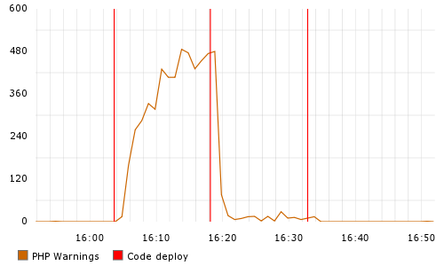
Flagging System Changes
You can log a variety of changes to graphite, for example:
  Server Reboot
  Postgres Start/Stop/Reload, etc.
  Website Code Changes
  DDL Changes
These could overlay such items as:
  Database Size
  Connections
  Query/Command Speed
echo "events.deploy.website.lister 1 `date +%s`" | nc graphite.example.com 2003
echo "events.deploy.postgres.db 1 `date +%s`" | nc graphite.example.com 2003
drawAsInfinite(events.deploy.website.lister)
Notes:
Thanks to Mike Brittain @ Etsy for the Code Deploy idea:
https://codeascraft.com/2010/12/08/track-every-release/

